Slide 1
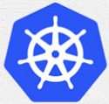
1 Install on Both Master/Slave: Slave
Peter H. Chen

Slide 2
1 Install on Both Master/Slave: Slave
https://www.youtube.com/watch?v=UWg3ORRRF60
Install for Both Master and Slave: Slave
Review:
We have the two machines master and the slave in the cluster.
The master must have at least 2GB of RAM and 2-core CPUs.
The slave must have at least 2GB RAM and 1-core CPU.
These are basic requirements for the master and slave machines.
> ping <ipv4-address>
> ping6 -I <interface> <ipv6-address> (Same machine OK. For different machine NG)
Kubernetes Installation Steps
1. At Both Master and Slave Nodes | 2.Only at Master Node | 3. Only at Slave Node
1.1. Update Your Repository | 2.1. Initiate Kubernetes Cluster | 3.1 Join the Cluster
1.2. Turn Off Swap Space | 2.2. Install the Pod Network
1.3. Update Hostname, Hosts, and Set Static IP | 2.3 Setup the Kubernetes Dashboard
1.4 Install OpenSSH Server and Docker
1.5 Install Kubeadm, Kubelet, and Kubectl

Slide 3
1 Install on Both Master/Slave: Slave
https://www.youtube.com/watch?v=UWg3ORRRF60
Install for Both Master and Slave: Slave
We have done the Master installation.
We will use the same command for salve.
We change from
1. “knode” (Kubernetes master) into “knode” (kubernetes slave).
2. Assign different static IP address depending on the Slave machine.
Kubernetes Installation Steps
1. At Both Master and Slave Nodes | 2.Only at Master Node | 3. Only at Slave Node
1.1. Update Your Repository | 2.1. Initiate Kubernetes Cluster | 3.1 Join the Cluster
1.2. Turn Off Swap Space | 2.2. Install the Pod Network
1.3. Update Hostname, Hosts, and Set Static IP | 2.3 Setup the Kubernetes Dashboard
1.4 Install OpenSSH Server and Docker
1.5 Install Kubeadm, Kubelet, and Kubectl

Slide 4
1.1 Update Your Repository: Slave

Slide 5
1.1 Update Your Repository: Slave
https://www.youtube.com/watch?v=UWg3ORRRF60
Update Your Repository: Slave
Kubernetes Installation Steps
1. At Both Master and Slave Nodes | 2.Only at Master Node | 3. Only at Slave Node
1.1. Update Your Repository | 2.1. Initiate Kubernetes Cluster | 3.1 Join the Cluster
1.2. Turn Off Swap Space | 2.2. Install the Pod Network
1.3. Update Hostname, Hosts, and Set Static IP | 2.3 Setup the Kubernetes Dashboard
1.4 Install OpenSSH Server and Docker
1.5 Install Kubeadm, Kubelet, and Kubectl

Slide 6
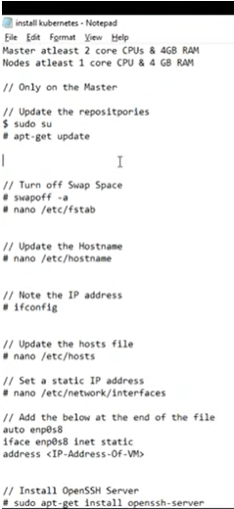
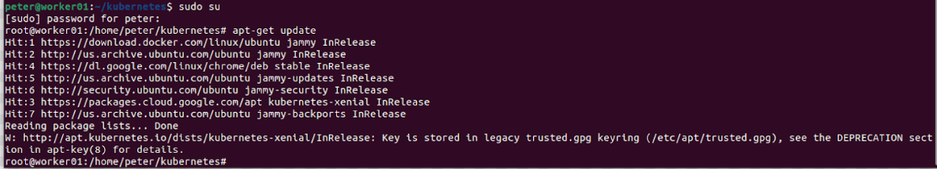
1.1 Update Your Repository: Slave
https://www.youtube.com/watch?v=UWg3ORRRF60
sudo su and apt-get update
We log in as the su.
We are going to execute the following command as the sudo user.
> sudo su
Let’s do the update. This update my ubuntu repository.
> apt-get update

Slide 7
1.2 Turn Off Swap Space: Slave

Slide 8
1.2 Turn Off Swap Space: Slave
https://www.youtube.com/watch?v=UWg3ORRRF60
Turn Off Swap Space: Slave
Kubernetes Installation Steps
1. At Both Master and Slave Nodes | 2.Only at Master Node | 3. Only at Slave Node
1.1. Update Your Repository | 2.1. Initiate Kubernetes Cluster | 3.1 Join the Cluster
1.2. Turn Off Swap Space | 2.2. Install the Pod Network
1.3. Update Hostname, Hosts, and Set Static IP | 2.3 Setup the Kubernetes Dashboard
1.4 Install OpenSSH Server and Docker
1.5 Install Kubeadm, Kubelet, and Kubectl

Slide 9
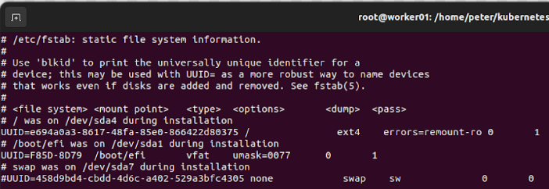
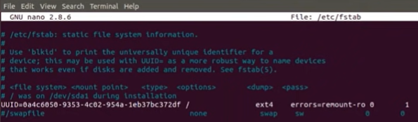
1.2 Turn Off Swap Space: Slave
https://www.youtube.com/watch?v=UWg3ORRRF60
swapoff -a
Next, we turn off my swap space.
The command to turn off my swap space is “swapoff -a”
> swapoff –a
It should be turn off swap space immediately. If it take long time, then ^C and reboot your system.
> vi /etc/fstab
We comment out the swap space.

Slide 10
1.3 Initialize Hostname and IP Address

Slide 11
1.3 Initialize Hostname and IP Address
https://www.youtube.com/watch?v=UWg3ORRRF60
Initialize Hostname and IP Address
Kubernetes Installation Steps
1. At Both Master and Slave Nodes | 2.Only at Master Node | 3. Only at Slave Node
1.1. Update Your Repository | 2.1. Initiate Kubernetes Cluster | 3.1 Join the Cluster
1.2. Turn Off Swap Space | 2.2. Install the Pod Network
1.3. Update Hostname, Hosts, and Set Static IP | 2.3 Setup the Kubernetes Dashboard
1.4 Install OpenSSH Server and Docker
1.5 Install Kubeadm, Kubelet, and Kubectl

Slide 12
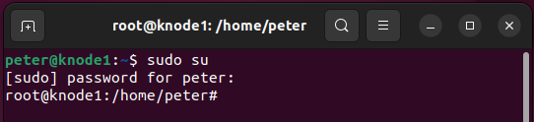
1.3 Initialize Hostname and IP Address
https://www.youtube.com/watch?v=UWg3ORRRF60
/etc/hostname and prompt hostname
Next, we update the hostname, hosts file, and set a static IP Address.
Let’s update the hostname.
> vi /etc/hostname
We change the host name to “knode1” which stand for Kubernetes Master.
The hostname is display in the prompt.
If we want to display the new prompt, we must re-start the VM (or Linux system).

Slide 13
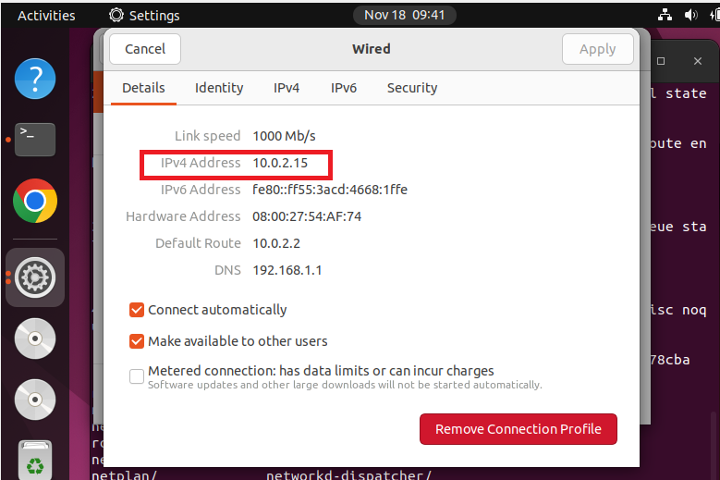
1.1.1 Install Both Master and Salve
https://www.youtube.com/watch?v=UWg3ORRRF60
Knode1 IP Address
https://www.folkstalk.com/2022/09/find-ip-address-of-virtualbox-vm-with-code-examples.html
Settings > Network > Wired
IP address: 10.0.2.15.

Slide 14
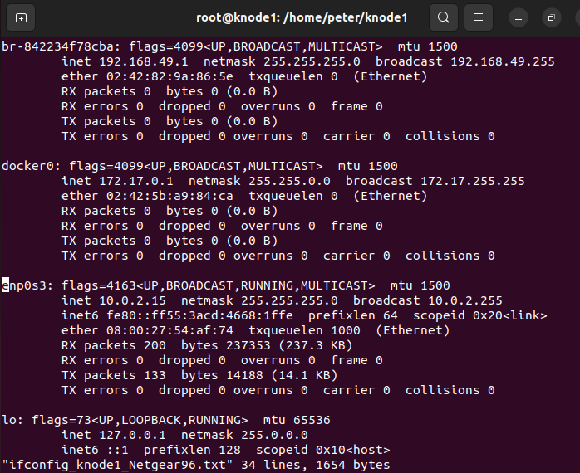
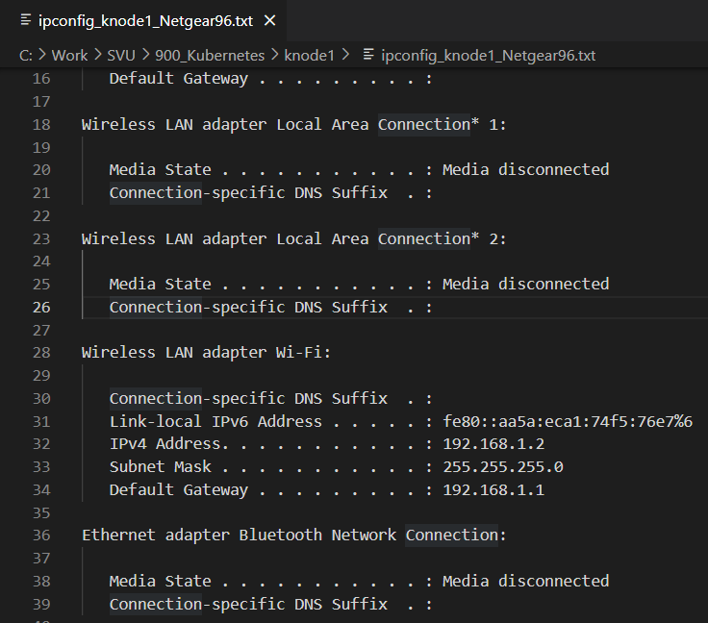
1.3 Initialize Hostname and IP Address
https://www.youtube.com/watch?v=UWg3ORRRF60
Ifconfig: Guest Virtual Machine
ifconfig: Interface configuration
ipconfig: internet protocol Configuration.
br: Bridge Networking Interface.
enp0s3: Wired Ethernet Network PCI device in LAN.
Ipconfig: Host Machine
Guest Virtual Machine (knode1) uses enp0s3 and IP 10.0.2.15 to communicate with Window Host machine which has IP address 192.168.1.2.

Slide 15
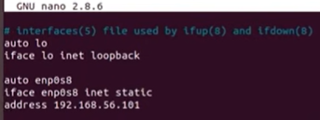
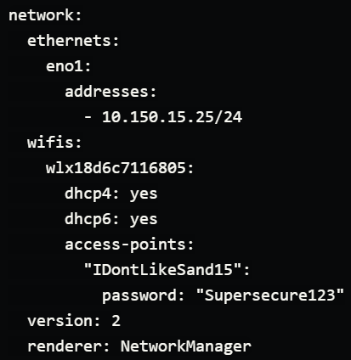
1.3 Initialize Hostname and IP Address
https://www.youtube.com/watch?v=UWg3ORRRF60
/etc/network/interface
https://netplan.io/examples
After Ubuntu 17.20 /etc/network/interface is changed to /etc/netplan

Slide 16
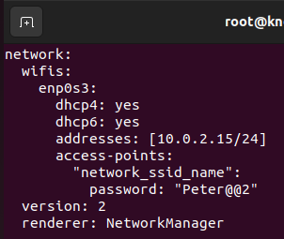
1.3 Initialize Hostname and IP Address
https://www.youtube.com/watch?v=UWg3ORRRF60
/etc/netplan/knode1.yaml
https://netplan.io/examples
> sudo vi /etc/netplan/knode1.yaml
>> network:
>> wifis:
>> enp0s3:
>> dhcp4: yes
>> dhcp6: yes
>> addresses: [10.0.2.15/24]
>> access-points:
>> “network_ssid_name”:
>> password: “Peter@@2”
>> version: 2
>> renderer: NetworkManager
> sudo netplan apply /etc/netplan/knode1.yaml

Slide 17
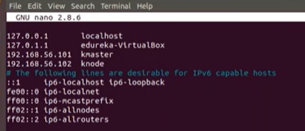
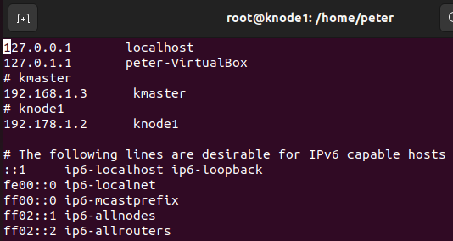
1.3 Initialize Hostname and IP Address
https://www.youtube.com/watch?v=UWg3ORRRF60
/etc/hosts (15:03/27:56)
Next,
> vi /etc/hosts
>> # Kmaster
>> 192.168.1.3 kmaster
>> # New knode 1
>> 10.0.2.15 knode1
Then, we re-start the machine.

Slide 18
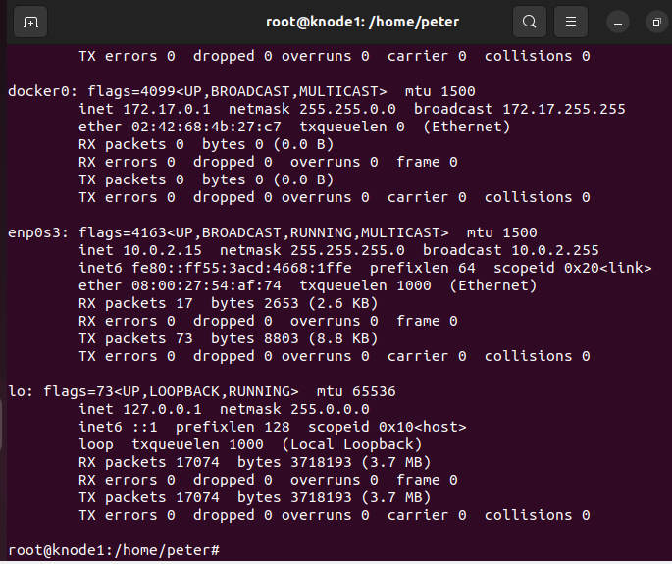
1.3 Initialize Hostname and IP Address
https://www.youtube.com/watch?v=UWg3ORRRF60
Restart Machine
Now, we car re-started the machine
…and check if my hostname and hosts have been updated.
The hostname and hosts are updated each time we start the machine.
1. root@knode1
2. > ifconfig
>> enp0s3: IP Address 10.0.2.15
We can see the hostname and IP-address keep the same as we specified.
2
1

Slide 19
1.3 Initialize Hostname and IP Address
https://www.youtube.com/watch?v=UWg3ORRRF60
Verify the hostname and IP Address
We verify:
1. The hostname to “knode1” is successfully updated by /etc/hostname.
2. Verify IP-address by ifconfig command. As we can see the IP address is updated as we setup.
This IP Address is good, and this is what we want.
We will get the same IP address each time we re-boot.
2
1

Slide 20
1.4 Install OpenSSH Server and Docker

Slide 21
1.4 Install OpenSSH Server and Docker
https://www.youtube.com/watch?v=UWg3ORRRF60
Install OpenSSH Server and Docker
Kubernetes Installation Steps
1. At Both Master and Slave Nodes | 2.Only at Master Node | 3. Only at Slave Node
1.1. Update Your Repository | 2.1. Initiate Kubernetes Cluster | 3.1 Join the Cluster
1.2. Turn Off Swap Space | 2.2. Install the Pod Network
1.3. Update Hostname, Hosts, and Set Static IP | 2.3 Setup the Kubernetes Dashboard
1.4 Install OpenSSH Server and Docker
1.5 Install Kubeadm, Kubelet, and Kubectl

Slide 22
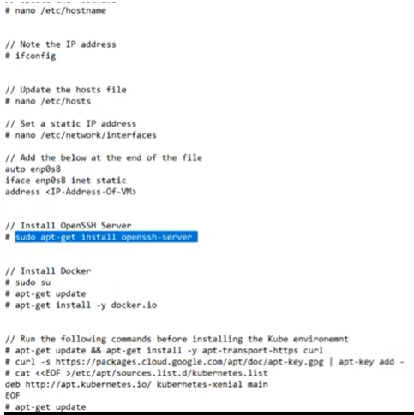
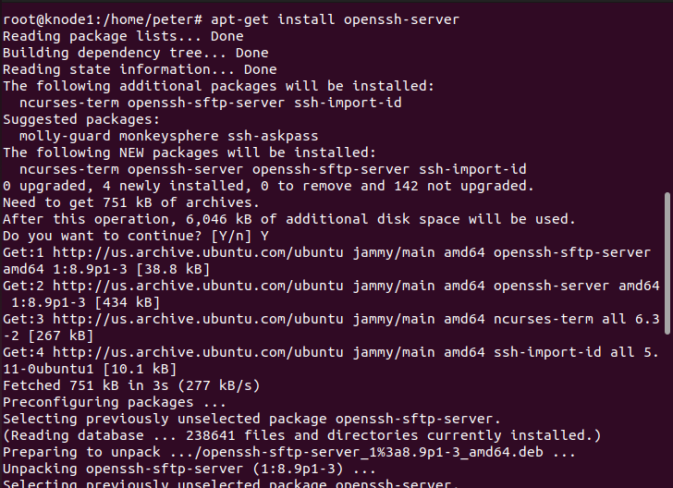
1.4 Install OpenSSH Server and Docker
https://www.youtube.com/watch?v=UWg3ORRRF60
Install the OpenSSH Server (7:48/27:56)
Now, we install openSSH
> sudo su
> apt-get install openssh-server
So, openSSH is installed right now.

Slide 23
1.4 Install OpenSSH Server and Docker
https://www.youtube.com/watch?v=UWg3ORRRF60
Install Docker (8:09/27:56)
https://docs.docker.com/engine/install/ubuntu/
Now, We install docker.
Follow the docker link above to remove the old version of docker, update ubuntu, and install new docker, and verify with “hello-world” example.
1. > sudo apt remove docker …
2. Get ca-certificate, url, etc.
> apt-get install ca-certificates curl …
3. Get docker official GPG key.
4. Setup docker repository
5. install docker engine
> sudo apt-get update
> sudo apt-get install docker-ce

Slide 24
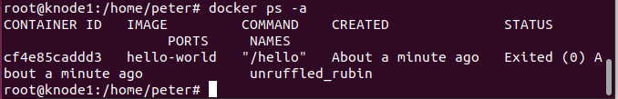
1.4 Install OpenSSH Server and Docker
https://www.youtube.com/watch?v=UWg3ORRRF60
Verify Docker run (8:09/27:56)
https://docs.docker.com/engine/install/ubuntu/
6. Run Docker “hello-world”
> sudo docker run hello-world
7. Verify Docker container is running
> docker ps -a

Slide 25
1.5 Install Kubeadm, Kubelet, and Kubectl

Slide 26
1.5 Install Kubeadm, Kubelet, and Kubectl
https://www.youtube.com/watch?v=UWg3ORRRF60
Install OpenSSH Server and Docker
Kubernetes Installation Steps
1. At Both Master and Slave Nodes | 2.Only at Master Node | 3. Only at Slave Node
1.1. Update Your Repository | 2.1. Initiate Kubernetes Cluster | 3.1 Join the Cluster
1.2. Turn Off Swap Space | 2.2. Install the Pod Network
1.3. Update Hostname, Hosts, and Set Static IP | 2.3 Setup the Kubernetes Dashboard
1.4 Install OpenSSH Server and Docker
1.5 Install Kubeadm, Kubelet, and Kubectl

Slide 27
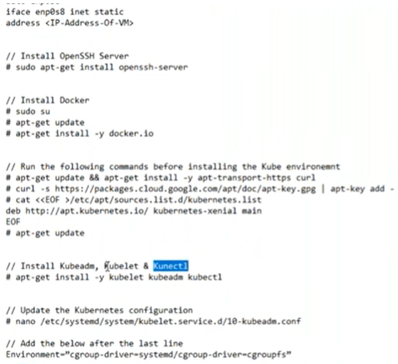
1.5 Install Kubeadm, Kubelet, and Kubectl
https://www.youtube.com/watch?v=UWg3ORRRF60
Install curl, download kubernetes, and install Kubernetes (9:26/27:56)
https://kubernetes.io/docs/setup/production-environment/tools/kubeadm/install-kubeadm/
Next, we install the Kubernetes.
1. There are a few things that we must do, such as
> install curl
> install kubernetes package
> apt-get update.
We have three major components in Kubernetes: kubeadm, kubelet, and kubectl
2. Install kubernetes:
> apt-get install –y kubelet kubeadm kubectl --allow-change-held-packages
Note: The option “--allow-change-held-packages” is suggested from installation prompt error message.
1
2

Slide 28
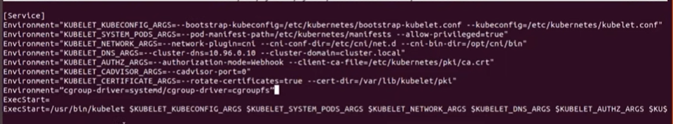
1.5 Install Kubeadm, Kubelet, and Kubectl
https://www.youtube.com/watch?v=UWg3ORRRF60
Update Kubernetes Configuration (11:35/27:56)
Next,
> vi /etc/systemd/system/kubelet.service.d/10-kubeadm.conf
> add one line below:
> Environment=“cgroup-driver=systemd/cgroup-driver=cgroupfs”

Slide 29
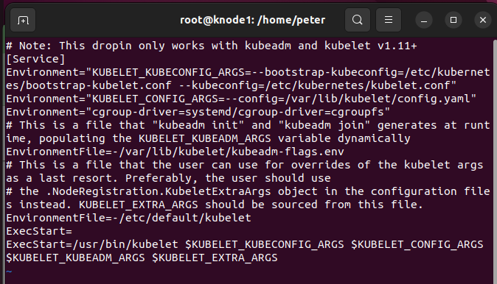
1.5 Install Kubeadm, Kubelet, and Kubectl
https://www.youtube.com/watch?v=UWg3ORRRF60
Update Kubernetes Configuration (11:35/27:56)
Next,
> vi /etc/system/system/kubelet.service.d/10-kubeadm.conf
> add one line below:
> Environment=“cgroup-driver=systemd/cgroup-driver=cgroupfs”

Slide 30
1.5 Install Kubeadm, Kubelet, and Kubectl
https://www.youtube.com/watch?v=UWg3ORRRF60
Finished Master and Slave (12:07/27:56)
Now, we have done installation to install salve.

Slide 31
End

