Slide 1
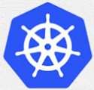
1 Install on Both Master/Slave: Master
Peter H. Chen

Slide 2
1 Install on Both Master/Slave: Master
https://www.youtube.com/watch?v=UWg3ORRRF60
Install for Both Master and Slave: Master
Review:
We have the two machines master and the slave in the cluster.
The master must have at least 2GB of RAM and 2-core CPUs.
The slave must have at least 2GB RAM and 1-core CPU.
These are basic requirements for the master and slave machines.
> ping <ipv4-address>
Note: We need to turn off the Virus protection, such as, NORTON utility to prevent error “Request timed out”
Kubernetes Installation Steps
1. At Both Master and Slave Nodes | 2.Only at Master Node | 3. Only at Slave Node
1.1. Update Your Repository | 2.1. Initiate Kubernetes Cluster | 3.1 Join the Cluster
1.2. Turn Off Swap Space | 2.2. Install the Pod Network
1.3. Update Hostname, Hosts, and Set Static IP | 2.3 Setup the Kubernetes Dashboard
1.4 Install OpenSSH Server and Docker
1.5 Install Kubeadm, Kubelet, and Kubectl

Slide 3
1.1 Update Your Repository: Master

Slide 4
1.1 Update Your Repository: Master
https://www.youtube.com/watch?v=UWg3ORRRF60
Update Your Repository: Master
Kubernetes Installation Steps
1. At Both Master and Slave Nodes | 2.Only at Master Node | 3. Only at Slave Node
1.1. Update Your Repository | 2.1. Initiate Kubernetes Cluster | 3.1 Join the Cluster
1.2. Turn Off Swap Space | 2.2. Install the Pod Network
1.3. Update Hostname, Hosts, and Set Static IP | 2.3 Setup the Kubernetes Dashboard
1.4 Install OpenSSH Server and Docker
1.5 Install Kubeadm, Kubelet, and Kubectl

Slide 5
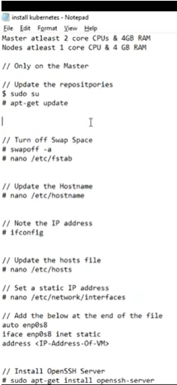
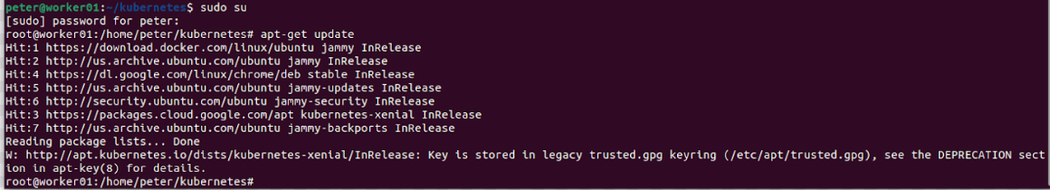
1.1 Update Your Repository: Master
https://www.youtube.com/watch?v=UWg3ORRRF60
sudo su and apt-get update
We log in as the su.
We are going to execute the following command as the sudo user.
> sudo su
Let’s do the update. This update my ubuntu repository.
> apt-get update

Slide 6
1.2 Turn Off Swap Space: Master

Slide 7
1.2 Turn Off Swap Space: Master
https://www.youtube.com/watch?v=UWg3ORRRF60
Turn Off Swap Space: Master
Kubernetes Installation Steps
1. At Both Master and Slave Nodes | 2.Only at Master Node | 3. Only at Slave Node
1.1. Update Your Repository | 2.1. Initiate Kubernetes Cluster | 3.1 Join the Cluster
1.2. Turn Off Swap Space | 2.2. Install the Pod Network
1.3. Update Hostname, Hosts, and Set Static IP | 2.3 Setup the Kubernetes Dashboard
1.4 Install OpenSSH Server and Docker
1.5 Install Kubeadm, Kubelet, and Kubectl

Slide 8
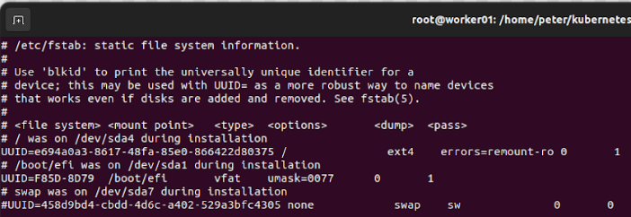
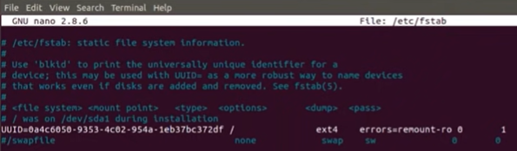
1.2 Turn Off Swap Space: Master
https://www.youtube.com/watch?v=UWg3ORRRF60
swapoff -a
Next, we turn off my swap space.
The command to turn off my swap space is “swapoff -a”
> swapoff –a
It should be turn off swap space immediately. If it take long time, then ^C and reboot your system.
> vi /etc/fstab
We comment out the swap space.

Slide 9
1.3 Initialize Hostname and IP Address

Slide 10
1.3 Initialize Hostname and IP Address
https://www.youtube.com/watch?v=UWg3ORRRF60
Initialize Hostname and IP Address
Kubernetes Installation Steps
1. At Both Master and Slave Nodes | 2.Only at Master Node | 3. Only at Slave Node
1.1. Update Your Repository | 2.1. Initiate Kubernetes Cluster | 3.1 Join the Cluster
1.2. Turn Off Swap Space | 2.2. Install the Pod Network
1.3. Update Hostname, Hosts, and Set Static IP | 2.3 Setup the Kubernetes Dashboard
1.4 Install OpenSSH Server and Docker
1.5 Install Kubeadm, Kubelet, and Kubectl

Slide 11
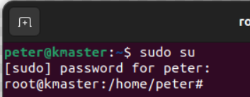
1.3 Initialize Hostname and IP Address
https://www.youtube.com/watch?v=UWg3ORRRF60
/etc/hostname and prompt hostname
Next, we update the hostname, hosts file, and set a static IP Address.
Let’s update the hostname.
> vi /etc/hostname
We change the host name to “kmaster” which stand for Kubernetes Master.
The hostname is display in the prompt.
If we want to display the new prompt, we must re-start the VM (or Linux system).

Slide 12
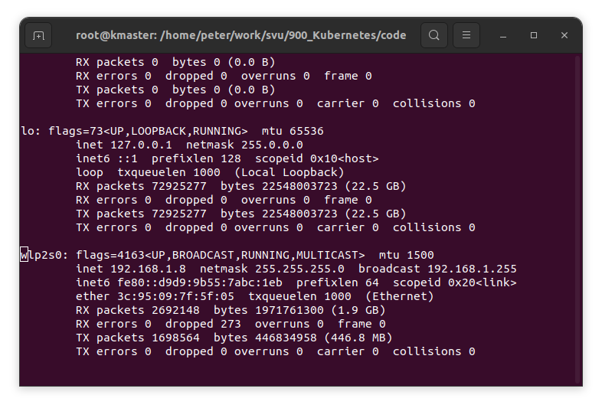
1.3 Install Both Master and Salve
https://www.youtube.com/watch?v=UWg3ORRRF60
ifconfig
Next, we run the “ifconfig” command.
> ifconfig > ifconfig.txt
> vi ifconfig.txt
Search for keyword wlp (Wireless Link Prioritization) for IP Address, the IP address is 192.168.1.8.

Slide 13
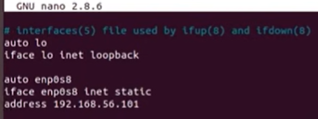
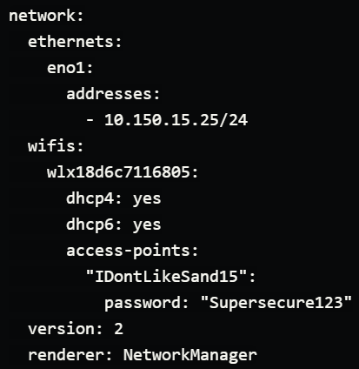
1.3 Initialize Hostname and IP Address
https://www.youtube.com/watch?v=UWg3ORRRF60
/etc/network/interface
https://netplan.io/examples
After Ubuntu 17.20 /etc/network/interface is changed to /etc/netplan/kmaster.yaml

Slide 14
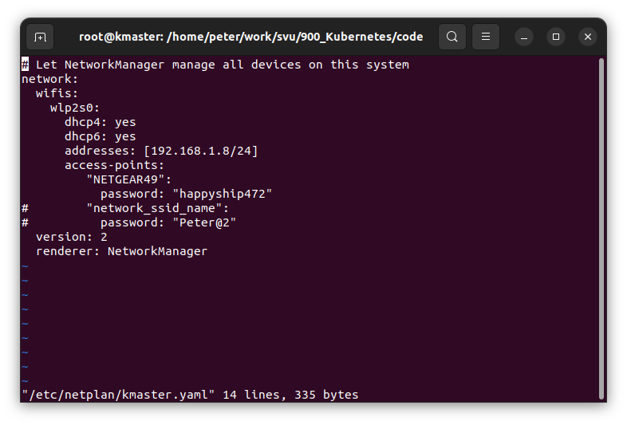
1.3 Initialize Hostname and IP Address
https://www.youtube.com/watch?v=UWg3ORRRF60
/etc/network/interface
https://netplan.io/examples
> sudo vi /etc/netplan/master.yaml
>> network:
>> wifis:
>> wlp2s0:
>> dhcp4: yes
>> dhcp6: yes
>> addresses: [192.168.1.8/24]
>> access-point:
>> “NETGEAR49”:
>> password: “happyshipxxx”
>> version: 2
>> render: NetworkManager
> sudo netplan apply /etc/netplan/kmaster.yaml>

Slide 15
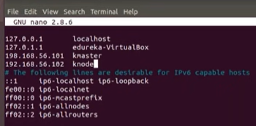
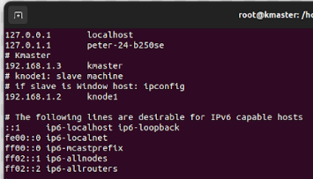
1.3 Initialize Hostname and IP Address
https://www.youtube.com/watch?v=UWg3ORRRF60
/etc/hosts (15:23/27:56)
Next,
> vi /etc/hosts
>> # Kmaster
>> 192.168.1.8 kmaster
>>
# knode1
>> 192.168.1.2 knode1
Then, we re-start the machine.

Slide 16
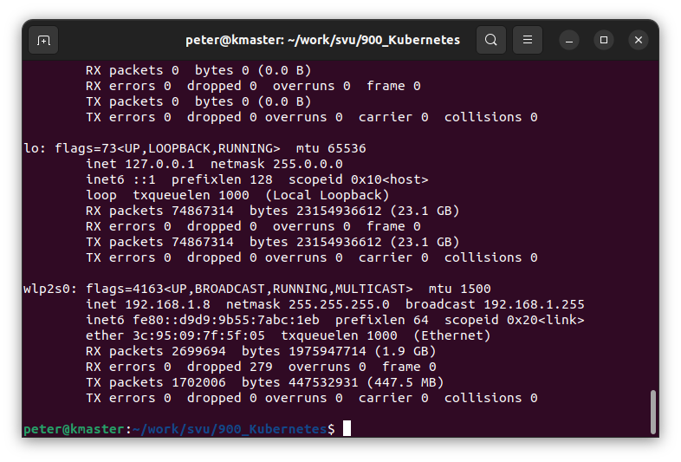
1.3 Initialize Hostname and IP Address
https://www.youtube.com/watch?v=UWg3ORRRF60
Restart Machine
We verify:
1. The hostname to “kmaster” is successfully updated by /etc/hostname.
2. Verify IP-address by ifconfig command. As we can see the IP address is updated as we setup by /etc/hosts.
This IP Address is dynamic host with dhcp4 and dhcp6 by /etc/netplan/kmaster.yaml.
We will get the same IP address each time we re-boot.
2
1

Slide 17
1.4 Install OpenSSH Server and Docker

Slide 18
1.4 Install OpenSSH Server and Docker
https://www.youtube.com/watch?v=UWg3ORRRF60
Install OpenSSH Server and Docker
Kubernetes Installation Steps
1. At Both Master and Slave Nodes | 2.Only at Master Node | 3. Only at Slave Node
1.1. Update Your Repository | 2.1. Initiate Kubernetes Cluster | 3.1 Join the Cluster
1.2. Turn Off Swap Space | 2.2. Install the Pod Network
1.3. Update Hostname, Hosts, and Set Static IP | 2.3 Setup the Kubernetes Dashboard
1.4 Install OpenSSH Server and Docker
1.5 Install Kubeadm, Kubelet, and Kubectl

Slide 19
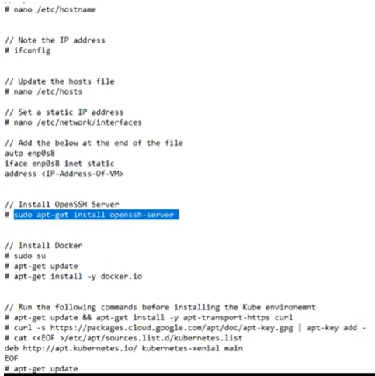
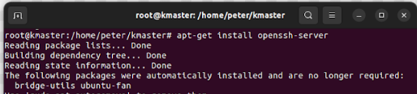
1.4 Install OpenSSH Server and Docker
https://www.youtube.com/watch?v=UWg3ORRRF60
Install the OpenSSH Server (7:48/27:56)
Now, we install openSSH
> sudo su
> apt-get install openssh-server
So, openSSH is installed right now.

Slide 20
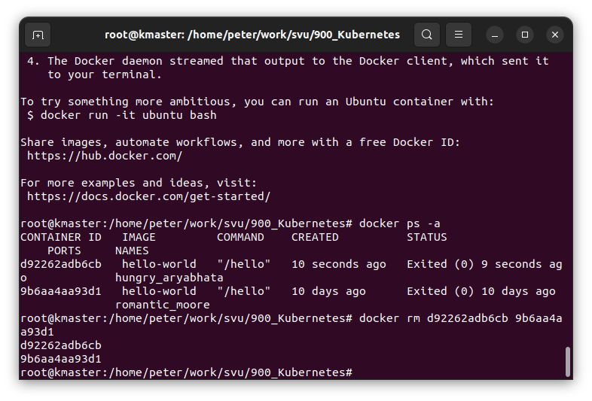
1.4 Install OpenSSH Server and Docker
https://www.youtube.com/watch?v=UWg3ORRRF60
Install Docker (8:09/27:56)
https://docs.docker.com/engine/install/ubuntu/
Now, We install docker.
Follow the docker link above to remove the old version of docker, update Ubuntu, and install new docker, and verify with “hello-world” example.
> sudo apt autoremove ...
> apt-get update
We install docker
> apt-get install -y docker-ce …
Verify docker is installed:
> sudo docker run hello-world
> docker ps -a

Slide 21
1.5 Install Kubeadm, Kubelet, and Kubectl

Slide 22
1.5 Install Kubeadm, Kubelet, and Kubectl
https://www.youtube.com/watch?v=UWg3ORRRF60
Install OpenSSH Server and Docker
Kubernetes Installation Steps
1. At Both Master and Slave Nodes | 2.Only at Master Node | 3. Only at Slave Node
1.1. Update Your Repository | 2.1. Initiate Kubernetes Cluster | 3.1 Join the Cluster
1.2. Turn Off Swap Space | 2.2. Install the Pod Network
1.3. Update Hostname, Hosts, and Set Static IP | 2.3 Setup the Kubernetes Dashboard
1.4 Install OpenSSH Server and Docker
1.5 Install Kubeadm, Kubelet, and Kubectl

Slide 23
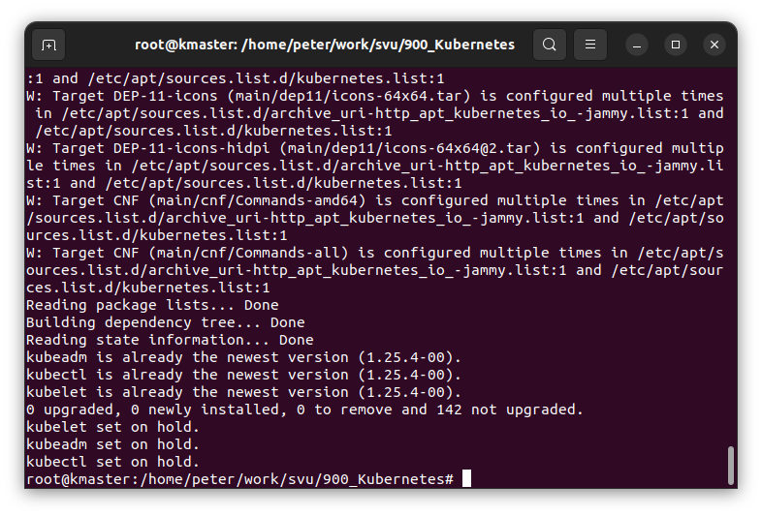
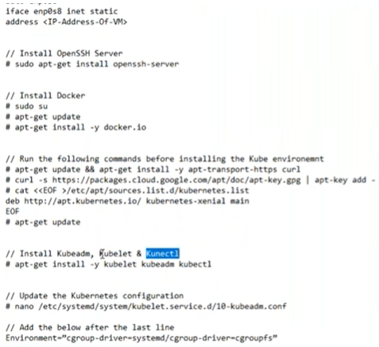
1.5 Install Kubeadm, Kubelet, and Kubectl
https://www.youtube.com/watch?v=UWg3ORRRF60
Install curl, download Kubernetes, and install Kubernetes (9:26/27:56)
https://kubernetes.io/docs/setup/production-environment/tools/kubeadm/install-kubeadm/
Next, we install the Kubernetes.
1. There are a few things that we must do, such as
> install curl
> install kubernetes package
> apt-get update.
We have three major components in Kubernetes: kubeadm, kubelet, and kubectl
2. Install kubernetes:
> apt-get install –y kubelet kubeadm kubectl
1
2

Slide 24
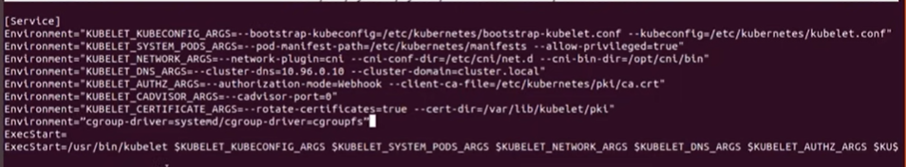
1.5 Install Kubeadm, Kubelet, and Kubectl
https://www.youtube.com/watch?v=UWg3ORRRF60
Update Kubernetes Configuration (11:35/27:56)
Next,
> vi /etc/systemd/system/kubelet.service.d/10-kubeadm.conf
https://kubernetes.io/docs/setup/production-environment/container-runtimes/
We need to install container runtime into each node in the cluster so that PODS can be run there. There is two cgroup drivers: cgroupfs and systemd. The cgroupfs driver is the default driver.
> add one line below:
> Environment=“cgroup-driver=systemd/cgroup-driver=cgroupfs”

Slide 25
1.5 Install Kubeadm, Kubelet, and Kubectl
https://www.youtube.com/watch?v=UWg3ORRRF60
Finished Master and Slave (12:07/27:56)
Now, we have done for the Master.
We need to do the same installation for Slave.

Slide 26
End

