Slide 1
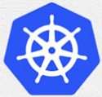
2 Config Master
Peter H. Chen

Slide 2
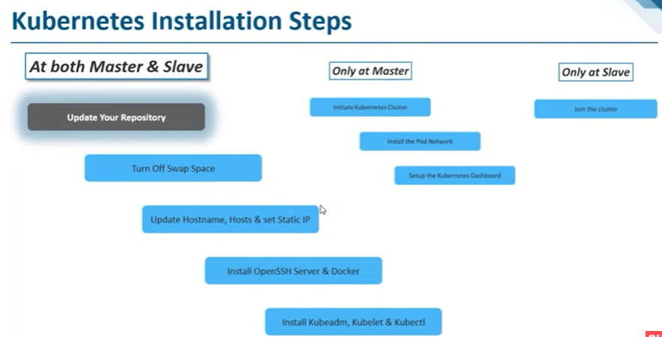
2 Config Master
https://www.youtube.com/watch?v=UWg3ORRRF60
Install/Setup Kubernetes on Ubuntu
The installation includes the followings:
1. At Both Master and Slave Nodes: five steps (1.1-1.5) to install Kubernetes
2. Master Node: three commands (2.1-2.3) to bring up the cluster.
3. Slave Node: one command (3.1) to join the cluster.
Kubernetes Installation Steps
1. At Both Master and Slave Nodes | 2.Only at Master Node | 3. Only at Slave Node
1.1. Update Your Repository | 2.1. Initiate Kubernetes Cluster | 3.1 Join the Cluster
1.2. Turn Off Swap Space | 2.2. Install the Pod Network
1.3. Update Hostname, Hosts, and Set Static IP | 2.3 Setup the Kubernetes Dashboard
1.4 Install OpenSSH Server and Docker
1.1 Install Kubeadm, Kubelet, and Kubectl

Slide 3
2.1 Initiate Kubernetes Cluster

Slide 4
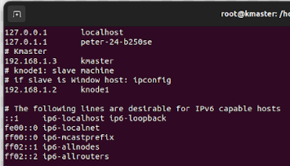
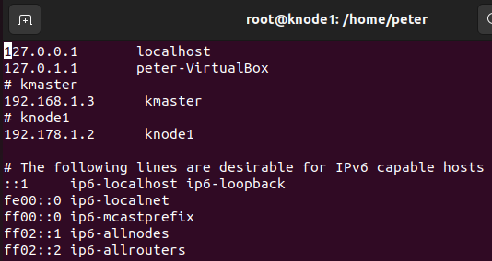
2.1 Initiate Kubernetes Cluster
https://www.youtube.com/watch?v=UWg3ORRRF60
Initiate Kubernetes Cluster (16:07/27:56)
We defined IP Addresses for both kmaster and knode1 in /etc/hosts of kmaster machine
> # kmaster
> 192.168.1.3 kmaster
> # knode1
> 192.168.1.2
>> reboot the kmaster machine
We defined IP address for both kmaster and knode1 in /etc/hosts of k node 1 machine
> # kmaster
> 192.168.1.3 kmaster
> # knode1
> 192.168.1.2
>> reboot the kmaster machine
/etc/hosts on Kmaster machine
/etc/hosts on knode1 machine

Slide 5
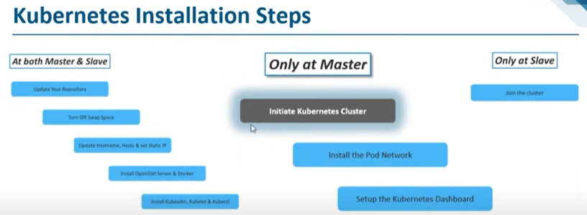
2.1 Install Same Command for Salve
https://www.youtube.com/watch?v=UWg3ORRRF60
Reboot Master and Slave Machine (16:53/27:56)
After we reboot both master and slave machine, we need to initiate kubernetes Cluster.
…and then we need to install POD network.
Kubernetes Installation Steps
1. At Both Master and Slave Nodes | 2.Only at Master Node | 3. Only at Slave Node
1.1. Update Your Repository | 2.1. Initiate Kubernetes Cluster | 3.1 Join the Cluster
1.2. Turn Off Swap Space | 2.2. Install the Pod Network
1.3. Update Hostname, Hosts, and Set Static IP | 2.3 Setup the Kubernetes Dashboard
1.4 Install OpenSSH Server and Docker
1.1 Install Kubeadm, Kubelet, and Kubectl

Slide 6
2.2 Install POD Network

Slide 7
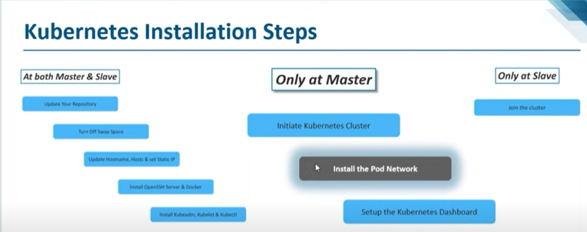
2.2 Install POD Network
https://www.youtube.com/watch?v=UWg3ORRRF60
Install POD Network (17:17/27:56)
Why do we need to install the POD network?
https://opensource.com/article/22/6/kubernetes-networking-fundamentals
https://github.com/flannel-io/flannel
Because all out containers inside a single PDS will have to communicate over a network.
POD is nothing but a network of containers.
Kubernetes Installation Steps
1. At Both Master and Slave Nodes | 2.Only at Master Node | 3. Only at Slave Node
1.1. Update Your Repository | 2.1. Initiate Kubernetes Cluster | 3.1 Join the Cluster
1.2. Turn Off Swap Space | 2.2. Install the Pod Network
1.3. Update Hostname, Hosts, and Set Static IP | 2.3 Setup the Kubernetes Dashboard
1.4 Install OpenSSH Server and Docker
1.1 Install Kubeadm, Kubelet, and Kubectl

Slide 8
2.2 Install POD Network
https://www.youtube.com/watch?v=UWg3ORRRF60
Install POD Network (17:17/27:56)
https://github.com/flannel-io/flannel
There are various containers network which we can use, such as, Calico CNI (Container Network Interface) POD network, Calico Flannel POD network, or Azure.
Please refer to Kubernetes document for entire list of POD network list.
Here, we will use Calico POD CNI (Container Network Interface) Network.
Calico POD Network is simple and straightforward.
Kubernetes Installation Steps
1. At Both Master and Slave Nodes | 2.Only at Master Node | 3. Only at Slave Node
1.1. Update Your Repository | 2.1. Initiate Kubernetes Cluster | 3.1 Join the Cluster
1.2. Turn Off Swap Space | 2.2. Install the Pod Network
1.3. Update Hostname, Hosts, and Set Static IP | 2.3 Setup the Kubernetes Dashboard
1.4 Install OpenSSH Server and Docker
1.1 Install Kubeadm, Kubelet, and Kubectl

Slide 9
1.1.2 Install Same Command for Salve
https://www.youtube.com/watch?v=UWg3ORRRF60
Install POD Network (17:17/27:56)
Here, we will use Calico POD Network.
Calico POD Network is simple and straightforward.
Kubernetes Installation Steps
1. At Both Master and Slave Nodes | 2.Only at Master Node | 3. Only at Slave Node
1.1. Update Your Repository | 2.1. Initiate Kubernetes Cluster | 3.1 Join the Cluster
1.2. Turn Off Swap Space | 2.2. Install the Pod Network
1.3. Update Hostname, Hosts, and Set Static IP | 2.3 Setup the Kubernetes Dashboard
1.4 Install OpenSSH Server and Docker
1.1 Install Kubeadm, Kubelet, and Kubectl

Slide 10
2.3 Install Kubernetes Dashboard

Slide 11
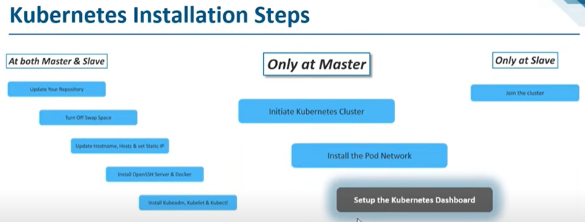
2.3 Install Kubernetes Dashboard
https://www.youtube.com/watch?v=UWg3ORRRF60
Install Kubernetes Dashboard (17:26/27:56)
Next, we will brin up the Kubernetes Dashboard.
We must bring up the Kubernetes Dashboard before our nodes join the clusters.
First, We bring up the Kubernetes Dashboard on the master.
Then, let the nodes join the clusters.
Kubernetes Installation Steps
1. At Both Master and Slave Nodes | 2.Only at Master Node | 3. Only at Slave Node
1.1. Update Your Repository | 2.1. Initiate Kubernetes Cluster | 3.1 Join the Cluster
1.2. Turn Off Swap Space | 2.2. Install the Pod Network
1.3. Update Hostname, Hosts, and Set Static IP | 2.3 Setup the Kubernetes Dashboard
1.4 Install OpenSSH Server and Docker
1.1 Install Kubeadm, Kubelet, and Kubectl

Slide 12
2.4 Setup Kubernetes on Master

Slide 13
2.4 Setup Kubernetes on Master
https://www.youtube.com/watch?v=UWg3ORRRF60
Setup Kubernetes on Master (18:01/27:56)
So, let go to the master and run three commands below:
1. Initiate Kubernetes Cluster
2. Install POD network
3. Setup up the Kubernetes Dashboard.
Kubernetes Installation Steps
1. At Both Master and Slave Nodes | 2.Only at Master Node | 3. Only at Slave Node
1.1. Update Your Repository | 2.1. Initiate Kubernetes Cluster | 3.1 Join the Cluster
1.2. Turn Off Swap Space | 2.2. Install the Pod Network
1.3. Update Hostname, Hosts, and Set Static IP | 2.3 Setup the Kubernetes Dashboard
1.4 Install OpenSSH Server and Docker
1.1 Install Kubeadm, Kubelet, and Kubectl

Slide 14

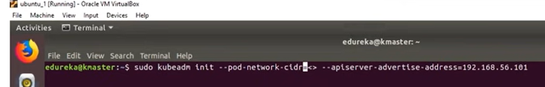
2.4 Setup Kubernetes on Master
https://www.youtube.com/watch?v=UWg3ORRRF60
Setup Kubernetes on Master (18:14/27:56)
On Master:
> sudo kubeadm init --pod-network-cidr=<> --apiserver-advertise-address=<ip-address-of-master>
> sudo kubeadm init --pod-network-cidr=<> --apiserver-advertise-address =192.168.50.101
Any slave knode can come and join this IP-Address 192.168.50.101

Slide 15
2.4 Setup Kubernetes on Master
https://www.youtube.com/watch?v=UWg3ORRRF60
Setup Kubernetes on Master (18:45/27:56)
https://www.cnblogs.com/apink/p/15176060.html
For Calico network, we use CNI (Container Network Interface).
If we use Calico POD Network, we use 192.168.0.0/16
If we use Flannel CNI, we use 10.244.0.0/16
> sudo kubeadm init --pod-network-cidr=192.168.0.0/16 --apiserver-advertise-address=192.168.56.191

Slide 16
2.5 Setup POD Network on Master

Slide 17
2.5 Setup POD Network on Master
https://www.youtube.com/watch?v=UWg3ORRRF60
Setup Calico POD Network on Master (19:00/27:56)
We setup Calico POD Network on Master.
Kubernetes Installation Steps
1. At Both Master and Slave Nodes | 2.Only at Master Node | 3. Only at Slave Node
1.1. Update Your Repository | 2.1. Initiate Kubernetes Cluster | 3.1 Join the Cluster
1.2. Turn Off Swap Space | 2.2. Install the Pod Network
1.3. Update Hostname, Hosts, and Set Static IP | 2.3 Setup the Kubernetes Dashboard
1.4 Install OpenSSH Server and Docker
1.1 Install Kubeadm, Kubelet, and Kubectl

Slide 18
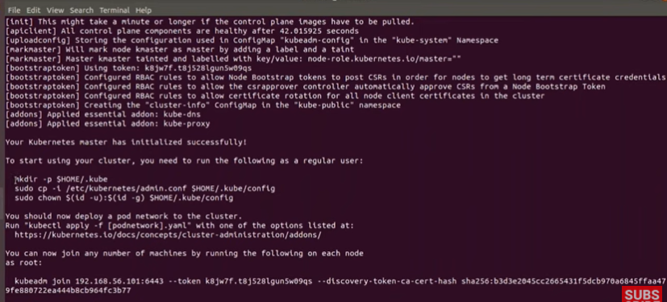
2.5 Setup POD Network on Master
https://www.youtube.com/watch?v=UWg3ORRRF60
Setup Calico POD Network on Master (19:30/27:56)
https://www.cnblogs.com/apink/p/15176060.html
We need below three commands:
> mkdir -p $HOME/.kube
> sudo cp -t /etc/kubernetes/admin.conf $HOME/.kube/config
> sudo chowm $(id -u) $(id -g) $HOME/.kube/config

Slide 19
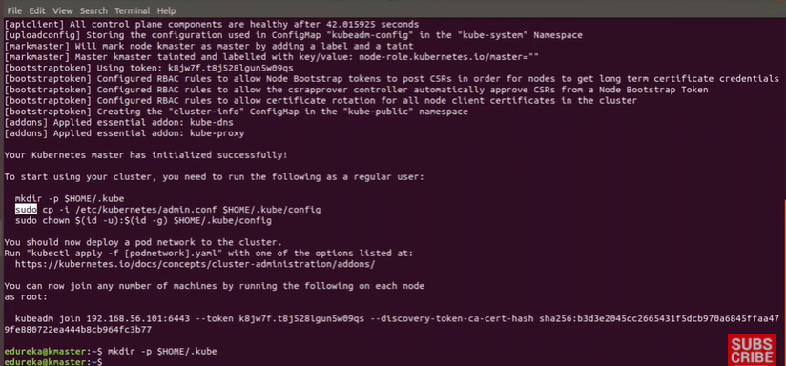
2.5 Setup POD Network on Master
https://www.youtube.com/watch?v=UWg3ORRRF60
Setup Calico POD Network on Master (19:45/27:56)
https://www.cnblogs.com/apink/p/15176060.html
We need below three commands:
> kubeadm join ….

Slide 20
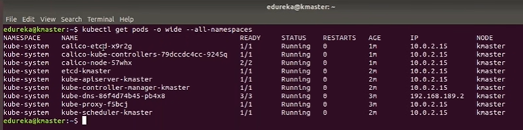
2.5 Setup POD Network on Master
https://www.youtube.com/watch?v=UWg3ORRRF60
Setup Calico POD Network on Master (22:00/27:56)
https://www.cnblogs.com/apink/p/15176060.html
> kubectl get pods -o wide --all-namespaces
This command is used to check all the computers are inside the same cluster.
“calixxxx” stands for “Calico POD Network”.
We also see the apiserver, controller, dns, proxy, and scheduler.
These are the default deployments that we get.
The default deployments are healthy if everything are running.
These are all running in kmaster (kubernetes master).

Slide 21
2.6 Setup Kubernetes Dashboard

Slide 22
2.6 Setup Kubernetes Dashboard
https://www.youtube.com/watch?v=UWg3ORRRF60
Setup Kubernetes Dashboard on Master (22:10/27:56)
We setup Kubernetes Dashboard on Master.
Kubernetes Installation Steps
1. At Both Master and Slave Nodes | 2.Only at Master Node | 3. Only at Slave Node
1.1. Update Your Repository | 2.1. Initiate Kubernetes Cluster | 3.1 Join the Cluster
1.2. Turn Off Swap Space | 2.2. Install the Pod Network
1.3. Update Hostname, Hosts, and Set Static IP | 2.3 Setup the Kubernetes Dashboard
1.4 Install OpenSSH Server and Docker
1.1 Install Kubeadm, Kubelet, and Kubectl

Slide 23
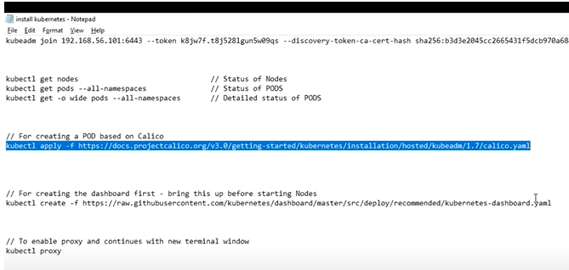
2.6 Setup Kubernetes Dashboard
https://www.youtube.com/watch?v=UWg3ORRRF60
Setup Kubernetes Dashboard on Master (22:20/27:56)
> kubectl create -f https://raw.githubusercontent.com/projectcalico/calico/v3.24.5/manifests/tigera-operator.yaml

Slide 24
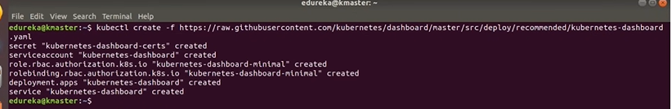
2.6 Setup Kubernetes Dashboard
https://www.youtube.com/watch?v=UWg3ORRRF60
Setup Kubernetes Dashboard on Master (22:30/27:56)
> kubectl create -f https://raw.githubusercontent.com/projectcalico/calico/v3.24.5/manifests/tigera-operator.yaml
Copy the dashboard.

Slide 25
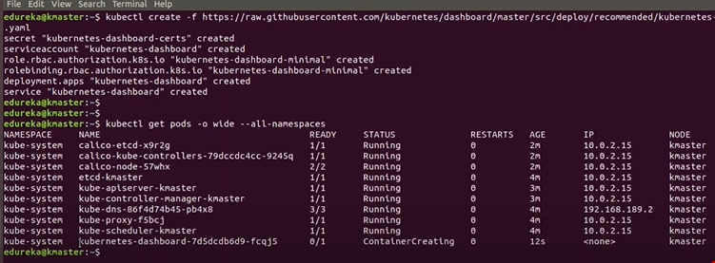
2.6 Setup Kubernetes Dashboard
https://www.youtube.com/watch?v=UWg3ORRRF60
Setup Kubernetes Dashboard on Master (22:45/27:56)
> kubectl create -f https://raw.githubusercontent.com/projectcalico/calico/v3.24.5/manifests/tigera-operator.yaml
We got one more POD which is deployed.
Last time, this was not there because I had not deployed dashboard.

Slide 26
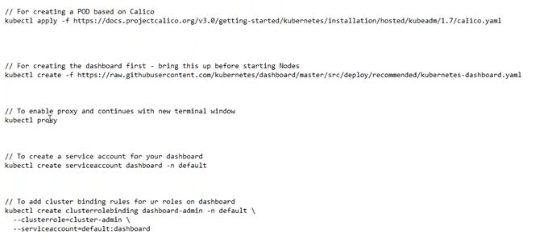

2.6 Setup Kubernetes Dashboard
https://www.youtube.com/watch?v=UWg3ORRRF60
Setup Kubernetes Dashboard on Master (23:00/27:56)
> kubectl create -f https://raw.githubusercontent.com/projectcalico/calico/v3.24.5/manifests/tigera-operator.yaml
We enable the proxy and server.
We start the server at 127.0.0.1:8001

Slide 27
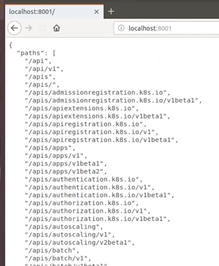
2.6 Setup Kubernetes Dashboard
https://www.youtube.com/watch?v=UWg3ORRRF60
Setup Kubernetes Dashboard on Master (23:30/27:56)
> kubectl create -f https://raw.githubusercontent.com/projectcalico/calico/v3.24.5/manifests/tigera-operator.yaml
Open the browser.
> localhost:8001
We can see the kubernetes server running there.

Slide 28
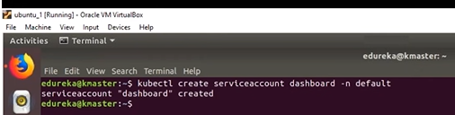
2.6 Setup Kubernetes Dashboard
https://www.youtube.com/watch?v=UWg3ORRRF60
Setup Kubernetes Dashboard on Master (24:00/27:56)
> kubectl create -f https://raw.githubusercontent.com/projectcalico/calico/v3.24.5/manifests/tigera-operator.yaml
Right now, I cannot login.
We must create the service first.

Slide 29
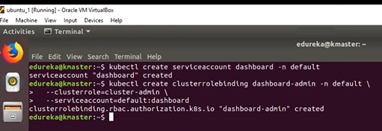
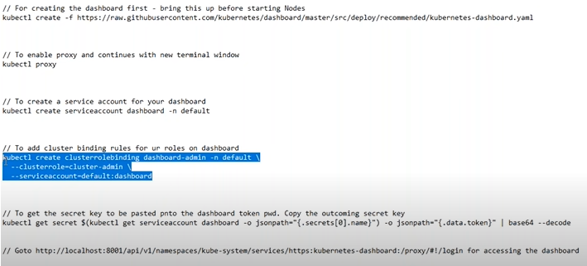
2.6 Setup Kubernetes Dashboard
https://www.youtube.com/watch?v=UWg3ORRRF60
Setup Kubernetes Dashboard on Master (24:35/27:56)
> kubectl create -f https://raw.githubusercontent.com/projectcalico/calico/v3.24.5/manifests/tigera-operator.yaml
We add the cluster, proxy, with token.

Slide 30
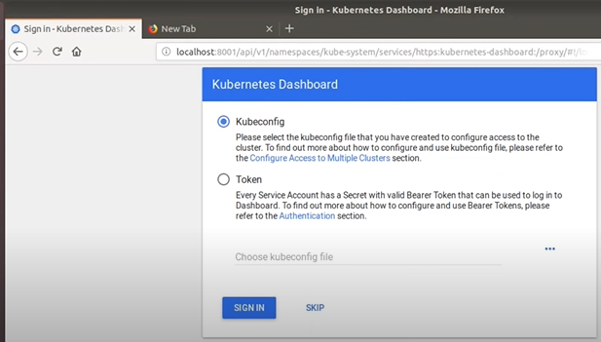
2.6 Setup Kubernetes Dashboard
https://www.youtube.com/watch?v=UWg3ORRRF60
Setup Kubernetes Dashboard on Master (24:46/27:56)
> kubectl create -f https://raw.githubusercontent.com/projectcalico/calico/v3.24.5/manifests/tigera-operator.yaml
We need to login with token.

Slide 31
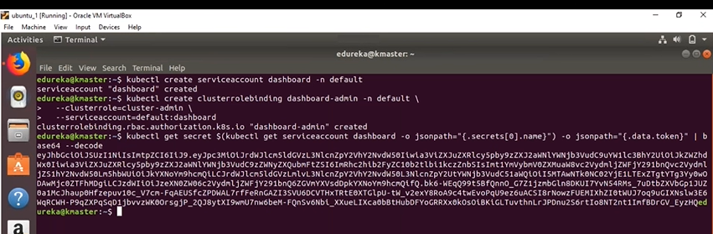
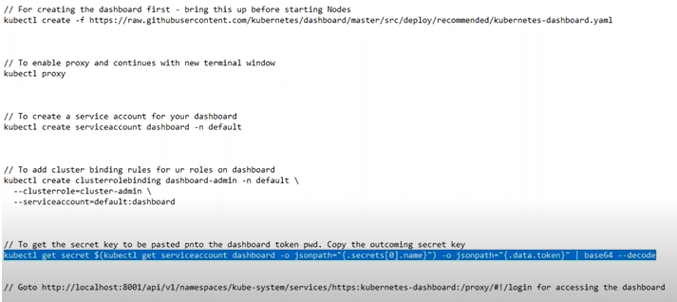
2.6 Setup Kubernetes Dashboard
https://www.youtube.com/watch?v=UWg3ORRRF60
Setup Kubernetes Dashboard on Master (24:54/27:56)
> kubectl create -f https://raw.githubusercontent.com/projectcalico/calico/v3.24.5/manifests/tigera-operator.yaml
We add token.

Slide 32
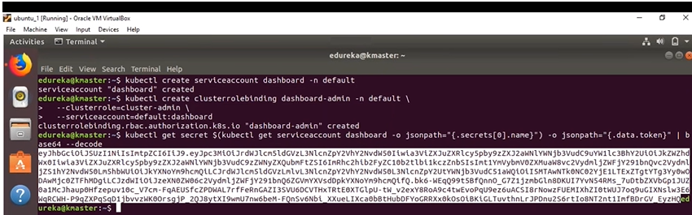
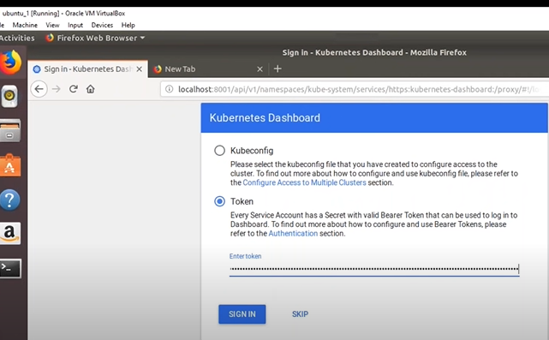
2.6 Setup Kubernetes Dashboard
https://www.youtube.com/watch?v=UWg3ORRRF60
Setup Kubernetes Dashboard on Master (24:54/27:56)
> kubectl create -f https://raw.githubusercontent.com/projectcalico/calico/v3.24.5/manifests/tigera-operator.yaml
We copy the token and paste below.

Slide 33
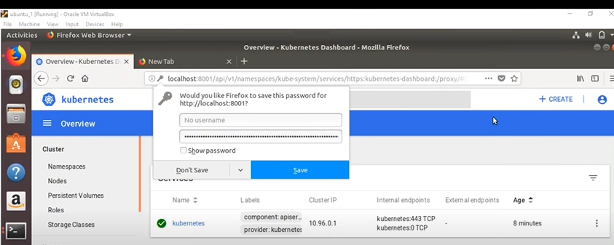
2.6 Setup Kubernetes Dashboard
https://www.youtube.com/watch?v=UWg3ORRRF60
Setup Kubernetes Dashboard on Master (25:17/27:56)
> kubectl create -f https://raw.githubusercontent.com/projectcalico/calico/v3.24.5/manifests/tigera-operator.yaml
We save the token.

Slide 34
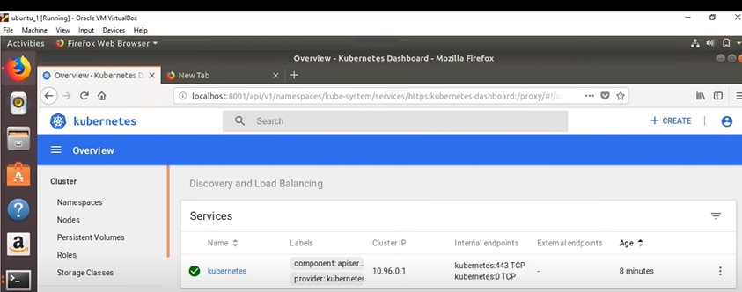
2.6 Setup Kubernetes Dashboard
https://www.youtube.com/watch?v=UWg3ORRRF60
Setup Kubernetes Dashboard on Master (25:30/27:56)
> kubectl create -f https://raw.githubusercontent.com/projectcalico/calico/v3.24.5/manifests/tigera-operator.yaml
Now, you can see our kubernetes cluster are setup.
We have dashboard and kubernetes server are deployed.
Let’s go the final part. We will connect the Kubernetes Server.

Slide 35
End

