Slide 1
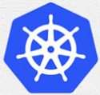
3 Slave Connect the Kubernetes Server
Peter H. Chen

Slide 2
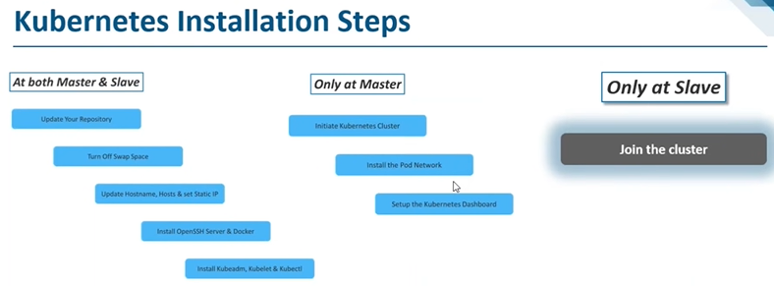
3 Slave Connect the Kubernetes Server
https://www.youtube.com/watch?v=UWg3ORRRF60
Slave Connect the Kubernetes Server (25:33/27:56)
Now, we are in the final part which Slave to connect the Kubernetes Server.
Kubernetes Installation Steps
1. At Both Master and Slave Nodes | 2.Only at Master Node | 3. Only at Slave Node
1.1. Update Your Repository | 2.1. Initiate Kubernetes Cluster | 3.1 Join the Cluster
1.2. Turn Off Swap Space | 2.2. Install the Pod Network
1.3. Update Hostname, Hosts, and Set Static IP | 2.3 Setup the Kubernetes Dashboard
1.4 Install OpenSSH Server and Docker
1.1 Install Kubeadm, Kubelet, and Kubectl

Slide 3
3.1 Slave: Join the Cluster

Slide 4
3.1 Slave: Join the Cluster
https://www.youtube.com/watch?v=UWg3ORRRF60
Slave: Join the Cluster (25:43/27:56)
Now, on the slave, we want to add the slave in, i.e., to join the cluster.
Kubernetes Installation Steps
1. At Both Master and Slave Nodes | 2.Only at Master Node | 3. Only at Slave Node
1.1. Update Your Repository | 2.1. Initiate Kubernetes Cluster | 3.1 Join the Cluster
1.2. Turn Off Swap Space | 2.2. Install the Pod Network
1.3. Update Hostname, Hosts, and Set Static IP | 2.3 Setup the Kubernetes Dashboard
1.4 Install OpenSSH Server and Docker
1.1 Install Kubeadm, Kubelet, and Kubectl

Slide 5
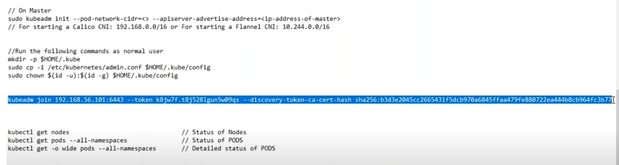
3.1 Slave: Join the Cluster
https://www.youtube.com/watch?v=UWg3ORRRF60
Slave: Join the Cluster (25:52/27:56)
Below is the command to join the cluster.

Slide 6
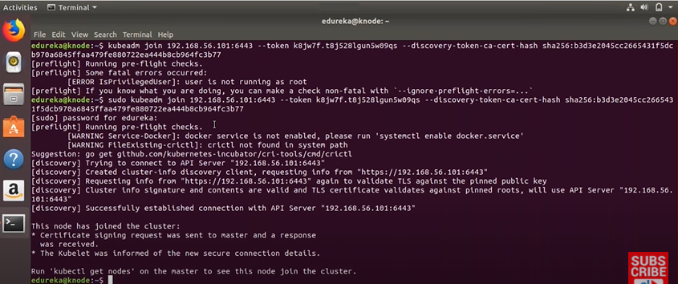
3.1 Slave: Join the Cluster
https://www.youtube.com/watch?v=UWg3ORRRF60
Slave: Command to Join the Cluster (26:07/27:56)
> sudo kubeadm join 192.168.x.xxx:6443 --token xxxxx --discovery-token-ca-cert-hash xxxxxx

Slide 7
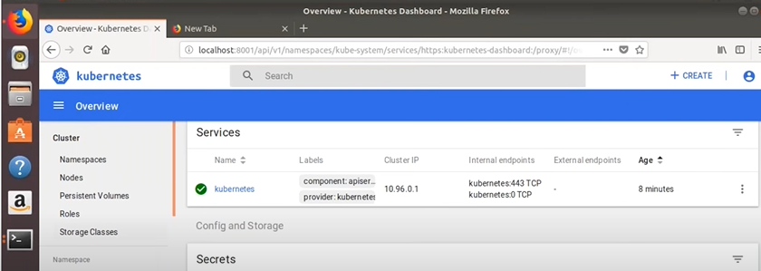
3.1 Slave: Join the Cluster
https://www.youtube.com/watch?v=UWg3ORRRF60
Master: Verify the Join of Slave Node (26:24/27:56)
Click on Nodes.
We will get the details of the Nodes

Slide 8
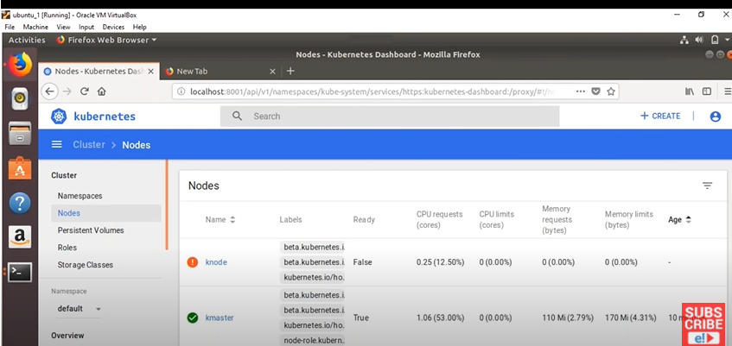
3.1 Slave: Join the Cluster
https://www.youtube.com/watch?v=UWg3ORRRF60
Master: Verify the Join of Slave Node (26:30/27:56)
Earlier, we only have kmaster.
Node, we have both kmaster and knode.

Slide 9
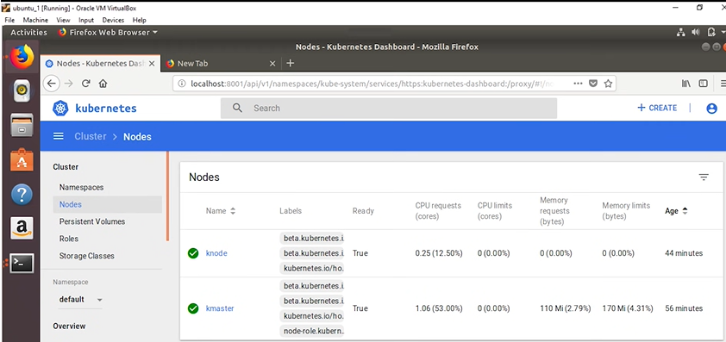
3.1 Slave: Join the Cluster
https://www.youtube.com/watch?v=UWg3ORRRF60
Master: Verify the Join of Slave Node (26:38/27:56)
Wait for several seconds, the knode comes up.

Slide 10
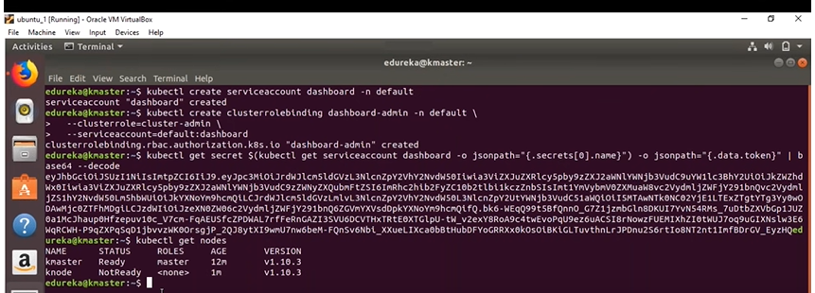
3.1 Slave: Join the Cluster
https://www.youtube.com/watch?v=UWg3ORRRF60
Master: Verify the Join of Slave Node (26:51/27:56)
We also can verify by the command line on the kmaster.
> kubectl get nodes
>> NAME …
>> kmaster
>> knode …

Slide 11
3.1 Slave: Join the Cluster
https://www.youtube.com/watch?v=UWg3ORRRF60
Master: Verify the Join of Slave Node (27:02/27:56)
That is about how to deploy the cluster.
From here, we can deployment whatever we want.
We can deploy very easy and very effectively from Dashboard or from CLI.

Slide 12
End

