Slide 1
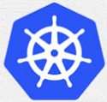
7 Yaml: pod
Peter H. Chen

Slide 2
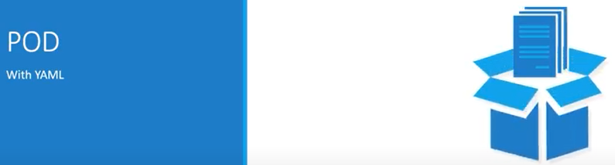
7 Yaml: pod
https://www.youtube.com/watch?v=T6E2yzlEX0Q&list=PL2We04F3Y_43dAehLMT5GxJhtk3mJtkl5&index=7
Yaml: pod (0:14/7:04)
We discuss creating a pod with Yaml.

Slide 3
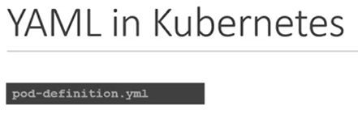
7 Yaml: pod
https://www.youtube.com/watch?v=T6E2yzlEX0Q&list=PL2We04F3Y_43dAehLMT5GxJhtk3mJtkl5&index=7
Yaml: pod (0:23/7:04)
In previous discussion, we discussed about the Yaml files in general.
Now, we will discuss how to develop Yaml files, specifically, for Kubernetes.
Kubernetes uses Yaml files as inputs, for the creation of objects, such as, pods, Replicas, Deployments, Services, etc.

Slide 4
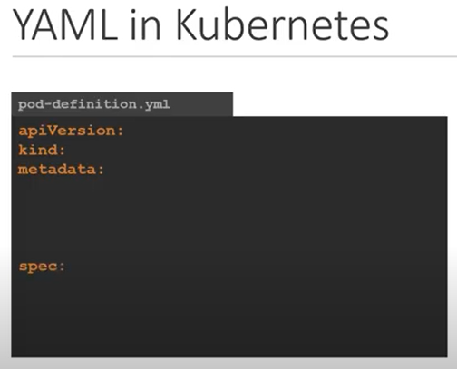
7 Yaml: pod
https://www.youtube.com/watch?v=T6E2yzlEX0Q&list=PL2We04F3Y_43dAehLMT5GxJhtk3mJtkl5&index=7
Yaml: pod (0:41/7:04)
All of these (pods, Replicas, Deployments, Services, etc.) follow similar structure.
A Kubernetes definition file always contains four top-level fields:
1. apiVersion,
2. kind,
3. metadata, and
4. spec
These are top-level or root-level properties.
These also required fields.
So, we must have fields in our configuration file.
Let’s look at each one of them.

Slide 5
7.1 apiVersion

Slide 6
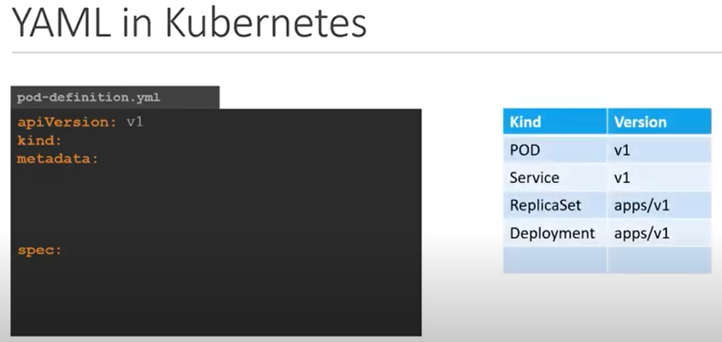
7.1 apiVersion
https://www.youtube.com/watch?v=T6E2yzlEX0Q&list=PL2We04F3Y_43dAehLMT5GxJhtk3mJtkl5&index=7
apiVersion (1:04/7:04)
The first one is apiVersion.
This is the Kubernetes API we are using to create the objects.
Depending on what we are trying to create, we must use the right API Version.
For now, since we are working on pods, we will set apiVersion as V1.

Slide 7
7.1 apiVersion
https://www.youtube.com/watch?v=T6E2yzlEX0Q&list=PL2We04F3Y_43dAehLMT5GxJhtk3mJtkl5&index=7
apiVersion (1:32/7:04)
There are few possible values for this field are apps/v1, beta extensions (extensions/b1beta), etc.
We will discuss more about API Version later.

Slide 8
7.2 Kind

Slide 9
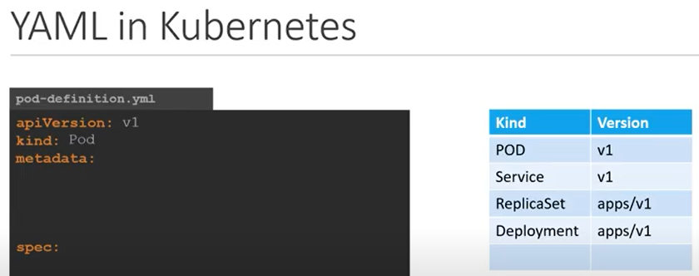
7.2 Kind
https://www.youtube.com/watch?v=T6E2yzlEX0Q&list=PL2We04F3Y_43dAehLMT5GxJhtk3mJtkl5&index=7
Kind (1:39/7:04)
The second is the Kind.
The kind refers to the type of object that we are trying to create.
In this case, the kind is “pod”.
We set kind to “pod” as below.

Slide 10
7.2 Kind
https://www.youtube.com/watch?v=T6E2yzlEX0Q&list=PL2We04F3Y_43dAehLMT5GxJhtk3mJtkl5&index=7
Kind (1:47/7:04)
Some other of kind could be Service, ReplicaSet, or Deployment as the Kind field in the table as below table.

Slide 11
7.3 Metadata

Slide 12
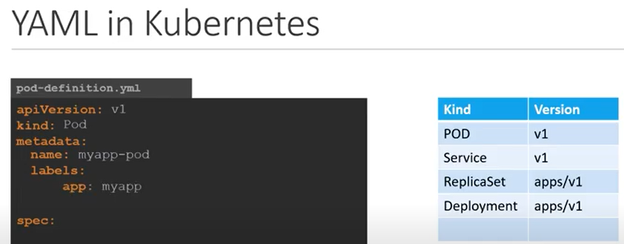
7.3 Metadata
https://www.youtube.com/watch?v=T6E2yzlEX0Q&list=PL2We04F3Y_43dAehLMT5GxJhtk3mJtkl5&index=7
Metadata (1:59/7:04)
The third is metadata.
The metadata is the data about the object, such as, object name, object labels, etc.

Slide 13
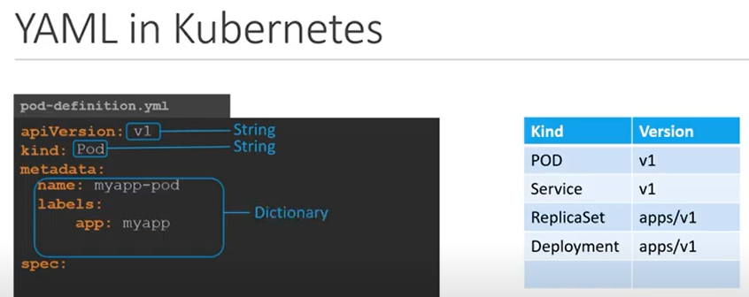
7.3 Metadata
https://www.youtube.com/watch?v=T6E2yzlEX0Q&list=PL2We04F3Y_43dAehLMT5GxJhtk3mJtkl5&index=7
Metadata (2:14/7:04)
As we can see, unlike the apiVersion and Kind, where we have specified a string value (key-value pairs), metadata is in the form of a dictionary.

Slide 14
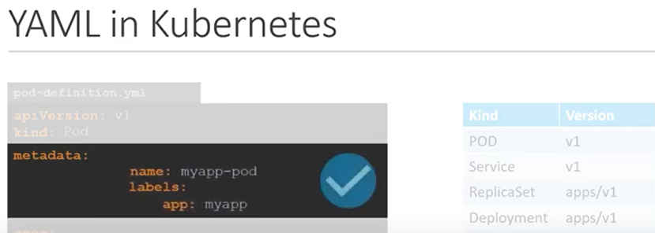
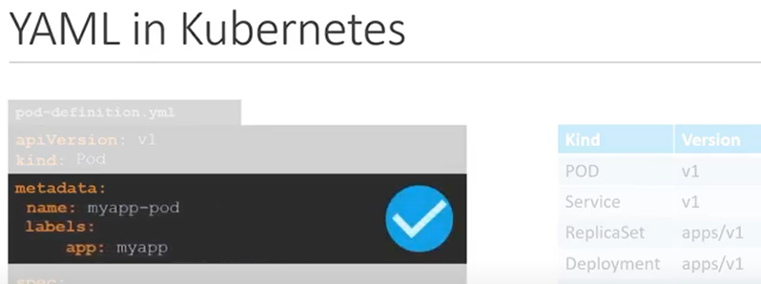
7.3 Metadata
https://www.youtube.com/watch?v=T6E2yzlEX0Q&list=PL2We04F3Y_43dAehLMT5GxJhtk3mJtkl5&index=7
Metadata (2:29/7:04)
The number of spaces before the two properties name and labels does not matter.
But name and labels have the same spaces since they are siblings.

Slide 15
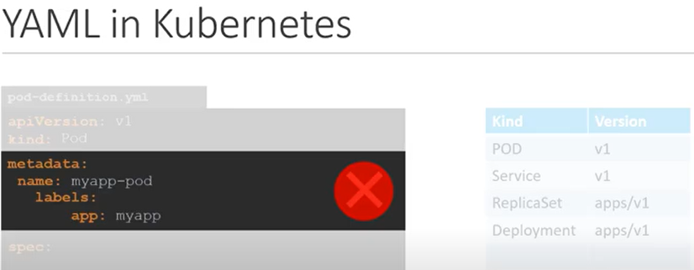
7.3 Metadata
https://www.youtube.com/watch?v=T6E2yzlEX0Q&list=PL2We04F3Y_43dAehLMT5GxJhtk3mJtkl5&index=7
Metadata (2:43/7:04)
In the below case, the labels has more spaces on the left than name.
…and labels is now the child of the name property instead of sibling which is incorrect.

Slide 16
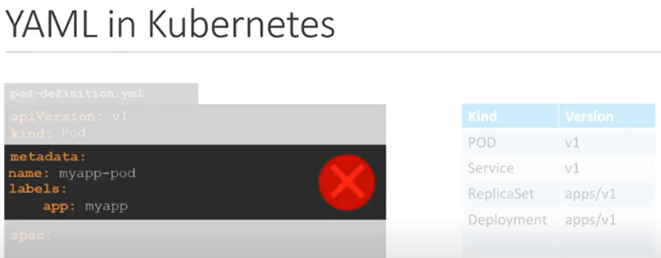
7.3 Metadata
https://www.youtube.com/watch?v=T6E2yzlEX0Q&list=PL2We04F3Y_43dAehLMT5GxJhtk3mJtkl5&index=7
Metadata (2:52/7:04)
Notice the name and labels properties must have more spaces than their parent which is metadata.
So, name and labels need to right indented to the right with spaces.
In this case, all three (metadata, name, and labels) have the same number of space before them. So, they are all siblings which is not correct.
parent

Slide 17
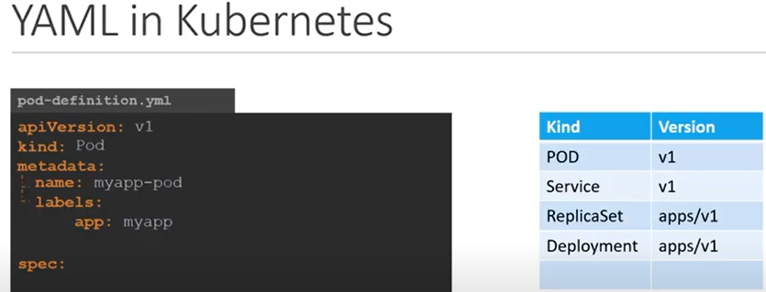
7.3 Metadata
https://www.youtube.com/watch?v=T6E2yzlEX0Q&list=PL2We04F3Y_43dAehLMT5GxJhtk3mJtkl5&index=7
Metadata (3:07/7:04)
Under Metadata, the name is string value.
So, we can name our pod as “myapp-pod”.
…and labels is a dictionary.
So, labels is a dictionary within the metadata dictionary.

Slide 18
7.3 Metadata
https://www.youtube.com/watch?v=T6E2yzlEX0Q&list=PL2We04F3Y_43dAehLMT5GxJhtk3mJtkl5&index=7
Metadata (3:30/7:04)
…and labels can have any key-value as we need.
For now, we have added labels with key-value (app: myapp).
Similarly, we can add other labels as fit which will help us identify these objects in later discussion.

Slide 19
7.3 Metadata
https://www.youtube.com/watch?v=T6E2yzlEX0Q&list=PL2We04F3Y_43dAehLMT5GxJhtk3mJtkl5&index=7
Metadata (3:42/7:04)
If we have hundreds of pods running a frontend application.
…and hundreds of pods running a backend application or database.
It will be difficult for us to group these pods once they are deployed.

Slide 20

7.3 Metadata
https://www.youtube.com/watch?v=T6E2yzlEX0Q&list=PL2We04F3Y_43dAehLMT5GxJhtk3mJtkl5&index=7
Metadata (3:55/7:04)
If we label the pod as front end, backend, or database, we will be able to filter the pods based on this label at a later point in time.
It is important to know that under metadata, we can only specify name, labels, or anything else that Kubernetes expects to be under metadata.
We cannot add any other property as we wish under metadata.

Slide 21
7.3 Metadata
https://www.youtube.com/watch?v=T6E2yzlEX0Q&list=PL2We04F3Y_43dAehLMT5GxJhtk3mJtkl5&index=7
Metadata (4:17/7:04)
However, under labels, we can have ANY kind of key-value pairs as we want.
So, it is important to understand what each of these parameters expect.

Slide 22
7.3 Metadata
https://www.youtube.com/watch?v=T6E2yzlEX0Q&list=PL2We04F3Y_43dAehLMT5GxJhtk3mJtkl5&index=7
Metadata (4:43/7:04)
So far, we only mentioned the type and name of the object.
We need to create a pod with a name “myapp-pod”.
But we have not specified the container or image we need in the pod.

Slide 23
7.4 Spec

Slide 24
7.4 Spec
https://www.youtube.com/watch?v=T6E2yzlEX0Q&list=PL2We04F3Y_43dAehLMT5GxJhtk3mJtkl5&index=7
Spec (4:50/7:04)
So far, we only mentioned the type and name of the object.
We need to create a pod with a name “myapp-pod”.
But we have not specified the container or image we need in the pod.
The last section of the file is the specification section which is written as spec.

Slide 25
7.4 Spec
https://www.youtube.com/watch?v=T6E2yzlEX0Q&list=PL2We04F3Y_43dAehLMT5GxJhtk3mJtkl5&index=7
Spec (4:53/7:04)
Depending the object that we are going to create, the spec is where we provide the additional information to Kubernetes pertaining to that object.
For different objects, the spec is different.
It is important to understand or refer to the documentation section to get the right format for each spec.

Slide 26
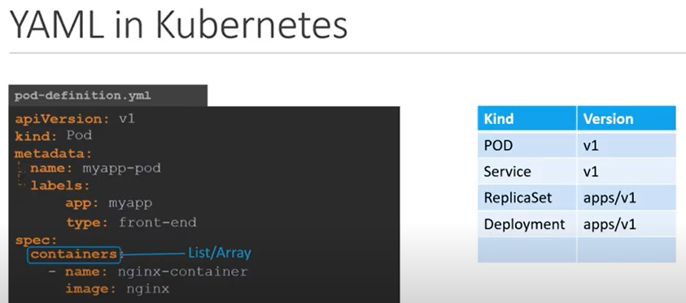
7.4 Spec
https://www.youtube.com/watch?v=T6E2yzlEX0Q&list=PL2We04F3Y_43dAehLMT5GxJhtk3mJtkl5&index=7
Spec (5:20/7:04)
Since we are only creating a pod with a single container in it (pod), it is easy.
The spec is a dictionary.
So, add a property under spec called containers.

Slide 27
7.4 Spec
https://www.youtube.com/watch?v=T6E2yzlEX0Q&list=PL2We04F3Y_43dAehLMT5GxJhtk3mJtkl5&index=7
Spec (5:30/7:04)
So, add a property under spec called containers.
Container is a list or array.
The reason of container property is a list is because the pods can have multiple containers within them as we discussed in previous discussion.

Slide 28
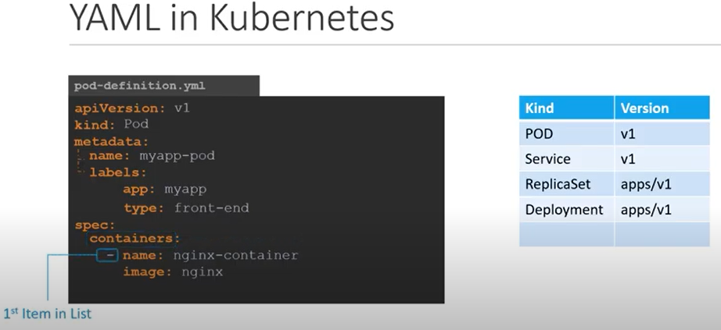
7.4 Spec
https://www.youtube.com/watch?v=T6E2yzlEX0Q&list=PL2We04F3Y_43dAehLMT5GxJhtk3mJtkl5&index=7
Spec (5:38/7:04)
In this case, we only add a single item in the list since we plan to have only a single container in the pod.
The dash (-) right before the name indicates this is the first item in the List (or Array).

Slide 29
7.4 Spec
https://www.youtube.com/watch?v=T6E2yzlEX0Q&list=PL2We04F3Y_43dAehLMT5GxJhtk3mJtkl5&index=7
Spec (5:46/7:04)
The item in the list is a dictionary.
So, add a name and image property.
The value for image is “nginx” which is the name of docker image in the docker repository.

Slide 30
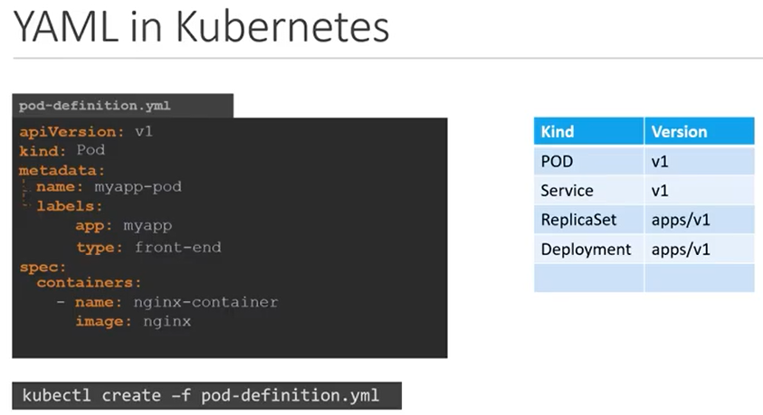
7.4 Spec
https://www.youtube.com/watch?v=T6E2yzlEX0Q&list=PL2We04F3Y_43dAehLMT5GxJhtk3mJtkl5&index=7
Spec (5:59/7:04)
Once the file is created, from the command
> kubectl create -f pod-definition.yml
And Kubernetes creates the pod.

Slide 31
7.5 Summary

Slide 32
7.5 Summary
https://www.youtube.com/watch?v=T6E2yzlEX0Q&list=PL2We04F3Y_43dAehLMT5GxJhtk3mJtkl5&index=7
Summary (6:16/7:04)
To Summarize, remember the four top level properties: apiVersion, kind, metadata, and spec.

Slide 33
7.5 Summary
https://www.youtube.com/watch?v=T6E2yzlEX0Q&list=PL2We04F3Y_43dAehLMT5GxJhtk3mJtkl5&index=7
Summary (6:26/7:04)
Then, start by adding values to those properties depending on the object that we are going to create.

Slide 34
7.6 Command

Slide 35
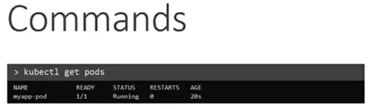
7.6 Command
https://www.youtube.com/watch?v=T6E2yzlEX0Q&list=PL2We04F3Y_43dAehLMT5GxJhtk3mJtkl5&index=7
Command (6:30/7:04)
Once we create the pod, how do we see it?
Use the command
> kubectl get pods
To see a list of pods available.
In this case, we have just one pod (myapp-pod).

Slide 36
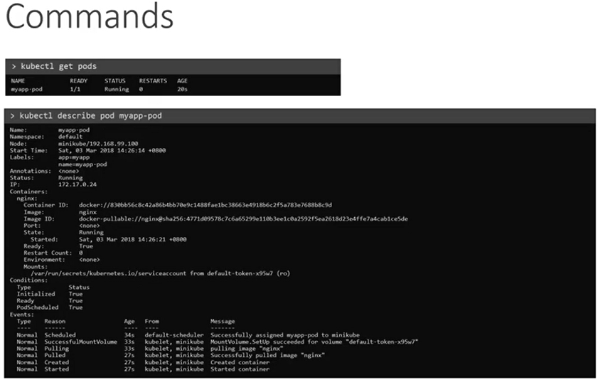
7.6 Command
https://www.youtube.com/watch?v=T6E2yzlEX0Q&list=PL2We04F3Y_43dAehLMT5GxJhtk3mJtkl5&index=7
Command (6:42/7:04)
To see the detail information about the pod, run the command
> kubectl describe pod myapp-pod

Slide 37
7.6 Command
https://www.youtube.com/watch?v=T6E2yzlEX0Q&list=PL2We04F3Y_43dAehLMT5GxJhtk3mJtkl5&index=7
Command (6:47/7:04)
This (kubectl describe pod) command will tell you the information about the pod, when it was created, what labels are assigned to it, what docker containers are part of it, and events associated with that pod.

Slide 38
7.6 Command
https://www.youtube.com/watch?v=T6E2yzlEX0Q&list=PL2We04F3Y_43dAehLMT5GxJhtk3mJtkl5&index=7
Command (7:00/7:04)
We will demo the command in next discussion.

Slide 39
End

