Slide 1

8 Demo: pod
Peter H. Chen

Slide 2
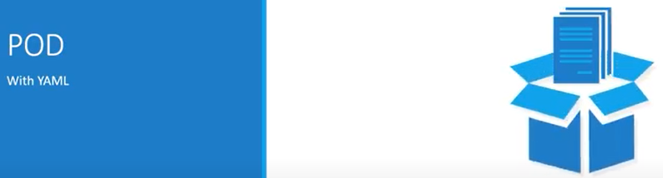
8 Demo: pod
https://www.youtube.com/watch?v=AAJ6FTqIVMY&list=PL2We04F3Y_43dAehLMT5GxJhtk3mJtkl5&index=8
Demo: pod (0:14/7:04)
We discuss creating a pod with Demo.

Slide 3
7.1 apiVersion

Slide 4
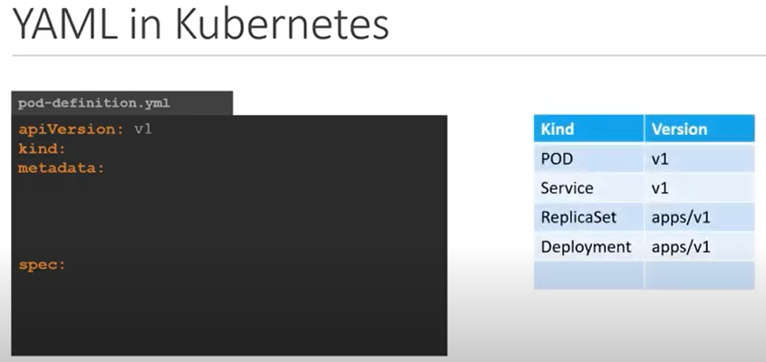
8.1 apiVersion
https://www.youtube.com/watch?v=AAJ6FTqIVMY&list=PL2We04F3Y_43dAehLMT5GxJhtk3mJtkl5&index=8
apiVersion (1:04/7:04)
The first one is apiVersion.
This is the Kubernetes API we are using to create the objects.
Depending on what we are trying to create, we must use the right API Version.
For now, since we are working on pods, we will set apiVersion as V1.

Slide 5
End

