Slide 1
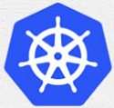
0 Install Kubernetes: Introduction
Peter H. Chen

Slide 2
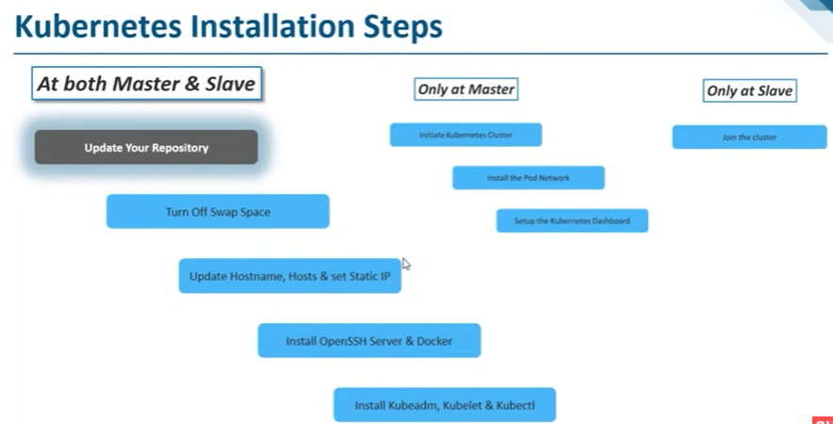
0 Install Kubernetes: Introduction
https://www.youtube.com/watch?v=UWg3ORRRF60
Install Kubernetes: Introduction
The installation includes the followings:
1. At Both Master and Slave Nodes: five steps (1.1-1.5) to install Kubernetes
2. Master Node: three commands (2.1-2.3) to bring up the cluster.
3. Slave Node: one command (3.1) to join the cluster.
Kubernetes Installation Steps
1. At Both Master and Slave Nodes | 2.Only at Master Node | 3. Only at Slave Node
1.1. Update Your Repository | 2.1. Initiate Kubernetes Cluster | 3.1 Join the Cluster
1.2. Turn Off Swap Space | 2.2. Install the Pod Network
1.3. Update Hostname, Hosts, and Set Static IP | 2.3 Setup the Kubernetes Dashboard
1.4 Install OpenSSH Server and Docker
1.5 Install Kubeadm, Kubelet, and Kubectl

Slide 3
0 Install Kubernetes: Introduction
https://www.youtube.com/watch?v=UWg3ORRRF60
Install Kubernetes: Introduction
We install commands on both master and slave.
Kubernetes Installation Steps
1. At Both Master and Slave Nodes | 2.Only at Master Node | 3. Only at Slave Node
1.1. Update Your Repository | 2.1. Initiate Kubernetes Cluster | 3.1 Join the Cluster
1.2. Turn Off Swap Space | 2.2. Install the Pod Network
1.3. Update Hostname, Hosts, and Set Static IP | 2.3 Setup the Kubernetes Dashboard
1.4 Install OpenSSH Server and Docker
1.5 Install Kubeadm, Kubelet, and Kubectl

Slide 4
0 Install Kubernetes: Introduction
https://www.youtube.com/watch?v=UWg3ORRRF60
1.1 Update Your Repository
First, we must update the repository.
Since we are using Ubuntu, we must update our repository.
Kubernetes Installation Steps
1. At Both Master and Slave Nodes | 2.Only at Master Node | 3. Only at Slave Node
1.1. Update Your Repository | 2.1. Initiate Kubernetes Cluster | 3.1 Join the Cluster
1.2. Turn Off Swap Space | 2.2. Install the Pod Network
1.3. Update Hostname, Hosts, and Set Static IP | 2.3 Setup the Kubernetes Dashboard
1.4 Install OpenSSH Server and Docker
1.5 Install Kubeadm, Kubelet, and Kubectl

Slide 5
0 Install Kubernetes: Introduction
https://www.youtube.com/watch?v=UWg3ORRRF60
1.2 Turn off Swap Space
We must turn OFF the swap space.
Kubernetes will not work if the swap space is ON.
We must disable the Swap Space.
There are a couple of commands for disable the swap space.
Kubernetes Installation Steps
1. At Both Master and Slave Nodes | 2.Only at Master Node | 3. Only at Slave Node
1.1. Update Your Repository | 2.1. Initiate Kubernetes Cluster | 3.1 Join the Cluster
1.2. Turn Off Swap Space | 2.2. Install the Pod Network
1.3. Update Hostname, Hosts, and Set Static IP | 2.3 Setup the Kubernetes Dashboard
1.4 Install OpenSSH Server and Docker
1.5 Install Kubeadm, Kubelet, and Kubectl

Slide 6
0 Install Kubernetes: Introduction
https://www.youtube.com/watch?v=UWg3ORRRF60
1.3 Update Hostname, Hosts, and Set Static IP
We must update the host name, hosts file, and set Static IP Address for all nodes in our cluster.
We must do that because at any point of time, if our master or our node in the cluster fails, then Kubernetes restart, the Kubernetes should have the same IP Address.
If we have a dynamic IP Address, then if Kubernetes restart because of failure condition, then Kubernetes will not be able to ON the cluster because they have different IP Address. That is the reason that we must set static IP Address.
There are several commands for this step.
Kubernetes Installation Steps
1. At Both Master and Slave Nodes | 2.Only at Master Node | 3. Only at Slave Node
1.1. Update Your Repository | 2.1. Initiate Kubernetes Cluster | 3.1 Join the Cluster
1.2. Turn Off Swap Space | 2.2. Install the Pod Network
1.3. Update Hostname, Hosts, and Set Static IP | 2.3 Setup the Kubernetes Dashboard
1.4 Install OpenSSH Server and Docker
1.5 Install Kubeadm, Kubelet, and Kubectl

Slide 7
0 Install Kubernetes: Introduction
https://www.youtube.com/watch?v=UWg3ORRRF60
1.4 Install OpenSSH Server and Docker
We must install the OpenSSH and Docker.
Because Kubernetes requires the OpenSSH functionality.
Kubernetes needs Docker because every running apps in Kubernetes is container.
We need to install OpenSSH Component and Docker component.
Kubernetes Installation Steps
1. At Both Master and Slave Nodes | 2.Only at Master Node | 3. Only at Slave Node
1.1. Update Your Repository | 2.1. Initiate Kubernetes Cluster | 3.1 Join the Cluster
1.2. Turn Off Swap Space | 2.2. Install the Pod Network
1.3. Update Hostname, Hosts, and Set Static IP | 2.3 Setup the Kubernetes Dashboard
1.4 Install OpenSSH Server and Docker
1.5 Install Kubeadm, Kubelet, and Kubectl

Slide 8
0 Install Kubernetes: Introduction
https://www.youtube.com/watch?v=UWg3ORRRF60
1.5 Install Kubeadm, Kubelet, and Kubectl
We must install Kubeadm, Kubelet, and Kubectl.
These are core components of Kubernetes.
These are all components that we must install on both Master and Slave Machines.
We will install these components next.
Kubernetes Installation Steps
1. At Both Master and Slave Nodes | 2.Only at Master Node | 3. Only at Slave Node
1.1. Update Your Repository | 2.1. Initiate Kubernetes Cluster | 3.1 Join the Cluster
1.2. Turn Off Swap Space | 2.2. Install the Pod Network
1.3. Update Hostname, Hosts, and Set Static IP | 2.3 Setup the Kubernetes Dashboard
1.4 Install OpenSSH Server and Docker
1.5 Install Kubeadm, Kubelet, and Kubectl

Slide 9
0 Install Kubernetes: Introduction
https://www.youtube.com/watch?v=UWg3ORRRF60
1.1.1 Install for Both Master and Slave
We have the two machines master and the slave in the cluster.
The master must have at least 2GB of RAM and 2-core CPUs.
The slave must have at least 2GB RAM and 1-core CPU.
These are basic requirements for the master and slave machines.
> ping <ipv4-address>
> ping6 -I <interface> <ipv6-address> (Same machine OK. For different machine NG)
Kubernetes Installation Steps
1. At Both Master and Slave Nodes | 2.Only at Master Node | 3. Only at Slave Node
1.1. Update Your Repository | 2.1. Initiate Kubernetes Cluster | 3.1 Join the Cluster
1.2. Turn Off Swap Space | 2.2. Install the Pod Network
1.3. Update Hostname, Hosts, and Set Static IP | 2.3 Setup the Kubernetes Dashboard
1.4 Install OpenSSH Server and Docker
1.5 Install Kubeadm, Kubelet, and Kubectl

Slide 10
0.1 Cluster

Slide 11



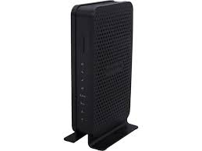

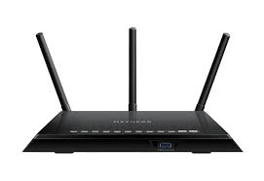


0.1 Cluster
https://www.youtube.com/watch?v=UWg3ORRRF60
1.1.1 Install for Both Master and Slave
https://lazyadmin.nl/home-network/home-network-diagram/
1. N600 Wi-Fi Cable Modem Router (Model C3700): Coaxial Cable to Ethernet and Wi-Fi internet.
Cable Modem Router: Netgear96, password: sweetxxxxx774.
2. AC1750 Smart Wi-Fi Router (Model R6400):
Smart Router: Netgear49, password: happyxxxx772.
Netgear96:
Cable Modem Router
Netgear49:
Smart Router
Coaxial cable
Ethernet
Wire
SVU Desktop (kmaster)
Ethernet Wire
Laptop (knode1)
Samsung network TV
Laptop (knode2)

Slide 12
End

