Slide 1
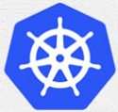
1 Install on Both Master/Slave: Master
Peter H. Chen

Slide 2
1 Install on Both Master/Slave: Master
https://www.youtube.com/watch?v=UWg3ORRRF60
Install for Both Master and Slave: Master
Review:
We have the two machines master and the slave in the cluster.
The master must have at least 2GB of RAM and 2-core CPUs.
The slave must have at least 2GB RAM and 1-core CPU.
These are basic requirements for the master and slave machines.
> ping <ipv4-address>
> ping6 -I <interface> <ipv6-address> (Same machine OK. For different machine NG)
Kubernetes Installation Steps
1. At Both Master and Slave Nodes | 2.Only at Master Node | 3. Only at Slave Node
1.1. Update Your Repository | 2.1. Initiate Kubernetes Cluster | 3.1 Join the Cluster
1.2. Turn Off Swap Space | 2.2. Install the Pod Network
1.3. Update Hostname, Hosts, and Set Static IP | 2.3 Setup the Kubernetes Dashboard
1.4 Install OpenSSH Server and Docker
1.5 Install Kubeadm, Kubelet, and Kubectl

Slide 3
1.1 Update Your Repository: Master

Slide 4
1.1 Update Your Repository: Master
https://www.youtube.com/watch?v=UWg3ORRRF60
Update Your Repository: Master
Kubernetes Installation Steps
1. At Both Master and Slave Nodes | 2.Only at Master Node | 3. Only at Slave Node
1.1. Update Your Repository | 2.1. Initiate Kubernetes Cluster | 3.1 Join the Cluster
1.2. Turn Off Swap Space | 2.2. Install the Pod Network
1.3. Update Hostname, Hosts, and Set Static IP | 2.3 Setup the Kubernetes Dashboard
1.4 Install OpenSSH Server and Docker
1.5 Install Kubeadm, Kubelet, and Kubectl

Slide 5
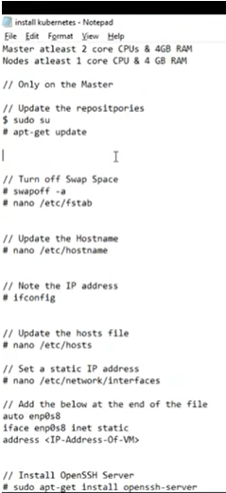
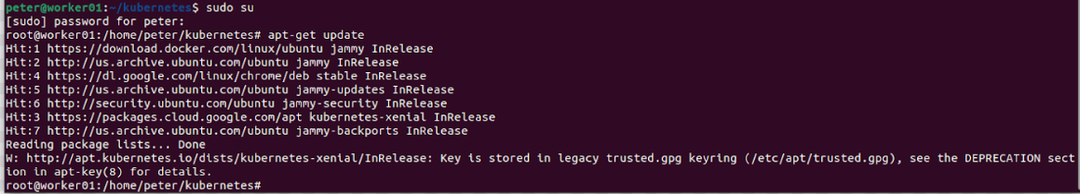
1.1 Update Your Repository: Master
https://www.youtube.com/watch?v=UWg3ORRRF60
sudo su and apt-get update
We log in as the su.
We are going to execute the following command as the sudo user.
> sudo su
Let’s do the update. This update my ubuntu repository.
> apt-get update

Slide 6
1.2 Turn Off Swap Space: Master

Slide 7
1.2 Turn Off Swap Space: Master
https://www.youtube.com/watch?v=UWg3ORRRF60
Turn Off Swap Space: Master
Kubernetes Installation Steps
1. At Both Master and Slave Nodes | 2.Only at Master Node | 3. Only at Slave Node
1.1. Update Your Repository | 2.1. Initiate Kubernetes Cluster | 3.1 Join the Cluster
1.2. Turn Off Swap Space | 2.2. Install the Pod Network
1.3. Update Hostname, Hosts, and Set Static IP | 2.3 Setup the Kubernetes Dashboard
1.4 Install OpenSSH Server and Docker
1.5 Install Kubeadm, Kubelet, and Kubectl

Slide 8
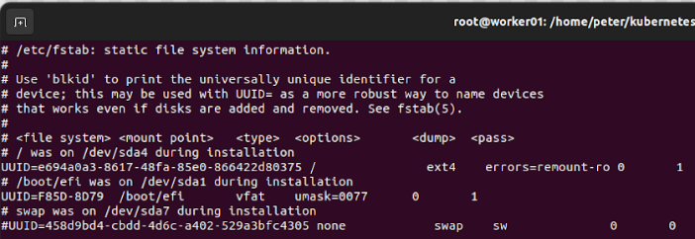
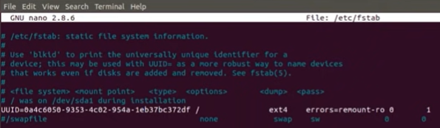
1.2 Turn Off Swap Space: Master
https://www.youtube.com/watch?v=UWg3ORRRF60
swapoff -a
Next, we turn off my swap space.
The command to turn off my swap space is “swapoff -a”
> swapoff –a
It should be turn off swap space immediately. If it take long time, then ^C and reboot your system.
> vi /etc/fstab
We comment out the swap space.

Slide 9
1.3 Initialize Hostname and IP Address

Slide 10
1.3 Initialize Hostname and IP Address
https://www.youtube.com/watch?v=UWg3ORRRF60
Initialize Hostname and IP Address
Kubernetes Installation Steps
1. At Both Master and Slave Nodes | 2.Only at Master Node | 3. Only at Slave Node
1.1. Update Your Repository | 2.1. Initiate Kubernetes Cluster | 3.1 Join the Cluster
1.2. Turn Off Swap Space | 2.2. Install the Pod Network
1.3. Update Hostname, Hosts, and Set Static IP | 2.3 Setup the Kubernetes Dashboard
1.4 Install OpenSSH Server and Docker
1.5 Install Kubeadm, Kubelet, and Kubectl

Slide 11
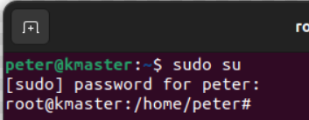
1.3 Initialize Hostname and IP Address
https://www.youtube.com/watch?v=UWg3ORRRF60
/etc/hostname and prompt hostname
Next, we update the hostname, hosts file, and set a static IP Address.
Let’s update the hostname.
> vi /etc/hostname
We change the host name to “kmaster” which stand for Kubernetes Master.
The hostname is display in the prompt.
If we want to display the new prompt, we must re-start the VM (or Linux system).

Slide 12
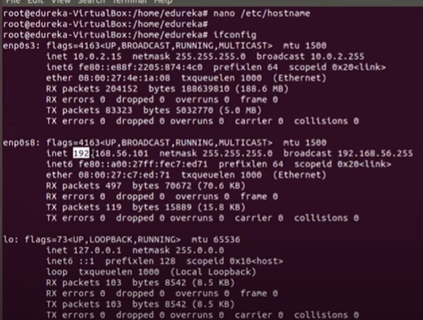
1.1.1 Install Both Master and Salve
https://www.youtube.com/watch?v=UWg3ORRRF60
ifconfig
Next, we run the “ifconfig” command.
> mkdir kmaster
> cd kmaster
> ifconfig > ifconfig.txt
> vi ifconfig.txt
The video's IP address is 192.168.56.101.

Slide 13
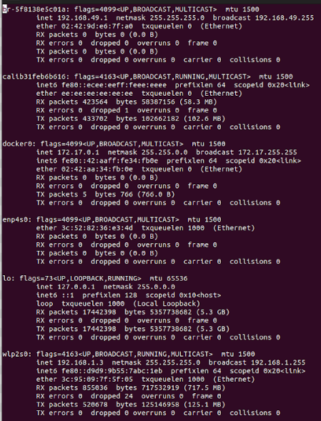
1.3 Initialize Hostname and IP Address
1
https://www.youtube.com/watch?v=UWg3ORRRF60
Check kmaster IP-Address: ifconfig
ifconfig: Interface configuration for Linux. The ifconfig is used to find IP Address of My computer (kmaster).
1. br-5828e5c01a: Bridge Networking Interface Bridge is used in Layer 2 (data frame). ethernet address is 02:42:9d:e6:7f:d0. IP address is 192.168.49.1 is assigned.
2. enp4s0: Wired Ethernet Network PCI device. MAC address is 3c:52:82:36:e3:4d. No IP Address is assigned (since no Ethernet cable is connected).
wlps20: Wireless network PCI device for layer 3 (Network Layer). Ethernet address is 3c:95:09:7f:5f:05. kmaster IP Address IP address is : 192.168.1.3.
2
3

Slide 14
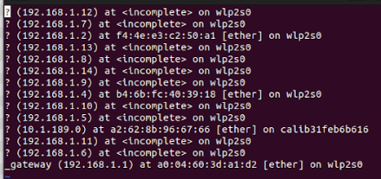
1.3 Initialize Hostname and IP Address
https://www.youtube.com/watch?v=UWg3ORRRF60
Check Who is Connected to My Computer (Kmaster): arp -a
arp (Address Resolution Protocol): arp is a layer 2 protocol map MAC address to IP Address. The arp is to find IP Address of other computers).
We have:
3. 192.168.1.2: Knode 1 Machine
Knode 2 IP Address: 192.168.0.17.
11. calib31feb6b616: Wired Ethernet address a2:62:8b:96:67:66. IP address is 10.1.189.0.
14.Gateway: Ethernet address is a0:04:60:3d:a1:d2. Wireless IP address is 192.168.1.1.

Slide 15
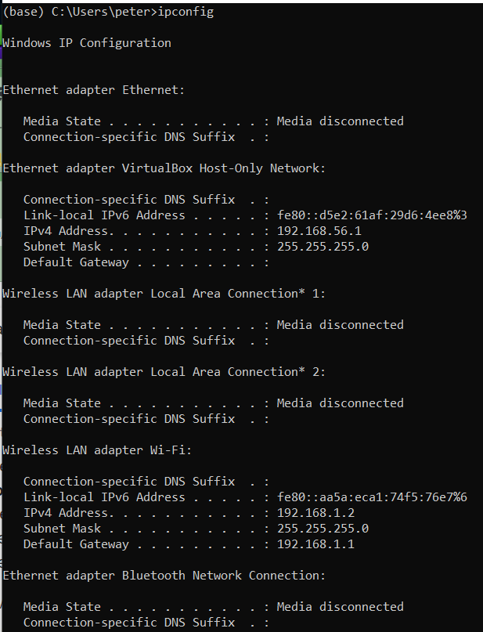
1.3 Initialize Hostname and IP Address
https://www.youtube.com/watch?v=UWg3ORRRF60
Knode 1 (Window Machine): ipconfig
Since Windows and Oracle VirtualBox connected by PCI, we check windows IP Address only.
Kmaster and Knode 2 can only see the Gate way of Knode 1 IP Address: 192.168.1.1.

Slide 16
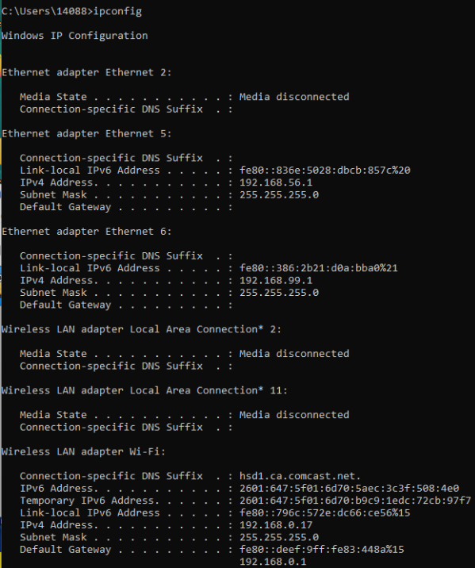
1.3 Initialize Hostname and IP Address
https://www.youtube.com/watch?v=UWg3ORRRF60
Knode 2 (Window Machine): ipconfig
Since Windows and Oracle VirtualBox connected by PCI, we check windows IP Address only.
Kmaster and Knode 1 can only see Knode 2 IP Address: 192.168.0.1.

Slide 17
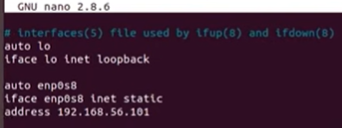
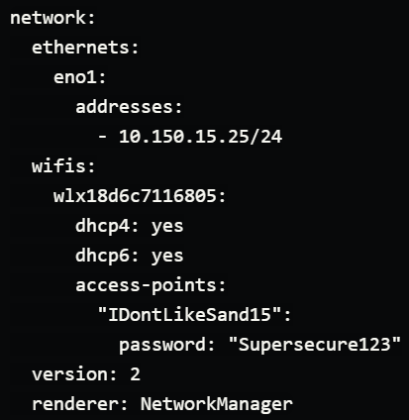
1.3 Initialize Hostname and IP Address
https://www.youtube.com/watch?v=UWg3ORRRF60
/etc/network/interface
https://netplan.io/examples
After Ubuntu 17.20 /etc/network/interface is changed to /etc/netplan

Slide 18
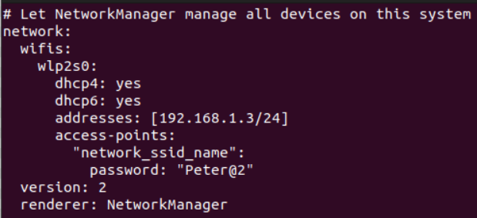
1.3 Initialize Hostname and IP Address
https://www.youtube.com/watch?v=UWg3ORRRF60
/etc/network/interface
https://netplan.io/examples
> sudo vi /etc/netplan/master.yaml
>> network:
>> wifis:
>> wlp2s0:
>> dhcp4: yes
>> dhcp6: yes
>> addresses: [192.168.1.3/24]
>> access-point:
>> “network_ssid_name”:
>> password: “Peter@2”
>> version: 2
>> render: NetworkManager
> sudo netplan apply kmaster.yaml>

Slide 19
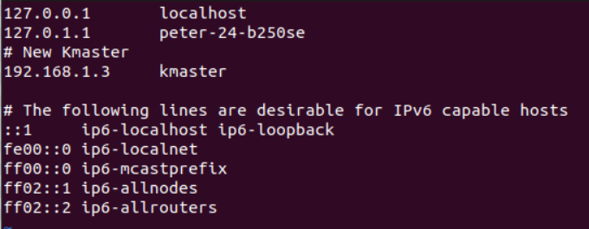
1.3 Initialize Hostname and IP Address
https://www.youtube.com/watch?v=UWg3ORRRF60
/etc/hosts
Next,
> vi /etc/hosts
>> # New Kmaster
>> 192.168.1.3 kmaster
Then, we re-start the machine.

Slide 20



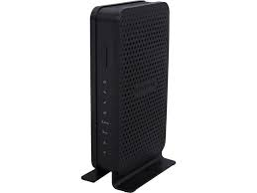

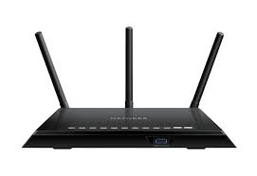


1.3 Initialize Hostname and IP Address
https://www.youtube.com/watch?v=UWg3ORRRF60
Cluster with Two Networks
https://lazyadmin.nl/home-network/home-network-diagram/
1. N600 Wi-Fi Cable Modem Router (Model C3700): Coaxial Cable to Ethernet and Wi-Fi internet.
Cable Modem Router: Netgear96, password: sweetxxxxx774.
2. AC1750 Smart Wi-Fi Router (Model R6400):
Smart Router: Netgear49, password: happyxxxx772.
Netgear96:
Cable Modem Router
Netgear49:
Smart Router
Coaxial cable
Ethernet
Wire
SVU Desktop (kmaster)
Ethernet Wire
Laptop (knode1)
Samsung network TV
Laptop (knode2)

Slide 21
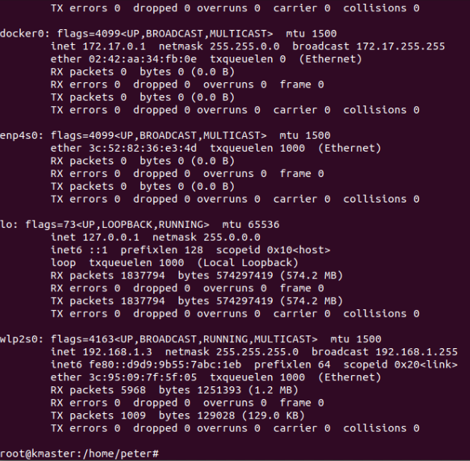
1.3 Initialize Hostname and IP Address
https://www.youtube.com/watch?v=UWg3ORRRF60
Restart Machine
Now, we car re-started the machine
…and check if my hostname and hosts have been updated.
The hostname and hosts are updated each time we start the machine.
1. root@kmaster
2. > ifconfig
>> wlp2s0: IP Address 192.168.1.3
We can see the hostname and IP-address keep the same as we specified.
2
1

Slide 22
1.3 Initialize Hostname and IP Address
https://www.youtube.com/watch?v=UWg3ORRRF60
Verify the hostname and IP Address
We verify:
1. The hostname to “kmaster” is successfully updated by /etc/hostname.
2. Verify IP-address by ifconfig command. As we can see the IP address is updated as we setup.
This IP Address is good, and this is what we want.
We will get the same IP address each time we re-boot.
2
1

Slide 23
1.4 Install OpenSSH Server and Docker

Slide 24
1.4 Install OpenSSH Server and Docker
https://www.youtube.com/watch?v=UWg3ORRRF60
Install OpenSSH Server and Docker
Kubernetes Installation Steps
1. At Both Master and Slave Nodes | 2.Only at Master Node | 3. Only at Slave Node
1.1. Update Your Repository | 2.1. Initiate Kubernetes Cluster | 3.1 Join the Cluster
1.2. Turn Off Swap Space | 2.2. Install the Pod Network
1.3. Update Hostname, Hosts, and Set Static IP | 2.3 Setup the Kubernetes Dashboard
1.4 Install OpenSSH Server and Docker
1.5 Install Kubeadm, Kubelet, and Kubectl

Slide 25
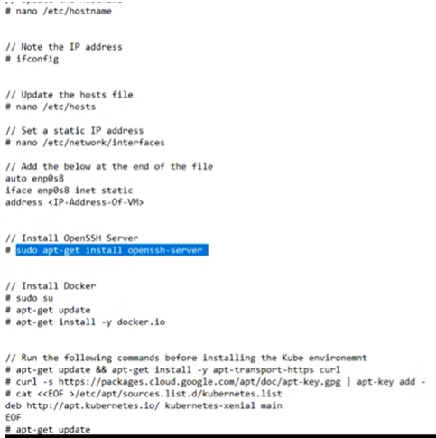
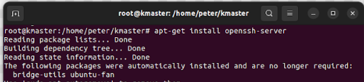
1.4 Install OpenSSH Server and Docker
https://www.youtube.com/watch?v=UWg3ORRRF60
Install the OpenSSH Server (7:48/27:56)
Now, we install openSSH
> sudo su
> apt-get install openssh-server
So, openSSH is installed right now.

Slide 26
1.4 Install OpenSSH Server and Docker
https://www.youtube.com/watch?v=UWg3ORRRF60
Install Docker (8:09/27:56)
https://docs.docker.com/engine/install/ubuntu/
Now, We install docker.
Follow the docker link above to remove the old version of docker, update ubuntu, and install new docker, and verify with “hello-world” example.
> sudo apt autoremove
> apt-get update
We install docker
> apt-get install -y docker-ce …
> sudo docker run hello-world

Slide 27
1.5 Install Kubeadm, Kubelet, and Kubectl

Slide 28
1.5 Install Kubeadm, Kubelet, and Kubectl
https://www.youtube.com/watch?v=UWg3ORRRF60
Install OpenSSH Server and Docker
Kubernetes Installation Steps
1. At Both Master and Slave Nodes | 2.Only at Master Node | 3. Only at Slave Node
1.1. Update Your Repository | 2.1. Initiate Kubernetes Cluster | 3.1 Join the Cluster
1.2. Turn Off Swap Space | 2.2. Install the Pod Network
1.3. Update Hostname, Hosts, and Set Static IP | 2.3 Setup the Kubernetes Dashboard
1.4 Install OpenSSH Server and Docker
1.5 Install Kubeadm, Kubelet, and Kubectl

Slide 29
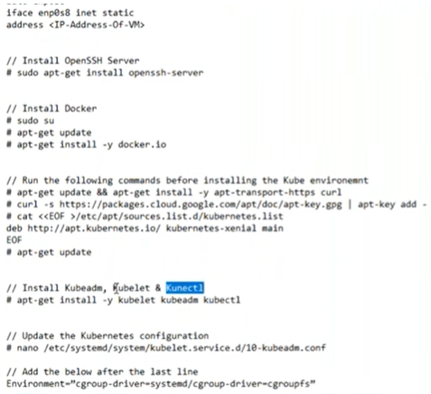
1.5 Install Kubeadm, Kubelet, and Kubectl
https://www.youtube.com/watch?v=UWg3ORRRF60
Install curl, download kubernetes, and install Kubernetes (9:26/27:56)
Next, we install the Kubernetes.
1. There are a few things that we must do, such as
> install curl
> install kubernetes package
> apt-get update.
We have three major components in Kubernetes: kubeadm, kubelet, and kubectl
2. Install kubernetes:
> apt-get install –y kubelet kubeadm kubectl --allow-change-held-packages
Note: The option “--allow-change-held-packages” is suggested from installation prompt error message.
1
2

Slide 30
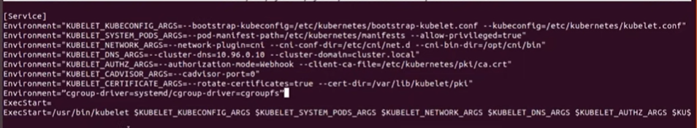
1.5 Install Kubeadm, Kubelet, and Kubectl
https://www.youtube.com/watch?v=UWg3ORRRF60
Update Kubernetes Configuration (11:35/27:56)
Next,
> vi /etc/system/system/kubelet.service.d/10-kubeadm.conf
> add one line below:
> Environment=“cgroup-driver=systemd/cgroup-driver=cgroupfs”

Slide 31
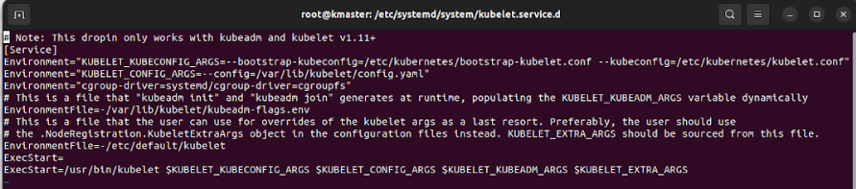
1.5 Install Kubeadm, Kubelet, and Kubectl
https://www.youtube.com/watch?v=UWg3ORRRF60
Update Kubernetes Configuration (11:35/27:56)
Next,
> vi /etc/system/system/kubelet.service.d/10-kubeadm.conf
> add one line below:
> Environment=“cgroup-driver=systemd/cgroup-driver=cgroupfs”

Slide 32
1.5 Install Kubeadm, Kubelet, and Kubectl
https://www.youtube.com/watch?v=UWg3ORRRF60
Finished Master and Slave (12:07/27:56)
Now, we have same installation for Master.

Slide 33
End

