Slide 1

1 Install/Setup Kubernetes on Ubuntu
Peter H. Chen

Slide 2
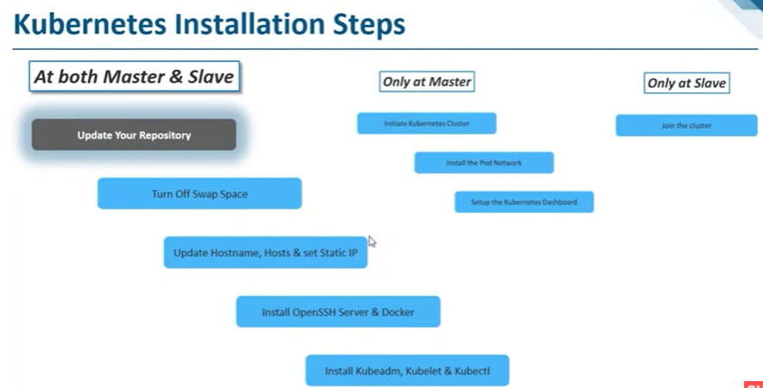
1 Install/Setup Kubernetes on Ubuntu
https://www.youtube.com/watch?v=UWg3ORRRF60
Install/Setup Kubernetes on Ubuntu
The installation includes the followings:
1. At Both Master and Slave Nodes: five steps (1.1-1.5) to install Kubernetes
2. Master Node: three commands (2.1-2.3) to bring up the cluster.
3. Slave Node: one command (3.1) to join the cluster.
Kubernetes Installation Steps
1. At Both Master and Slave Nodes | 2.Only at Master Node | 3. Only at Slave Node
1.1. Update Your Repository | 2.1. Initiate Kubernetes Cluster | 3.1 Join the Cluster
1.2. Turn Off Swap Space | 2.2. Install the Pod Network
1.3. Update Hostname, Hosts, and Set Static IP | 2.3 Setup the Kubernetes Dashboard
1.4 Install OpenSSH Server and Docker
1.1 Install Kubeadm, Kubelet, and Kubectl

Slide 3
1.1 Install on Both Master/Slave

Slide 4
1.1 Install on Both Master/Slave
https://www.youtube.com/watch?v=UWg3ORRRF60
1. Install Commands on Both Master and Slave
We install commands on both master and slave.
Kubernetes Installation Steps
1. At Both Master and Slave Nodes | 2.Only at Master Node | 3. Only at Slave Node
1.1. Update Your Repository | 2.1. Initiate Kubernetes Cluster | 3.1 Join the Cluster
1.2. Turn Off Swap Space | 2.2. Install the Pod Network
1.3. Update Hostname, Hosts, and Set Static IP | 2.3 Setup the Kubernetes Dashboard
1.4 Install OpenSSH Server and Docker
1.1 Install Kubeadm, Kubelet, and Kubectl

Slide 5
1.1 Install on Both Master/Slave
https://www.youtube.com/watch?v=UWg3ORRRF60
1.1 Update Your Repository
First, we must update the repository.
Since we are using Ubuntu, we must update our repository.
Kubernetes Installation Steps
1. At Both Master and Slave Nodes | 2.Only at Master Node | 3. Only at Slave Node
1.1. Update Your Repository | 2.1. Initiate Kubernetes Cluster | 3.1 Join the Cluster
1.2. Turn Off Swap Space | 2.2. Install the Pod Network
1.3. Update Hostname, Hosts, and Set Static IP | 2.3 Setup the Kubernetes Dashboard
1.4 Install OpenSSH Server and Docker
1.1 Install Kubeadm, Kubelet, and Kubectl

Slide 6
1.1 Install on Both Master/Slave
https://www.youtube.com/watch?v=UWg3ORRRF60
1.2 Turn off Swap Space
We must turn OFF the swap space.
Kubernetes will not work if the swap space is ON.
We must disable the Swap Space.
There are a couple of commands for disable the swap space.
Kubernetes Installation Steps
1. At Both Master and Slave Nodes | 2.Only at Master Node | 3. Only at Slave Node
1.1. Update Your Repository | 2.1. Initiate Kubernetes Cluster | 3.1 Join the Cluster
1.2. Turn Off Swap Space | 2.2. Install the Pod Network
1.3. Update Hostname, Hosts, and Set Static IP | 2.3 Setup the Kubernetes Dashboard
1.4 Install OpenSSH Server and Docker
1.1 Install Kubeadm, Kubelet, and Kubectl

Slide 7
1.1 Install on Both Master/Slave
https://www.youtube.com/watch?v=UWg3ORRRF60
1.3 Update Hostname, Hosts, and Set Static IP
We must update the host name, hosts file, and set Static IP Address for all nodes in our cluster.
We must do that because at any point of time, if our master or our node in the cluster fails, then Kubernetes restart, the Kubernetes should have the same IP Address.
If we have a dynamic IP Address, then if Kubernetes restart because of failure condition, then Kubernetes will not be able to ON the cluster because they have different IP Address. That is the reason that we must set static IP Address.
There are several commands for this step.
Kubernetes Installation Steps
1. At Both Master and Slave Nodes | 2.Only at Master Node | 3. Only at Slave Node
1.1. Update Your Repository | 2.1. Initiate Kubernetes Cluster | 3.1 Join the Cluster
1.2. Turn Off Swap Space | 2.2. Install the Pod Network
1.3. Update Hostname, Hosts, and Set Static IP | 2.3 Setup the Kubernetes Dashboard
1.4 Install OpenSSH Server and Docker
1.1 Install Kubeadm, Kubelet, and Kubectl

Slide 8
1.1 Install on Both Master/Slave
https://www.youtube.com/watch?v=UWg3ORRRF60
1.4 Install OpenSSH Server and Docker
We must install the OpenSSH and Docker.
Because Kubernetes requires the OpenSSH functionality.
Kubernetes needs Docker because every running apps in Kubernetes is container.
We need to install OpenSSH Component and Docker component.
Kubernetes Installation Steps
1. At Both Master and Slave Nodes | 2.Only at Master Node | 3. Only at Slave Node
1.1. Update Your Repository | 2.1. Initiate Kubernetes Cluster | 3.1 Join the Cluster
1.2. Turn Off Swap Space | 2.2. Install the Pod Network
1.3. Update Hostname, Hosts, and Set Static IP | 2.3 Setup the Kubernetes Dashboard
1.4 Install OpenSSH Server and Docker
1.1 Install Kubeadm, Kubelet, and Kubectl

Slide 9
1.1 Install on Both Master/Slave
https://www.youtube.com/watch?v=UWg3ORRRF60
1.1 Install Kubeadm, Kubelet, and Kubectl
We must install Kubeadm, Kubelet, and Kubectl.
These are core components of Kubernetes.
These are all components that we must install on both Master and Slave Machines.
We will install these components next.
Kubernetes Installation Steps
1. At Both Master and Slave Nodes | 2.Only at Master Node | 3. Only at Slave Node
1.1. Update Your Repository | 2.1. Initiate Kubernetes Cluster | 3.1 Join the Cluster
1.2. Turn Off Swap Space | 2.2. Install the Pod Network
1.3. Update Hostname, Hosts, and Set Static IP | 2.3 Setup the Kubernetes Dashboard
1.4 Install OpenSSH Server and Docker
1.1 Install Kubeadm, Kubelet, and Kubectl

Slide 10
1.1.1 Install Both Master and Salve

Slide 11
1.1.1 Install Both Master and Salve
https://www.youtube.com/watch?v=UWg3ORRRF60
1.1.1 Install for Both Master and Slave
We have the two machines master and the slave in the cluster.
The master must have at least 2GB of RAM and 2-core CPUs.
The slave must have at least 2GB RAM and 1-core CPU.
These are basic requirements for the master and slave machines.
> ping <ipv4-address>
> ping6 -I <interface> <ipv6-address> (Same machine OK. For different machine NG)
Kubernetes Installation Steps
1. At Both Master and Slave Nodes | 2.Only at Master Node | 3. Only at Slave Node
1.1. Update Your Repository | 2.1. Initiate Kubernetes Cluster | 3.1 Join the Cluster
1.2. Turn Off Swap Space | 2.2. Install the Pod Network
1.3. Update Hostname, Hosts, and Set Static IP | 2.3 Setup the Kubernetes Dashboard
1.4 Install OpenSSH Server and Docker
1.1 Install Kubeadm, Kubelet, and Kubectl

Slide 12
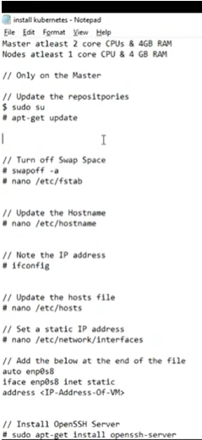
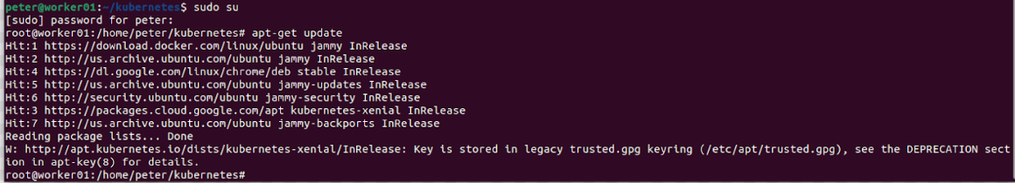
1.1.1 Install Both Master and Salve
https://www.youtube.com/watch?v=UWg3ORRRF60
sudo su and apt-get update
We log in as the su.
We are going to execute the following command as the sudo user.
> sudo su
Let’s do the update. This update my ubuntu repository.
> apt-get update

Slide 13
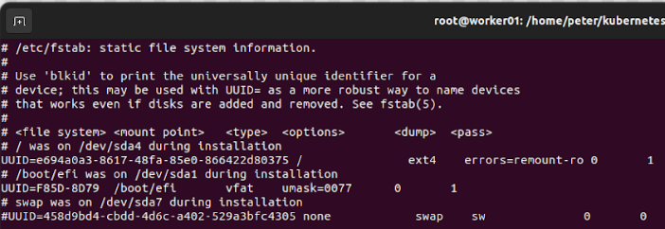
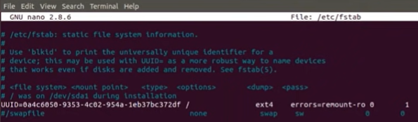
1.1.1 Install Both Master and Salve
https://www.youtube.com/watch?v=UWg3ORRRF60
swapoff -a
Next, we turn off my swap space.
The command to turn off my swap space is “swapoff -a”
> swapoff –a
It should be turn off swap space immediately. If it take long time, then ^C and reboot your system.
> vi /etc/fstab
We comment out the swap space.

Slide 14
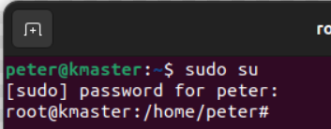
1.1.1 Install Both Master and Salve
https://www.youtube.com/watch?v=UWg3ORRRF60
/etc/hostname and prompt hostname
Next, we update the hostname, hosts file, and set a static IP Address.
Let’s update the hostname.
> vi /etc/hostname
We change the host name to “kmaster” which stand for Kubernetes Master.
The hostname is display in the prompt.
If we want to display the new prompt, we must re-start the VM (or Linux system).

Slide 15
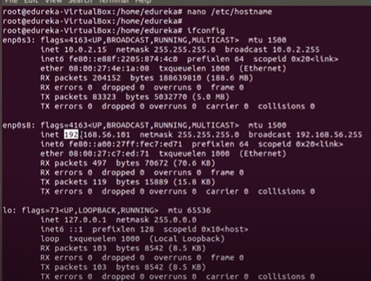
1.1.1 Install Both Master and Salve
https://www.youtube.com/watch?v=UWg3ORRRF60
ifconfig
Next, we run the “ifconfig” command.
> mkdir kmaster
> cd kmaster
> ifconfig > ifconfig.txt
> vi ifconfig.txt
The video's IP address is 192.168.56.101.

Slide 16
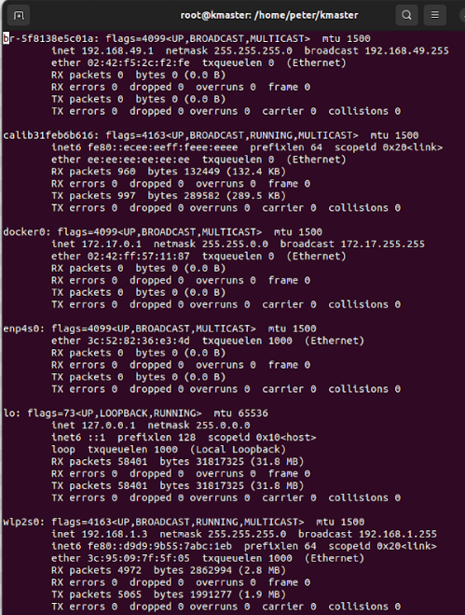
1.1.1 Install Both Master and Salve
https://www.youtube.com/watch?v=UWg3ORRRF60
ifconfig
ifconfig: Interface configuration
ipconfig: internet protocol Configuration.
br: Bridge Networking Interface.
enp: Wired Ethernet Network PCI device in LAN.
wlp: Wireless network PCI device for Linux.
We have two IP-addresses:
br-xxx bridge: 192.168.49.1
wlpxxx wireless PCI: 192.168.1.3
Bridge is used in Layer 2 (data frame). enp/wlp are used in layer 3 router. All IPs can be used.
We can use wlpxxx: 192.168.1.3

Slide 17
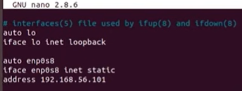
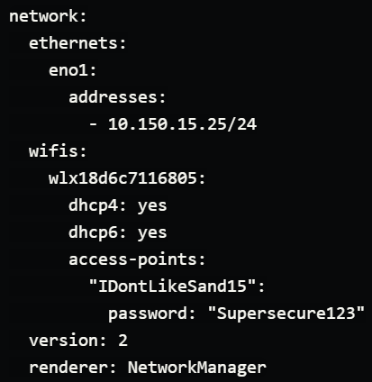
1.1.1 Install Both Master and Salve
https://www.youtube.com/watch?v=UWg3ORRRF60
/etc/network/interface
https://netplan.io/examples
After Ubuntu 17.20 /etc/network/interface is changed to /etc/netplan

Slide 18
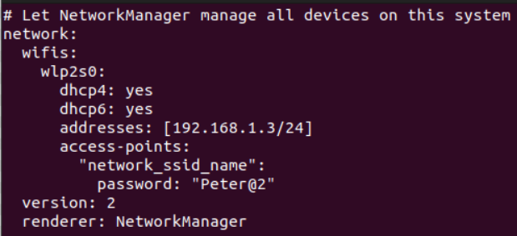
1.1.1 Install Both Master and Salve
https://www.youtube.com/watch?v=UWg3ORRRF60
/etc/network/interface
https://netplan.io/examples
> sudo vi /etc/netplan/master.yaml
>> network:
>> wifis:
>> wlp2s0:
>> dhcp4: yes
>> dhcp6: yes
>> addresses: [192.168.1.3/24]
>> access-point:
>> “network_ssid_name”:
>> password: “Peter@2”
>> version: 2
>> render: NetworkManager
> sudo netplan apply kmaster.yaml>

Slide 19
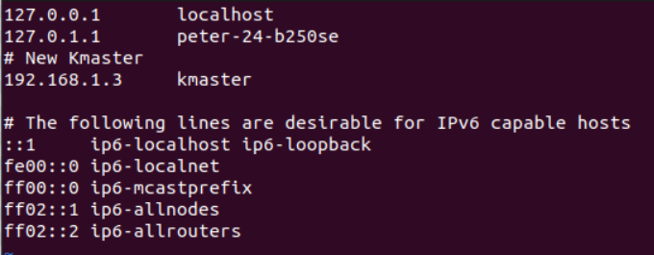
1.1.1 Install Both Master and Salve
https://www.youtube.com/watch?v=UWg3ORRRF60
/etc/hosts
Next,
> vi /etc/hosts
>> # New Kmaster
>> 192.168.1.3 kmaster
Then, we re-start the machine.

Slide 20
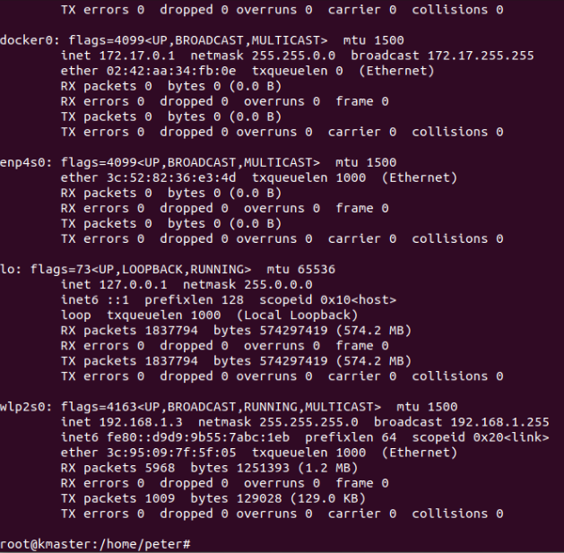
1.1.1 Install Both Master and Salve
https://www.youtube.com/watch?v=UWg3ORRRF60
Restart Machine
Now, we car re-started the machine
…and check if my hostname and hosts have been updated.
The hostname and hosts are updated each time we start the machine.
1. root@kmaster
2. > ifconfig
>> wlp2s0: IP Address 192.168.1.3
We can see the hostname and IP-address keep the same as we specified.
2
1

Slide 21
1.1.1 Install Both Master and Salve
https://www.youtube.com/watch?v=UWg3ORRRF60
Verify the hostname and IP Address
We verify:
1. The hostname to “kmaster” is successfully updated by /etc/hostname.
2. Verify IP-address by ifconfig command. As we can see the IP address is updated as we setup.
This IP Address is good, and this is what we want.
We will get the same IP address each time we re-boot.
2
1

Slide 22
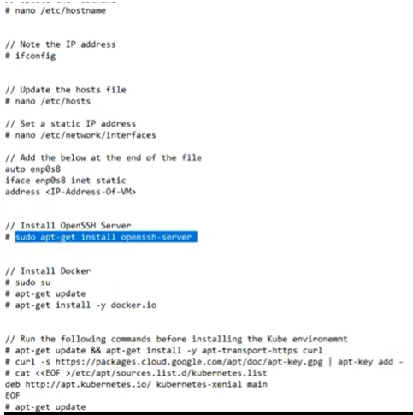
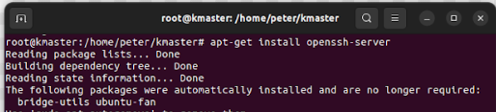
1.1.1 Install Both Master and Salve
https://www.youtube.com/watch?v=UWg3ORRRF60
Install the OpenSSH Server (7:48/27:56)
Now, we install openSSH
> sudo su
> apt-get install openssh-server
So, openSSH is installed right now.

Slide 23
1.1.1 Install Both Master and Salve
https://www.youtube.com/watch?v=UWg3ORRRF60
Install Docker (8:09/27:56)
https://docs.docker.com/engine/install/ubuntu/
Now, We install docker.
Follow the docker link above to remove the old version of docker, update ubuntu, and install new docker, and verify with “hello-world” example.
> sudo apt autoremove
> apt-get update
We install docker
> apt-get install -y docker-ce …
> sudo docker run hello-world

Slide 24
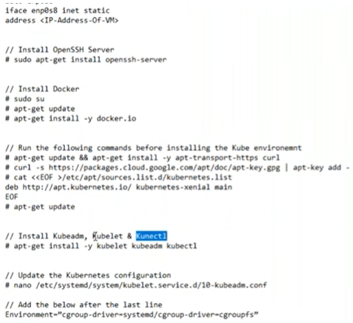
1.1.1 Install Both Master and Salve
https://www.youtube.com/watch?v=UWg3ORRRF60
Install curl, download kubernetes, and install Kubernetes (9:26/27:56)
Next, we install the Kubernetes.
1. There are a few things that we must do, such as
> install curl
> install kubernetes package
> apt-get update.
We have three major components in Kubernetes: kubeadm, kubelet, and kubectl
2. Install kubernetes:
> apt-get install –y kubelet kubeadm kubectl --allow-change-held-packages
Note: The option “--allow-change-held-packages” is suggested from installation prompt error message.
1
2

Slide 25
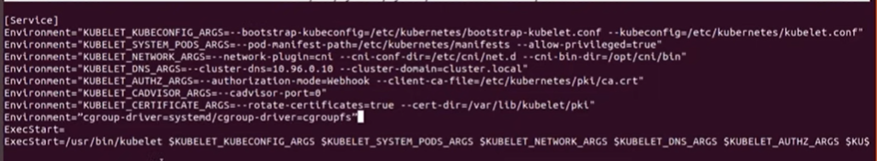
1.1.1 Install Both Master and Salve
https://www.youtube.com/watch?v=UWg3ORRRF60
Update Kubernetes Configuration (11:35/27:56)
Next,
> vi /etc/system/system/kubelet.service.d/10-kubeadm.conf
> add one line below:
> Environment=“cgroup-driver=systemd/cgroup-driver=cgroupfs”

Slide 26
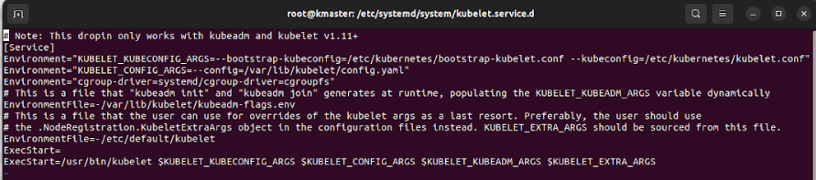
1.1.1 Install Both Master and Salve
https://www.youtube.com/watch?v=UWg3ORRRF60
Update Kubernetes Configuration (11:35/27:56)
Next,
> vi /etc/system/system/kubelet.service.d/10-kubeadm.conf
> add one line below:
> Environment=“cgroup-driver=systemd/cgroup-driver=cgroupfs”

Slide 27
1.1.1 Install Both Master and Salve
https://www.youtube.com/watch?v=UWg3ORRRF60
Finished Master and Slave (12:07/27:56)
Now, we have same installation for Master.

Slide 28
1.1.2 Install Same Command for Salve

Slide 29

1.1.2 Install Same Command for Salve
https://www.youtube.com/watch?v=UWg3ORRRF60
Install Same Command for Slave (13:03/27:56)
We have done the command for Master.
Now, we need to repeat all the Master commands for the Salve.
> sudo su
>> password: Peterxxx
> vi /etc/hostname
>> knode
> reboot slave node
We see “peter@knode”

Slide 30

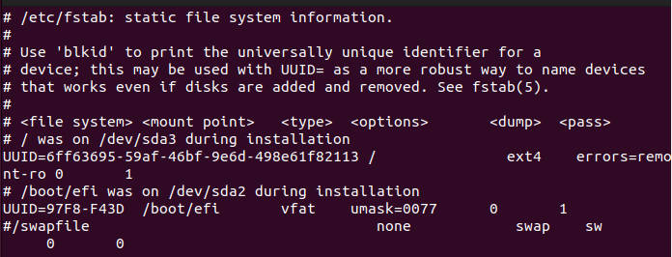
1.1.2 Install Same Command for Salve
https://www.youtube.com/watch?v=UWg3ORRRF60
Swapoff -a for Slave (13:03/27:56)
> sudo su
>> password: Peterxxx
> swapoff -a
> vi /etc/fstab
Turn off the swapfile by commenting out the “/swapfile …”
#/swapfile ….

Slide 31
End

