Slide 1
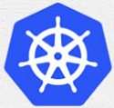
0 Install Kubernetes: Introduction
Peter H. Chen

Slide 2
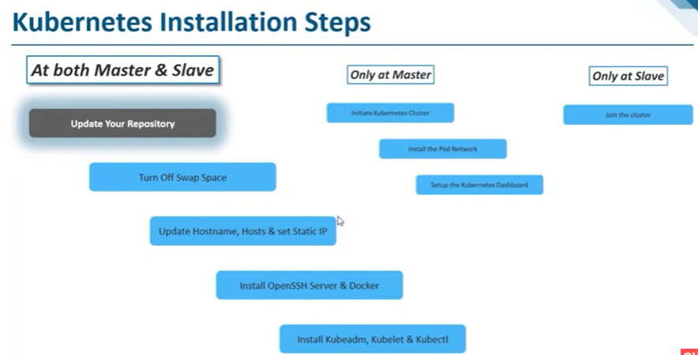
0 Install Kubernetes: Introduction
https://www.youtube.com/watch?v=UWg3ORRRF60
Install Kubernetes: Introduction
The installation includes the followings:
1. At Both Master and Slave Nodes: five steps (1.1-1.5) to install Kubernetes
2. Master Node: three commands (2.1-2.3) to bring up the cluster.
3. Slave Node: one command (3.1) to join the cluster.
Kubernetes Installation Steps
1. At Both Master and Slave Nodes | 2.Only at Master Node | 3. Only at Slave Node
1.1. Update Your Repository | 2.1. Initiate Kubernetes Cluster | 3.1 Join the Cluster
1.2. Turn Off Swap Space | 2.2. Install the Pod Network
1.3. Update Hostname, Hosts, and Set Static IP | 2.3 Setup the Kubernetes Dashboard
1.4 Install OpenSSH Server and Docker
1.5 Install Kubeadm, Kubelet, and Kubectl

Slide 3
0 Install Kubernetes: Introduction
https://www.youtube.com/watch?v=UWg3ORRRF60
Install Kubernetes: Introduction
We install commands on both master and slave.
Kubernetes Installation Steps
1. At Both Master and Slave Nodes | 2.Only at Master Node | 3. Only at Slave Node
1.1. Update Your Repository | 2.1. Initiate Kubernetes Cluster | 3.1 Join the Cluster
1.2. Turn Off Swap Space | 2.2. Install the Pod Network
1.3. Update Hostname, Hosts, and Set Static IP | 2.3 Setup the Kubernetes Dashboard
1.4 Install OpenSSH Server and Docker
1.5 Install Kubeadm, Kubelet, and Kubectl

Slide 4
0 Install Kubernetes: Introduction
https://www.youtube.com/watch?v=UWg3ORRRF60
1.1 Update Your Repository
First, we must update the repository.
Since we are using Ubuntu, we must update our repository.
Kubernetes Installation Steps
1. At Both Master and Slave Nodes | 2.Only at Master Node | 3. Only at Slave Node
1.1. Update Your Repository | 2.1. Initiate Kubernetes Cluster | 3.1 Join the Cluster
1.2. Turn Off Swap Space | 2.2. Install the Pod Network
1.3. Update Hostname, Hosts, and Set Static IP | 2.3 Setup the Kubernetes Dashboard
1.4 Install OpenSSH Server and Docker
1.5 Install Kubeadm, Kubelet, and Kubectl

Slide 5
0 Install Kubernetes: Introduction
https://www.youtube.com/watch?v=UWg3ORRRF60
1.2 Turn off Swap Space
We must turn OFF the swap space.
Kubernetes will not work if the swap space is ON.
We must disable the Swap Space.
There are a couple of commands for disable the swap space.
Kubernetes Installation Steps
1. At Both Master and Slave Nodes | 2.Only at Master Node | 3. Only at Slave Node
1.1. Update Your Repository | 2.1. Initiate Kubernetes Cluster | 3.1 Join the Cluster
1.2. Turn Off Swap Space | 2.2. Install the Pod Network
1.3. Update Hostname, Hosts, and Set Static IP | 2.3 Setup the Kubernetes Dashboard
1.4 Install OpenSSH Server and Docker
1.5 Install Kubeadm, Kubelet, and Kubectl

Slide 6
0 Install Kubernetes: Introduction
https://www.youtube.com/watch?v=UWg3ORRRF60
1.3 Update Hostname, Hosts, and Set Static IP
We must update the host name, hosts file, and set Static IP Address for all nodes in our cluster.
We must do that because at any point of time, if our master or our node in the cluster fails, then Kubernetes restart, the Kubernetes should have the same IP Address.
If we have a dynamic IP Address, then if Kubernetes restart because of failure condition, then Kubernetes will not be able to ON the cluster because they have different IP Address. That is the reason that we must set static IP Address.
There are several commands for this step.
Kubernetes Installation Steps
1. At Both Master and Slave Nodes | 2.Only at Master Node | 3. Only at Slave Node
1.1. Update Your Repository | 2.1. Initiate Kubernetes Cluster | 3.1 Join the Cluster
1.2. Turn Off Swap Space | 2.2. Install the Pod Network
1.3. Update Hostname, Hosts, and Set Static IP | 2.3 Setup the Kubernetes Dashboard
1.4 Install OpenSSH Server and Docker
1.5 Install Kubeadm, Kubelet, and Kubectl

Slide 7
0 Install Kubernetes: Introduction
https://www.youtube.com/watch?v=UWg3ORRRF60
1.4 Install OpenSSH Server and Docker
We must install the OpenSSH and Docker.
Because Kubernetes requires the OpenSSH functionality.
Kubernetes needs Docker because every running apps in Kubernetes is container.
We need to install OpenSSH Component and Docker component.
Kubernetes Installation Steps
1. At Both Master and Slave Nodes | 2.Only at Master Node | 3. Only at Slave Node
1.1. Update Your Repository | 2.1. Initiate Kubernetes Cluster | 3.1 Join the Cluster
1.2. Turn Off Swap Space | 2.2. Install the Pod Network
1.3. Update Hostname, Hosts, and Set Static IP | 2.3 Setup the Kubernetes Dashboard
1.4 Install OpenSSH Server and Docker
1.5 Install Kubeadm, Kubelet, and Kubectl

Slide 8
0 Install Kubernetes: Introduction
https://www.youtube.com/watch?v=UWg3ORRRF60
1.5 Install Kubeadm, Kubelet, and Kubectl
We must install Kubeadm, Kubelet, and Kubectl.
These are core components of Kubernetes.
These are all components that we must install on both Master and Slave Machines.
We will install these components next.
Kubernetes Installation Steps
1. At Both Master and Slave Nodes | 2.Only at Master Node | 3. Only at Slave Node
1.1. Update Your Repository | 2.1. Initiate Kubernetes Cluster | 3.1 Join the Cluster
1.2. Turn Off Swap Space | 2.2. Install the Pod Network
1.3. Update Hostname, Hosts, and Set Static IP | 2.3 Setup the Kubernetes Dashboard
1.4 Install OpenSSH Server and Docker
1.5 Install Kubeadm, Kubelet, and Kubectl

Slide 9
0 Install Kubernetes: Introduction
https://www.youtube.com/watch?v=UWg3ORRRF60
1.1.1 Install for Both Master and Slave
We have the two machines master and the slave in the cluster.
The master must have at least 2GB of RAM and 2-core CPUs.
The slave must have at least 2GB RAM and 1-core CPU.
These are basic requirements for the master and slave machines.
> ping <ipv4-address>
> ping6 -I <interface> <ipv6-address> (Same machine OK. For different machine NG)
Kubernetes Installation Steps
1. At Both Master and Slave Nodes | 2.Only at Master Node | 3. Only at Slave Node
1.1. Update Your Repository | 2.1. Initiate Kubernetes Cluster | 3.1 Join the Cluster
1.2. Turn Off Swap Space | 2.2. Install the Pod Network
1.3. Update Hostname, Hosts, and Set Static IP | 2.3 Setup the Kubernetes Dashboard
1.4 Install OpenSSH Server and Docker
1.5 Install Kubeadm, Kubelet, and Kubectl

Slide 10
0.1 Cluster

Slide 11


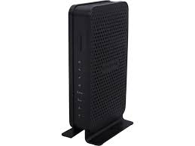


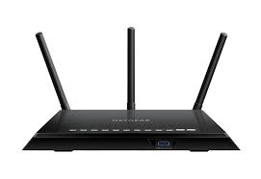
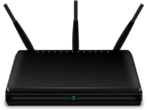


0.1 Cluster
https://www.youtube.com/watch?v=UWg3ORRRF60
Cluster with Two Networks
https://lazyadmin.nl/home-network/home-network-diagram/
1. N600 Wi-Fi Cable Modem Router (Model C3700): Coaxial Cable to Ethernet and Wi-Fi internet.
Cable Modem Router: Netgear96, password: sweetxxxxx774.
2. AC1750 Smart Wi-Fi Router (Model R6400):
Smart Router: Netgear49, password: happyxxxx772.
3. Need Access point for network computer without firewall.
Netgear96:
Cable Modem Router
Coaxial cable
Ethernet
Wire
Netgear49:
Smart Router
Access Point
SVU Desktop (kmaster)
Ethernet Wire
Laptop (knode2)
Laptop (knode1)
Samsung network TV

Slide 12
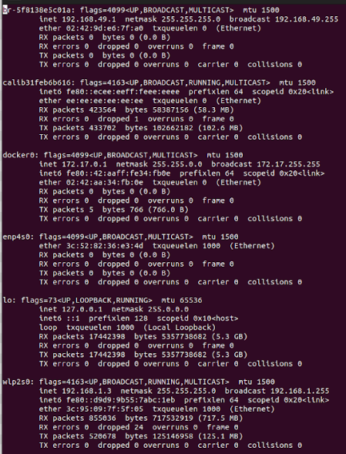
0.1 Cluster
1
https://www.youtube.com/watch?v=UWg3ORRRF60
Check kmaster IP-Address: ifconfig
ifconfig: Interface configuration for Linux. The ifconfig is used to find IP Address of My computer (kmaster).
1. br-5828e5c01a: Bridge Networking Interface Bridge is used in Layer 2 (data frame). ethernet address is 02:42:9d:e6:7f:d0. IP address is 192.168.49.1 is assigned.
2. enp4s0: Wired Ethernet Network PCI device. MAC address is 3c:52:82:36:e3:4d. No IP Address is assigned (since no Ethernet cable is connected).
wlps20: Wireless network PCI device for layer 3 (Network Layer). Ethernet address is 3c:95:09:7f:5f:05. kmaster IP Address IP address is : 192.168.1.3.
2
3

Slide 13
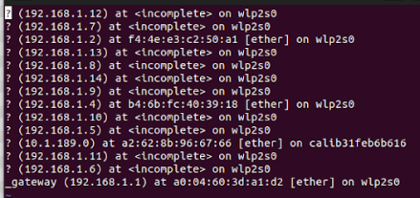
0.1 Cluster
https://www.youtube.com/watch?v=UWg3ORRRF60
Check Who is Connected to My Computer (Kmaster): arp -a
arp (Address Resolution Protocol): arp is a layer 2 protocol map MAC address to IP Address. The arp is to find IP Address of other computers).
We have:
3. 192.168.1.2: Knode 1 Machine
Knode 2 IP Address: 192.168.0.17.
11. calib31feb6b616: Wired Ethernet address a2:62:8b:96:67:66. IP address is 10.1.189.0.
14.Gateway: Ethernet address is a0:04:60:3d:a1:d2. Wireless IP address is 192.168.1.1.

Slide 14
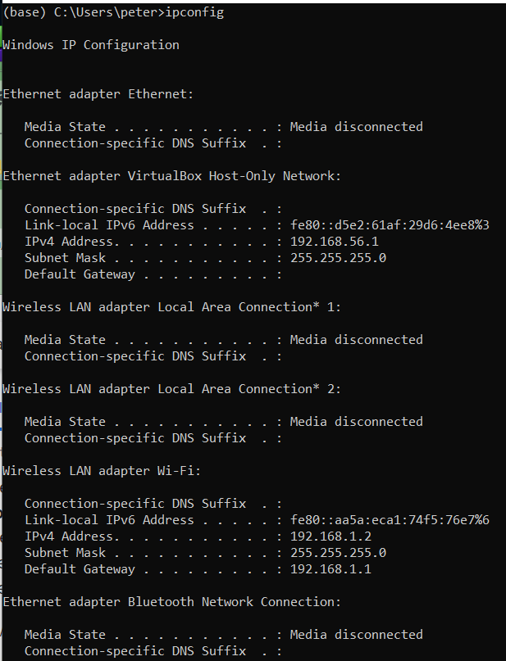
0.1 Cluster
https://www.youtube.com/watch?v=UWg3ORRRF60
Knode 1 (Window Machine): ipconfig
Since Windows and Oracle VirtualBox connected by PCI, we check windows IP Address only.
Kmaster and Knode 2 can only see the Gate way of Knode 1 IP Address: 192.168.1.1.

Slide 15
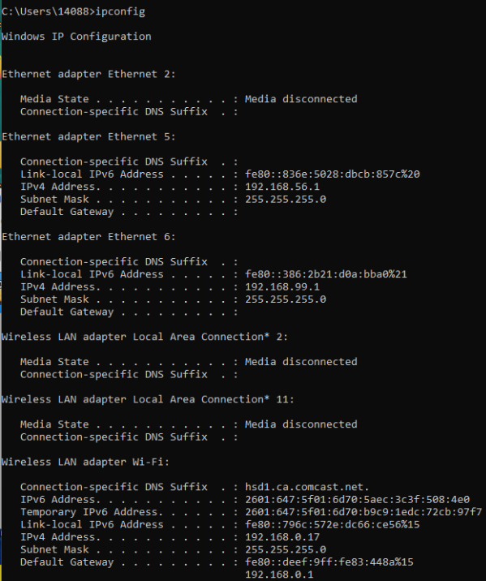
0.1 Cluster
https://www.youtube.com/watch?v=UWg3ORRRF60
Knode 2 (Window Machine): ipconfig
Since Windows and Oracle VirtualBox connected by PCI, we check windows IP Address only.
Kmaster and Knode 1 can only see Knode 2 IP Address: 192.168.0.1.

Slide 16
0.2 Communication between Routers

Slide 17
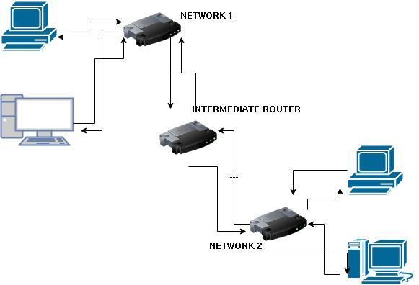
0.2 Communication between Routers
https://www.youtube.com/watch?v=UWg3ORRRF60
Route add: Create a Route between Two Routers
https://linuxhint.com/route-add-command-linux/#:~:text=The%20command%20you%20are%20looking,chosen%20routing%20method%20explained%20below.
The command (“route add”) is to add proper routes to reach the destination or multiple destinations.
We can add more than one gateway to access different networks.

Slide 18
0.2 Communication between Routers
https://www.youtube.com/watch?v=UWg3ORRRF60
Route add: Create a Route between Two Routers
https://linuxhint.com/route-add-command-linux/#:~:text=The%20command%20you%20are%20looking,chosen%20routing%20method%20explained%20below.
For example, if a computer from the NETWORK 1 wants to connect to a computer from NETWORK 2 using static routing, the computer from the NETWORK 1 must define in the routing table that both exit interfaces, ROUTER 1 and Intermediating router, need to be used to connect to the next router until reaching the final destination.
When using static routing, the computer must also define the outgoing interface to connect to the intermediating router and the interface the intermediating router needs to use to connect to the router belonging to NETWORK 2.
However, the NETWORK 2 router does not need to be specified in the routing table because it is already connected directly to the destination.

Slide 19
0.2 Communication between Routers
https://www.youtube.com/watch?v=UWg3ORRRF60
Route add: Create a Route between Two Routers
https://linuxhint.com/route-add-command-linux/#:~:text=The%20command%20you%20are%20looking,chosen%20routing%20method%20explained%20below.
The network devices allow connectivity between two networks is called “gateways”.
Gateways must have two network cards, each connected to the networks we want to connect between them.
If a client from the NETWORK 2 wants to connect to NETWORK 1 (Inverse), it also will be required to add the inverse route or path (including its router but without including the NETWORK 1 router, which is already connected to NETWORK 1).
Static routes are the fastest and safest routing method.
It is fast because clients provide routing devices the full path, while routers must learn them by themselves in other methods.

Slide 20
0.2 Communication between Routers
https://www.youtube.com/watch?v=UWg3ORRRF60
Route add: Create a Route between Two Routers
https://linuxhint.com/route-add-command-linux/#:~:text=The%20command%20you%20are%20looking,chosen%20routing%20method%20explained%20below.
And it is safe because sysadmins hold full knowledge of the network topology, and packets go precisely through the defined route (Path).
The most significant disadvantage of static routing is that each client must be configured manually, which is not practical for big networks.
It is called “static” because each client predefines routes.

Slide 21
0.1 Cluster
https://www.youtube.com/watch?v=UWg3ORRRF60
Knode 1 (Window Machine): ipconfig
IP address: 192.168.1.2
Gateway: 192.168.1.1
Knode 2 (Window Machine): ipconfig
IP address: 192.168.0.17
Gateway: 192.168.0.1

Slide 22
0.1 Cluster
https://www.youtube.com/watch?v=UWg3ORRRF60
Knode 1 (Window Machine): ipconfig
IP address: 192.168.1.2
Gateway: 192.168.1.1
> route add 192.168.1.0 MASK 255.255.255.0 192.168.0.1
Note:
How to choose destination?
Use 193.268.1.x (x exclude 2).
Knode 2 (Window Machine): ipconfig
IP address: 192.168.0.17
Gateway: 192.168.0.1
> route add 192.168.1.0 MASK 255.255.255.0 192.168.0.1
Note:
How to choose destination?
Use 193.268.0.x (x exclude 17).

Slide 23
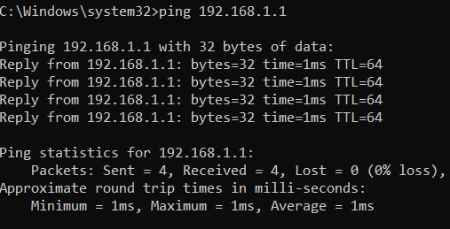
0.1 Cluster
https://www.youtube.com/watch?v=UWg3ORRRF60
Ping new route 192.168.1.1 from Knode1 to Knode2
> ping 192.168.1.1
Ping new route 192.168.0.0 from Knode1 to Knode2
> ping 192.168.0.0

Slide 24
End

