Slide 1

32 Node and Express
Peter H. Chen

Slide 2
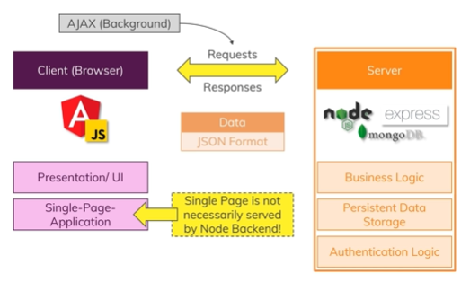
32 Node and Express
https://github.com/peterhchen/900_MEAN_Proj
Node and Express
Node is a JavaScript runtime that runs on the server, so that means you can execute JavaScript code with some extra features.
You can create the server that listens to requests and sends back responses with it and you can handle your server side logic.
With node and express framework building up on node, so you use it to make node development easier.

Slide 3
32 Node and Express
https://github.com/peterhchen/900_MEAN_Proj
Node and Express
In the big picture of mean stack, the server side is on the right here on the slide, you see node and express are on the server side, we use the server for our core business logic especially the parts that are too performance intensive or security relevant and therefore shouldn't be run on the client, so in the browser and node express is the important backend for our client side, the angular app is about the user interface.

Slide 4
32 Node and Express
https://github.com/peterhchen/900_MEAN_Proj
Node and Express
Now in order to do anything with the data the user enters and to persist it for example or do any transformations, calculations, to add user authentication, for all this fun stuff, we need a server.

Slide 5
End of Chapter

