Slide 1

33 Node and Angular
Peter H. Chen

Slide 2
33 Node and Angular
https://github.com/peterhchen/900_MEAN_Proj
Node and Angular
> ng serve
“ng serve” uses a NodeJS server and gives us a development server.
Now what does “development server” mean?
It is a server aimed at angular development.
It is not a production ready server.
It doesn't contain any of the logic we want to add to our server side.
It also doesn't give us an entry point to add such logic.
It is really just a server that returns the angular app.
It has useful features like auto-restart whenever we have a new angular app version.
“ng serve” is nice for developing our angular application, it's not the server we will use as a backend because there's one important thing you have to understand regarding the way angular and a node backend or any backend work together.

Slide 3
33 Node and Angular
https://github.com/peterhchen/900_MEAN_Proj
Node and Angular
We've got two ways of connecting a node and angular backend, the first approach we can take is that we have a node application, a node express application that serves the angular single page application as part of it.
It contains our other server side logic but it also has a certain path, so a url endpoint to which we can send a request where it will return that angular single page application.
The alternative is that we have two separate servers.
We have our node express server for our business logic, for the authentication, for the data storage, and a separate static host which only returns our angular single page application.
In our discussion, we will actually see both approaches because they really only matter or differ when we reach the deployment section in the later sections of discussion.

Slide 4
33 Node and Angular
https://github.com/peterhchen/900_MEAN_Proj
Node and Angular
In the first approach, we have our node express back which handles incoming requests and that’s not just the request for the angular app but also requests sent by the angular app because as you saw in the big picture, angular sends background http requests to store data, to fetch data and these requests need to be handled by the node express backend.
We have the endpoints for this but additionally, we have one special endpoint, one special url we were able to handle and this is for example the /path.
If we just send our request to our domain slash nothing and you will see what I mean with that slash and with the path thing but if we send such a simple request, then we return the angular single page application, for requests targeting any other path, we will do whatever our business logic is.
Again these will become more clear once we actually implement our paths.

Slide 5
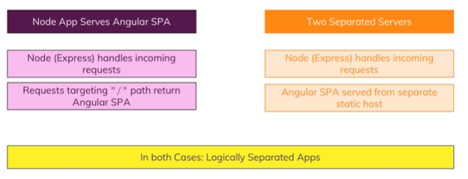
33 Node and Angular
https://github.com/peterhchen/900_MEAN_Proj
Node and Angular
Now for the separate server solution, we still have our node express app handling incoming requests because we have these background requests sent by angular but additionally.
We also serve our angular single page application from a totally separate static host.
A static host is really just a simple server, could be a node server but could be any server, an apache, an nginx server, so any server that doesn't run any server side logic, any server side code but simply returns html, JavaScript and CSS files and that's all our angular app consists of, so this is all we need.

Slide 6
33 Node and Angular
https://github.com/peterhchen/900_MEAN_Proj
Node and Angular
In both cases, we got logically separated apps though, so even if we use one and the same node server for serving both the angular app and hosting our core business logic, well in both cases we actually have separated apps in a sense of angular handles the UI and sends background requests and node express handles these background requests and does something with them.
The only difference on the left approach where we also serve the SPA is that we got one special route, one special path where we do also return the angular app but that's all, besides that there is no strict connection because what we build is a restful API with our node express backend.
Now what is a restful API?

Slide 7
End of Chapter

