Slide 1

17 Event
Peter H. Chen

Slide 2



17 Event
https://www.udemy.com/course/angular-2-and-nodejs-the-practical-guide/learn/lecture/10416232#overview
First Component
Ajax (Background)
Requests
Client (Browser)
Server
Responses
Data
(JSON Format)
Node, Express, MongoDB
Presentation /UI
Business Logic
Single Page is not necessary served by Node Backend, such as, AWS static host S3.
SPA (Single Page Application)
Persistent Data Storage
Authentication Logic

Slide 3
17.1 Code

Slide 4
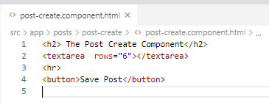
17.1 Code
https://www.udemy.com/course/angular-2-and-nodejs-the-practical-guide/learn/lecture/10416232#overview
Code
In post-create.component.html, add <textarea> and <button>

Slide 5
17.2 Verify

Slide 6
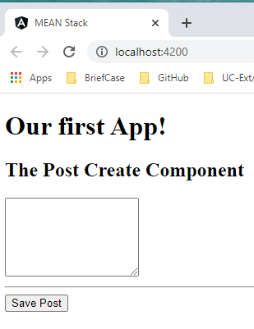
17.2 Verify
https://www.udemy.com/course/angular-2-and-nodejs-the-practical-guide/learn/lecture/10416232#overview
Verify
We can enter any text in the textarea but we cannot click the button.

Slide 7
17.3 Code

Slide 8
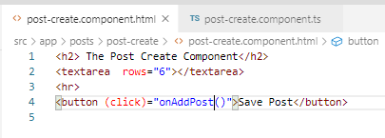
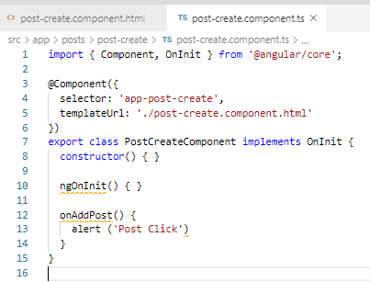
17.3 Code
https://www.udemy.com/course/angular-2-and-nodejs-the-practical-guide/learn/lecture/10416232#overview
Code
In post-create.component,html, add (click)=“onAddPost()”.
In post-create.component.ts, add onAddPost() { … }

Slide 9
17.4 Verify

Slide 10
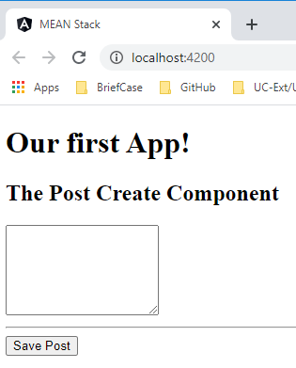
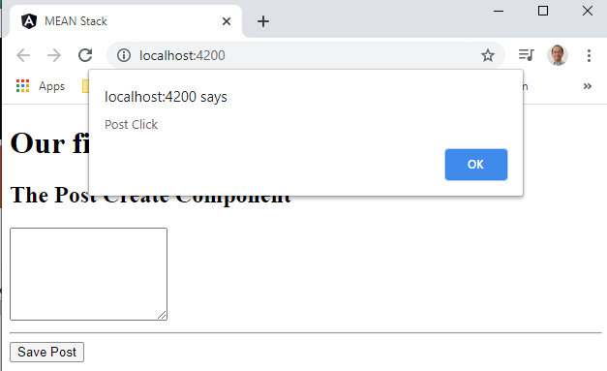
17.4 Verify
https://www.udemy.com/course/angular-2-and-nodejs-the-practical-guide/learn/lecture/10416232#overview
Verify
Click “Save Post”.

Slide 11
17.5 Summary

Slide 12
17.5 Summary
https://www.udemy.com/course/angular-2-and-nodejs-the-practical-guide/learn/lecture/10416232#overview
Summary
We add the event and alert in this discussion.

Slide 13
End of Chapter

