Slide 1

27 Posts from Post Create and Post List
Peter H. Chen

Slide 2



27 Posts from Post Create and Post List
https://www.udemy.com/course/angular-2-and-nodejs-the-practical-guide/learn/lecture/10416274#overview
Posts from Post Create and Post List
Ajax (Background)
Requests
Client (Browser)
Server
Responses
Data
(JSON Format)
Node, Express, MongoDB
Presentation /UI
Business Logic
Single Page is not necessary served by Node Backend, such as, AWS static host S3.
SPA (Single Page Application)
Persistent Data Storage
Authentication Logic

Slide 3
27 Posts from Post Create and Post List
https://www.udemy.com/course/angular-2-and-nodejs-the-practical-guide/learn/lecture/10416274#overview
Posts from Post Create and Post List
A service is a class which you add to your angular application.
A service can be injected by Angular into components.
A service can be centralized some task and provide easy access to data among different components without property and event binding.

Slide 4
27.1 Code

Slide 5
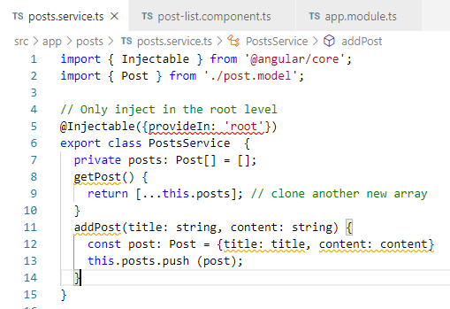
27.1 Code
https://www.udemy.com/course/angular-2-and-nodejs-the-practical-guide/learn/lecture/10416274#overview
Code
Create posts service (posts.service.ts) in the posts folder.
Create posts service (posts.service.ts) in the posts folder.
Specify the service with @Injectable decorator. (We do not need to put it in the provider if we use @Injectable decorator).

Slide 6
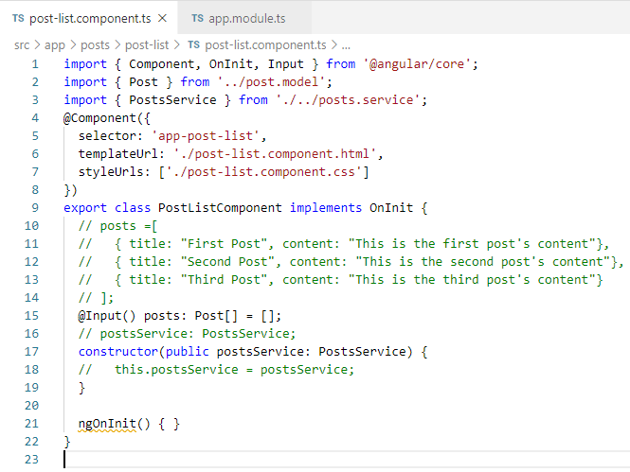
27.1 Code
https://www.udemy.com/course/angular-2-and-nodejs-the-practical-guide/learn/lecture/10416274#overview
Code
Import PostsService.

Slide 7
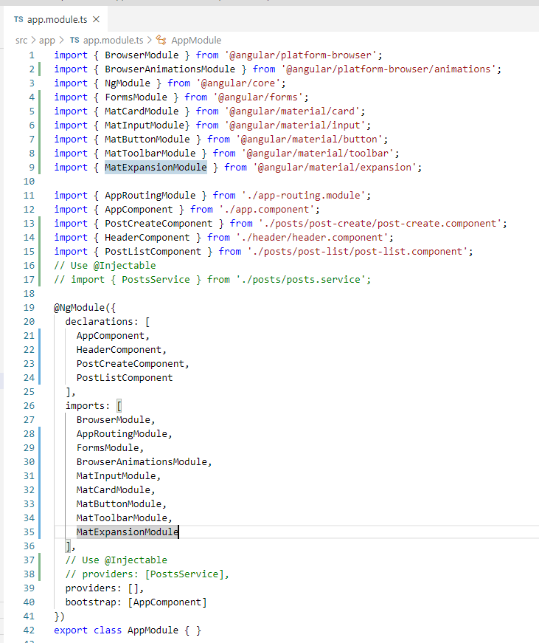
27.1 Code
https://www.udemy.com/course/angular-2-and-nodejs-the-practical-guide/learn/lecture/10416274#overview
Code
Providers: []
We do not need providers array since we use “@Injectable()” decorator for service class.

Slide 8
End of Chapter

