Slide 1

144 Deploy REST API
Peter H. Chen

Slide 2
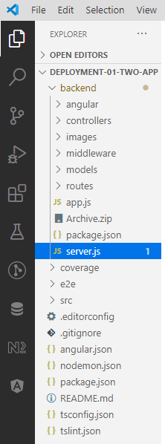
144 Deploy REST API
https://github.com/peterhchen/900_MEAN_Proj
Deploy REST API
In our project, we have the two apps, the back-end and the front-end.
We squeezed that back-end into the Angular CLI project, not because we could manage it through the CLI but because that made switching between files much easier.
For deployment, this can be a bit confusing though because we are not going to deploy the entire folder, instead we're going to build the Angular app.
This will give us a new folder actually which we will deploy and we will deploy the server.js file and the files in the back-end folder.
We will now actually split this up, at least a little bit.
We will keep the back-end folder but we will move the server.js file into that back-end folder because now all the back-end related things are in one place.

Slide 3
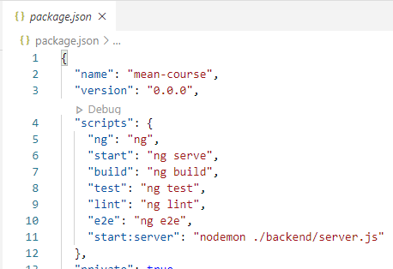
144 Deploy REST API
https://github.com/peterhchen/900_MEAN_Proj
Deploy REST API
Now that will break our package.json file here where we started Nodemon with server.js, we would now have to point at ./back-end/server.js.
We have “scripts” in node, we have to use “npm run xxx”. The scripts define alias “start:server” to “nodemon ./backend/server.js”

Slide 4
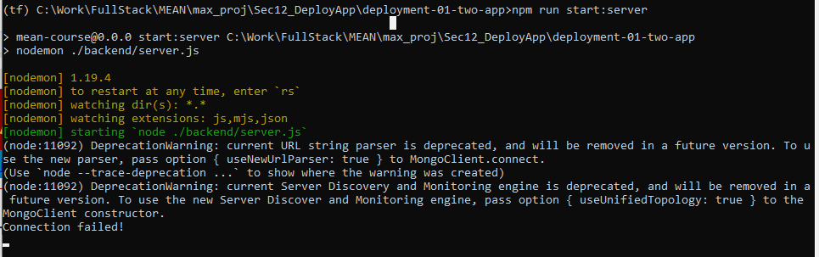
144 Deploy REST API
https://github.com/peterhchen/900_MEAN_Proj
Deploy REST API
We have “scripts” in node, we have to to “npm run xxx”
> npm install # install all the node_modules
> npm run start:server
We need to bring up the mongo server first.

Slide 5
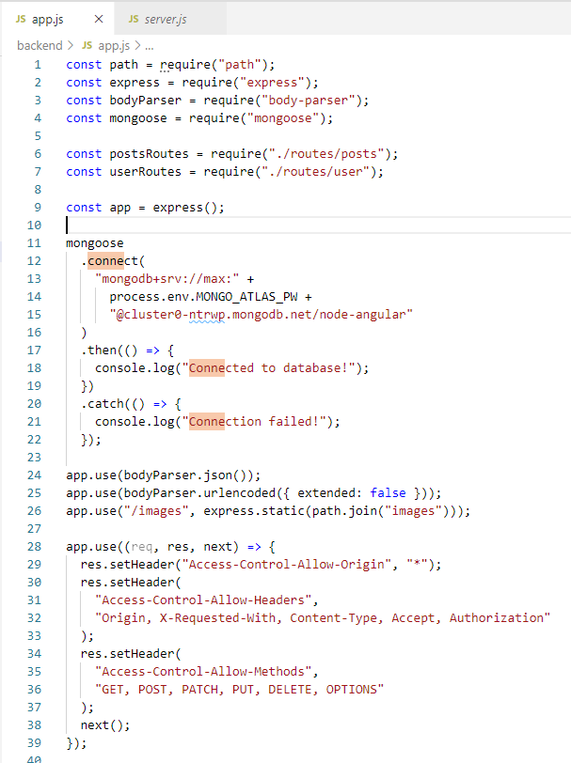
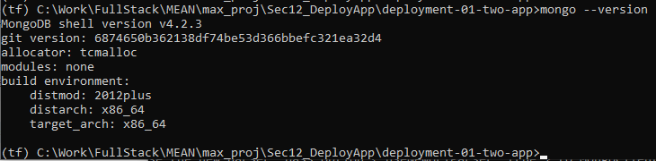
144 Deploy REST API
https://github.com/peterhchen/900_MEAN_Proj
Deploy REST API
>mongo --version
https://stackoverflow.com/questions/50448272/avoid-current-url-string-parser-is-deprecated-warning-by-setting-usenewurlpars

Slide 6
144 Deploy REST API
https://github.com/peterhchen/900_MEAN_Proj
Deploy REST API
Now this still kind of works but now it's not able to access its dependencies because now we, well move the entire file, so all the imports here are wrong.
There, it's now looking for app in the wrong folder, it should look in the same folder as itself because now the app.js file is in the same folder, so let's look for ./app. With that added if I restart this, now it's working again.
And now I need to add one thing here, I want to move or I want to copy, not move, copy the package.json file into the back-end folder because my back-end will need certain dependencies and Angular will also need dependencies.
Let's now edit that file though.
The package.json file in the back-end folder, I don't need all the Angular related scripts, I can even remove this one because for development, I'll still use the other package.json file, I'm just caring about the dependencies now because if we deploy our back-end folder later, this dependency is or these dependencies here will be used by the hosting provider which hosts our NodeJS app because pretty much all hosting providers scan that file and install these dependencies before they start your Node app because obviously, your Node app needs them.

Slide 7
144 Deploy REST API
https://github.com/peterhchen/900_MEAN_Proj
Deploy REST API
It doesn't need the Angular ones though, so we can strip these out in the back-end folder, that's important.
We need bcrypt, body parser, NodeJS, that's an Angular one, we can remove that. We need Express, we need JSON Web Token, we need Mongoose and Mongoose unique validator, we need multer, we don't need these two though, these are all the Angular dependencies and we need none of the development dependencies because these are all just required by the Angular CLI, so now this is our stripped down package.json file for the back-end.
I will leave all the dependencies in the front-end file but now for deployment, this file in the back-end folder will be the important one. So with that, the back-end is prepared and before we care about Angular, the front-end, let's actually deploy the back-end, so this rest API because that should work stand-alone, that's the idea behind these two separated apps and we could actually connect any front-end app, be that a mobile app or another web app to that API then. Now for deployment, we got a lot of options.

Slide 8
144 Deploy REST API
https://github.com/peterhchen/900_MEAN_Proj
Deploy REST API
You can use your favorite hosting provider, I will go with AWS since I really like AWS, I work with a lot but again, the steps in general are the same. It's this preparation which is important and it's important to simply understand that you work with, well basically with that folder structure that you need that package.json file.
We can clear all the images by the way of course, we don't need these and now with that, we are prepared.
So let's now go back to AWS and there, the service for deploying a Node app would be Elastic Beanstalk.
This is simply a service which will automatically set up a Node server and makes it easy for us to push our code to it.
Here we can click create new application, you need an AWS account for that of course, enter any name you want like Node Angular, any description you want, MEAN app and hit create, this creates the application and now you create a so-called environment there.

Slide 9
144 Deploy REST API
https://github.com/peterhchen/900_MEAN_Proj
Deploy REST API
There you define what you want to build, I want to build a web server for a website.
You can give it a name, I'll leave the default, add a domain, I'll leave the default, add a description if you want and now for the platform, you can choose one of these pre-configured ones, like of course NodeJS in our case here and I don't want to start with a sample application but I want to start with my own code which we now have to upload.
Now regarding what to upload here, this is easy to mess up so let's do it together.
We go into the back-end folder and there, we select all files and that's important, go into that folder and select the files, don't select the top level folder and then simply compress them, so zip them and you can of course do that on both Windows and Mac.

Slide 10
144 Deploy REST API
https://github.com/peterhchen/900_MEAN_Proj
Deploy REST API
This will give you a zip file and it's this zip file which you now select, here you can choose a local file in the back-end folder, choose that zip file and click open and then click upload and this will now upload this zip file to your Elastic Beanstalk project or to be precise, it will do so once you click create environment.
First of all, let's configure more options though.
Here make sure that low cost is chosen to use the AWS free tier if you still have that available. Now you can also check what you'll get or what will be created for you, now let's modify the software and let's actually pick the latest NodeJS version which is available here to ensure that our cutting edge Javascript code is working correctly.
You can leave all the other default settings, though I want to set these environment properties which are passed into the application.

Slide 11
144 Deploy REST API
https://github.com/peterhchen/900_MEAN_Proj
Deploy REST API
You remember I said this would be handled by most hosts or by pretty much all hosting providers.
So here I will use my Mongo Atlas password as a key and that value here as well a value and here, my JWT key which is also holding a value,
I need to do this because we're now of course not using Nodemon.
So save this, now the software is configured, the other settings should be all right. So with that, let's click create environment now, we'll still use MongoDB Atlas as a cloud database by the way.
If you were using a local one, you will now need to switch to some cloud solution or deploy your local one which is a topic for a separate course because database deployment, that is definitely something more advanced.
So now this will take a few minutes and I will be back once this stack as it is called, so once this app has been deployed. So the setup finished but with an error as you can see.

Slide 12
144 Deploy REST API
https://github.com/peterhchen/900_MEAN_Proj
Deploy REST API
Now if we have a look, you'll see that it failed to run npm install and that we should see the snapshot logs for more details.
We can find them here under health, there we can have a detailed output of what went wrong and it failed to install the bcrypt script here.
The reason for that is that the bcrypt package we're using here is actually a package which needs to be compiled in the place where you're using it and that can fail.
Now a fix is to use a different package instead, you install it in your project folder with npm install --save bcrypt.js, that is a special implementation of that which is pre-compiled.
So now if you run that, you'll see that a new entry was added to your package.json file, bcrypt.js, also copy that to your package.json file which you want to deploy.

Slide 13
144 Deploy REST API
https://github.com/peterhchen/900_MEAN_Proj
Deploy REST API
You can replace bcrypt with it there, you have to replace it to be precise and now you just have to adjust your code in the places where you use bcrypt, like in user.js or not like but in user.js, there you import bcrypt from bcrypt.js and that's all.
The methods it exposes are the same, so this should be all you need to do. With that set up, now you can redeploy this, so let's make sure to create a new zip file, let's delete the old one and zip all the back-end files one more time.
And with that, we can replace our current deployment with that by going back to the dashboard and choosing upload and deploy, give it a new version label like two and choose your archive again and hit deploy and now this will upload this new package and try to put that into production here on this back-end.
Again this will take a couple of minutes, so let's wait for this to finish. Now this looks good but if you click that link here at the top, you will probably get a bad gateway error which means it’s still not working correctly.

Slide 14
144 Deploy REST API
https://github.com/peterhchen/900_MEAN_Proj
Deploy REST API
Let's go back to our setup there and the reason is that our app is probably not running correctly.
Let's go back to configuration and modify the software and here, you can enter the Node command which should be run to start your application.
Here it actually tells you what it tries to do to start your app, it looks for app.js if you don't enter anything there and tries to start that file.
And that's the problem, we don't want to start with app.js, we want to start with server.js, that however is only its second option.
So what you can do here is you can enter a new command here, Node server.js to tell it that it should run the server.js file. Let's click apply then and now we will again put that into production and update your environment accordingly and now once it is done, click refresh if you are not sure if you're seeing the latest status, if you now click this link, it should take a while and then give you another error.

Slide 15
144 Deploy REST API
https://github.com/peterhchen/900_MEAN_Proj
Deploy REST API
Now do you have an idea where this error is coming from? Well our URL, just like that is simply not correct.
We don't support that path but we do support /apiposts, so let's try that. And here it then just loads and loads and eventually it will timeout.
Do you know which problem we face here? It can be hard to spot this, it's not actually an error with our code but on our MongoDB hosting service, so let me quickly login there. In MongoDB Atlas here as it is called, we of course have that security tab and there we define the user but we also if you remember, define the IP whitelist and this is our local IP address. So only our local machine is able to access this database.
Now theoretically, it would be best to create a new cluster for production anyways so that we don't mess with production data while developing but since this would cost money, we'll stick to this one project, for a real project, we would create and connect a separate cluster.

Slide 16
144 Deploy REST API
https://github.com/peterhchen/900_MEAN_Proj
Deploy REST API
Here I will do something which you don't want to do for your real production database,
I will add another IP address to the whitelist and this will be the IP address of my Node server, so of that server here. How do we find out which address this has?
You can go to your dashboard and click on show all to get a full log of the events that happened and there, you should somewhere see this created IP thing and that should be IP of your instance.
If you copy it and put it into your browser, you should get that same error you got when you clicked on that domain.
So that is the IP we want to add here to the whitelist, like this.
Confirm this and now this is pending and once it is done, we should be able to access this MongoDB from our Node server on Elastic Beanstalk too.

Slide 17
144 Deploy REST API
https://github.com/peterhchen/900_MEAN_Proj
Deploy REST API
So let's wait for this to finish and now with that added, you need to restart your server actually.
So let's go back to our dashboard, go to actions and click restart app servers.
Now I want to do this because I have to restart my NodeJS server of course because if we don't do that, it doesn't try to reconnect to our MongoDB and it needs to try that because now it will be allowed.
So now if we go back and reload that API posts route, we should see our posts here.
So our restful API is up and running, this is looking good, now let's upload our Angular application and see if everything about this is working.

Slide 18
End of Chapter

