Slide 1

21 Toolbar
Peter H. Chen

Slide 2
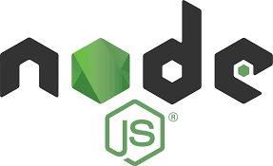


21 Toolbar
https://www.udemy.com/course/angular-2-and-nodejs-the-practical-guide/learn/lecture/10416248#overview
Toolbar
Ajax (Background)
Requests
Client (Browser)
Server
Responses
Data
(JSON Format)
Node, Express, MongoDB
Presentation /UI
Business Logic
Single Page is not necessary served by Node Backend, such as, AWS static host S3.
SPA (Single Page Application)
Persistent Data Storage
Authentication Logic

Slide 3
21.1 Code

Slide 4
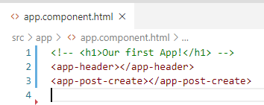
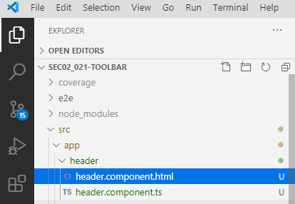
21.1 Code
https://www.udemy.com/course/angular-2-and-nodejs-the-practical-guide/learn/lecture/10416248#overview
Code
In app.component.html, add <app-header>
In app.module.ts, add “MatInputModule”
Add header/header.component.html
Add header/header.component.ts

Slide 5
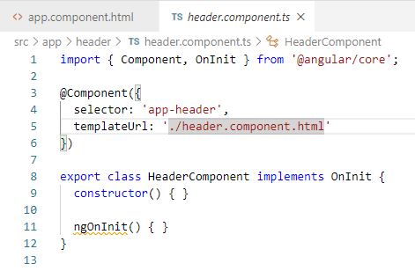

21.1 Code
https://www.udemy.com/course/angular-2-and-nodejs-the-practical-guide/learn/lecture/10416248#overview
Code
In header.component.ts, add Header Component.
In header.component.html, check material.io syntax and add <mat-toolbar>

Slide 6
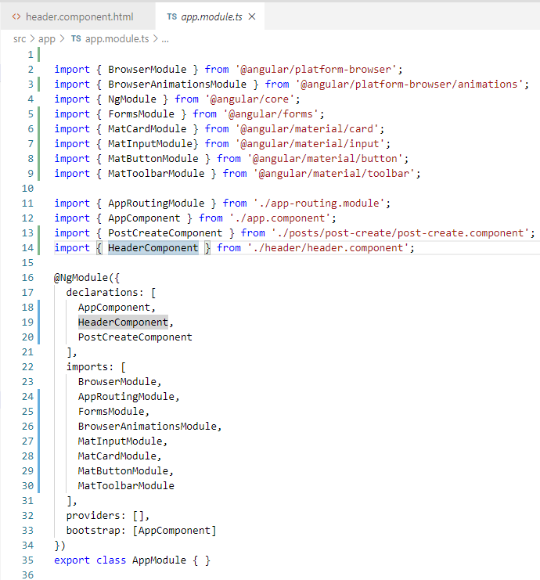
21.1 Code
https://www.udemy.com/course/angular-2-and-nodejs-the-practical-guide/learn/lecture/10416248#overview
Code
In app.module.ts, add MatToolbarModule.

Slide 7
21.2 Verify

Slide 8
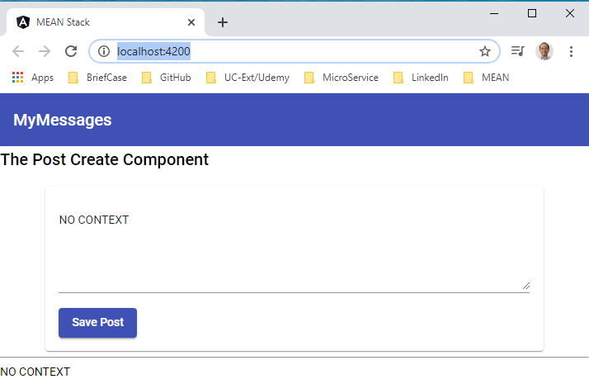
21.2 Verify
https://www.udemy.com/course/angular-2-and-nodejs-the-practical-guide/learn/lecture/10416248#overview
Verify

Slide 9
21.3 Code

Slide 10
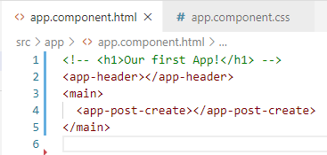
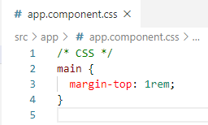
21.3 Code
https://www.udemy.com/course/angular-2-and-nodejs-the-practical-guide/learn/lecture/10416248#overview
Code
Add container <main> for <app-post-create>

Slide 11
21.4 Verify

Slide 12
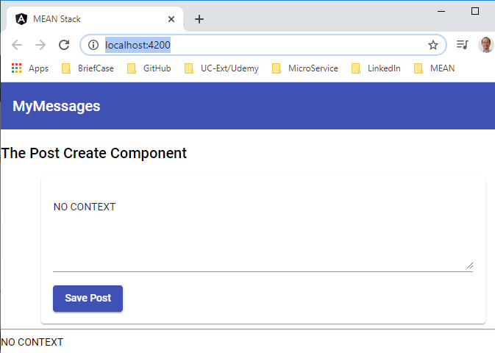
21.4 Verify
https://www.udemy.com/course/angular-2-and-nodejs-the-practical-guide/learn/lecture/10416248#overview
Verify

Slide 13
21.5 Summary

Slide 14
21.5 Summary
https://www.udemy.com/course/angular-2-and-nodejs-the-practical-guide/learn/lecture/10416248#overview
Summary
We use Material to add the Header and add main container for Post Create Component

Slide 15
End of Chapter

