Slide 1

30 Polish Form
Peter H. Chen

Slide 2



30 Polish Form
https://www.udemy.com/course/angular-2-and-nodejs-the-practical-guide/learn/lecture/10416292#overview
Polish Form
Ajax (Background)
Requests
Client (Browser)
Server
Responses
Data
(JSON Format)
Node, Express, MongoDB
Presentation /UI
Business Logic
Single Page is not necessary served by Node Backend, such as, AWS static host S3.
SPA (Single Page Application)
Persistent Data Storage
Authentication Logic

Slide 3
30 Polsih Form
https://www.udemy.com/course/angular-2-and-nodejs-the-practical-guide/learn/lecture/10416292#overview
Polish Form
We want to add some label to display the error message.

Slide 4
30.1 Code

Slide 5
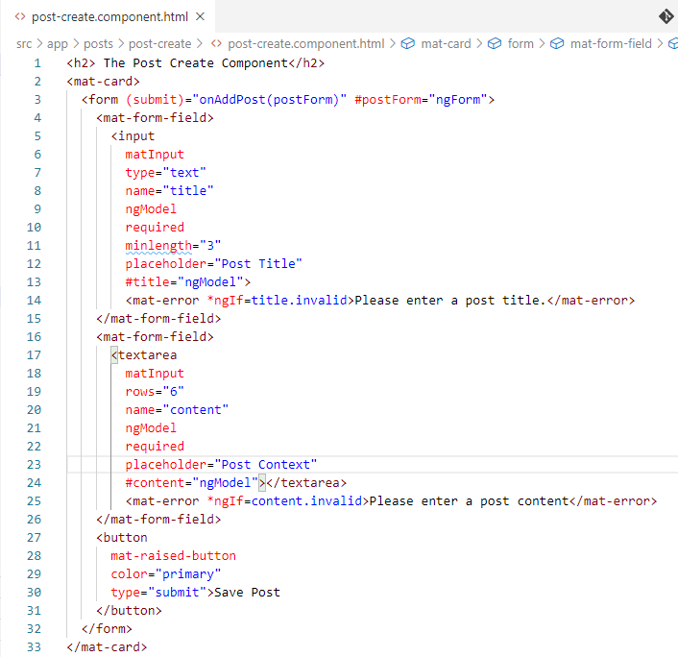
30.1 Code
https://www.udemy.com/course/angular-2-and-nodejs-the-practical-guide/learn/lecture/10416292#overview
Code
Add placeholder

Slide 6
30.2 Verify

Slide 7
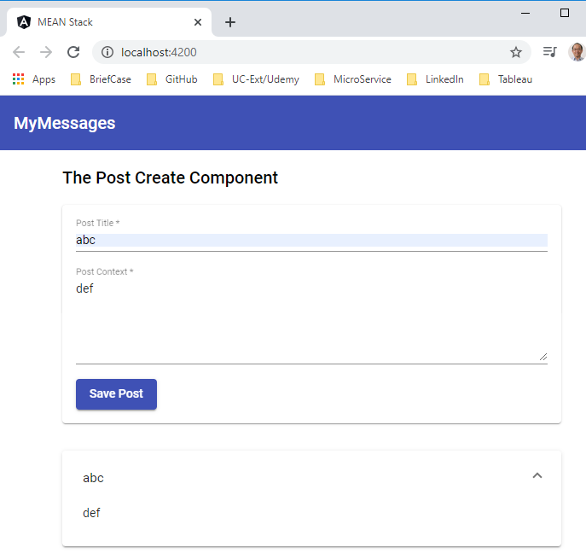
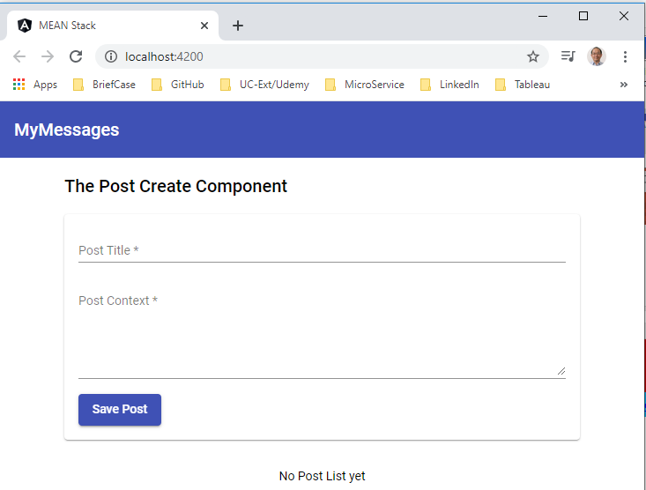
30.2 Verify
https://www.udemy.com/course/angular-2-and-nodejs-the-practical-guide/learn/lecture/10416292#overview
Verify

Slide 8
30.3 Code

Slide 9
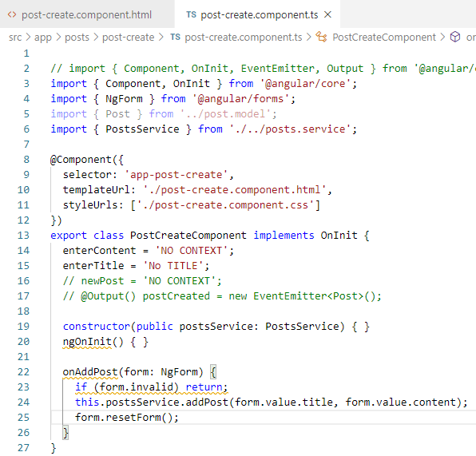
30.3 Code
https://www.udemy.com/course/angular-2-and-nodejs-the-practical-guide/learn/lecture/10416292#overview
Code
Clear “create form” after “Save Post”.

Slide 10
30.4 Verify

Slide 11
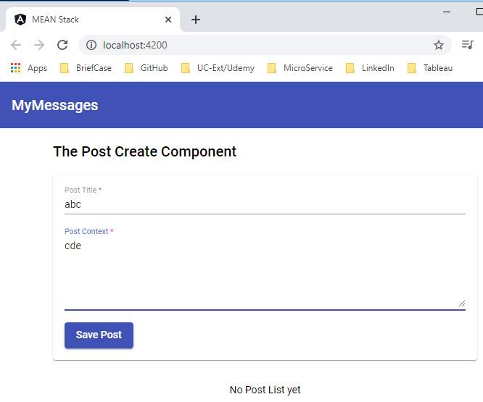
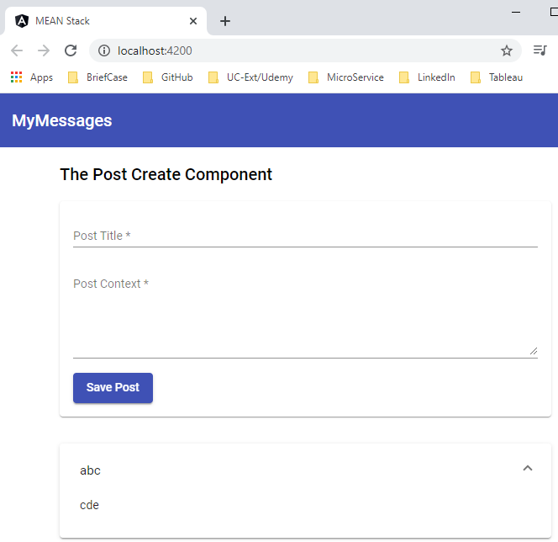
30.4 Verify
https://www.udemy.com/course/angular-2-and-nodejs-the-practical-guide/learn/lecture/10416292#overview
Verify
Clear the “create form” after “Save Post”.

Slide 12
30.5 Code

Slide 13
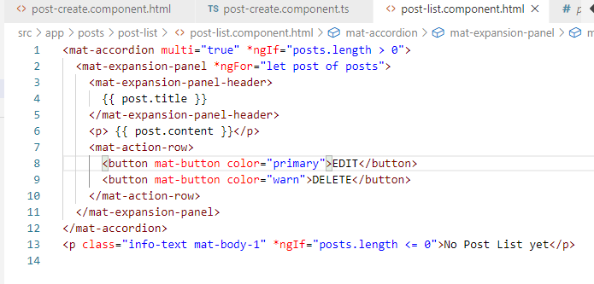
30.5 Code
https://www.udemy.com/course/angular-2-and-nodejs-the-practical-guide/learn/lecture/10416292#overview
Code
Add “Action bar”

Slide 14
30.6 Verify

Slide 15
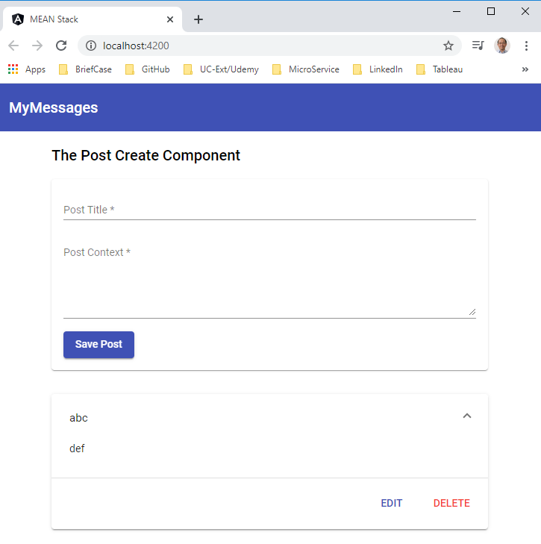
30.6 Verify
https://www.udemy.com/course/angular-2-and-nodejs-the-practical-guide/learn/lecture/10416292#overview
Verify

Slide 16
End of Chapter

