Slide 1

14 Folder Structure
Peter H. Chen

Slide 2



14 Folder Structure
https://www.udemy.com/course/angular-2-and-nodejs-the-practical-guide/learn/lecture/10416224#overview
Outline
Ajax (Background)
Requests
Client (Browser)
Server
Responses
Data
(JSON Format)
Node, Express, MongoDB
Presentation /UI
Business Logic
Single Page is not necessary served by Node Backend, such as, AWS static host S3.
SPA (Single Page Application)
Persistent Data Storage
Authentication Logic

Slide 3
14.1 Code

Slide 4
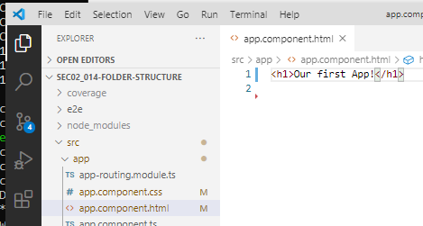
14.1 Code
https://www.udemy.com/course/angular-2-and-nodejs-the-practical-guide/learn/lecture/10416224#overview
Code

Slide 5
14.2 Verify

Slide 6
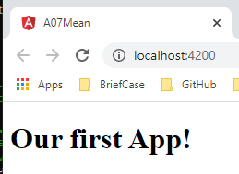
14.2 Verify
https://www.udemy.com/course/angular-2-and-nodejs-the-practical-guide/learn/lecture/10416224#overview
Verify
> ng serve --open

Slide 7
14.3 Structure

Slide 8
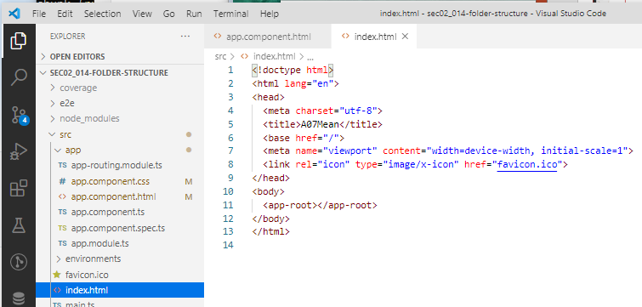
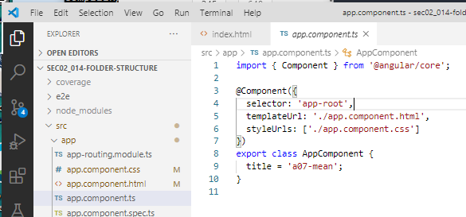
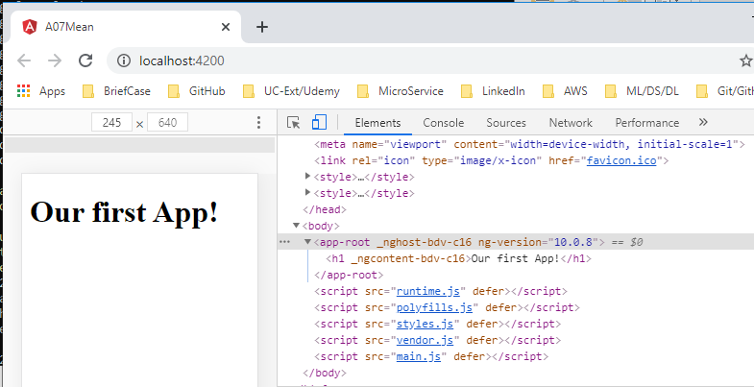
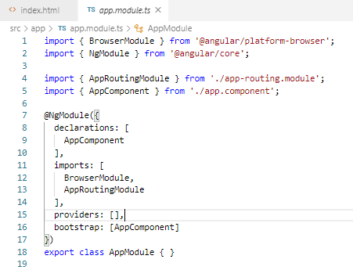
14.3 Structure
https://www.udemy.com/course/angular-2-and-nodejs-the-practical-guide/learn/lecture/10416224#overview
Structure

Slide 9
End of Chapter

