Slide 1

28 Call GET Post
Peter H. Chen

Slide 2

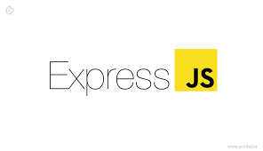

28 Call GET Post
https://www.udemy.com/course/angular-2-and-nodejs-the-practical-guide/learn/lecture/10416270#overview
Call GET Post
Ajax (Background)
Requests
Client (Browser)
Server
Responses
Data
(JSON Format)
Node, Express, MongoDB
Presentation /UI
Business Logic
Single Page is not necessary served by Node Backend, such as, AWS static host S3.
SPA (Single Page Application)
Persistent Data Storage
Authentication Logic

Slide 3
28.1 Code

Slide 4
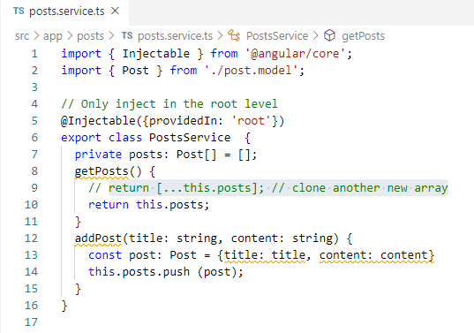
28.1 Code
https://www.udemy.com/course/angular-2-and-nodejs-the-practical-guide/learn/lecture/10416270#overview
Code
Create posts service (posts.service.ts) in the posts folder.
Create posts service (posts.service.ts) in the posts folder.
Specify the service with @Injectable decorator. (We do not need to put it in the provider if we use @Injectable decorator).

Slide 5
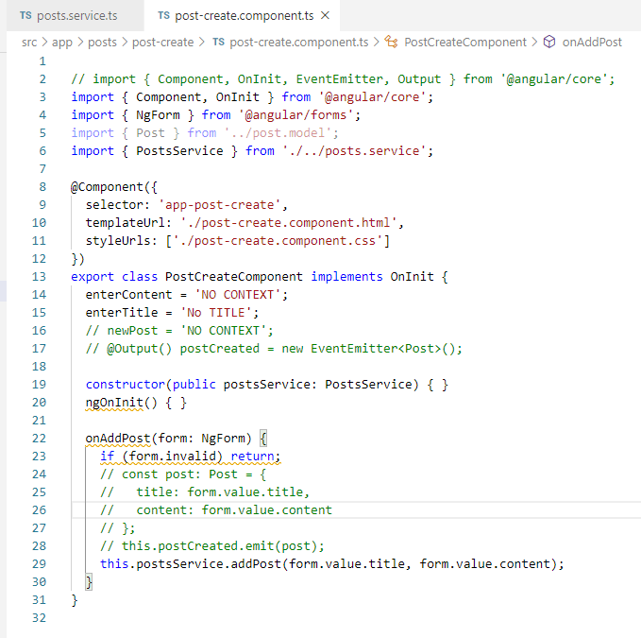
28.1 Code
https://www.udemy.com/course/angular-2-and-nodejs-the-practical-guide/learn/lecture/10416270#overview
Code

Slide 6
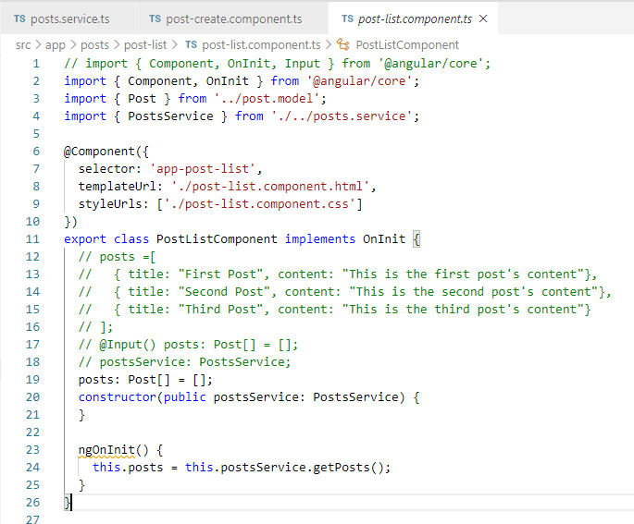
28.1 Code
https://www.udemy.com/course/angular-2-and-nodejs-the-practical-guide/learn/lecture/10416270#overview
Code

Slide 7
28.2 Verify

Slide 8
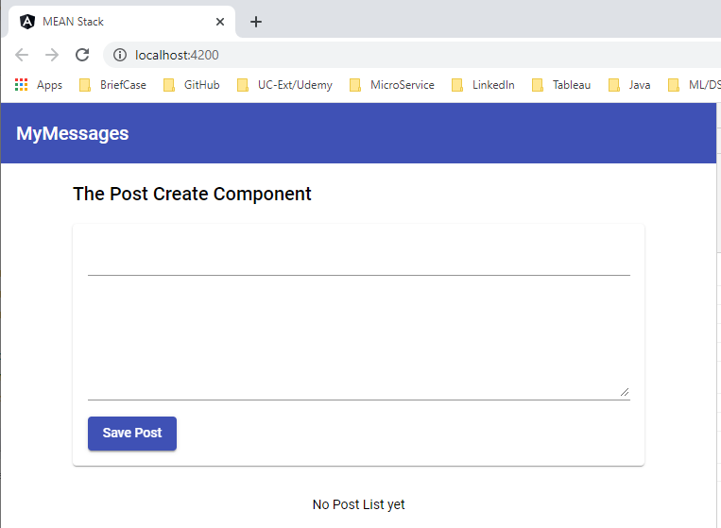
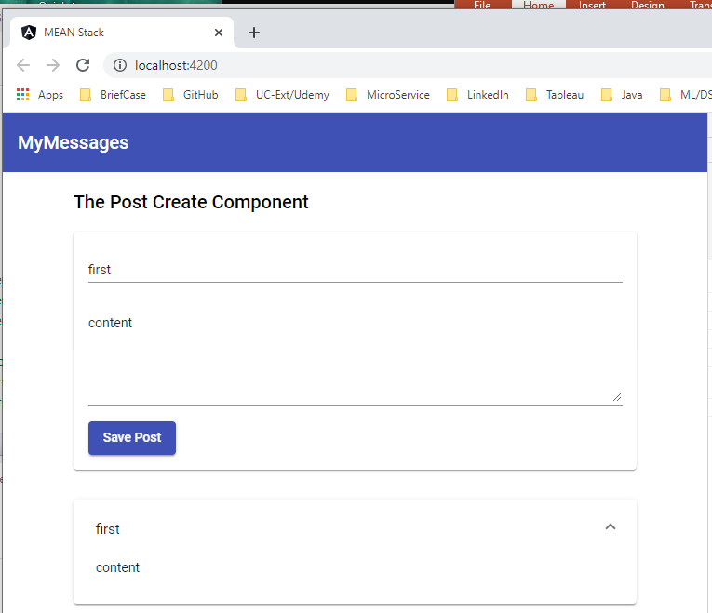
28.2 Verify
https://www.udemy.com/course/angular-2-and-nodejs-the-practical-guide/learn/lecture/10416270#overview
Verify

Slide 9
28.3 Code

Slide 10
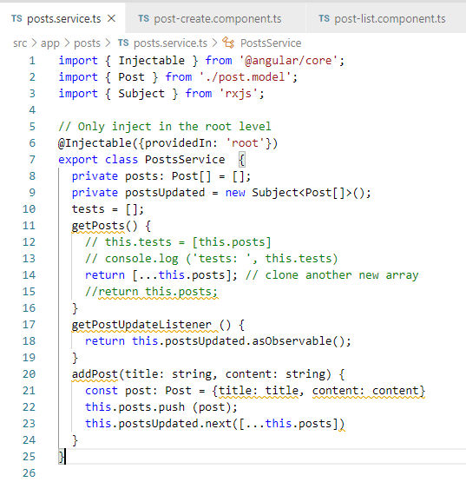
28.1 Code
https://www.udemy.com/course/angular-2-and-nodejs-the-practical-guide/learn/lecture/10416270#overview
Code: Service with Observable

Slide 11
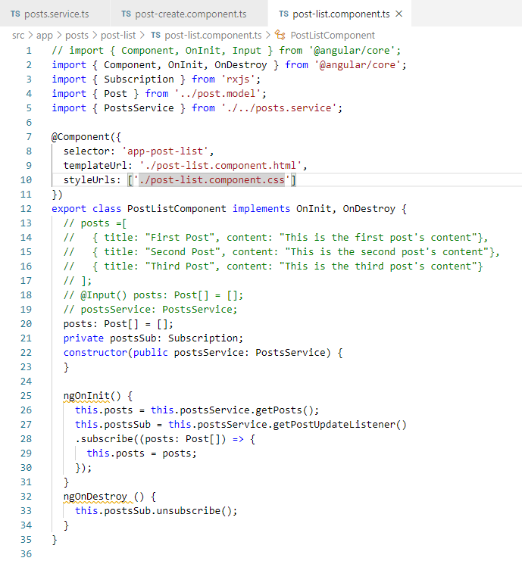
28.1 Code
https://www.udemy.com/course/angular-2-and-nodejs-the-practical-guide/learn/lecture/10416270#overview
Code: list with subscriber.

Slide 12
28.2 Verify

Slide 13
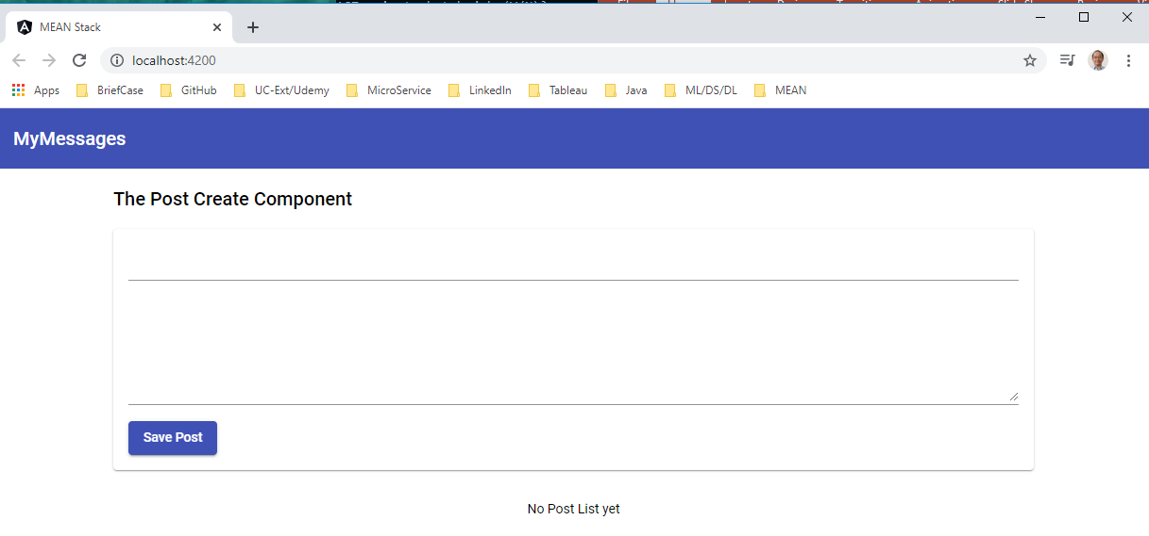
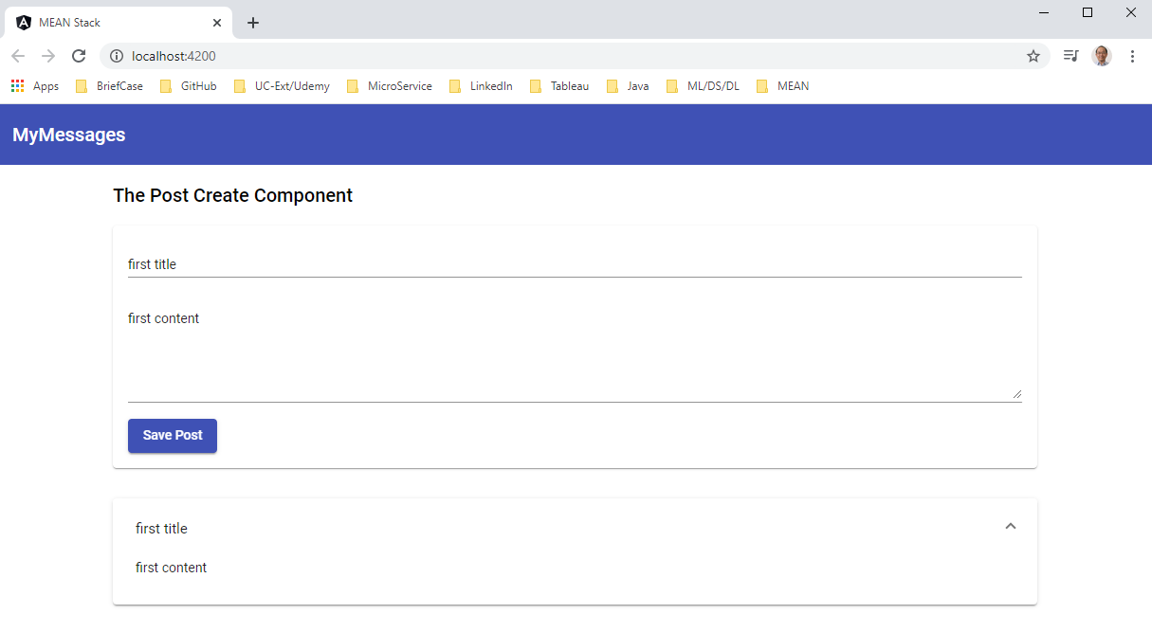
28.4 Verify
https://www.udemy.com/course/angular-2-and-nodejs-the-practical-guide/learn/lecture/10416270#overview
Verify

Slide 14
End of Chapter

