Slide 1

147 Deployment 02: One App
Peter H. Chen

Slide 2
147 Deployment 02: One App
https://github.com/peterhchen/900_MEAN_Proj
Deployment Frontend/Backend 02: One App Approach
In the discussions, we deployed the app by two separated apps, backend and Frontend Angular app.
In this discussion, we deploy it as one app though.

Slide 3
147.1 Angular.json

Slide 4
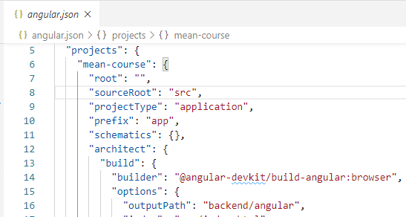
147.1 147.1 Angular.json
https://github.com/peterhchen/900_MEAN_Proj
Create Frontend Folder under Backend Folder
First, make sure that we build our Angular app as a folder into backend folder, so that we deploy the entire content of the backend folder as one single app.
For that we can go to the angular.json file which is used by the CLI to configure our project and there, we can change the output path for when we are building our application, we can do that here under output path.
Let's change this to backend/angular, you can name this whatever you want.

Slide 5
147.2 Generate Angular Folder

Slide 6
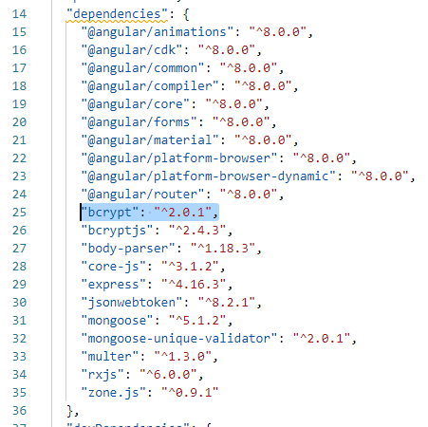
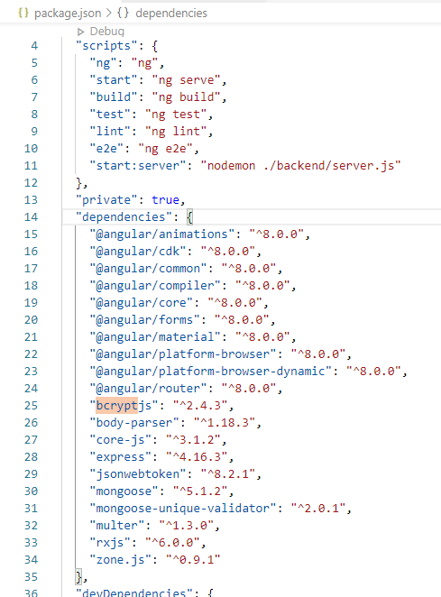
147.2 Generate Angular Folder
https://github.com/peterhchen/900_MEAN_Proj
In Package.json, Remove “bcrypt: “^2.0.1”,
> npm install bcrypt

Slide 7
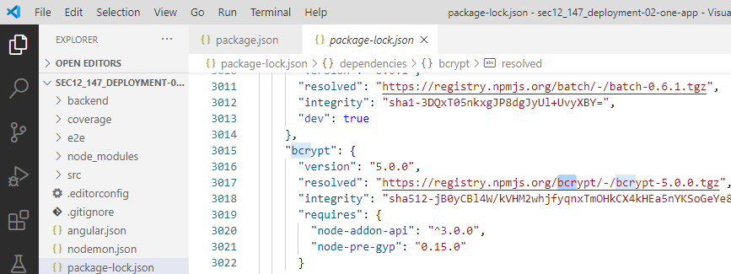
147.2 Generate Angular Folder
https://github.com/peterhchen/900_MEAN_Proj
Check Package-lock.json

Slide 8
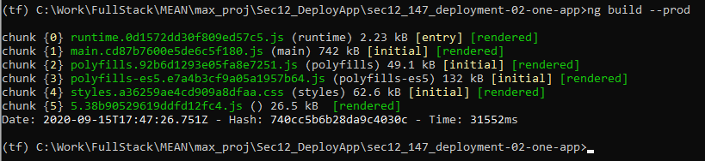
147.2 Generate Angular Folder
https://github.com/peterhchen/900_MEAN_Proj
Ng build --prod
> ng build --prod
Fix error: Job name “..getProjectMetadata” does not exist
https://stackoverflow.com/questions/60174503/job-name-getprojectmetadata-does-not-exist
> npm i @angular-devkit/build-angular@0.803.24
> ng build --prod

Slide 9
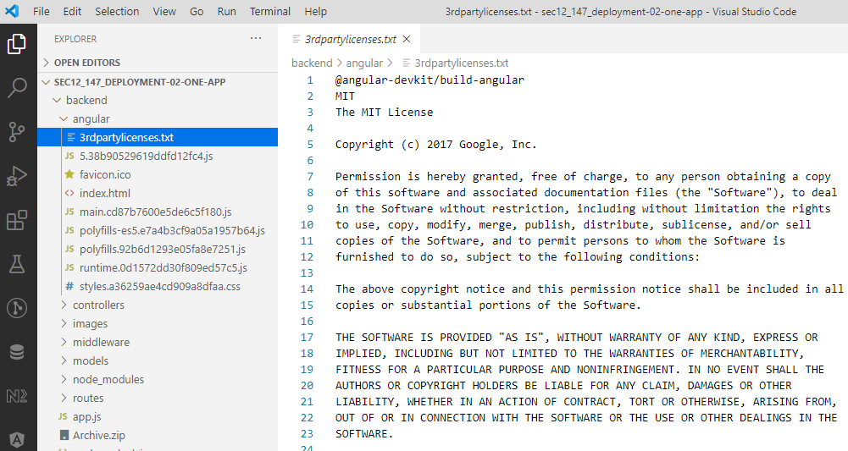
147.2 Generate Angular Folder
https://github.com/peterhchen/900_MEAN_Proj
Ng build --prod
The “backend/angular” folder under “backend” is generated.

Slide 10
147.3 Backend to Angular Request

Slide 11
147.3 Backend to Angular Request
https://github.com/peterhchen/900_MEAN_Proj
Backend to Angular Request
Now, we need to adjust backend/app.js to serve that application successfully.
If we have requests targeting posts or users, we forward them to the routes, “/api/posts” and “/api/user”.
If we have a request targeting anything default, such as, “/” or “”, then we want to handle that with Angular “index.html”.
This setting is especially important because you want to ensure that the Angular router can take over and if you only forward requests targeting “/” or “” to the Angular app, then you would not be able to handle the cases where the user directly enters /auth/.

Slide 12
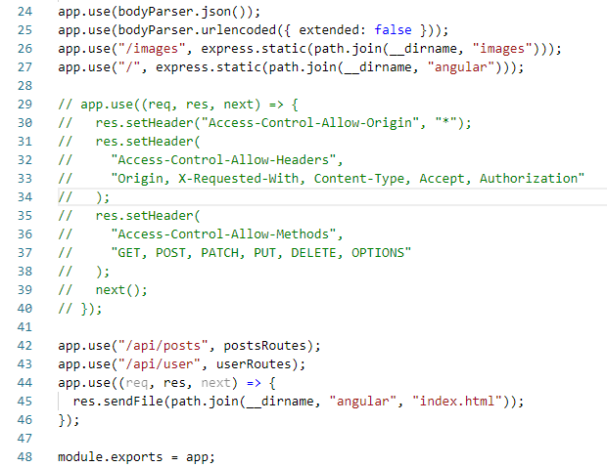
147.3 Backend to Angular Request
https://github.com/peterhchen/900_MEAN_Proj
Backend to Angular Request
Add REST API Route code.
1. For default route (“/” or “”), we add the index.html in “backend/angular” folder.
2. Commented out the previous codes.
3. Add Images files for static route from “backend/angular” folder.
3
2
1

Slide 13
147.4 Localhost Test

Slide 14
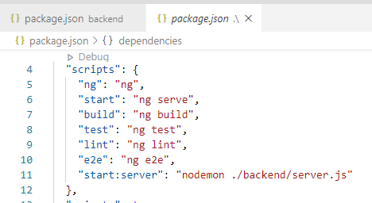
147.4 Localhost Test
https://github.com/peterhchen/900_MEAN_Proj
Localhost Test
> npm run start:server
This command brings “nodemon ./backend/server.js” with backend and frontend together.

Slide 15
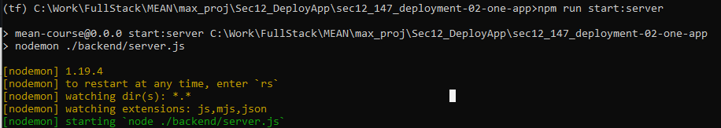
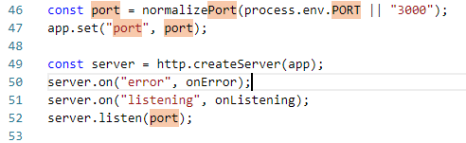
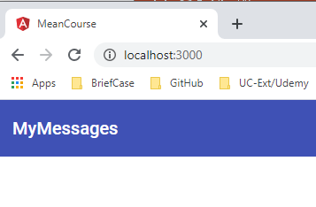
147.4 Localhost Test
https://github.com/peterhchen/900_MEAN_Proj
Localhost Test
> npm run start:server
Open Chrome. We use default port=3000 in backend. Frontend 4200 can be ignored since it automatically bring up from backend.
> localhost:3000

Slide 16
147.5 Deploy App on AWS/EB

Slide 17
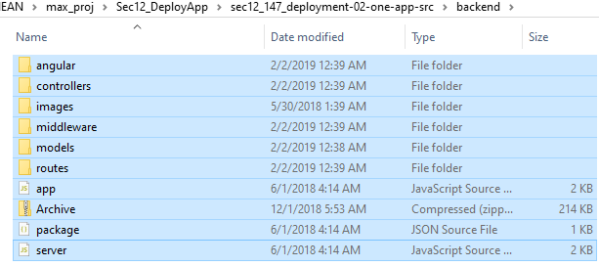
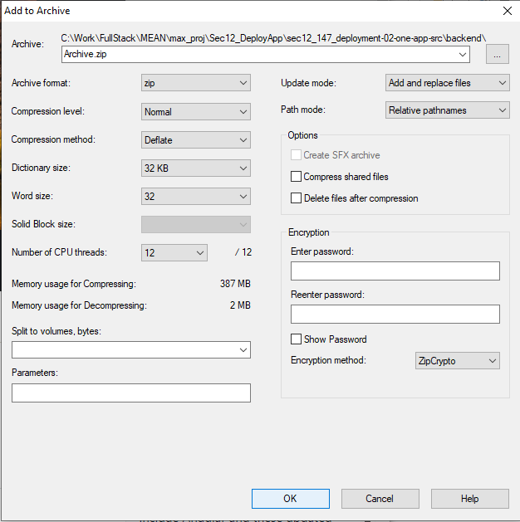
147.5 Deploy App on AWS/EB
https://github.com/peterhchen/900_MEAN_Proj
Deploy App on AWS/EB (Elastic Beanstalk)
Now, localhost test is fine.
“Compress 9 items” into “Archive.zip”
First, we compressed Archive.zip in the backend folder that contains all fodler with angular folder.

Slide 18
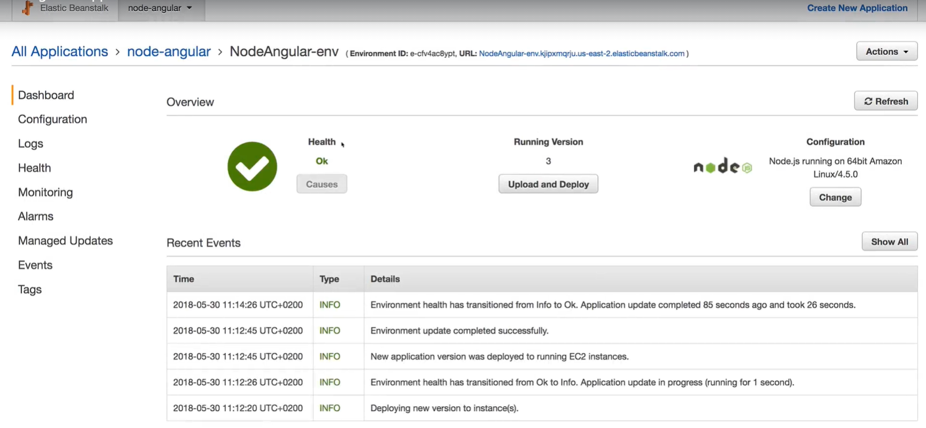
147.5 Deploy App on AWS/EB
https://github.com/peterhchen/900_MEAN_Proj
Deploy App on AWS/EB (Elastic Beanstalk)
Then, we use AWS EB (Elastic Beanstalk) to upload the “Archive.zip”.
Click the “Upload and Deploy” to upload the new version of Archive.zip.

Slide 19
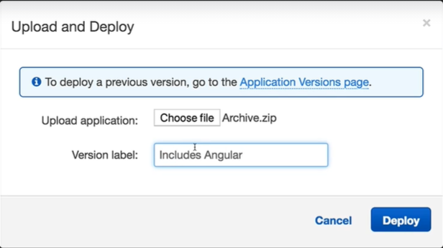
147.5 Deploy App on AWS/EB
https://github.com/peterhchen/900_MEAN_Proj
Deploy App on AWS/EB (Elastic Beanstalk)
Select “Archive.zip” from local drive.
Click “Deploy” button to upgrade.

Slide 20
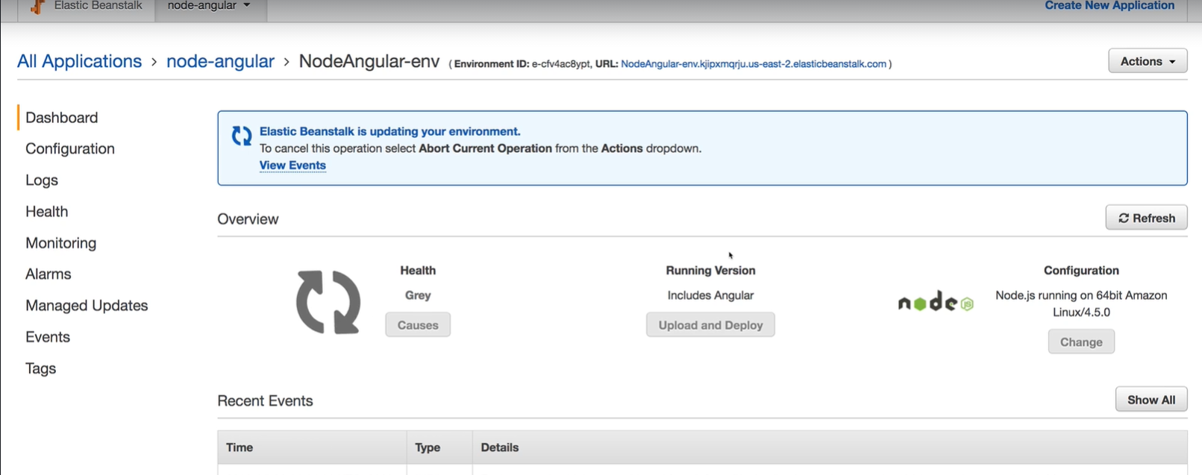
147.5 Deploy App on AWS/EB
https://github.com/peterhchen/900_MEAN_Proj
Deploy App on AWS/EB (Elastic Beanstalk)
Redeploying the Archive.zip.

Slide 21
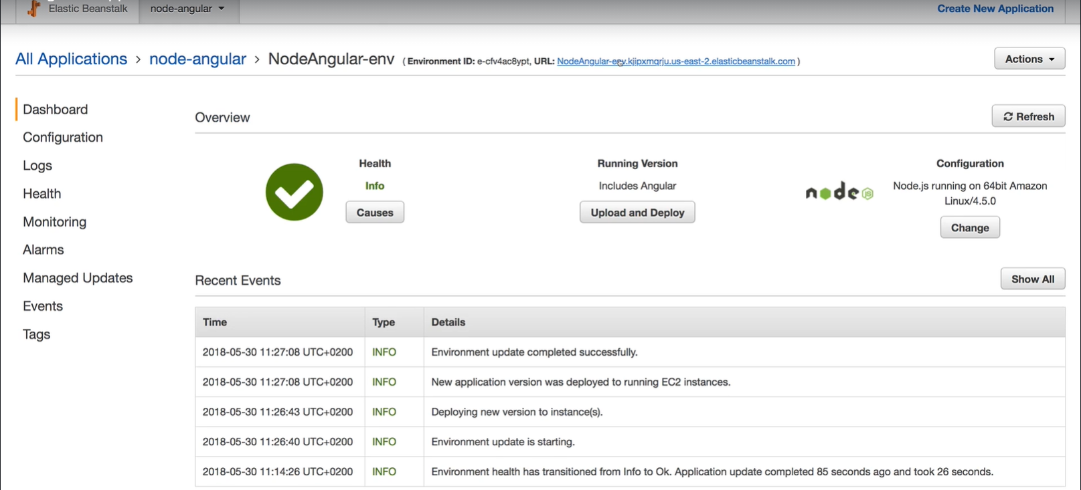
147.5 Deploy App on AWS/EB
https://github.com/peterhchen/900_MEAN_Proj
Deploy App on AWS/EB (Elastic Beanstalk)
Done with redeployed the Archive.zip.

Slide 22
147.6 Test App on AWS/EB

Slide 23
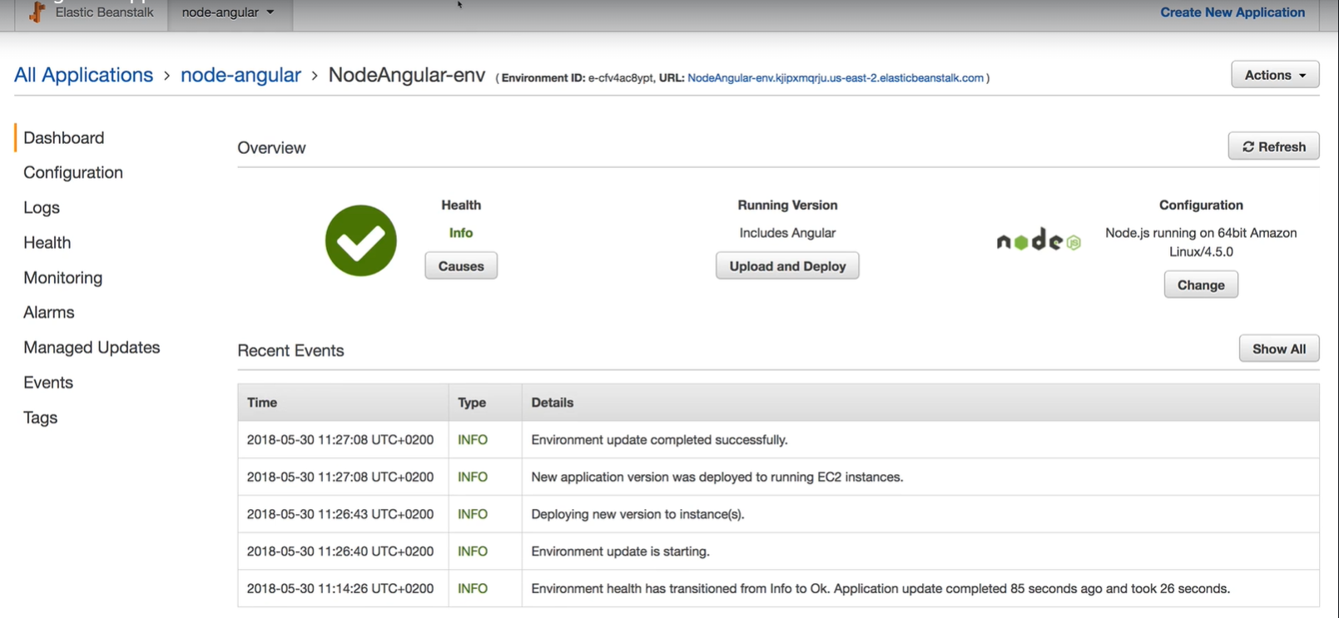
147.6 Test App on AWS/EB
https://github.com/peterhchen/900_MEAN_Proj
Test App on AWS/EB (Elastic Beanstalk)
Now, we have done with redeployed the Archive.zip.
We can click the link on the top-right.

Slide 24
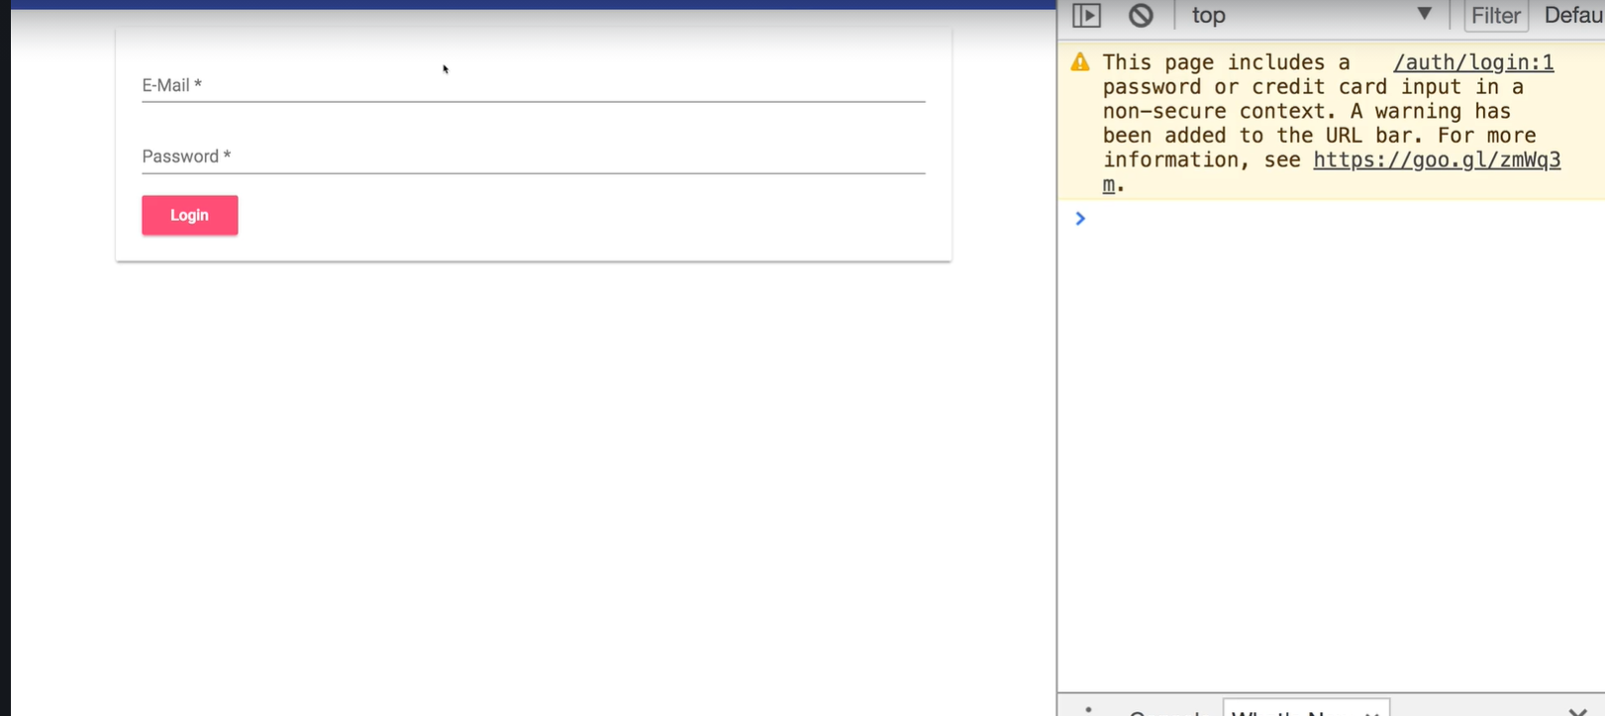
147.6 Test App on AWS/EB
https://github.com/peterhchen/900_MEAN_Proj
Test App on AWS/EB (Elastic Beanstalk)
Now, we can test our application with backend and frontend.

Slide 25
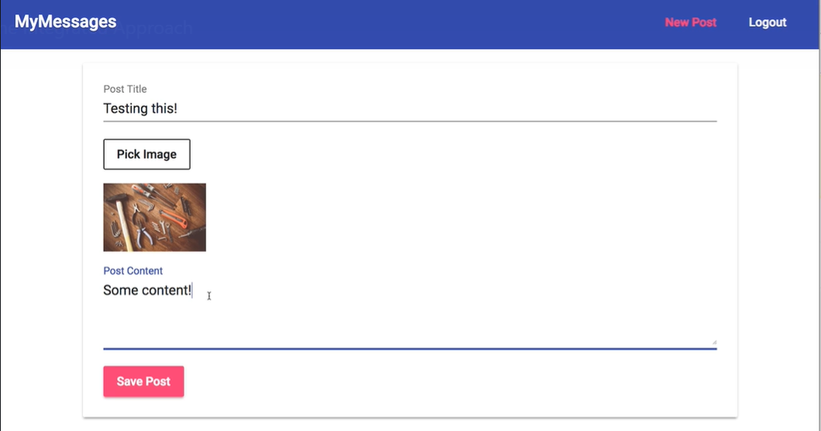
147.6 Test App on AWS/EB
https://github.com/peterhchen/900_MEAN_Proj
Test App on AWS/EB (Elastic Beanstalk)
Test “Pick Image” and Post Content.

Slide 26
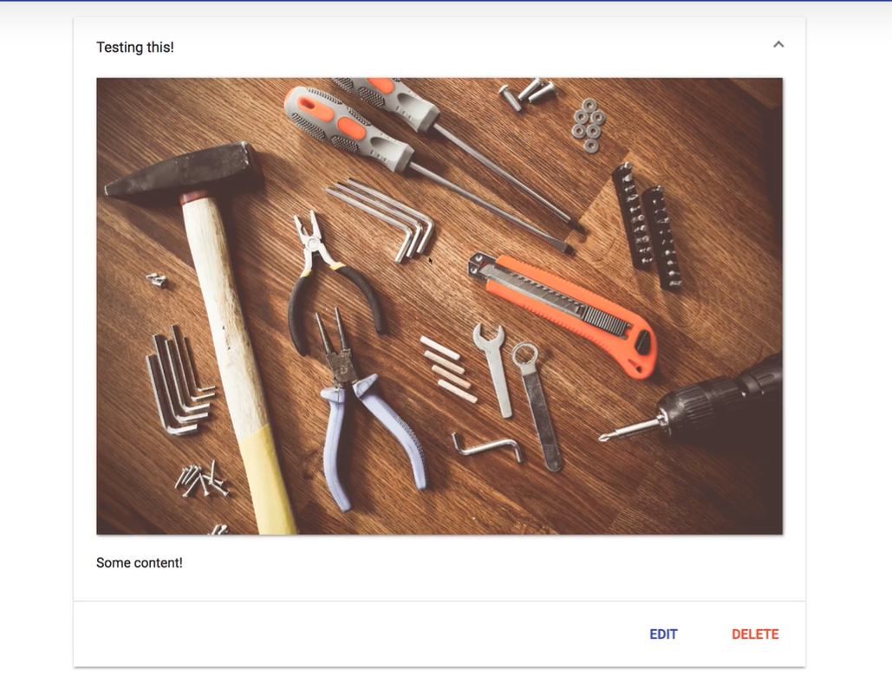
147.6 Test App on AWS/EB
https://github.com/peterhchen/900_MEAN_Proj
Test App on AWS/EB (Elastic Beanstalk)
Verify result.

Slide 27
End of Chapter

