Slide 1

22 Output Post
Peter H. Chen

Slide 2



22 Output Post
https://www.udemy.com/course/angular-2-and-nodejs-the-practical-guide/learn/lecture/10416252#overview
Output Post
Ajax (Background)
Requests
Client (Browser)
Server
Responses
Data
(JSON Format)
Node, Express, MongoDB
Presentation /UI
Business Logic
Single Page is not necessary served by Node Backend, such as, AWS static host S3.
SPA (Single Page Application)
Persistent Data Storage
Authentication Logic

Slide 3
22 Output Post
https://www.udemy.com/course/angular-2-and-nodejs-the-practical-guide/learn/lecture/10416252#overview
Output Post
The goal is to output the post.
In the posts folder, out create post-list.
Create two files:
posts/post-list/post-list.component.ts
posts/post-list/post-list.component.html

Slide 4
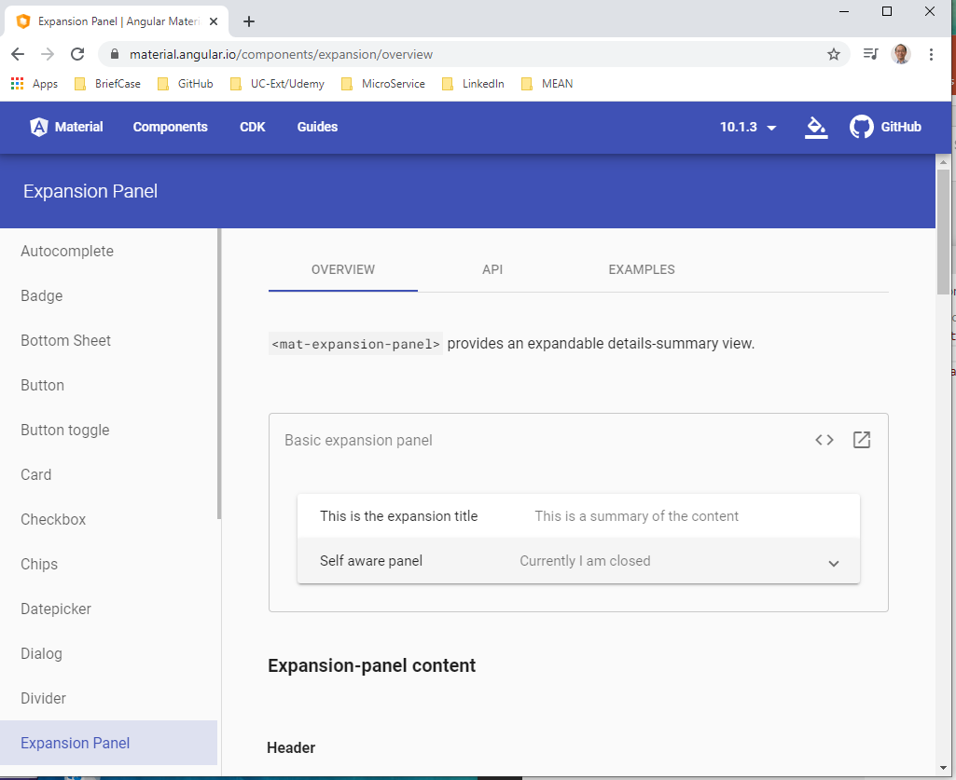
22 Output Post
https://www.udemy.com/course/angular-2-and-nodejs-the-practical-guide/learn/lecture/10416252#overview
Output Post
We want to use Material Expansion Panel to display the Post.
https://material.angular.io/components/expansion/overview

Slide 5
22.1 Code

Slide 6
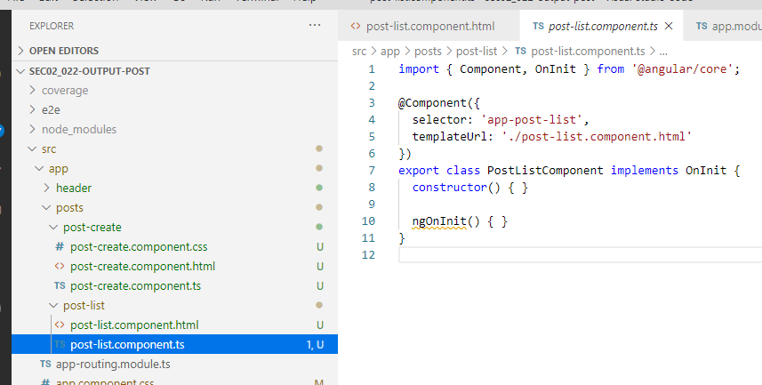
22.1 Code
https://www.udemy.com/course/angular-2-and-nodejs-the-practical-guide/learn/lecture/10416252#overview
Code
We want to use Material Expansion Panel to display the Post.
https://material.angular.io/components/expansion/overview
In post-list.component.ts, create component PostListComponent.
Add the selector: <app-post-list>

Slide 7
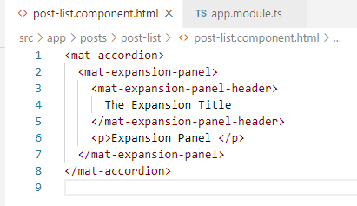
22.1 Code
https://www.udemy.com/course/angular-2-and-nodejs-the-practical-guide/learn/lecture/10416252#overview
Code
We want to use Material Expansion Panel to display the Post.
https://material.angular.io/components/expansion/overview
In post-list.component.html, follow the Material Expansion Panel to create the expansion panel.

Slide 8
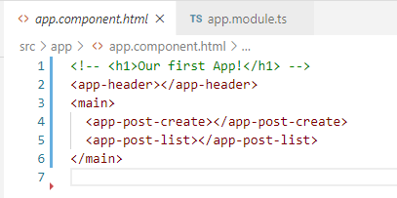
22.1 Code
https://www.udemy.com/course/angular-2-and-nodejs-the-practical-guide/learn/lecture/10416252#overview
Code
We want to use Material Expansion Panel to display the Post.
https://material.angular.io/components/expansion/overview
In app.component.html, call <app-post-list>

Slide 9
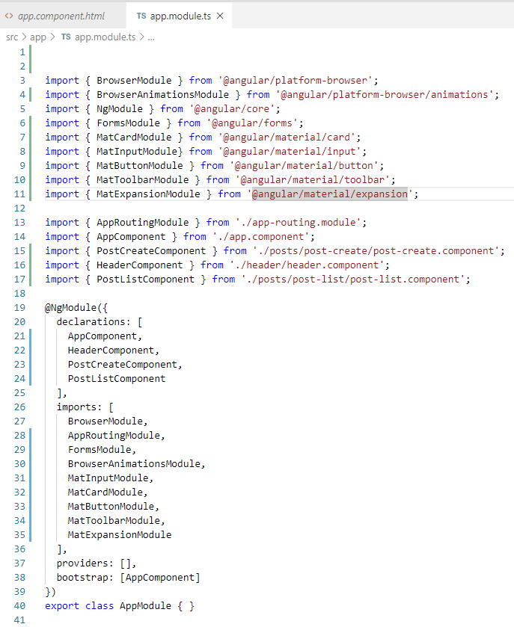
22.1 Code
https://www.udemy.com/course/angular-2-and-nodejs-the-practical-guide/learn/lecture/10416252#overview
Code
We want to use Material Expansion Panel to display the Post.
https://material.angular.io/components/expansion/overview
In app.module.ts, add the Material Expansion Panel Module and import component PostListComponent.

Slide 10
22.2 Verify

Slide 11
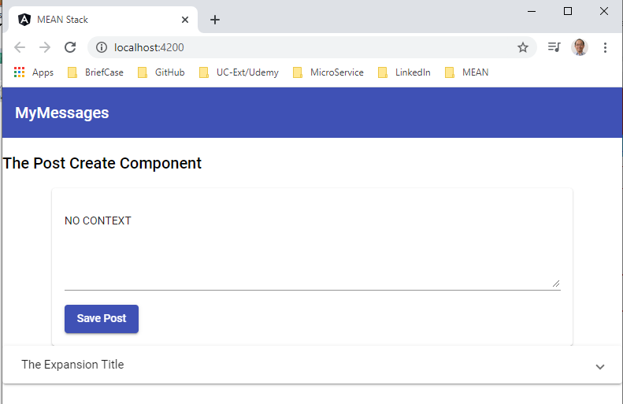
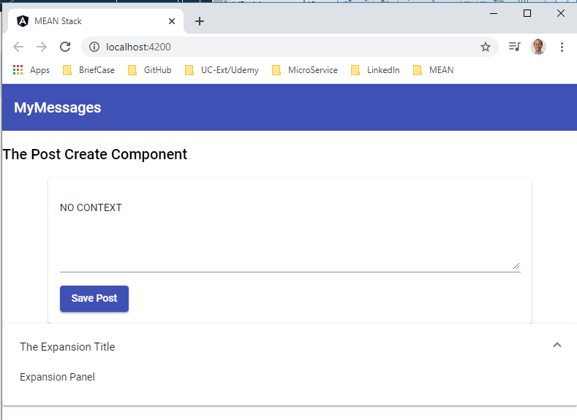
22.2 Verify
https://www.udemy.com/course/angular-2-and-nodejs-the-practical-guide/learn/lecture/10416252#overview
Verify

Slide 12
22.3 Code

Slide 13
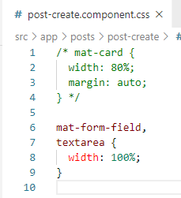
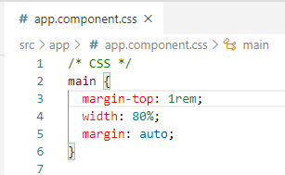
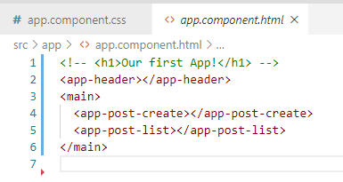
22.3 Code
https://www.udemy.com/course/angular-2-and-nodejs-the-practical-guide/learn/lecture/10416252#overview
Code
We want to use Material Expansion Panel to display the Post.
https://material.angular.io/components/expansion/overview
Remove the <mat-card> and setup <main>.

Slide 14
22.4 Verify

Slide 15
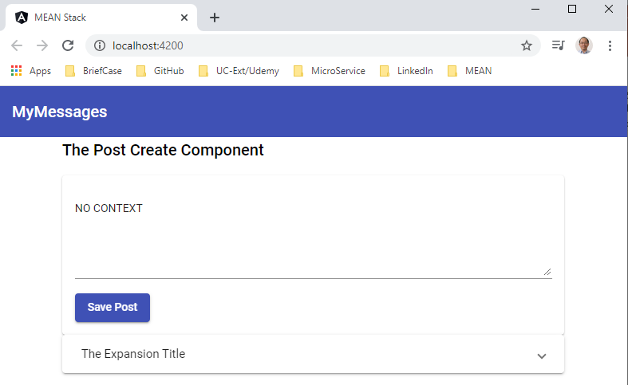
22.4 Verify
https://www.udemy.com/course/angular-2-and-nodejs-the-practical-guide/learn/lecture/10416252#overview
Verify

Slide 16
22.5 Code

Slide 17
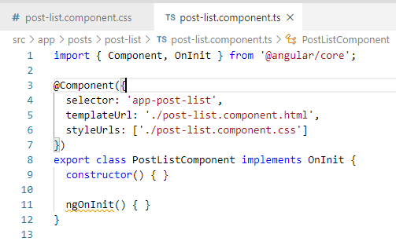
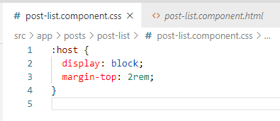
22.5 Code
https://www.udemy.com/course/angular-2-and-nodejs-the-practical-guide/learn/lecture/10416252#overview
Code
Control the CSS of host element.
https://developer.mozilla.org/en-US/docs/Web/CSS/:host
:host is the a show root hots.

Slide 18
22.6 Verify

Slide 19
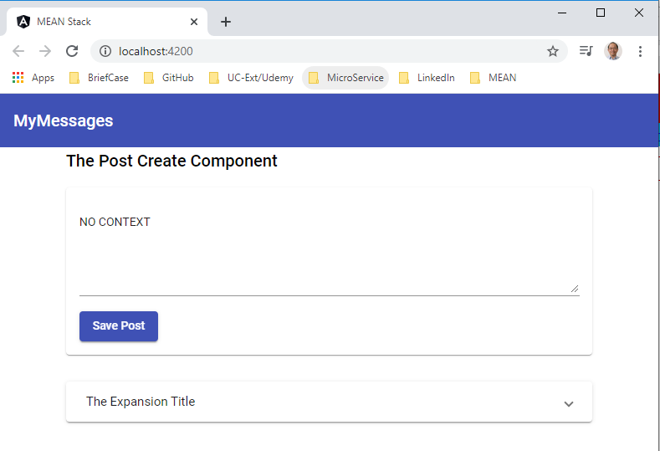
22.6 Verify
https://www.udemy.com/course/angular-2-and-nodejs-the-practical-guide/learn/lecture/10416252#overview
Verify
Spaces on top of Host is 2rems

Slide 20
22.7 Code

Slide 21
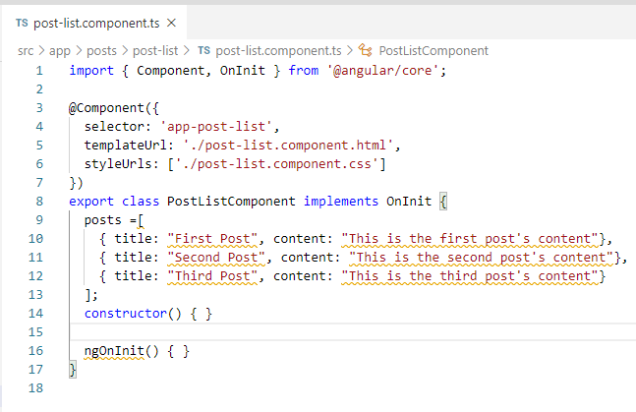
22.7 Code
https://www.udemy.com/course/angular-2-and-nodejs-the-practical-guide/learn/lecture/10416252#overview
Code
Add the Dynamic content.

Slide 22
22.8 Summary

Slide 23
22.8 Summary
https://www.udemy.com/course/angular-2-and-nodejs-the-practical-guide/learn/lecture/10416252#overview
Summary
In this discussion, we add the Material Expansion Panel.

Slide 24
End of Chapter

