Slide 1

24 Post Property and Event Binding
Peter H. Chen

Slide 2



24 Post Property and Event Binding
https://www.udemy.com/course/angular-2-and-nodejs-the-practical-guide/learn/lecture/10416262#overview
Post Property and Event Binding
Ajax (Background)
Requests
Client (Browser)
Server
Responses
Data
(JSON Format)
Node, Express, MongoDB
Presentation /UI
Business Logic
Single Page is not necessary served by Node Backend, such as, AWS static host S3.
SPA (Single Page Application)
Persistent Data Storage
Authentication Logic

Slide 3
24 Post Property and Event Binding
https://www.udemy.com/course/angular-2-and-nodejs-the-practical-guide/learn/lecture/10416262#overview
Post Property and Event Binding
Right now, we only display the text area.
We want to get the text from user input.

Slide 4
24 Post Property and Event Binding
https://www.udemy.com/course/angular-2-and-nodejs-the-practical-guide/learn/lecture/10416262#overview
Post Property and Event Binding
app.component.ts:
onPostAdded (post) {
this.storePosts.push(post)
}
app.component.html:
<app-post-create (postCreated)=“onPostAdded($event)”>
<app-post-list [posts]=“storePosts”>
Event binding
Data binding
post-create.component.ts:
@Output() postCreated
post = {tile: enterTile, content: enterContent}
this.postCreated.emit(post)
post-list.component.ts:
@Input() posts
Two way binding
post-create.component.html:
[(ngModel)] = “enterTile”
[(ngModel)] = “enterContent”
post-list.component.html:
*ngFor=“let … posts”

Slide 5
24.1 Code

Slide 6
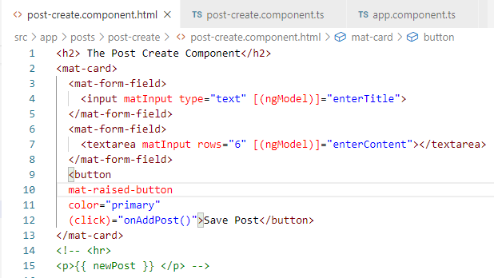
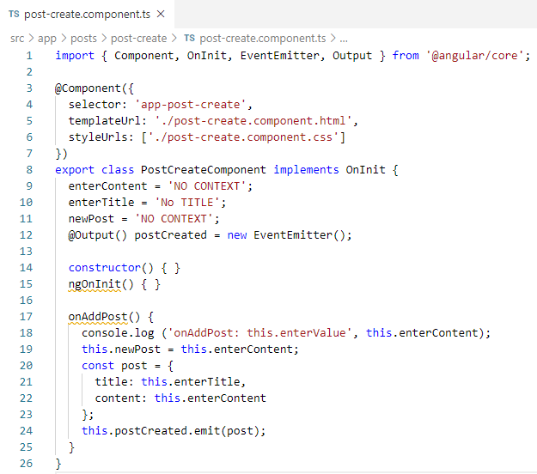
24.1 Code
https://www.udemy.com/course/angular-2-and-nodejs-the-practical-guide/learn/lecture/10416262#overview
Code
Two way binding: [(ngModle)] = “enterTitle”, “enterContent”

Slide 7
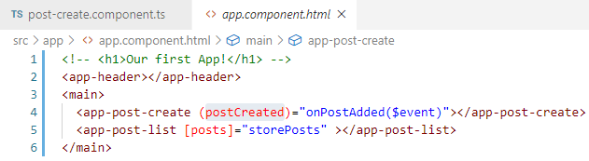
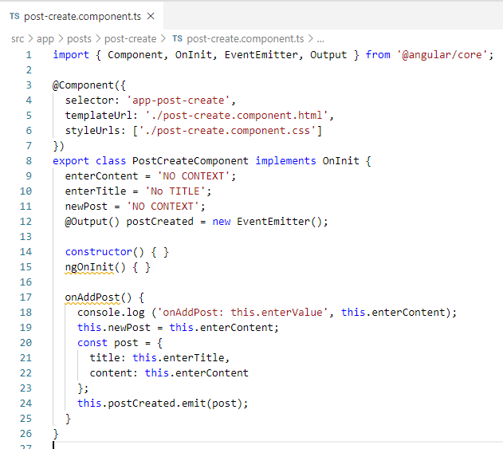
24.1 Code
https://www.udemy.com/course/angular-2-and-nodejs-the-practical-guide/learn/lecture/10416262#overview
Code
Event Binding: @Output and Emit from child to parent.
app.component.html:
<app-post-create (postCreated)=“onPostAdded($event)”>
<app-post-list [posts]=“storePosts”>
Event binding
post-create.component.ts:
@Output() postCreated
post = {tile: enterTile, content: enterContent}
this.postCreated.emit(post)

Slide 8
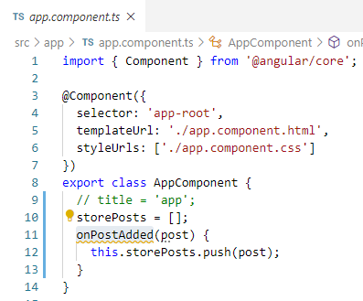
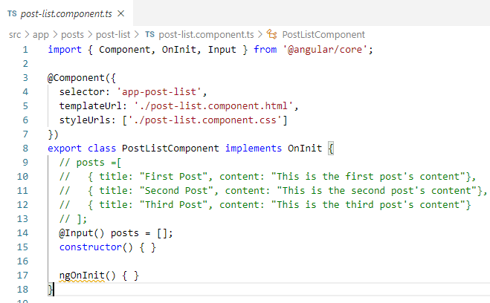
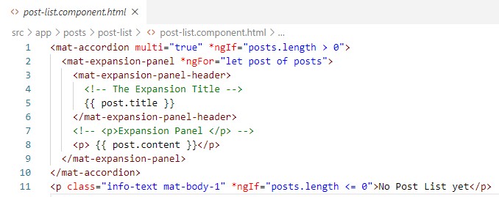
24.1 Code
https://www.udemy.com/course/angular-2-and-nodejs-the-practical-guide/learn/lecture/10416262#overview
Code
Data Binding: @Input Data from parent to child.
Data binding

Slide 9
24.2 Verify

Slide 10
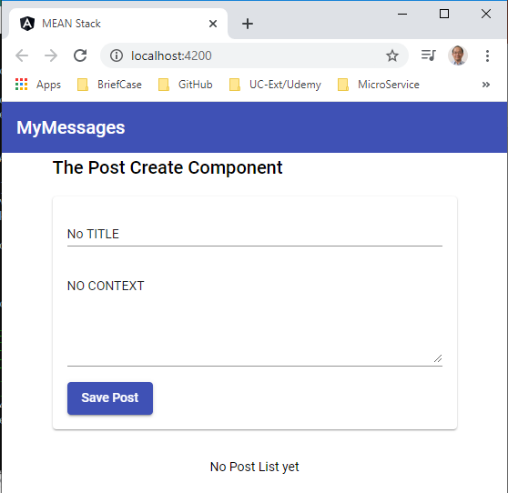
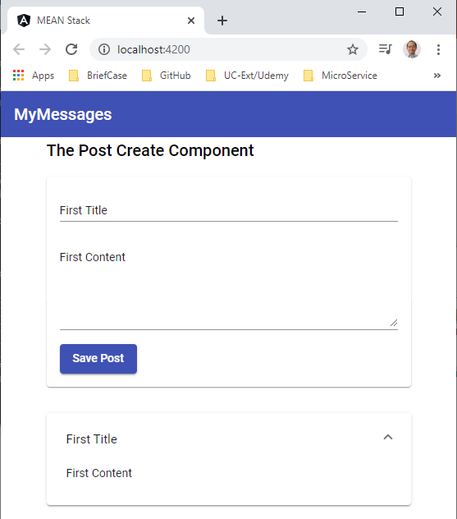
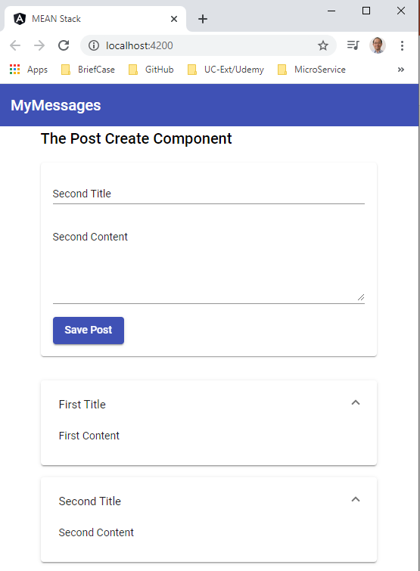
24.2 Verify
https://www.udemy.com/course/angular-2-and-nodejs-the-practical-guide/learn/lecture/10416262#overview
Verify

Slide 11
End of Chapter

