Slide 1

2 MEAN Stack
Peter H. Chen

Slide 2
1 MEAN Stack
https://www.udemy.com/course/angular-2-and-nodejs-the-practical-guide/learn/lecture/10416168#overview
MEAN Stack
Requests
Client (Browser)
Server
Responses
Node, Express, MongoDB
Data
(JSON Format)
Business Logic
Presentation /UI
SPA (Single Page Application)
Single Page is not necessary served by Node Backend!
Persistent Data Storage
Authentication

Slide 3
1 MEAN Stack
https://www.udemy.com/course/angular-2-and-nodejs-the-practical-guide/learn/lecture/10416168#overview
What is MEAN Stack?
M: MongoDB
E: Express (Framework to make Node easier)
A: Angular (UI Component for Single Page Application, Render UI with Dynamic Data, Handle User Input, Communicate with Backend)
N: Node (Logic on Server)

Slide 4
1 MEAN Stack
https://www.udemy.com/course/angular-2-and-nodejs-the-practical-guide/learn/lecture/10416168#overview
Angular
A Client-Side (Browser) Framework which allows you to build Single-Page-Application (SPA)
Render UI with Dynamic Data
Handle User Input
Communicate with Backend Services
Provides a “Mobile App”-like User Experience

Slide 5
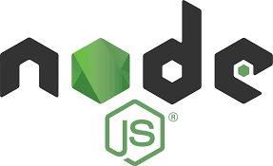
1 MEAN Stack
https://www.udemy.com/course/angular-2-and-nodejs-the-practical-guide/learn/lecture/10416168#overview
Node
A Server-Side Library: JavaScript on the Server-Side
Listen to Requests and Send Responses
Execute Server-Side Logic
Interact with Databases and Files
An Alternative to PHP, Ruby on Rails, Java, and etc.
Node is rarely used Standalone.

Slide 6
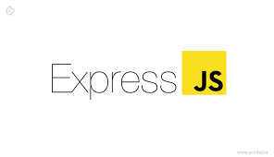
1 MEAN Stack
https://www.udemy.com/course/angular-2-and-nodejs-the-practical-guide/learn/lecture/10416168#overview
Express
A Node Framework which simplifies with Server-Side Code and Logic
Based on Node, offers some functionalities
Middleware-based: on Funnel Requests thorough Functions
Includes Routing, View-rendering, and etc.
Simplifies the Usage of Node.
Express is for Node What Laravel would be for PHP.

Slide 7

1 MEAN Stack
https://www.udemy.com/course/angular-2-and-nodejs-the-practical-guide/learn/lecture/10416168#overview
MongoDB: You can use other Database (SQL) as well.
A NoSQL Database which stores “documents” in “Collections” (instead of “Records” in “Tables” as in SQL)
Store Application Data (Users, Products, …)
Enforces no Data Schema or Relations
Easy to connect Node/Express (Not to Angular)
A Powerful Database which can easily be integrated into a Node/Express Environment.

Slide 8
End of Chapter

