Slide 1

5 Mean Stack
Peter H. Chen

Slide 2
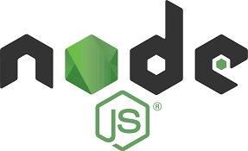


5 Mean Stack
https://www.udemy.com/course/angular-2-and-nodejs-the-practical-guide/learn/lecture/10416174#overview
MEAN Stack: The big picture
Requests
Client (Browser)
Server
Responses
Data
(JSON Format)
Node, Express, MongoDB
Presentation /UI
Business Logic
Single Page is not necessary served by Node Backend, such as, AWS static host S3.
SPA (Single Page Application)
Persistent Data Storage
Authentication

Slide 3
5 Mean Stack
https://www.udemy.com/course/angular-2-and-nodejs-the-practical-guide/learn/lecture/10416174#overview
MEAN Stack

Slide 4
End of Chapter

