Slide 1

7 Install Node/Angular CLI
Peter H. Chen

Slide 2
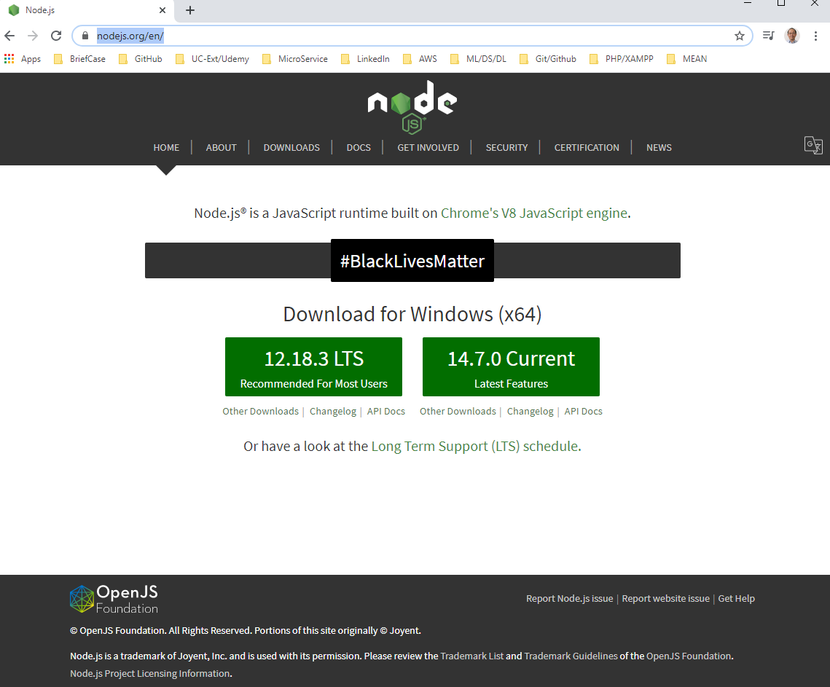
7 Install Node/Angular CLI
https://www.udemy.com/course/angular-2-and-nodejs-the-practical-guide/learn/lecture/12206930#overview
Install Node and Angular CLI
https://nodejs.org/en/

Slide 3
7 Install Node/Angular CLI
https://www.udemy.com/course/angular-2-and-nodejs-the-practical-guide/learn/lecture/12206930#overview
Install Node and Angular CLI
We need node JS for two reason:
We need Node JS for Angular optimization (stripe put the unused code and minify it) and
We need Node JS for backend development.

Slide 4
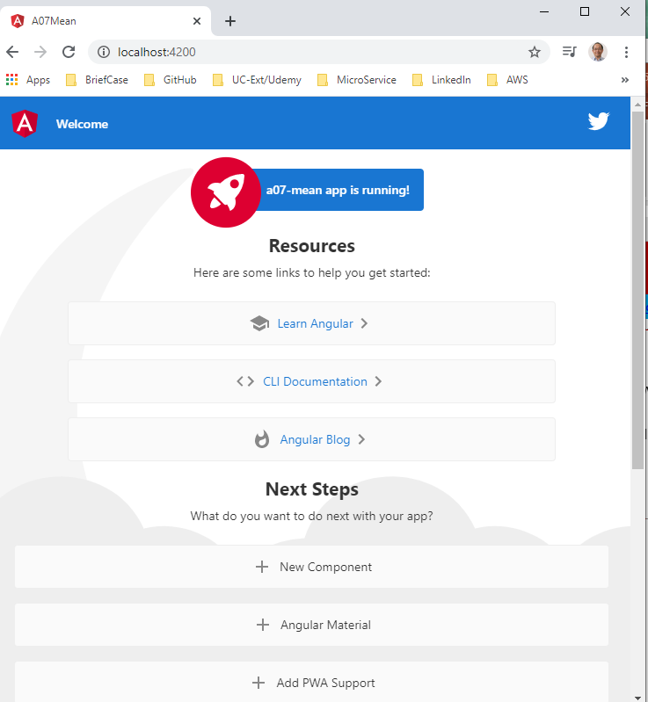
7 Install Node/Angular CLI
https://www.udemy.com/course/angular-2-and-nodejs-the-practical-guide/learn/lecture/12206930#overview
Angular CLI (Command Line Interface)
https://cli.angular.io/
We use npm (Node package manager) to install angular cli with –g (globally).
> npm install -g @angular/cli
In Linux or Mac, you need “sudo npm install –g @angular/cli)
> ng new n07-mean
> cd n07-mean
> ng serve

Slide 5
End of Chapter

