Slide 1

8 IDE: VS Code
Peter H. Chen

Slide 2
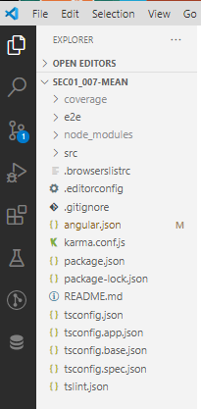
8 IDE: VS Code
https://www.udemy.com/course/angular-2-and-nodejs-the-practical-guide/learn/lecture/10416184#overview
We use VS Code IDE (Not Visual Studio)
Free, extension, awesome.

Slide 3
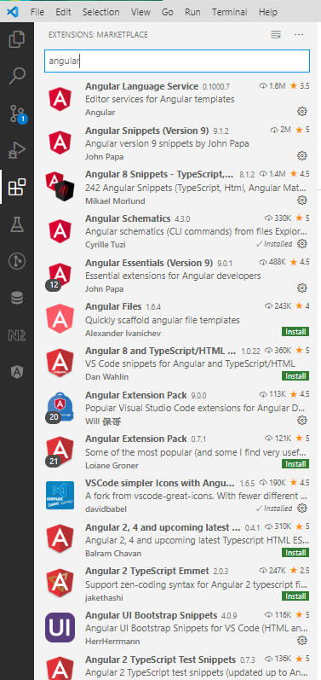
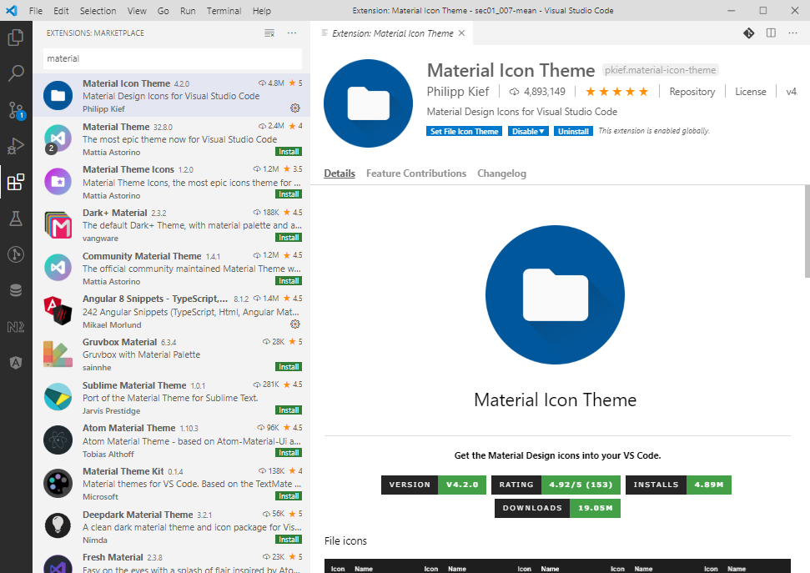
8 IDE: VS Code
https://www.udemy.com/course/angular-2-and-nodejs-the-practical-guide/learn/lecture/10416184#overview
We use VS Code IDE (Not Visual Studio)
Angular extension, material extension

Slide 4
End of Chapter

