Slide 1

9 Project Structure
Peter H. Chen

Slide 2
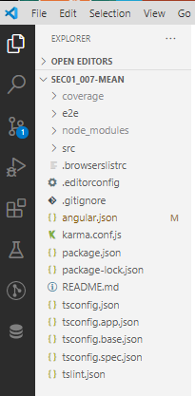
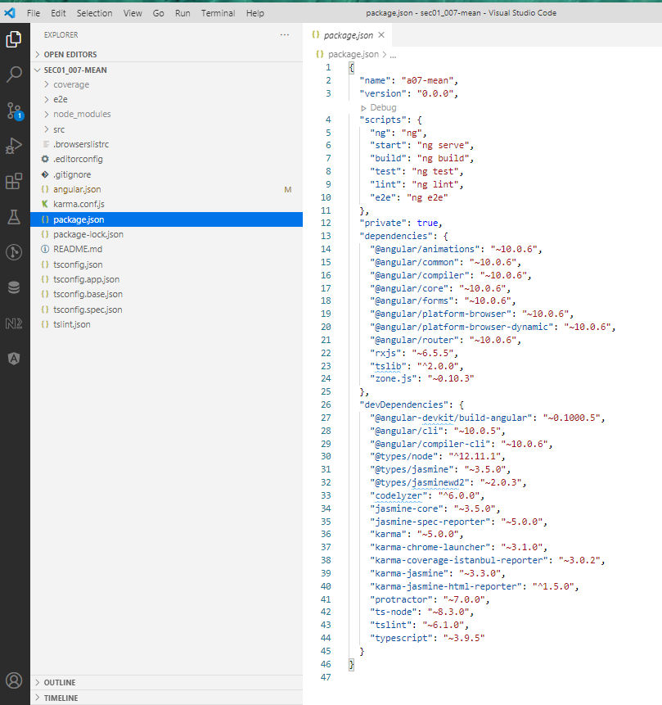
9 Project Structure
https://www.udemy.com/course/angular-2-and-nodejs-the-practical-guide/learn/lecture/10416194#overview
VS Code IDE (Not Visual Studio) Project structure

Slide 3
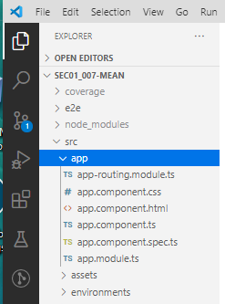
9 Project Structure
https://www.udemy.com/course/angular-2-and-nodejs-the-practical-guide/learn/lecture/10416188#overview
Write your app

Slide 4
End of Chapter

