Slide 1

18 Output Content
Peter H. Chen

Slide 2



18 Output Content
https://www.udemy.com/course/angular-2-and-nodejs-the-practical-guide/learn/lecture/10416234#overview
First Component
Ajax (Background)
Requests
Client (Browser)
Server
Responses
Data
(JSON Format)
Node, Express, MongoDB
Presentation /UI
Business Logic
Single Page is not necessary served by Node Backend, such as, AWS static host S3.
SPA (Single Page Application)
Persistent Data Storage
Authentication Logic

Slide 3
18.1 Code

Slide 4
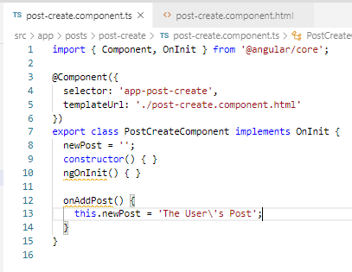
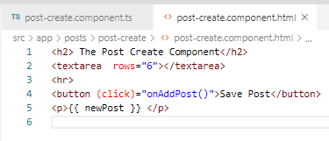
18.1 Code
https://www.udemy.com/course/angular-2-and-nodejs-the-practical-guide/learn/lecture/10416234#overview
Code
In post-create.component.ts, add property newPost = ‘’;
In post-create.component.html, add string interpolation {{ newPost }}.

Slide 5
18.2 Verify

Slide 6
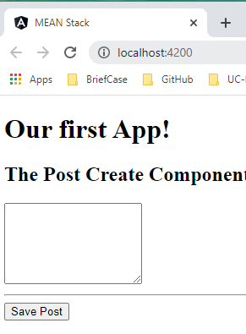
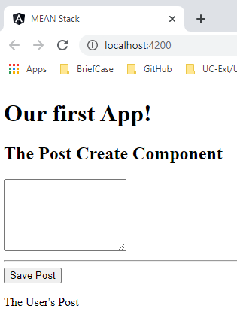
18.2 Verify
https://www.udemy.com/course/angular-2-and-nodejs-the-practical-guide/learn/lecture/10416234#overview
Verify

Slide 7
18.3 Code

Slide 8
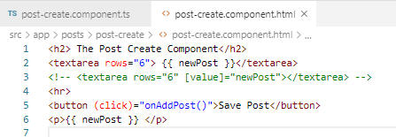
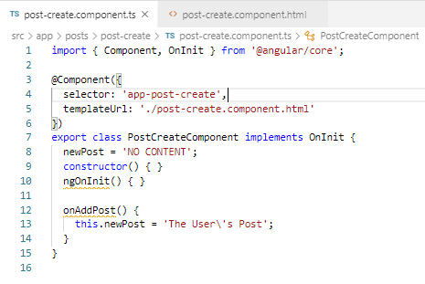
18.3 Code
https://www.udemy.com/course/angular-2-and-nodejs-the-practical-guide/learn/lecture/10416234#overview
Code
In textarea, we can output text string {{ newPost }}
Add the initialized string “No CONTENT”.

Slide 9
18.4 Verify

Slide 10
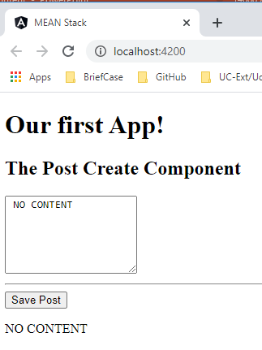
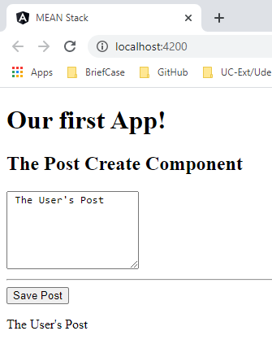
18.4 Verify
https://www.udemy.com/course/angular-2-and-nodejs-the-practical-guide/learn/lecture/10416234#overview
Verify

Slide 11
18.5 Code

Slide 12
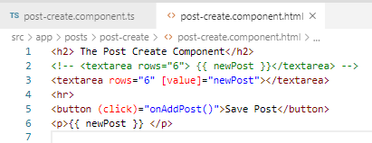
18.5 Code
https://www.udemy.com/course/angular-2-and-nodejs-the-practical-guide/learn/lecture/10416234#overview
Code
We can use property binding for element textarea: [value]=“newPost”.

Slide 13
18.6 Verify

Slide 14
18.6 Verify
https://www.udemy.com/course/angular-2-and-nodejs-the-practical-guide/learn/lecture/10416234#overview
Verify

Slide 15
18.7 Summary

Slide 16
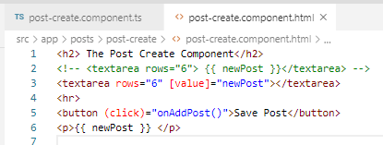
18.7 Summary
https://www.udemy.com/course/angular-2-and-nodejs-the-practical-guide/learn/lecture/10416234#overview
Summary
We can use string interpolation {{}} for component variable newPost.
We also can use [value] = “” for component variable newPost.

Slide 17
End of Chapter

