Slide 1

19 User Input
Peter H. Chen

Slide 2



19 User Input
https://www.udemy.com/course/angular-2-and-nodejs-the-practical-guide/learn/lecture/10416238#overview
User Input
Ajax (Background)
Requests
Client (Browser)
Server
Responses
Data
(JSON Format)
Node, Express, MongoDB
Presentation /UI
Business Logic
Single Page is not necessary served by Node Backend, such as, AWS static host S3.
SPA (Single Page Application)
Persistent Data Storage
Authentication Logic

Slide 3
19 User Input
https://www.udemy.com/course/angular-2-and-nodejs-the-practical-guide/learn/lecture/10416238#overview
Two ways to get the user input.
1) Use reference (#)
2) Use two way binding [(ngModel)]

Slide 4
19.1 Code

Slide 5
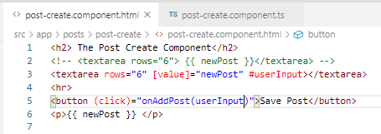
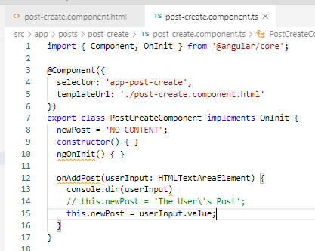
19.1 Code
https://www.udemy.com/course/angular-2-and-nodejs-the-practical-guide/learn/lecture/10416238#overview
Code
Use reference (#) for element data. Pass the data in callback function.
Use console.dir() to display data.

Slide 6
19.2 Verify

Slide 7
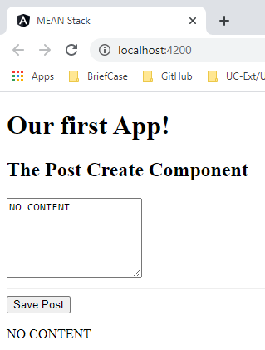
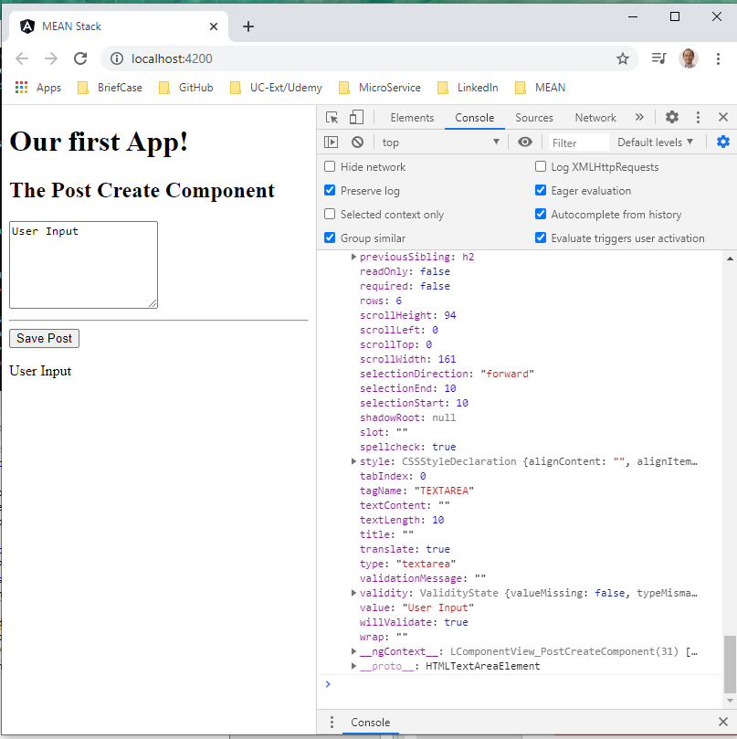
19.2 Verify
https://www.udemy.com/course/angular-2-and-nodejs-the-practical-guide/learn/lecture/10416238#overview
Verify

Slide 8
19.3 Code

Slide 9
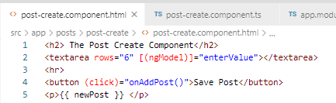
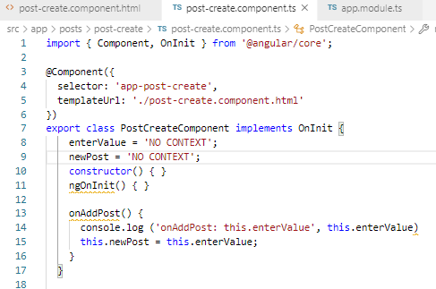
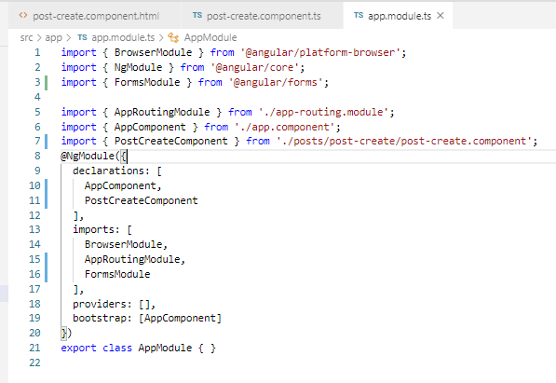
19.3 Code
https://www.udemy.com/course/angular-2-and-nodejs-the-practical-guide/learn/lecture/10416238#overview
Code
Use two way binding [(ngModel)]
In app.modules.ts, add “import FormsModule”.
In post-create.component.ts, add “enterValue = …”

Slide 10
19.4 Verify

Slide 11
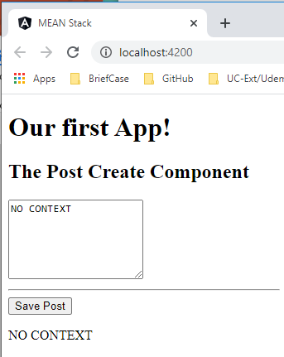
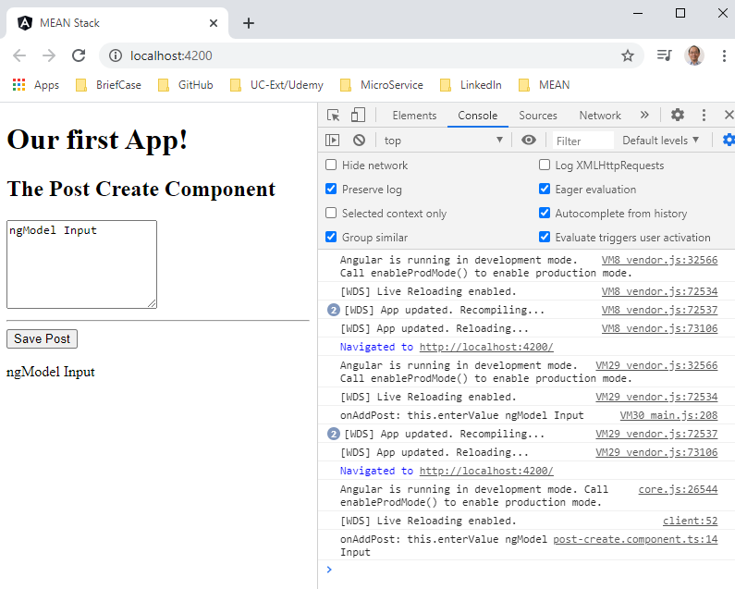
19.4 Verify
https://www.udemy.com/course/angular-2-and-nodejs-the-practical-guide/learn/lecture/10416238#overview
Verify

Slide 12
19.5 Summary

Slide 13
19.5 Summary
https://www.udemy.com/course/angular-2-and-nodejs-the-practical-guide/learn/lecture/10416238#overview
Summary
In Angular, event binding (click), Reference (#) binding, and two ways bindings [(ngModle)] are very import basics between the component in *.ts and element in *.html.

Slide 14
End of Chapter

