Slide 1

23 Structure Directive
Peter H. Chen

Slide 2



23 Structure Directive
https://www.udemy.com/course/angular-2-and-nodejs-the-practical-guide/learn/lecture/10416256#overview
Structure Directive
Ajax (Background)
Requests
Client (Browser)
Server
Responses
Data
(JSON Format)
Node, Express, MongoDB
Presentation /UI
Business Logic
Single Page is not necessary served by Node Backend, such as, AWS static host S3.
SPA (Single Page Application)
Persistent Data Storage
Authentication Logic

Slide 3
23.1 Code

Slide 4
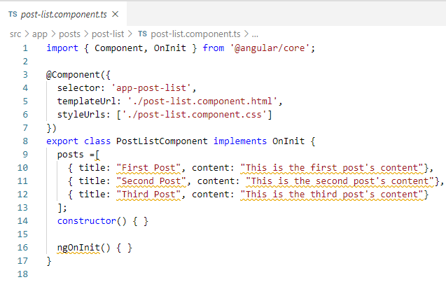
23.1 Code
https://www.udemy.com/course/angular-2-and-nodejs-the-practical-guide/learn/lecture/10416256#overview
Code
Now, we have some data to display.
These data may come from some backend, some servers, a list of posts, a list of users, and etc., you want to output in your template.

Slide 5
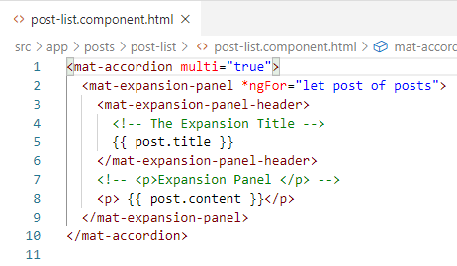
23.1 Code
https://www.udemy.com/course/angular-2-and-nodejs-the-practical-guide/learn/lecture/10416256#overview
Code
Set multi=“true” for multiple accordion.
*ngFor = “let post of posts”
{{ post.title }}
{{ post.content }}

Slide 6
23.2 Verify

Slide 7
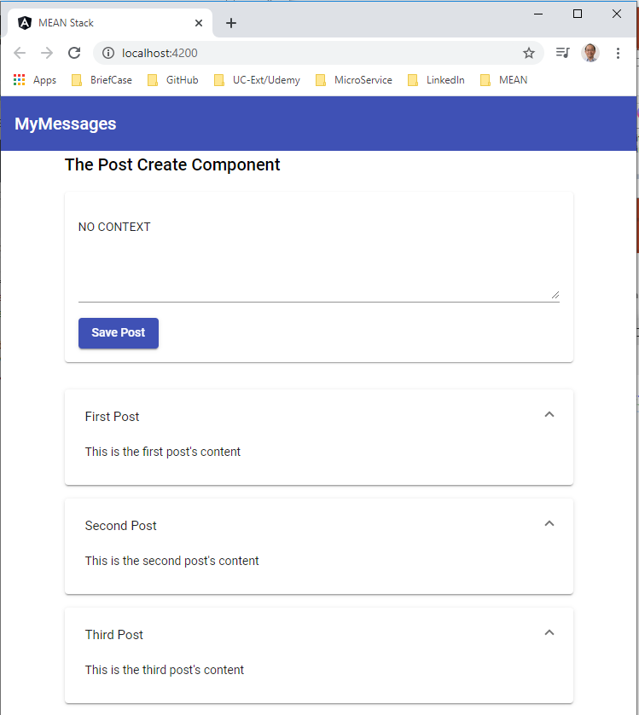
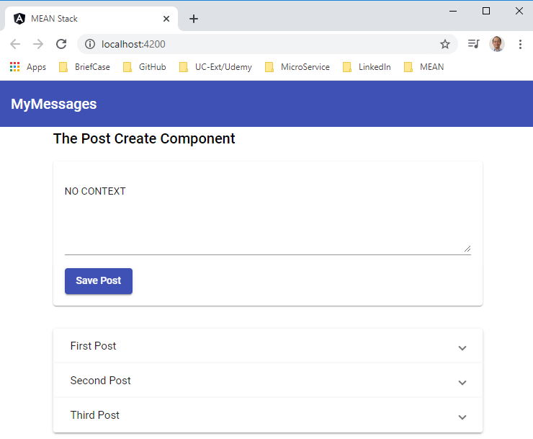
23.2 Verify
https://www.udemy.com/course/angular-2-and-nodejs-the-practical-guide/learn/lecture/10416256#overview
Verify
This is how accordion work.

Slide 8
23.3 Code

Slide 9
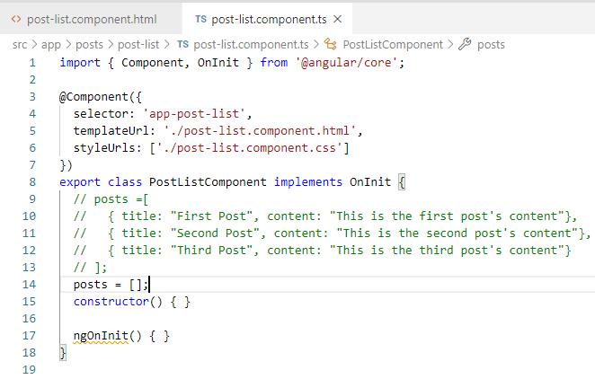
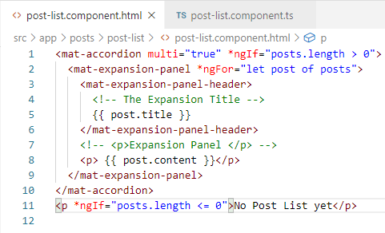
23.3 Code
https://www.udemy.com/course/angular-2-and-nodejs-the-practical-guide/learn/lecture/10416256#overview
Code
Set posts = [];
Add *ngIf = “posts.length > 0“ display the array template.
Add *ngIf = “post.length <= 0” display “No Post List yet” message.

Slide 10
23.4 Verify

Slide 11
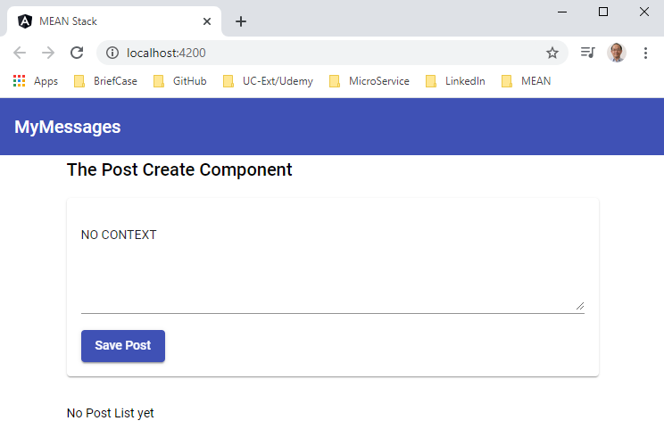
23.4 Verify
https://www.udemy.com/course/angular-2-and-nodejs-the-practical-guide/learn/lecture/10416256#overview
Verify

Slide 12
23.5 Code

Slide 13
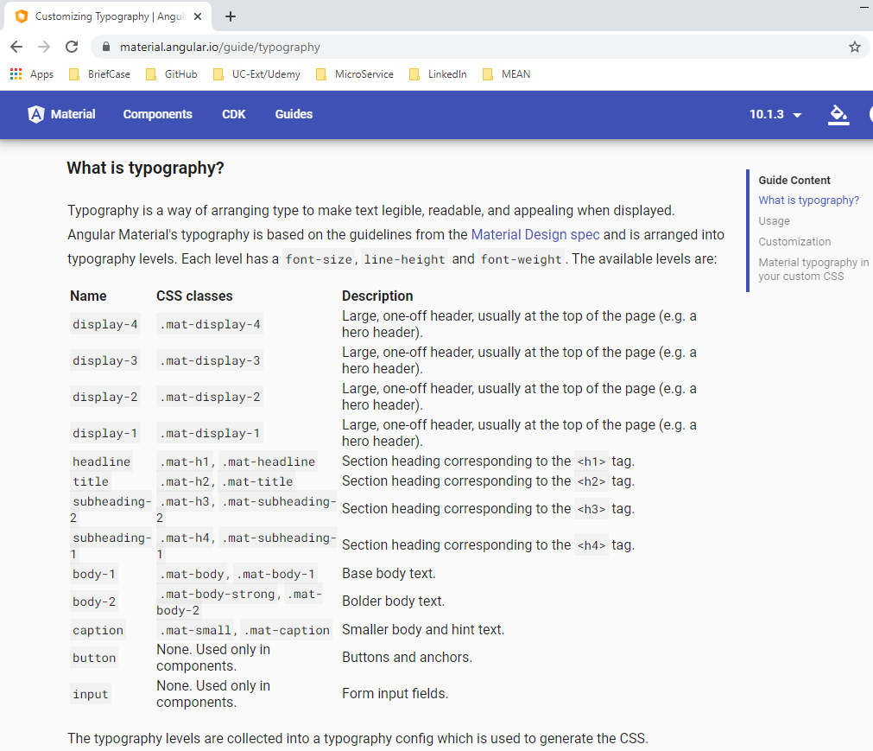
23.5 Code
https://www.udemy.com/course/angular-2-and-nodejs-the-practical-guide/learn/lecture/10416256#overview
Code
Display better typography by material.
https://material.angular.io/guide/typography

Slide 14
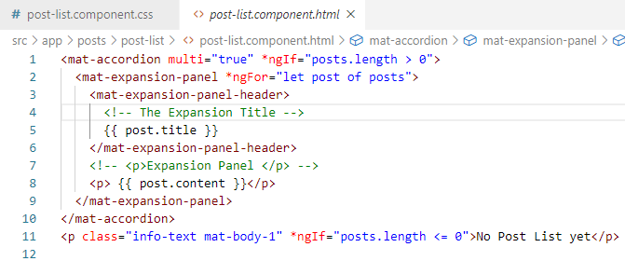
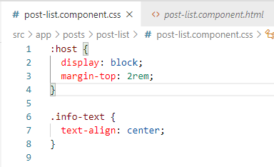
23.5 Code
https://www.udemy.com/course/angular-2-and-nodejs-the-practical-guide/learn/lecture/10416256#overview
Code
Display mat-body-1 instead of <p>.
Align text with css.

Slide 15
23.4 Verify

Slide 16
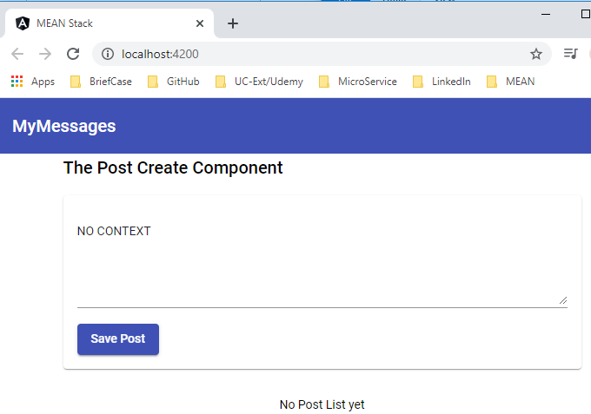
23.4 Verify
https://www.udemy.com/course/angular-2-and-nodejs-the-practical-guide/learn/lecture/10416256#overview
Verify

Slide 17
End of Chapter

