Slide 1

16 First Component
Peter H. Chen

Slide 2



16 First Component
https://www.udemy.com/course/angular-2-and-nodejs-the-practical-guide/learn/lecture/10416226#overview
First Component
Ajax (Background)
Requests
Client (Browser)
Server
Responses
Data
(JSON Format)
Node, Express, MongoDB
Presentation /UI
Business Logic
Single Page is not necessary served by Node Backend, such as, AWS static host S3.
SPA (Single Page Application)
Persistent Data Storage
Authentication Logic

Slide 3
16 First Component
https://www.udemy.com/course/angular-2-and-nodejs-the-practical-guide/learn/lecture/10416226#overview
First Component: create post, read post
Create subfolder: posts
Create subfolder: posts/post-create
Create component ts file: posts/post-create/post-create.component.ts
Create component html file: posts/post-create/post-create.component.html

Slide 4
16.1 Code

Slide 5
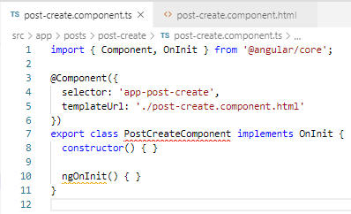

16.1 Code
https://www.udemy.com/course/angular-2-and-nodejs-the-practical-guide/learn/lecture/10416226#overview
Code
Type ‘a-comp” (Angular Component to create the component template.
Change the class name “PostCreateComponent”
Add the @Componet decorator in front of “class PostCreateComponent”. This is to specify the class is the Angular Component.
Add Selector “app-post-create” and templateUrl: “./post-create.component.html”
Add <h2> The Post Create Component </h2> in post-create-component.html.

Slide 6
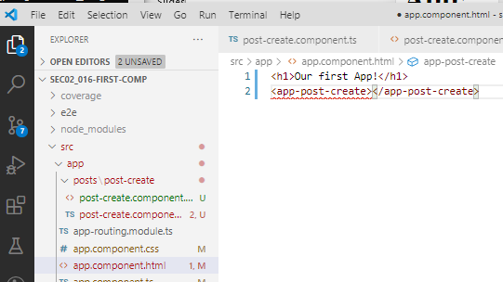
16.1 Code
https://www.udemy.com/course/angular-2-and-nodejs-the-practical-guide/learn/lecture/10416226#overview
Code
In the post-create.component.html, add the <app-post-create></app-post-create>
Use the selector <app-post-create> defined in post-create-component.ts. to bring up the class PostCreateComponent.

Slide 7
16.2 Verify

Slide 8
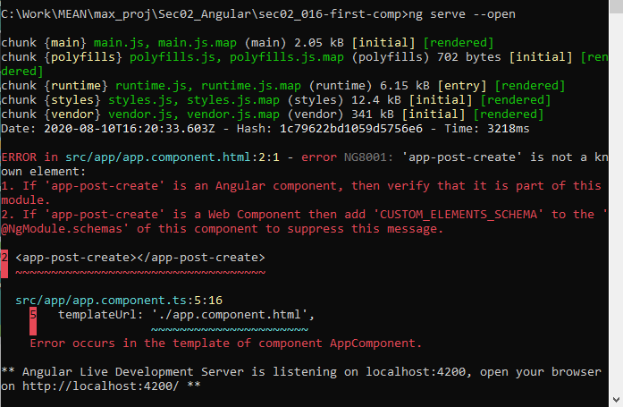
16.2 Verify
https://www.udemy.com/course/angular-2-and-nodejs-the-practical-guide/learn/lecture/10416226#overview
Verify
> ng server --opn
We see error in command prompt.

Slide 9
16.3 Fix Error and Verify

Slide 10
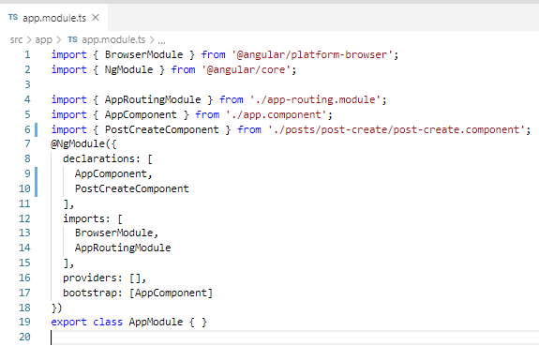
16.3 Fix Error and Verify
https://www.udemy.com/course/angular-2-and-nodejs-the-practical-guide/learn/lecture/10416226#overview
Fix Error:
Add declaration component: PostCreateComponent.

Slide 11
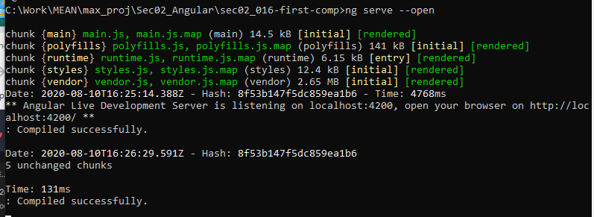
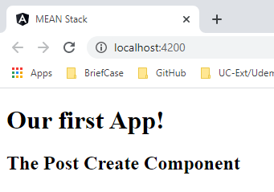
16.3 Fix Error and Verify
https://www.udemy.com/course/angular-2-and-nodejs-the-practical-guide/learn/lecture/10416226#overview
Try again

Slide 12
End of Chapter

