Slide 1

20 Material
Peter H. Chen

Slide 2



20 Material
https://www.udemy.com/course/angular-2-and-nodejs-the-practical-guide/learn/lecture/10416244#overview
Material
Ajax (Background)
Requests
Client (Browser)
Server
Responses
Data
(JSON Format)
Node, Express, MongoDB
Presentation /UI
Business Logic
Single Page is not necessary served by Node Backend, such as, AWS static host S3.
SPA (Single Page Application)
Persistent Data Storage
Authentication Logic

Slide 3
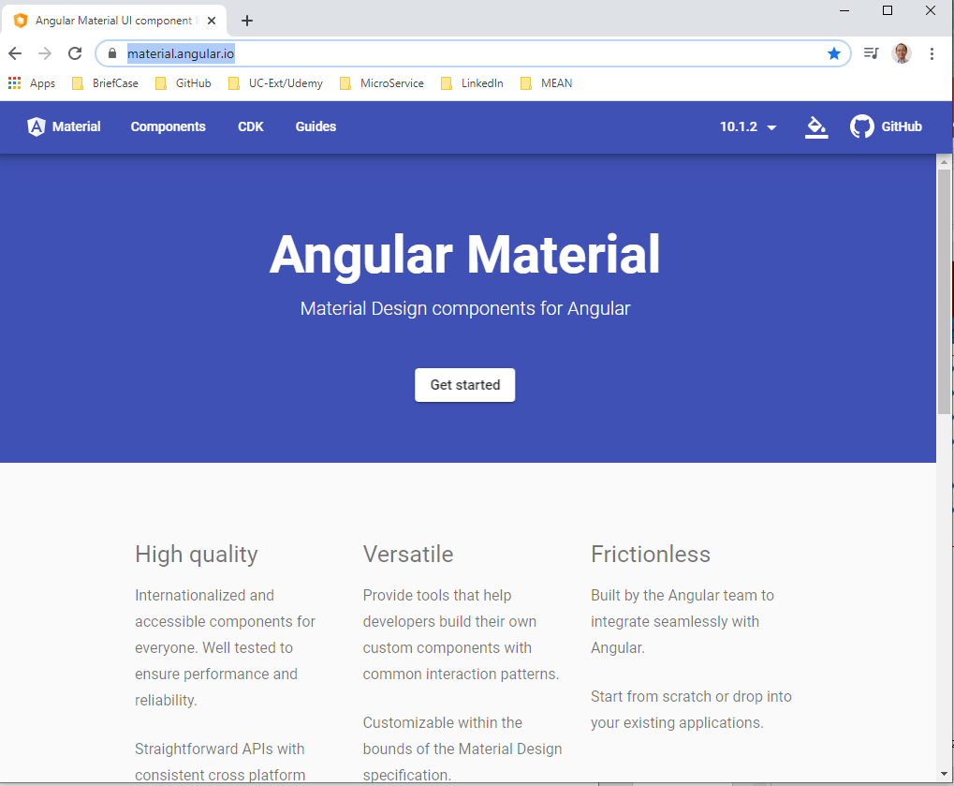
20 Material
https://www.udemy.com/course/angular-2-and-nodejs-the-practical-guide/learn/lecture/10416244#overview
Material
https://material.angular.io/
MEAN stack wants to focus on Angular component, not Angular styling.
MEAN stack uses Angular Material which is a package created by Angular Team which give us a set of pre-built Angular components.
That is very important.
Angular Material is not just a styling package. It is not like a Bootstrap.
Angular Material is actually a Angular Package which ships with a couple of Angular Components which we can drop into our application.
We will still write all the core logic for our application on our own.

Slide 4
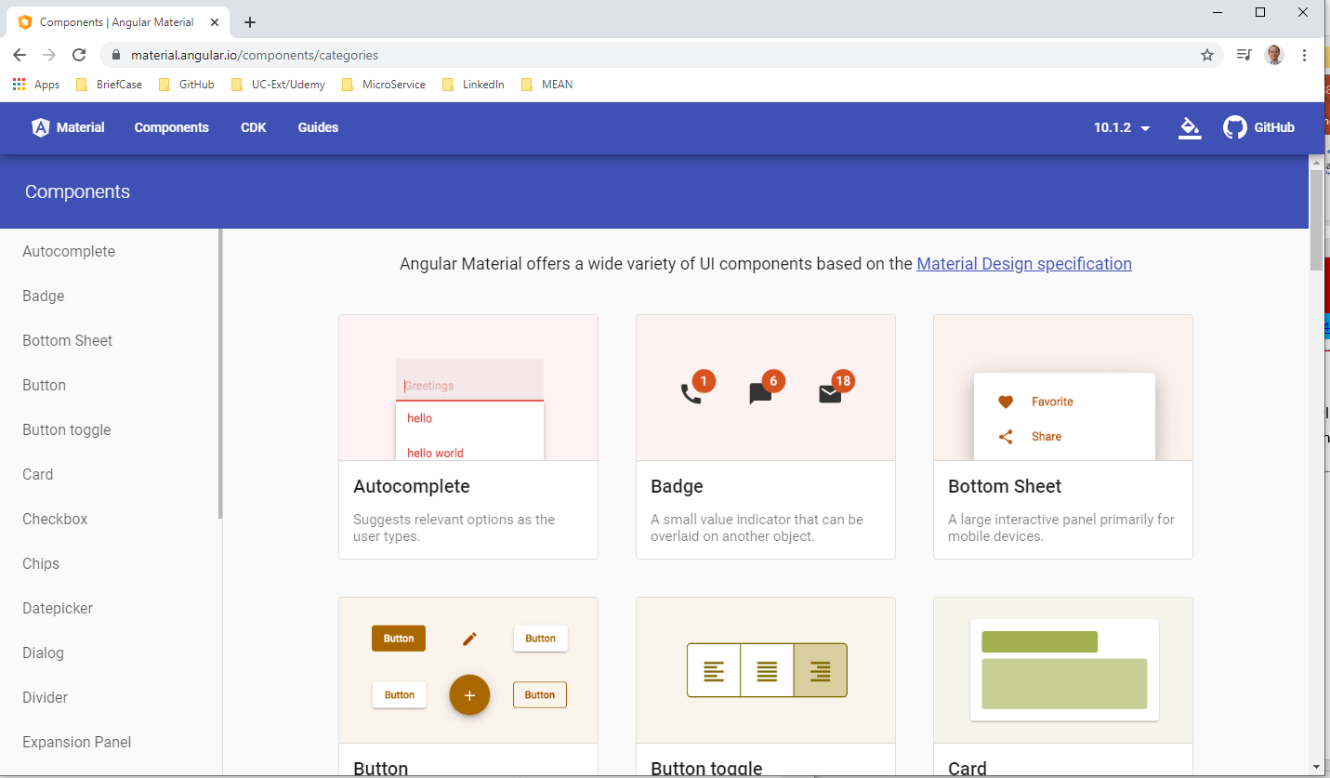
20 Material
https://www.udemy.com/course/angular-2-and-nodejs-the-practical-guide/learn/lecture/10416244#overview
Material
https://material.angular.io/
You can see a lot of pre-built components that should give us everything we need to build a nice application, including a header, button, and inputs.
This is what we want to work with.
To add material into your project.
> ng add @angular/material

Slide 5
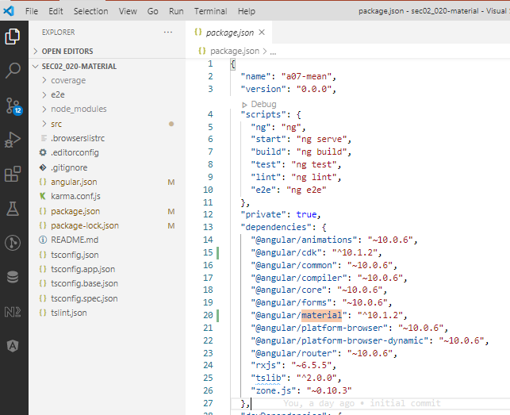
20 Material
https://www.udemy.com/course/angular-2-and-nodejs-the-practical-guide/learn/lecture/10416244#overview
Material
https://material.angular.io/
Check the dependencies: material and CDK.
Material is for Logic and Styling.
CDK is for the logic.

Slide 6
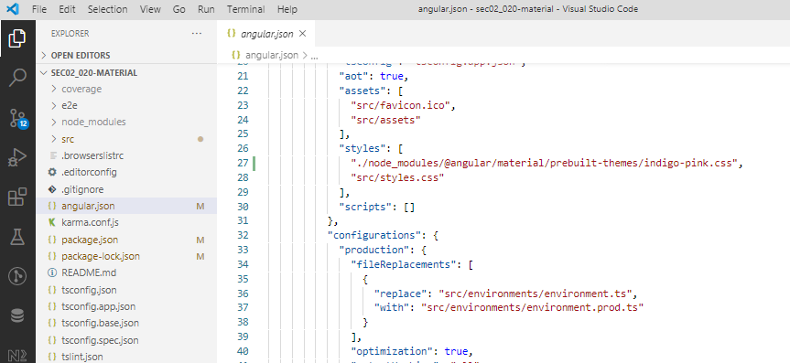
20 Material
https://www.udemy.com/course/angular-2-and-nodejs-the-practical-guide/learn/lecture/10416244#overview
Material
https://material.angular.io/
Angular default theme is indigo-pink.css.

Slide 7
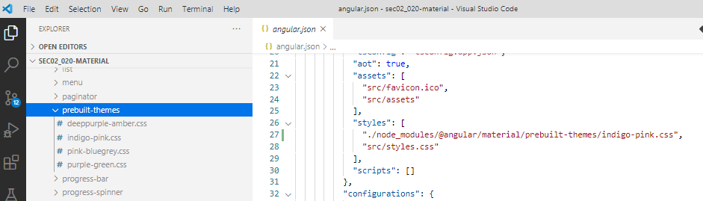
20 Material
https://www.udemy.com/course/angular-2-and-nodejs-the-practical-guide/learn/lecture/10416244#overview
Material
https://material.angular.io/
You can find all the themes in the node-modules/@angular/material/prebuilt-theme/indigon-pink, deeppurple-amber, pink-bluegrey, and purple-green.
We use default indigo-pink, we always can switch to other themes.

Slide 8
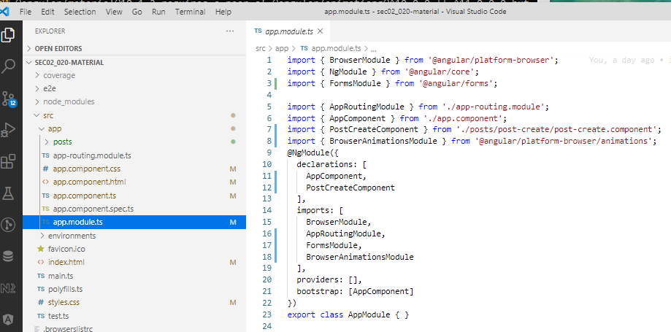
20 Material
https://www.udemy.com/course/angular-2-and-nodejs-the-practical-guide/learn/lecture/10416244#overview
Material
https://material.angular.io/
In the app.modules.ts, we can see “BrowserAnimationsModule” because some of material components require the Animation Module.

Slide 9
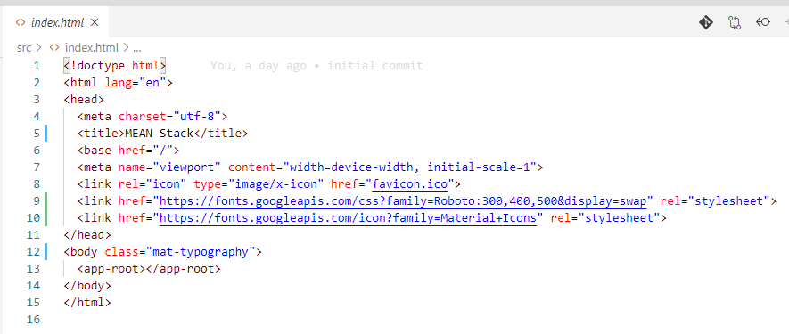
20 Material
https://www.udemy.com/course/angular-2-and-nodejs-the-practical-guide/learn/lecture/10416244#overview
Material
https://material.angular.io/
In the index.html file, you can see the material icon and Roboto for font.
Now, we can start to use material components.

Slide 10
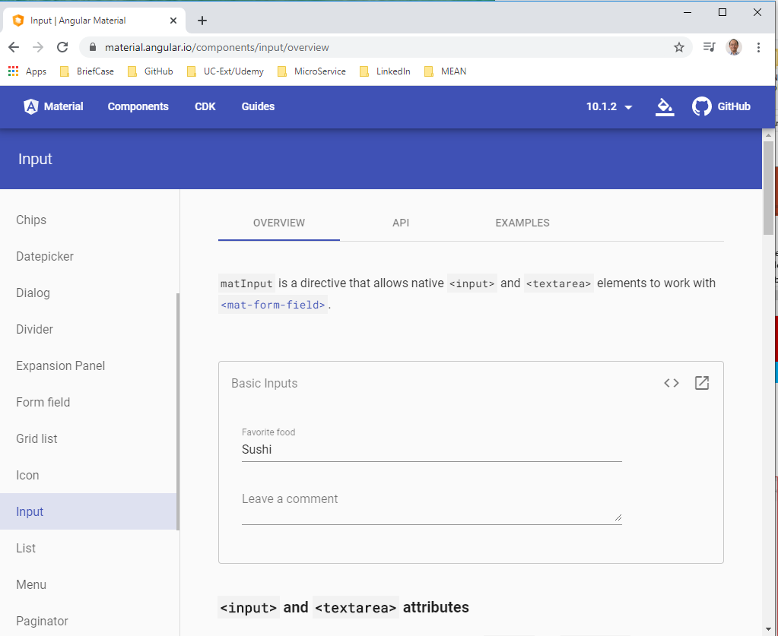
20 Material
https://www.udemy.com/course/angular-2-and-nodejs-the-practical-guide/learn/lecture/10416244#overview
Material
https://material.angular.io/
Look at the material input. We want the text area element.

Slide 11
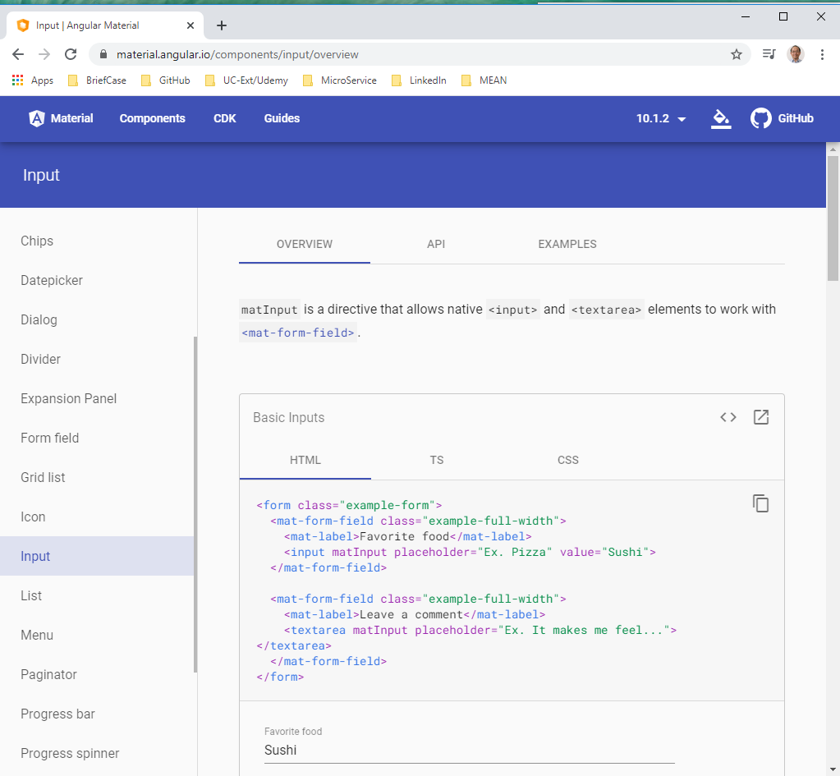
20 Material
https://www.udemy.com/course/angular-2-and-nodejs-the-practical-guide/learn/lecture/10416244#overview
Material
https://material.angular.io/
Click “<>” to view how to implement the text area.

Slide 12
20.1 Code

Slide 13
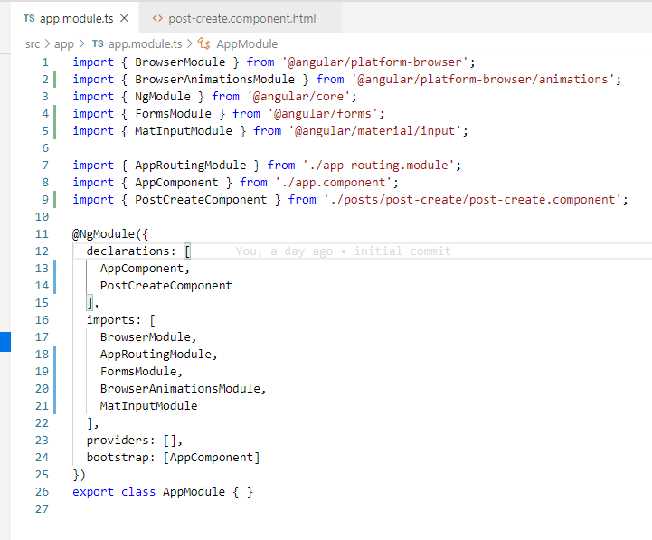
20.1 Code
https://www.udemy.com/course/angular-2-and-nodejs-the-practical-guide/learn/lecture/10416244#overview
Code
In app.module.ts, add “MatInputModule”

Slide 14
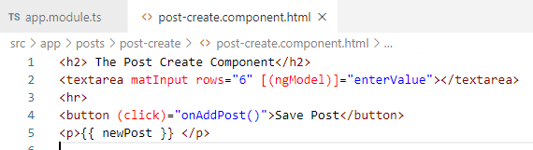
20.1 Code
https://www.udemy.com/course/angular-2-and-nodejs-the-practical-guide/learn/lecture/10416244#overview
Code
In post-create.component.ts, add attribute “matInput”

Slide 15
20.2 Verify

Slide 16
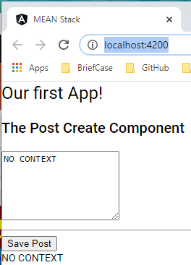
20.2 Verify
https://www.udemy.com/course/angular-2-and-nodejs-the-practical-guide/learn/lecture/10416244#overview
Verify

Slide 17
20.3 Code

Slide 18
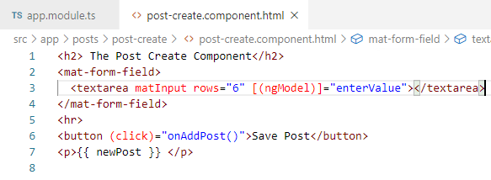
20.3 Code
https://www.udemy.com/course/angular-2-and-nodejs-the-practical-guide/learn/lecture/10416244#overview
Code
In post-create.component.ts, add <mat-form-field>

Slide 19
20.4 Verify

Slide 20
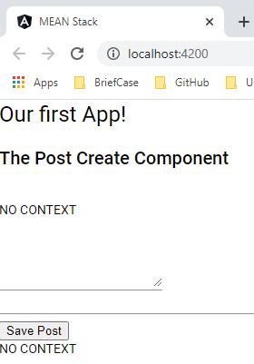
20.4 Verify
https://www.udemy.com/course/angular-2-and-nodejs-the-practical-guide/learn/lecture/10416244#overview
Verify

Slide 21
20.5 Code

Slide 22
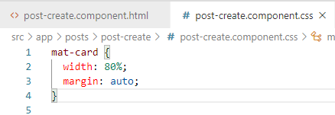
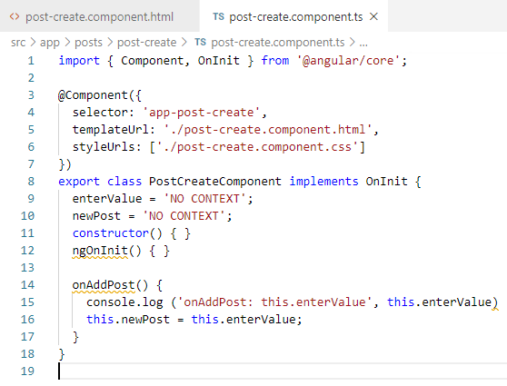
20.5 Code
https://www.udemy.com/course/angular-2-and-nodejs-the-practical-guide/learn/lecture/10416244#overview
Code
Add post-create.component.css

Slide 23
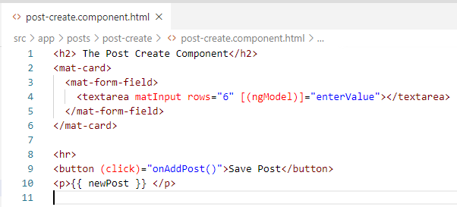
20.5 Code
https://www.udemy.com/course/angular-2-and-nodejs-the-practical-guide/learn/lecture/10416244#overview
Code
Add <mat-card> container.

Slide 24
20.6 Verify

Slide 25
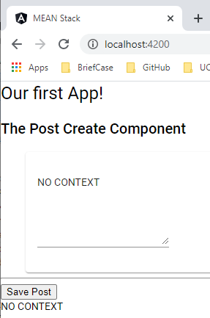
20.6 Verify
https://www.udemy.com/course/angular-2-and-nodejs-the-practical-guide/learn/lecture/10416244#overview
Verify

Slide 26
20.7 Code

Slide 27
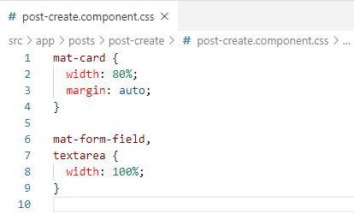
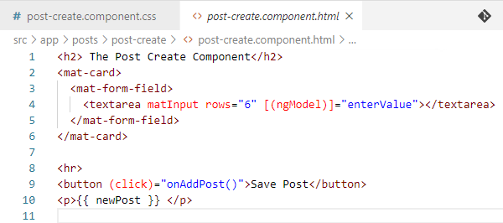
20.7 Code
https://www.udemy.com/course/angular-2-and-nodejs-the-practical-guide/learn/lecture/10416244#overview
Code
Enlarge the textarea

Slide 28
20.8 Verify

Slide 29
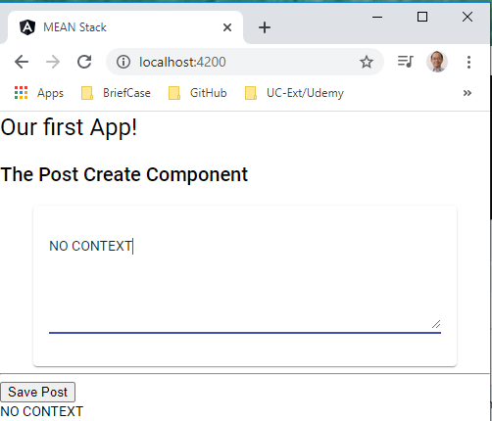
20.8 Verify
https://www.udemy.com/course/angular-2-and-nodejs-the-practical-guide/learn/lecture/10416244#overview
Verify

Slide 30
20.9 Code

Slide 31
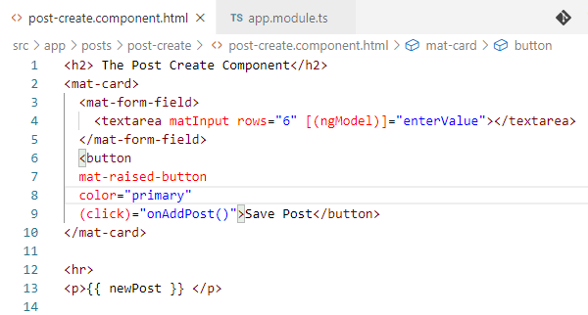
20.9 Code
https://www.udemy.com/course/angular-2-and-nodejs-the-practical-guide/learn/lecture/10416244#overview
Code
Put button inside the container
Color can be “primary”, “accent”, “warn”, and etc.

Slide 32
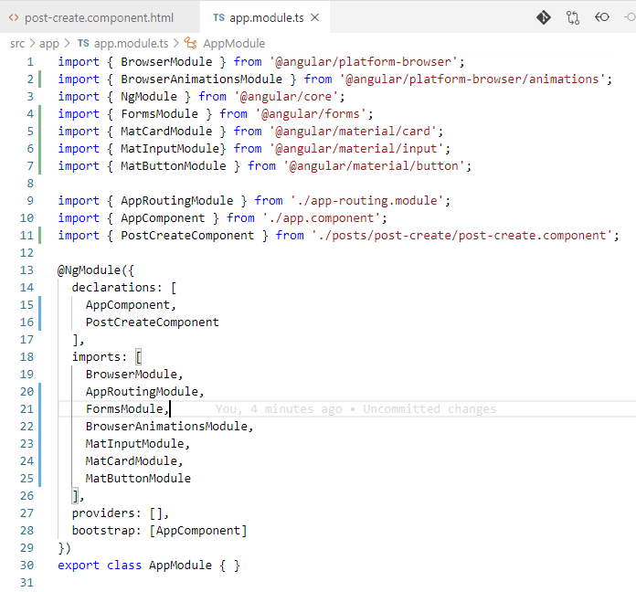
20.9 Code
https://www.udemy.com/course/angular-2-and-nodejs-the-practical-guide/learn/lecture/10416244#overview
Code
Add MatButtonModule

Slide 33
20.10 Verify

Slide 34
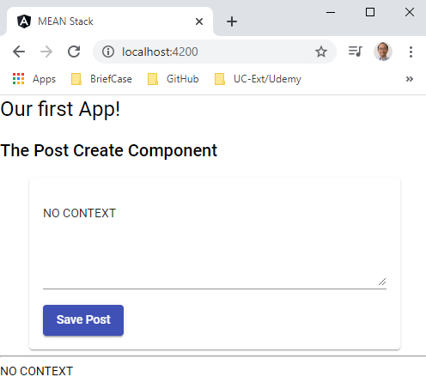
20.10 Verify
https://www.udemy.com/course/angular-2-and-nodejs-the-practical-guide/learn/lecture/10416244#overview
Verify

Slide 35
End of Chapter

