Slide 1

25 Create Post Model
Peter H. Chen

Slide 2



25 Create Post Model
https://www.udemy.com/course/angular-2-and-nodejs-the-practical-guide/learn/lecture/10416266#overview
Create Post Model
Ajax (Background)
Requests
Client (Browser)
Server
Responses
Data
(JSON Format)
Node, Express, MongoDB
Presentation /UI
Business Logic
Single Page is not necessary served by Node Backend, such as, AWS static host S3.
SPA (Single Page Application)
Persistent Data Storage
Authentication Logic

Slide 3
25 Create Post Model
https://www.udemy.com/course/angular-2-and-nodejs-the-practical-guide/learn/lecture/10416266#overview
Create Post Model
app.component.ts:
onPostAdded (post) {
this.storePosts.push(post)
}
app.component.html:
<app-post-create (postCreated)=“onPostAdded($event)”>
<app-post-list [posts]=“storePosts”>
post-create.component.ts:
@Output() postCreated
post = {tile: enterTile, content: enterContent}
this.postCreated.emit(post)
post-list.component.ts:
@Input() posts
post-create.component.html:
[(ngModel)] = “enterTile”
[(ngModel)] = “enterContent”
post-list.component.html:
*ngFor=“let … posts”

Slide 4
25.1 Code

Slide 5
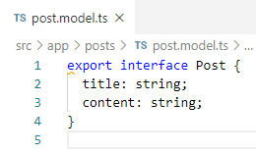
25.1 Code
https://www.udemy.com/course/angular-2-and-nodejs-the-practical-guide/learn/lecture/10416266#overview
Code
Interface is similar to class to hold the data type but interface cannot be instantiated.
Remember to add “export” before interface just like class.

Slide 6
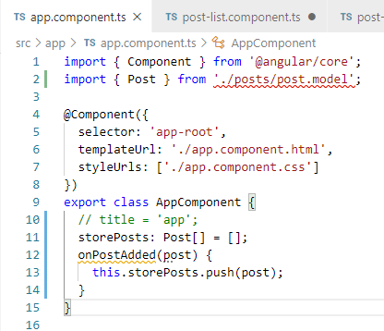
25.1 Code
https://www.udemy.com/course/angular-2-and-nodejs-the-practical-guide/learn/lecture/10416266#overview
Code

Slide 7
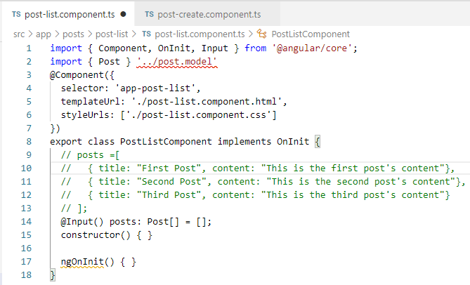
25.1 Code
https://www.udemy.com/course/angular-2-and-nodejs-the-practical-guide/learn/lecture/10416266#overview
Code

Slide 8
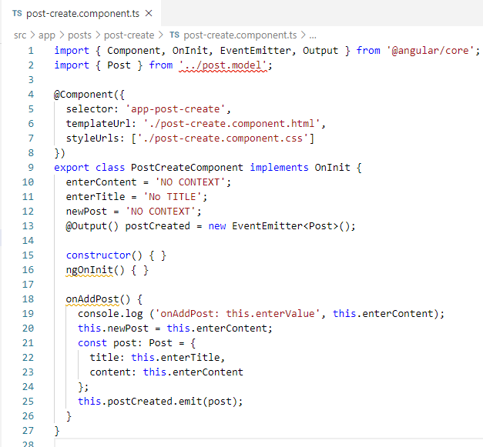
25.1 Code
https://www.udemy.com/course/angular-2-and-nodejs-the-practical-guide/learn/lecture/10416266#overview
Code

Slide 9
End of Chapter

