Slide 1

26 Add Forms
Peter H. Chen

Slide 2



26 Add Forms
https://www.udemy.com/course/angular-2-and-nodejs-the-practical-guide/learn/lecture/10416266#overview
Add Forms
Ajax (Background)
Requests
Client (Browser)
Server
Responses
Data
(JSON Format)
Node, Express, MongoDB
Presentation /UI
Business Logic
Single Page is not necessary served by Node Backend, such as, AWS static host S3.
SPA (Single Page Application)
Persistent Data Storage
Authentication Logic

Slide 3
26 Add Forms
https://www.udemy.com/course/angular-2-and-nodejs-the-practical-guide/learn/lecture/10416266#overview
Add Forms
There is nothing wrong with the two way binding.
Form provide the data validate and standard submit without two way bidning.
We can use form instead of two way binding for the element binding.
Forms let us easily to do the data validation.

Slide 4
26.1 Code

Slide 5
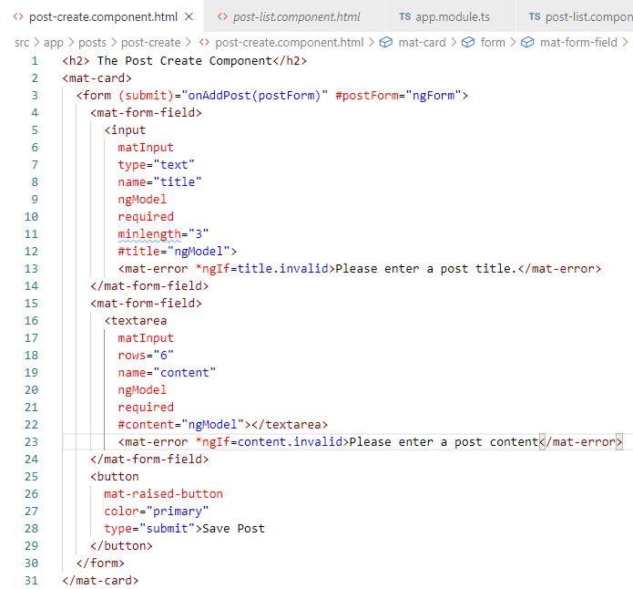
26.1 Code
https://www.udemy.com/course/angular-2-and-nodejs-the-practical-guide/learn/lecture/10416266#overview
Code

Slide 6
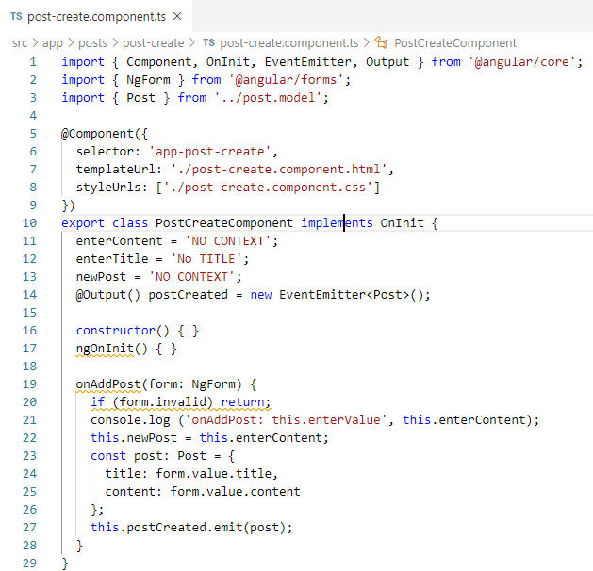
26.1 Code
https://www.udemy.com/course/angular-2-and-nodejs-the-practical-guide/learn/lecture/10416266#overview
Code

Slide 7
26.2 Verify

Slide 8
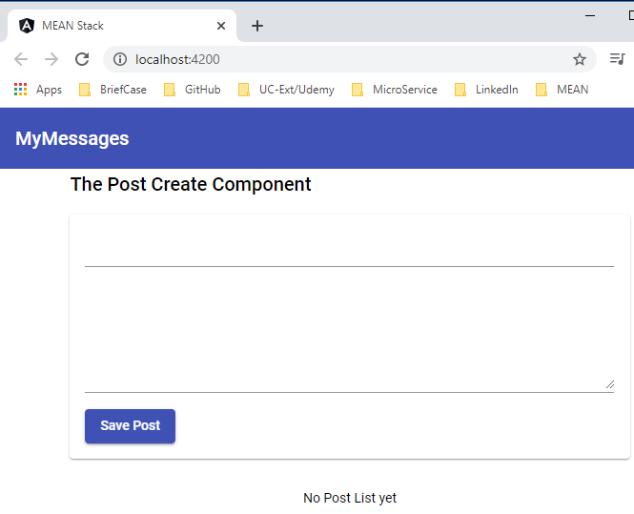
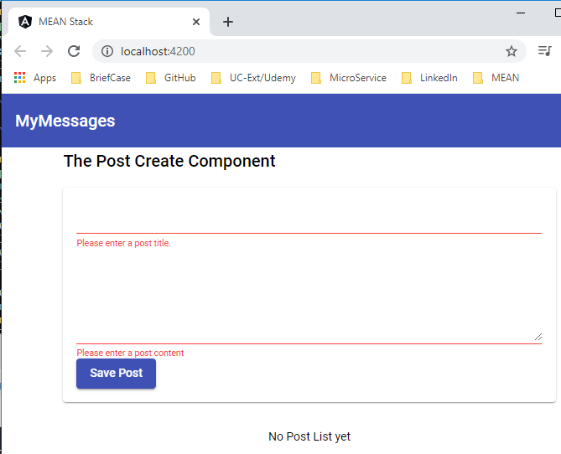
26.2 Verify
https://www.udemy.com/course/angular-2-and-nodejs-the-practical-guide/learn/lecture/10416266#overview
Verify
Validate no data enter.

Slide 9
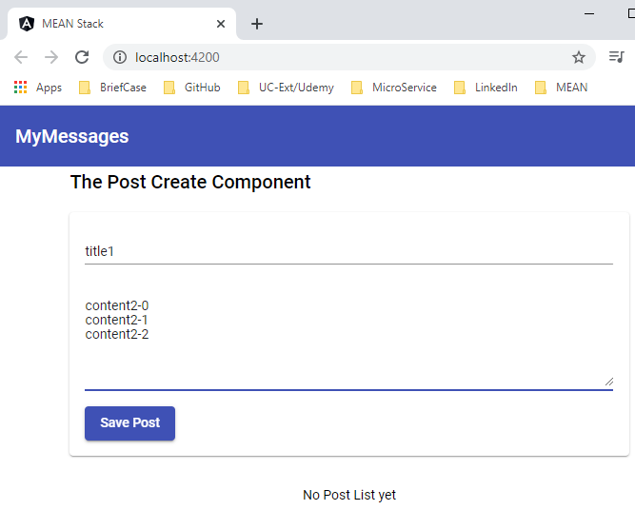
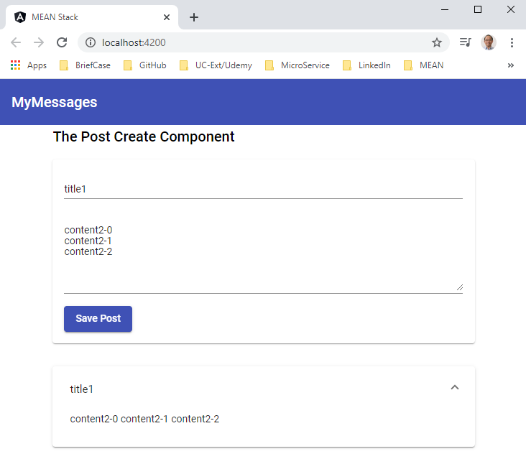
26.2 Verify
https://www.udemy.com/course/angular-2-and-nodejs-the-practical-guide/learn/lecture/10416266#overview
Verify
Enter Title and Content

Slide 10
End of Chapter

