Slide 1

3 Output to Browser
Peter H. Chen

Slide 2
3 Output to Browser
https://www.youtube.com/watch?v=mXdpCRgR-xE&list=PL0eyrZgxdwhwBToawjm9faF1ixePexft-&index=2
Output to Browser
Write HTML and PHP code in index.php.

Slide 3
3.1 Code

Slide 4
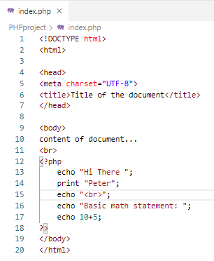
2.1 Code
https://www.youtube.com/watch?v=zlCwveRcyKQ&list=PL0eyrZgxdwhwBToawjm9faF1ixePexft-&index=3
Code
Add HTML and PHP Code.

Slide 5
3.2 Verify

Slide 6
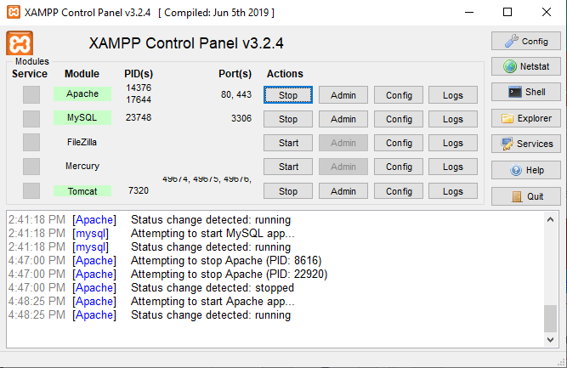
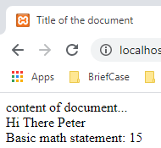
3.2 Verify
https://www.youtube.com/watch?v=zlCwveRcyKQ&list=PL0eyrZgxdwhwBToawjm9faF1ixePexft-&index=3
Verify
Start Apache and MySQL servers of XAMPP.
Open Chrome and type “localhost/PHPproject”.

Slide 7
End of Chapter

