Slide 1

21 Array
Peter H. Chen

Slide 2
21 Array
https://www.youtube.com/watch?v=QCwL0_wSSp4&list=PL0eyrZgxdwhwBToawjm9faF1ixePexft-&index=21
Array

Slide 3
21.1 Code

Slide 4
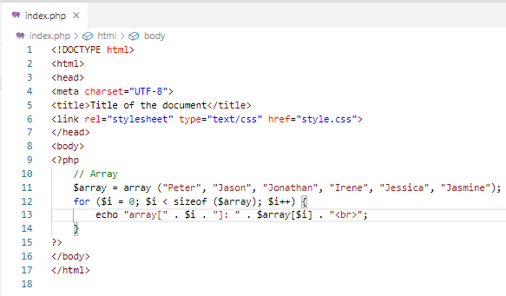
21.1 Code
https://www.youtube.com/watch?v=QCwL0_wSSp4&list=PL0eyrZgxdwhwBToawjm9faF1ixePexft-&index=21
Code

Slide 5
21.2 Verify

Slide 6
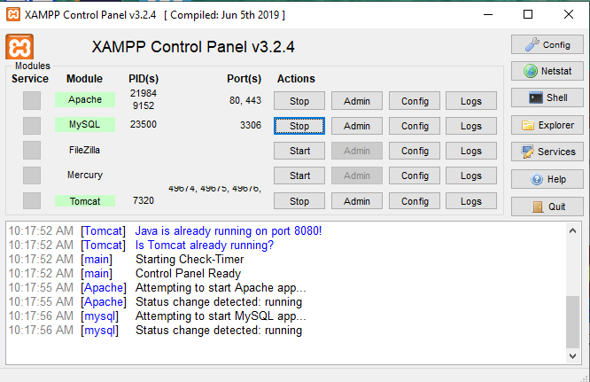
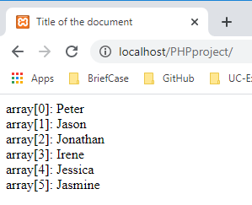
21.2 Verify
https://www.youtube.com/watch?v=QCwL0_wSSp4&list=PL0eyrZgxdwhwBToawjm9faF1ixePexft-&index=21
Verify:

Slide 7
End of Chapter

