Slide 1

30 Create Table in Database
Peter H. Chen

Slide 2
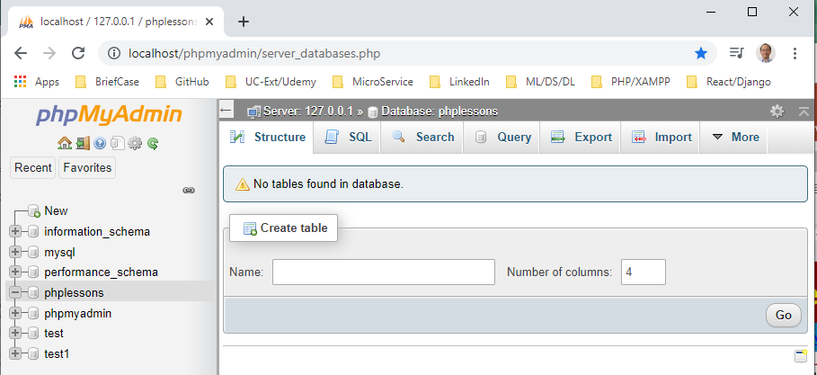
30 Create Table in Database
https://www.youtube.com/watch?v=9f_iSpieX6c&list=PL0eyrZgxdwhwBToawjm9faF1ixePexft-&index=30
Create Table in Database
We create database in the last discussion.
We will create table in this discussion.

Slide 3
30 Create Table in Database
https://www.youtube.com/watch?v=9f_iSpieX6c&list=PL0eyrZgxdwhwBToawjm9faF1ixePexft-&index=30
Create Table in Database
One table stores one type of data inside a web site.
This means that we may have one table for users.
We may have another table regarding a post inside a forum.
We may have many tables inside a single database.

Slide 4
30.1 Two Ways to Create Table

Slide 5
30.1 Two Ways to Create Table
https://www.youtube.com/watch?v=9f_iSpieX6c&list=PL0eyrZgxdwhwBToawjm9faF1ixePexft-&index=30
Two Ways to Create Table
There is a button “Create Table” inside the Database.
Inside the database, there are two ways to create the table: one is easy way and the other is hard way.
We use the hard way to create the table. We need to use the same way (the hard way) for our PHP code.

Slide 6
30.1 Two Ways to Create Table
https://www.youtube.com/watch?v=9f_iSpieX6c&list=PL0eyrZgxdwhwBToawjm9faF1ixePexft-&index=30
Two Ways to Create Table
For example, the id = 1, no other user can use this id = 1.
This mean, the table must have a primary id or primary key which cannot be identical to any other of rows.

Slide 7
30.1 Two Ways to Create Table
https://www.youtube.com/watch?v=9f_iSpieX6c&list=PL0eyrZgxdwhwBToawjm9faF1ixePexft-&index=30
Two Ways to Create Table
In the table, we have columns and rows.
The columns can be name, password, username, and etc.
The rows will be the data of each input of the columns.
One of the columns is the primary key that store the information to be identified to the row.

Slide 8
30.2 Easy Way to Create Table

Slide 9
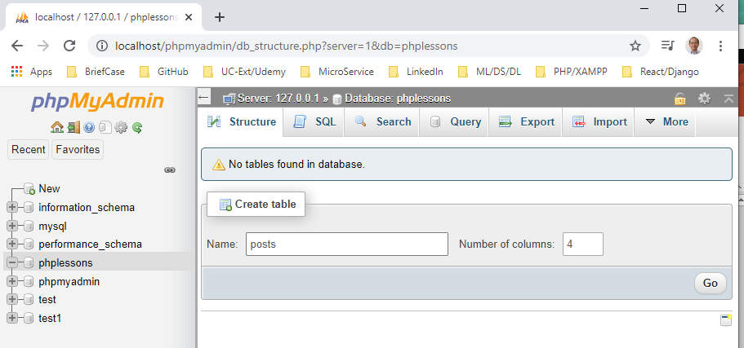
30.2 Easy Way to Create Table
https://www.youtube.com/watch?v=9f_iSpieX6c&list=PL0eyrZgxdwhwBToawjm9faF1ixePexft-&index=30
Easy Way to Create Table
Click the database “phplessons”.
The easy way to create table, we can just enter the table name (e.g., posts+, and decide how many columns (e.g., 4), and then click “Go” button.

Slide 10
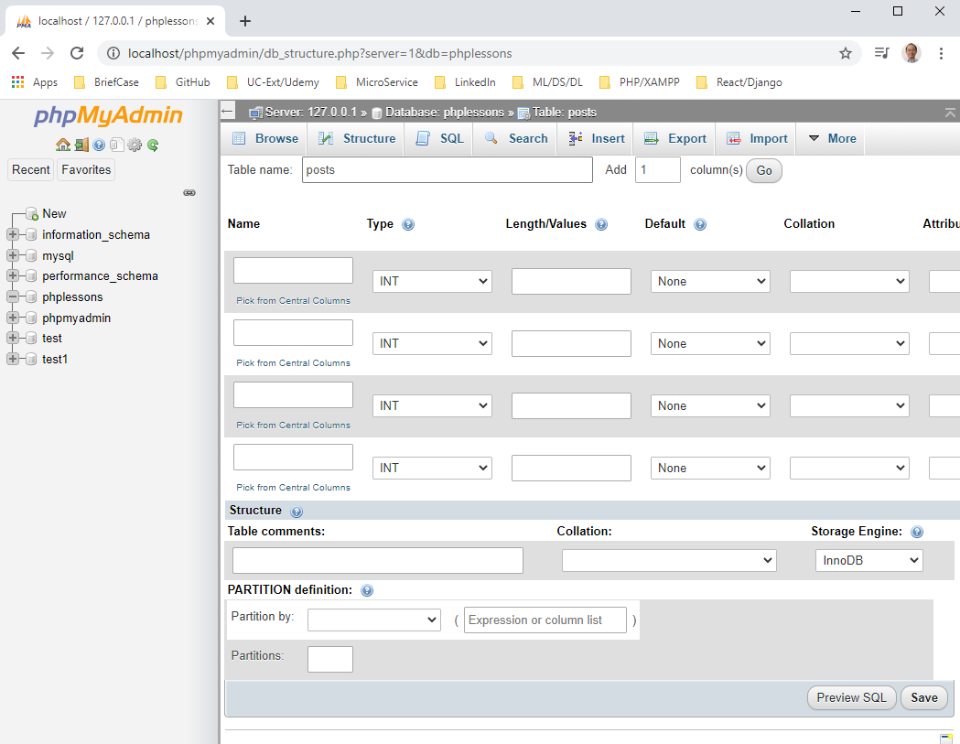
30.2 Easy Way to Create Table
https://www.youtube.com/watch?v=9f_iSpieX6c&list=PL0eyrZgxdwhwBToawjm9faF1ixePexft-&index=30
Easy Way to Create Table
We get serval columns

Slide 11
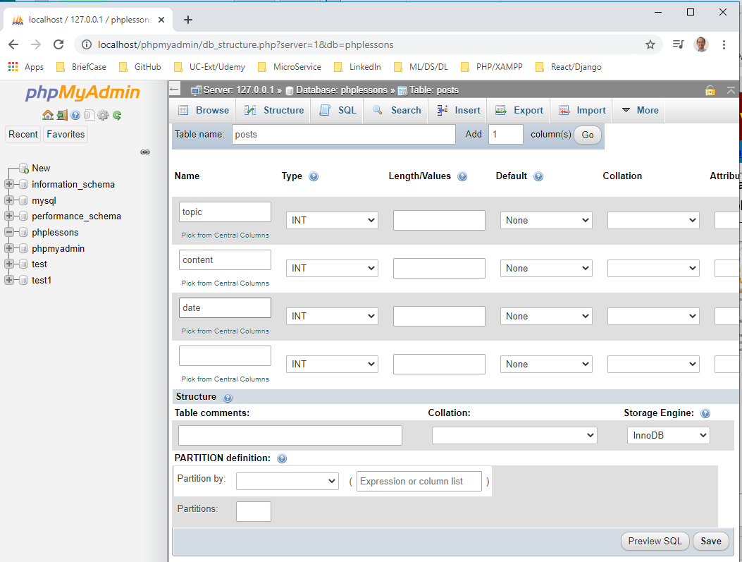
30.2 Easy Way to Create Table
https://www.youtube.com/watch?v=9f_iSpieX6c&list=PL0eyrZgxdwhwBToawjm9faF1ixePexft-&index=30
Easy Way to Create Table
We can type “topic”, “content”, and “date” for column titles.
Let’s go back the hard way to create a table.

Slide 12
30.3 Hard Way to Create Table

Slide 13
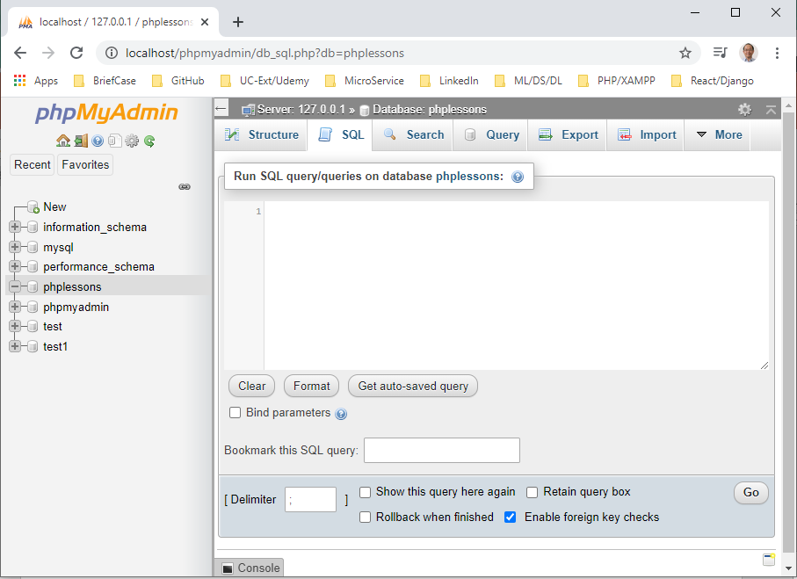
30.3 Hard Way to Create Table
https://www.youtube.com/watch?v=9f_iSpieX6c&list=PL0eyrZgxdwhwBToawjm9faF1ixePexft-&index=30
Hard Way to Create Table
Click the database “phplessons” and do not have the previous table “posts”.
Click “SQL” tab on the top menu.
In here, we can use SQL code to create database.
SQL Code is different type of coding language that deals with databases.
This is the code we need to know because these code will be using inside out PHP code as well which is the why we are going to do this hard way.

Slide 14
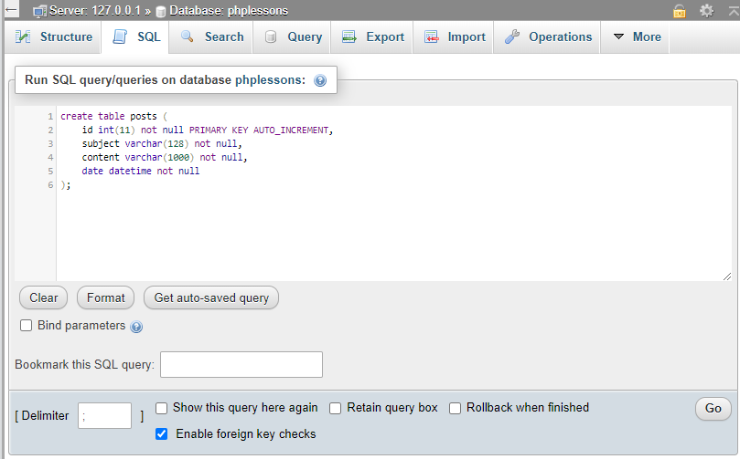
30.3 Hard Way to Create Table
https://www.youtube.com/watch?v=9f_iSpieX6c&list=PL0eyrZgxdwhwBToawjm9faF1ixePexft-&index=30
Hard Way to Create Table
Inside the textarea, we can write the SQL code as below.
> id is integer with length 11, not null, primary key, and auto increment.
> date is datetime and not null.

Slide 15
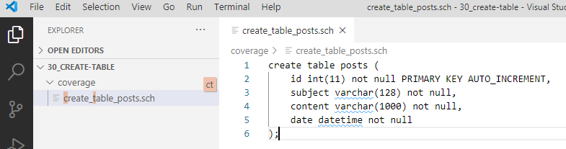
30.3 Hard Way to Create Table
https://www.youtube.com/watch?v=9f_iSpieX6c&list=PL0eyrZgxdwhwBToawjm9faF1ixePexft-&index=30
Hard Way to Create Table
Inside the textarea, we can write the SQL code as below.
Copy and paste to save to the file “create_table_posts.sch” for later use.

Slide 16
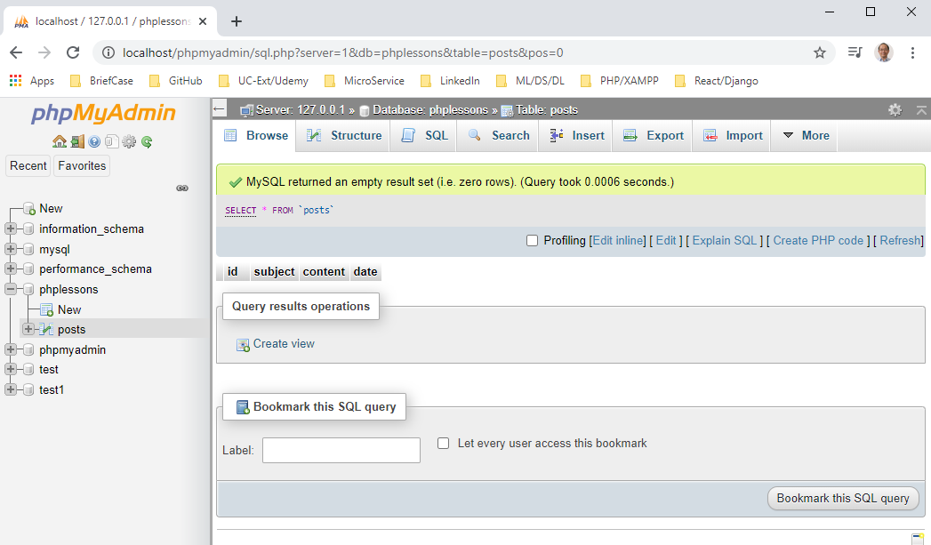
30.3 Hard Way to Create Table
https://www.youtube.com/watch?v=9f_iSpieX6c&list=PL0eyrZgxdwhwBToawjm9faF1ixePexft-&index=30
Hard Way to Create Table
Use “Go” button to check the syntax of the SQL code.

Slide 17
30.3 Hard Way to Create Table
https://www.youtube.com/watch?v=9f_iSpieX6c&list=PL0eyrZgxdwhwBToawjm9faF1ixePexft-&index=30
Hard Way to Create Table
The message “MySQL returned an empty result set (i.e., zero rows) (Query took 0.0006 seconds” which means there was no errors.

Slide 18
30.3 Hard Way to Create Table
https://www.youtube.com/watch?v=9f_iSpieX6c&list=PL0eyrZgxdwhwBToawjm9faF1ixePexft-&index=30
Hard Way to Create Table
After create this, we can actually go down and phplessons and see anther table called posts.

Slide 19
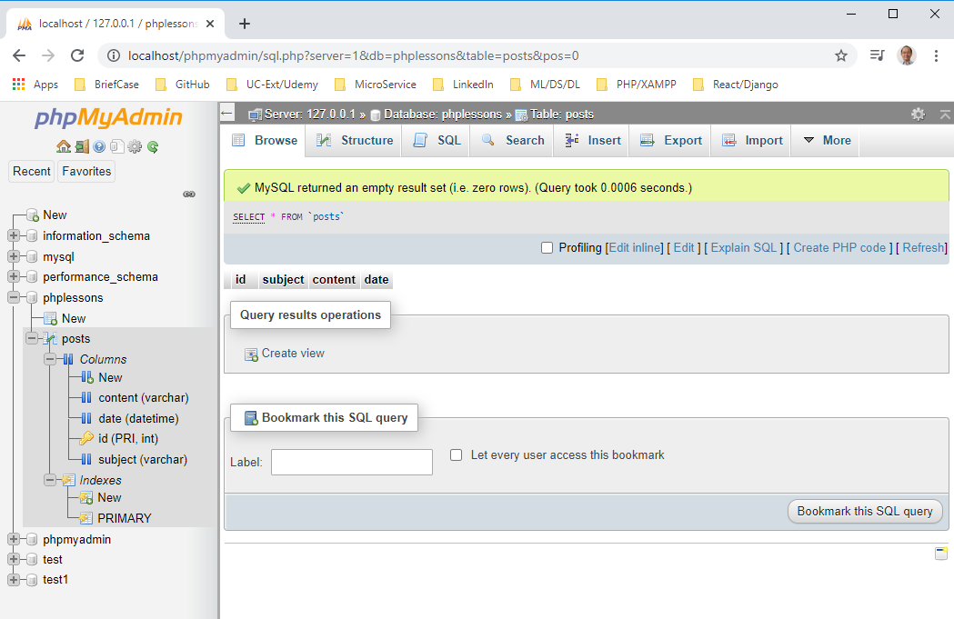
30.3 Hard Way to Create Table
https://www.youtube.com/watch?v=9f_iSpieX6c&list=PL0eyrZgxdwhwBToawjm9faF1ixePexft-&index=30
Hard Way to Create Table
Click the posts table to see inside.
We have nothing inside the table. We will fill in some data inside in the next discussion.

Slide 20
End of Chapter

