Slide 1

24 Local/Global Scope
Peter H. Chen

Slide 2
24 Local/Global Scope
https://www.youtube.com/watch?v=sBfSLbMnId0&list=PL0eyrZgxdwhwBToawjm9faF1ixePexft-&index=24
Local/Global Scope

Slide 3
24.1 Code

Slide 4
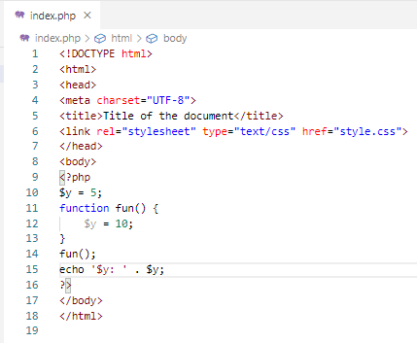
24.1 Code
https://www.youtube.com/watch?v=sBfSLbMnId0&list=PL0eyrZgxdwhwBToawjm9faF1ixePexft-&index=24
Code
Variable inside the local function scope will not vaisible outside the global scope.

Slide 5
24.2 Verify

Slide 6
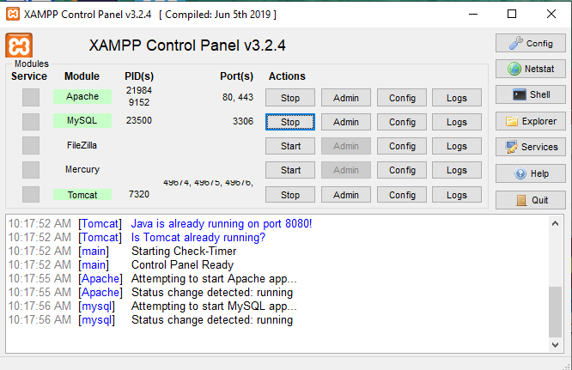
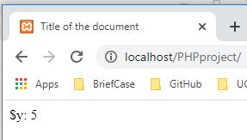
24.2 Verify
https://www.youtube.com/watch?v=sBfSLbMnId0&list=PL0eyrZgxdwhwBToawjm9faF1ixePexft-&index=24
Verify:

Slide 7
End of Chapter

