Slide 1

25 $GLOBALS
Peter H. Chen

Slide 2
25 $GLOBALS
https://www.youtube.com/watch?v=sBfSLbMnId0&list=PL0eyrZgxdwhwBToawjm9faF1ixePexft-&index=25
$GLOBALS

Slide 3
25.1 Code

Slide 4
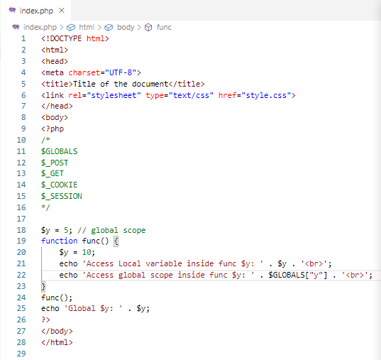
25.1 Code
https://www.youtube.com/watch?v=sBfSLbMnId0&list=PL0eyrZgxdwhwBToawjm9faF1ixePexft-&index=25
Code
How to access the global variable inside the local function?
Use $GLOBALS [‘$variable_name’] to access.

Slide 5
25.2 Verify

Slide 6
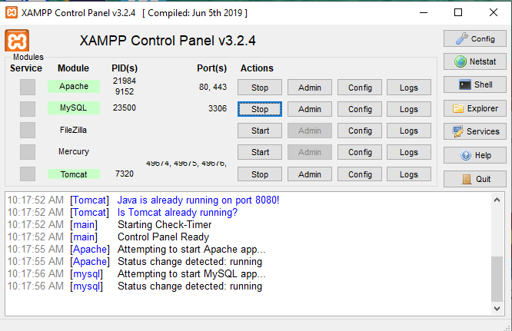
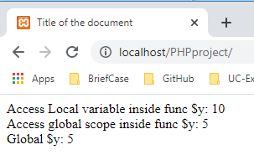
25.2 Verify
https://www.youtube.com/watch?v=sBfSLbMnId0&list=PL0eyrZgxdwhwBToawjm9faF1ixePexft-&index=25
Verify:

Slide 7
End of Chapter

