Slide 1

15 Calculator
Peter H. Chen

Slide 2
15 Calculator
https://www.youtube.com/watch?v=d6dnCQS8DCk&list=PL0eyrZgxdwhwBToawjm9faF1ixePexft-&index=15
Calculator

Slide 3
15.1 Code

Slide 4
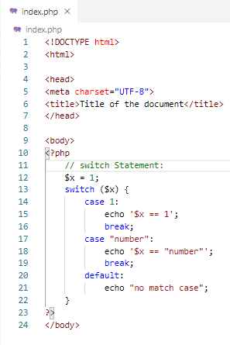
15.1 Code
https://www.youtube.com/watch?v=d6dnCQS8DCk&list=PL0eyrZgxdwhwBToawjm9faF1ixePexft-&index=15
Code

Slide 5
15.2 Verify

Slide 6
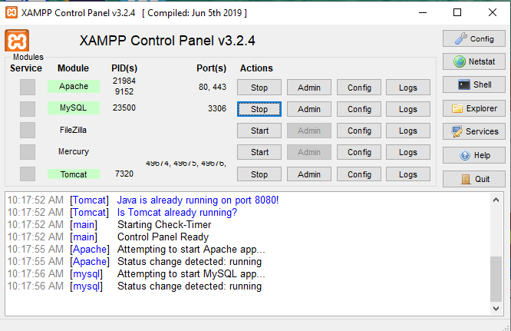
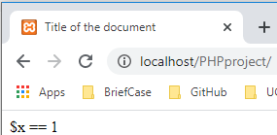
15.2 Verify
https://www.youtube.com/watch?v=d6dnCQS8DCk&list=PL0eyrZgxdwhwBToawjm9faF1ixePexft-&index=15
Verify

Slide 7
End of Chapter

