Slide 1

22 Function
Peter H. Chen

Slide 2
22 Function
https://www.youtube.com/watch?v=uOLGQ9ZoOSc&list=PL0eyrZgxdwhwBToawjm9faF1ixePexft-&index=22
Function

Slide 3
22.1 Code

Slide 4
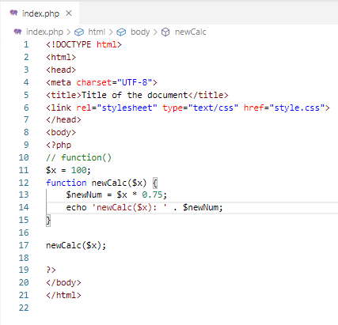
22.1 Code
https://www.youtube.com/watch?v=uOLGQ9ZoOSc&list=PL0eyrZgxdwhwBToawjm9faF1ixePexft-&index=22
Code

Slide 5
22.2 Verify

Slide 6
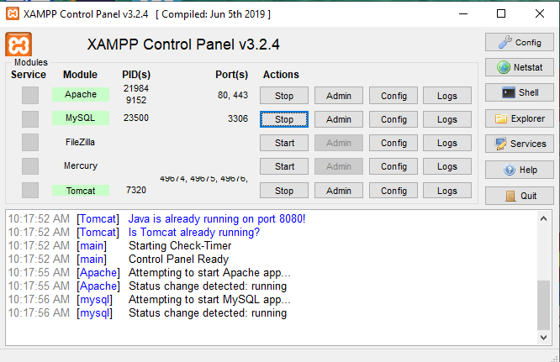
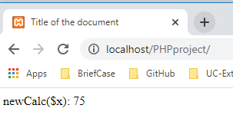
22.2 Verify
https://www.youtube.com/watch?v=uOLGQ9ZoOSc&list=PL0eyrZgxdwhwBToawjm9faF1ixePexft-&index=22
Verify:

Slide 7
End of Chapter

