Slide 1

17 While Loop
Peter H. Chen

Slide 2
17 While Loop
https://www.youtube.com/watch?v=ZFEAwdxH5xM&list=PL0eyrZgxdwhwBToawjm9faF1ixePexft-&index=17
While Loop

Slide 3
17.1 Code

Slide 4
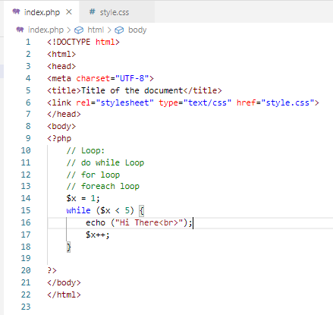
17.1 Code
https://www.youtube.com/watch?v=ZFEAwdxH5xM&list=PL0eyrZgxdwhwBToawjm9faF1ixePexft-&index=17
Code

Slide 5
17.2 Verify

Slide 6
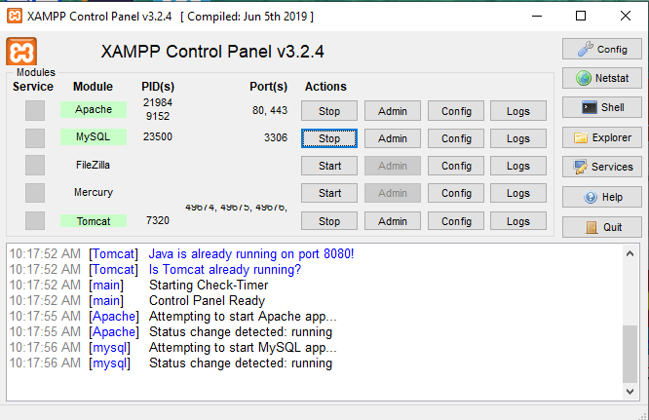
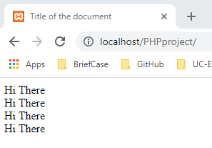
17.2 Verify
https://www.youtube.com/watch?v=ZFEAwdxH5xM&list=PL0eyrZgxdwhwBToawjm9faF1ixePexft-&index=17
Verify:

Slide 7
End of Chapter

