Slide 1

9 Assignmnent Operator
Peter H. Chen

Slide 2
9 Assignment Operator
https://www.youtube.com/watch?v=RcgUQ6U_HTI&list=PL0eyrZgxdwhwBToawjm9faF1ixePexft-&index=9
Assignment Operator
=, +=, -=, *=, /=, %=

Slide 3
3.1 Code

Slide 4
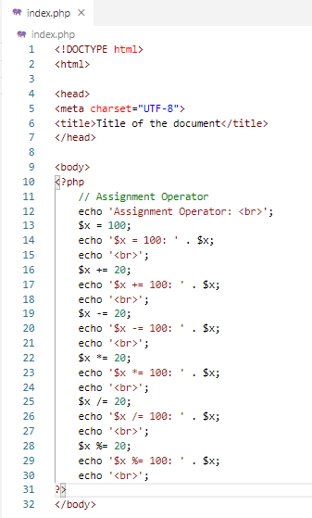
2.1 Code
https://www.youtube.com/watch?v=RcgUQ6U_HTI&list=PL0eyrZgxdwhwBToawjm9faF1ixePexft-&index=9
Code

Slide 5
3.2 Verify

Slide 6
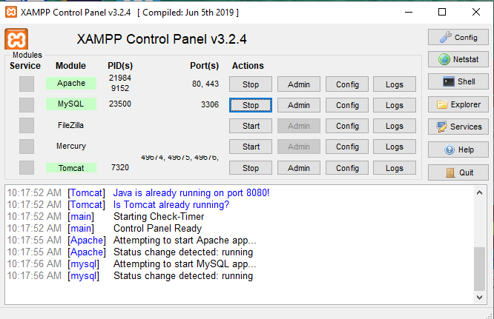
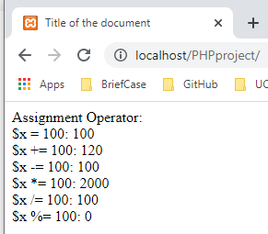
3.2 Verify
https://www.youtube.com/watch?v=RcgUQ6U_HTI&list=PL0eyrZgxdwhwBToawjm9faF1ixePexft-&index=9
Verify

Slide 7
End of Chapter

