Slide 1

18 Do While Loop
Peter H. Chen

Slide 2
18 Do While Loop
https://www.youtube.com/watch?v=BpHf4MqsoUg&list=PL0eyrZgxdwhwBToawjm9faF1ixePexft-&index=18
While Loop

Slide 3
18.1 Code

Slide 4
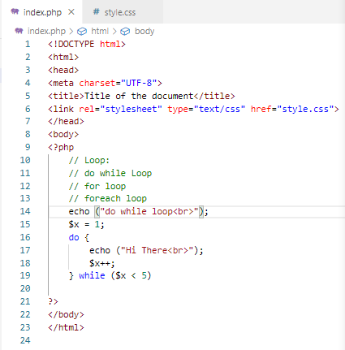
18.1 Code
https://www.youtube.com/watch?v=BpHf4MqsoUg&list=PL0eyrZgxdwhwBToawjm9faF1ixePexft-&index=18
Code

Slide 5
18.2 Verify

Slide 6
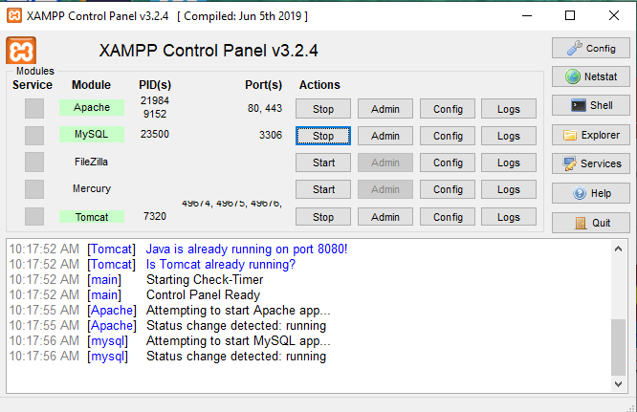
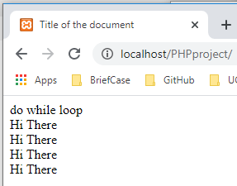
18.2 Verify
https://www.youtube.com/watch?v=BpHf4MqsoUg&list=PL0eyrZgxdwhwBToawjm9faF1ixePexft-&index=18
Verify:

Slide 7
End of Chapter

