Slide 1

10 Comparison Operator
Peter H. Chen

Slide 2
10 Comparison Operator
https://www.youtube.com/watch?v=wO5b8hcBTLM&list=PL0eyrZgxdwhwBToawjm9faF1ixePexft-&index=10
Comparison
We discuss comparison operator inside PHP.

Slide 3
3.1 Code

Slide 4
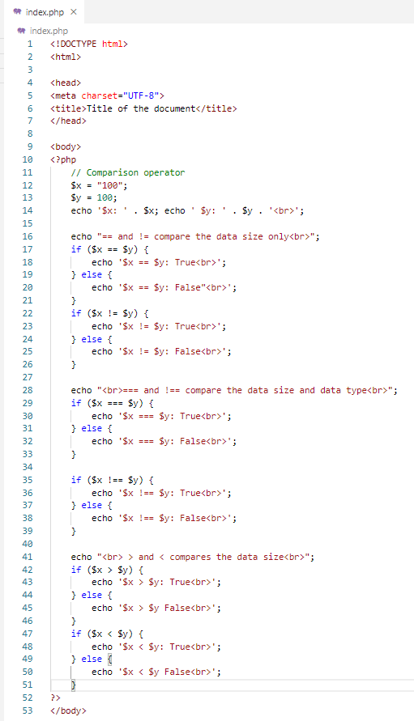
2.1 Code
https://www.youtube.com/watch?v=wO5b8hcBTLM&list=PL0eyrZgxdwhwBToawjm9faF1ixePexft-&index=10
Code

Slide 5
3.2 Verify

Slide 6
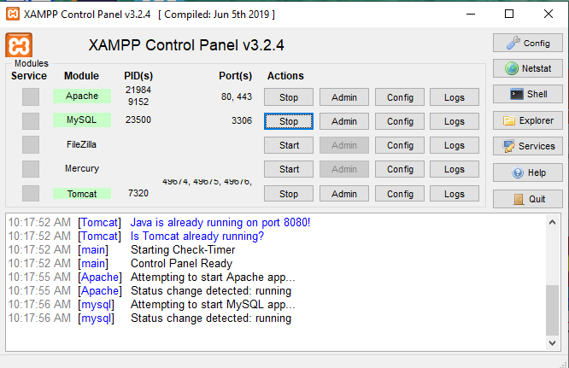
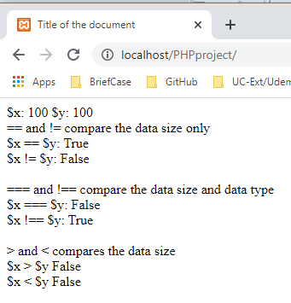
3.2 Verify
https://www.youtube.com/watch?v=wO5b8hcBTLM&list=PL0eyrZgxdwhwBToawjm9faF1ixePexft-&index=10
Verify

Slide 7
End of Chapter

