Slide 1

26 Super Global: $_GET and $_POST
Peter H. Chen

Slide 2
26 Super Global: $_GET and $_POST
https://www.youtube.com/watch?v=sBfSLbMnId0&list=PL0eyrZgxdwhwBToawjm9faF1ixePexft-&index=26
Super Global: $GET and $_POST
$_POST and $_GET are super global.
They are used to pass information from PHP into URL.
We can use information on another page.
<form method="GET“>.
The method GET tells out submit button what to do with the information.
Right now, the GET meaning that information is going to pass it into the URL and we can see the information inside a URL.
<form method="POST">
If we use to POST. The information pass to URL but we cannot see the information inside the URL.
Right now, we use "GET", we can see the name and value in the URL command line.

Slide 3
26.1 Code

Slide 4
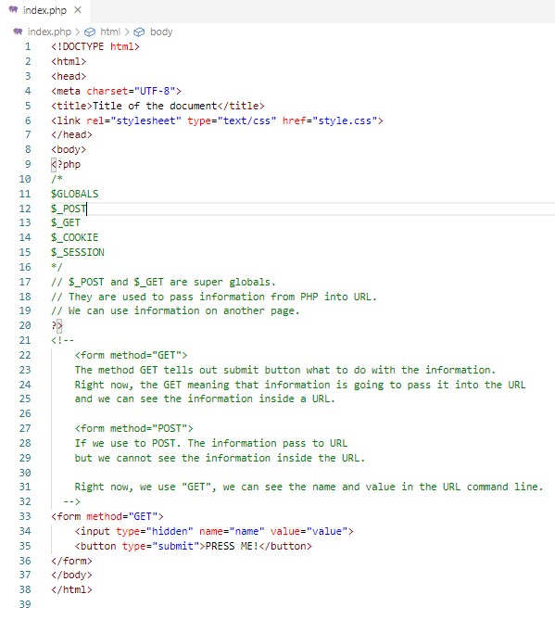
26.1 Code
https://www.youtube.com/watch?v=sBfSLbMnId0&list=PL0eyrZgxdwhwBToawjm9faF1ixePexft-&index=26
Code

Slide 5
26.2 Verify

Slide 6
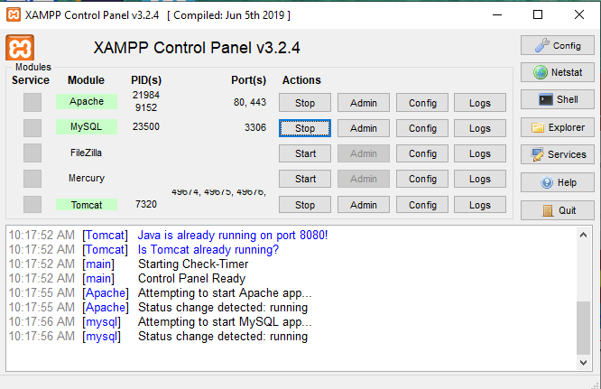
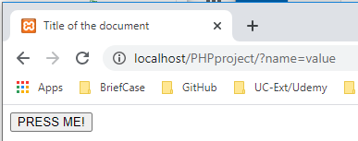
26.2 Verify
https://www.youtube.com/watch?v=sBfSLbMnId0&list=PL0eyrZgxdwhwBToawjm9faF1ixePexft-&index=26
Verify:
You can see information displayed in URL in super global $_GET.

Slide 7
26.3 Code: Change GET to POST

Slide 8
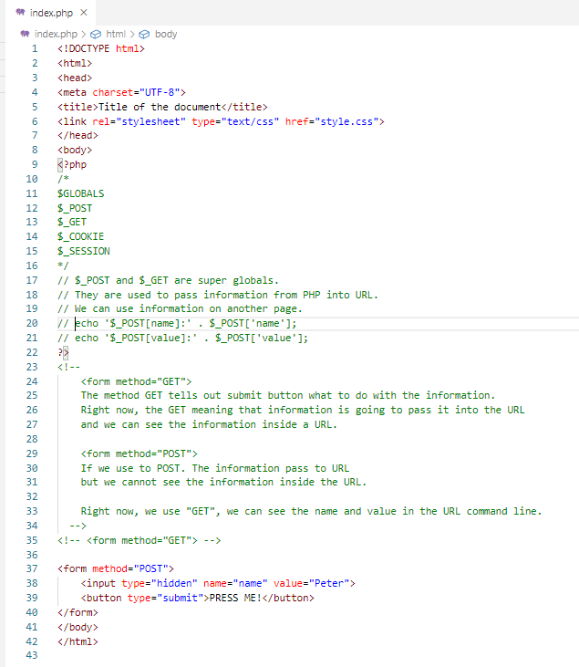
26.3 Code: Change GET to POST
https://www.youtube.com/watch?v=sBfSLbMnId0&list=PL0eyrZgxdwhwBToawjm9faF1ixePexft-&index=26
Code: Change to GET to POST

Slide 9
26.4 Verify

Slide 10
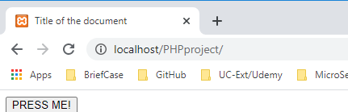
26.4 Verify
https://www.youtube.com/watch?v=sBfSLbMnId0&list=PL0eyrZgxdwhwBToawjm9faF1ixePexft-&index=26
Verify:
You cannot see any information in POST. This is used in Password or email.

Slide 11
26.5 Code: Add PHP Display

Slide 12
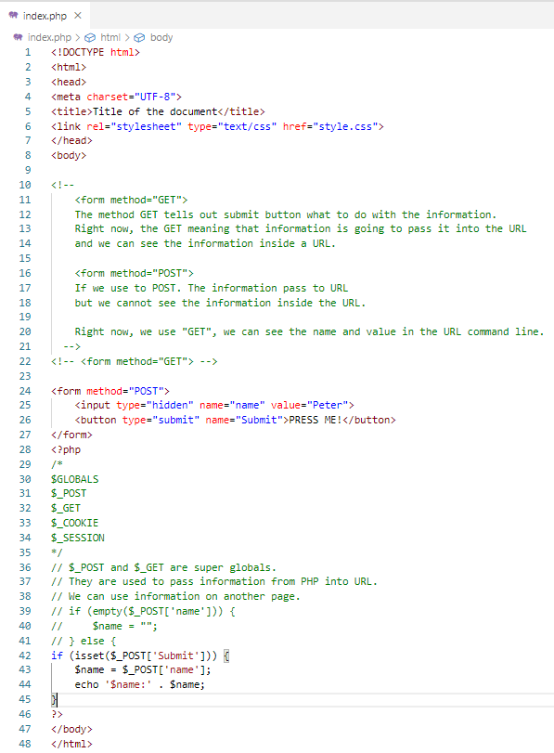
26.5 Code: Add PHP Display
https://www.youtube.com/watch?v=sBfSLbMnId0&list=PL0eyrZgxdwhwBToawjm9faF1ixePexft-&index=26
Code: Add PHP Display

Slide 13
26.6 Verify

Slide 14
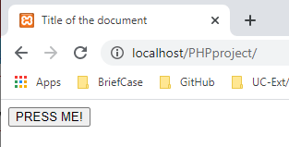
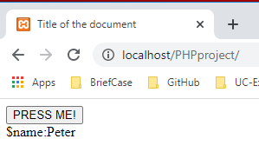
26.6 Verify
https://www.youtube.com/watch?v=sBfSLbMnId0&list=PL0eyrZgxdwhwBToawjm9faF1ixePexft-&index=26
Verify:
Default display is none. Click “PRESS ME” button display the $name: Peter

Slide 15
26.7 Code: Change to GET and Display

Slide 16
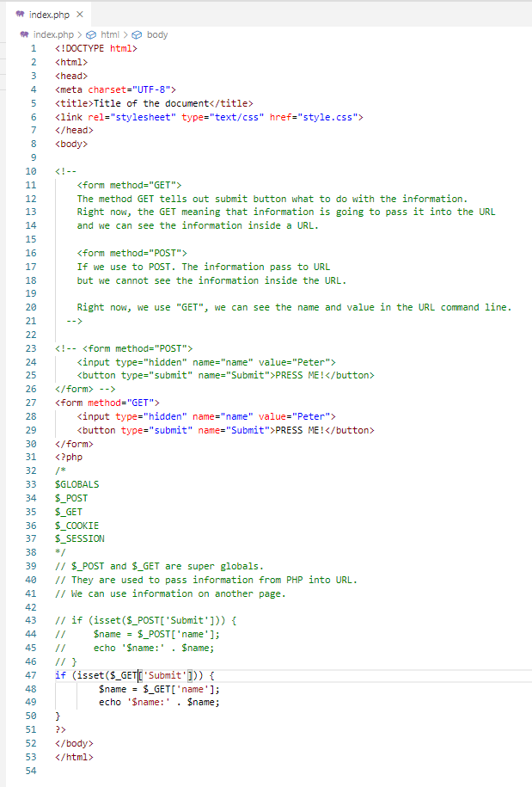
26.7 Code: Change to GET and Display
https://www.youtube.com/watch?v=sBfSLbMnId0&list=PL0eyrZgxdwhwBToawjm9faF1ixePexft-&index=26
Code: Add PHP Display

Slide 17
26.8 Verify

Slide 18
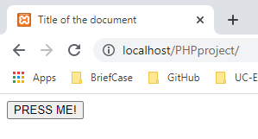
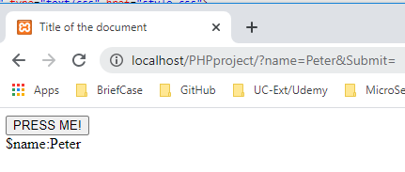
26.8 Verify
https://www.youtube.com/watch?v=sBfSLbMnId0&list=PL0eyrZgxdwhwBToawjm9faF1ixePexft-&index=26
Verify:
Should see both URL and display.

Slide 19
End of Chapter

