Slide 1

2 Setup Local Server
Peter H. Chen

Slide 2
2 Setup Local Server
https://www.youtube.com/watch?v=mXdpCRgR-xE&list=PL0eyrZgxdwhwBToawjm9faF1ixePexft-&index=2
Setup Local Server
PHP is a server side language. It will not work inside the browser without the server running.
Install a server on a computer is very easy and free.

Slide 3
2.1 Install Local Server

Slide 4
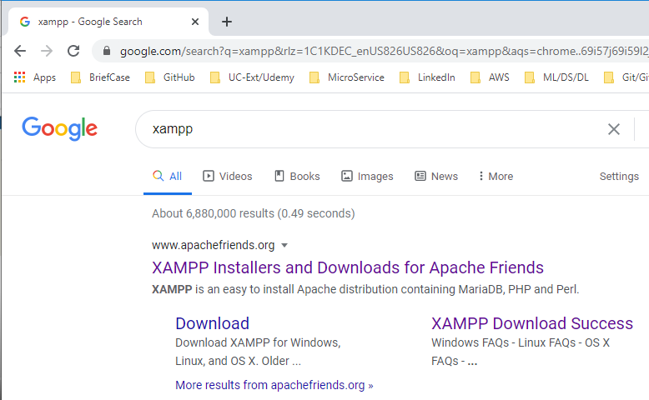
2.1 Install Local Server
https://www.youtube.com/watch?v=mXdpCRgR-xE&list=PL0eyrZgxdwhwBToawjm9faF1ixePexft-&index=2
Install Local Server
We need to download the software XAMPP. XAMPP is available for Windows, Linux, and Mac.
Open Chrome and search for “XAMPP”

Slide 5
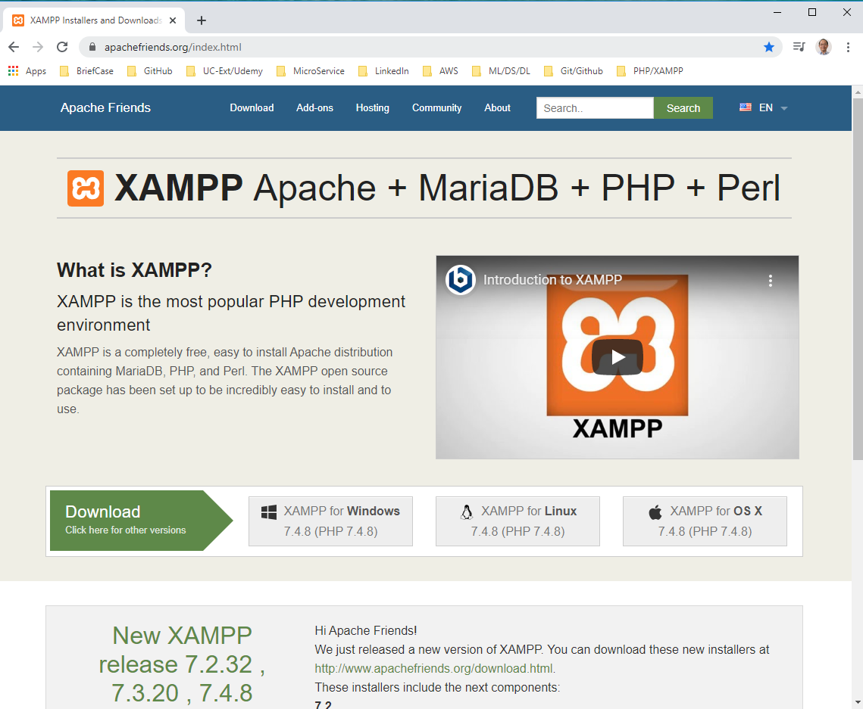
2.1 Install Local Server
https://www.youtube.com/watch?v=mXdpCRgR-xE&list=PL0eyrZgxdwhwBToawjm9faF1ixePexft-&index=2
Install Local Server
Download and install. XAMPP includes Apache, MySQL, PHP, and Perl.

Slide 6
2.2 Start Local Server

Slide 7
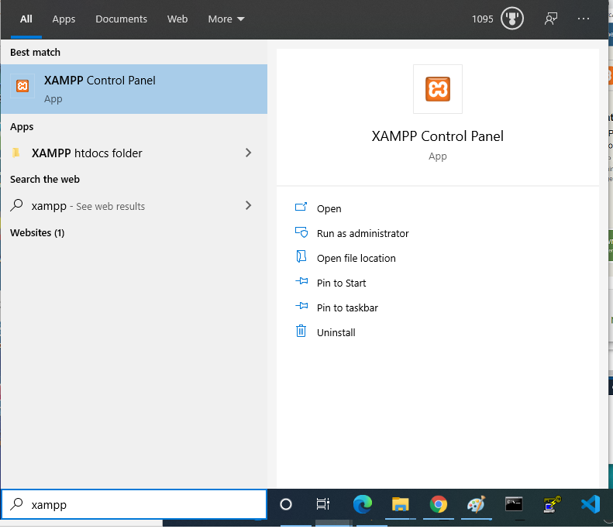
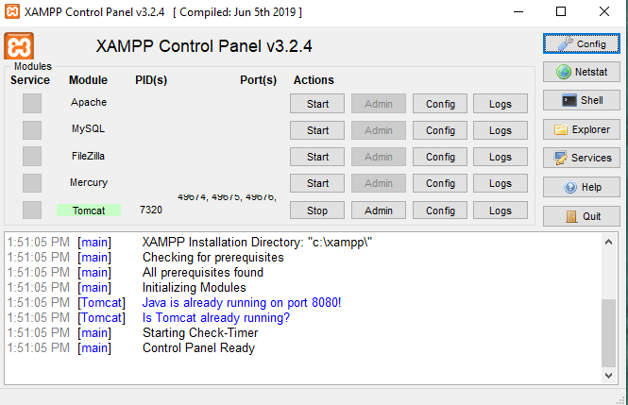
2.2 Start Local Server
https://www.youtube.com/watch?v=mXdpCRgR-xE&list=PL0eyrZgxdwhwBToawjm9faF1ixePexft-&index=2
Start Local Server
After installed, we can search “XAMPP”

Slide 8
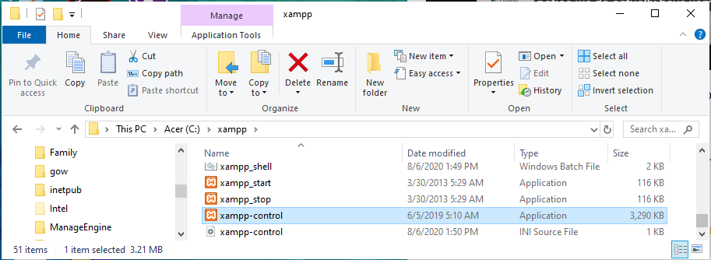
2.2 Start Local Server
https://www.youtube.com/watch?v=mXdpCRgR-xE&list=PL0eyrZgxdwhwBToawjm9faF1ixePexft-&index=2
Start Local Server
You also can double click “xmapp-control” in “C:\xmapp” as below.

Slide 9
2.2 Start Local Server
https://www.youtube.com/watch?v=mXdpCRgR-xE&list=PL0eyrZgxdwhwBToawjm9faF1ixePexft-&index=2
Start Local Server
Below is the xampp control panel which you use to run your server

Slide 10
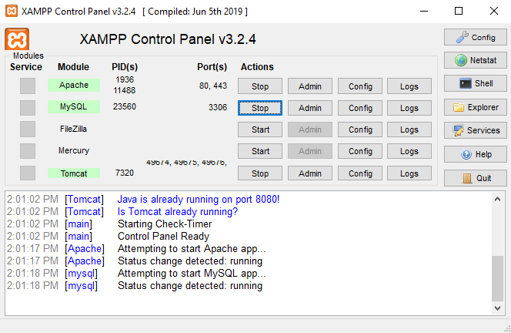
2.2 Start Local Server
https://www.youtube.com/watch?v=mXdpCRgR-xE&list=PL0eyrZgxdwhwBToawjm9faF1ixePexft-&index=2
Start Local Server
Click start of Apache and MySQL to start the Apache and MYSQL server.

Slide 11
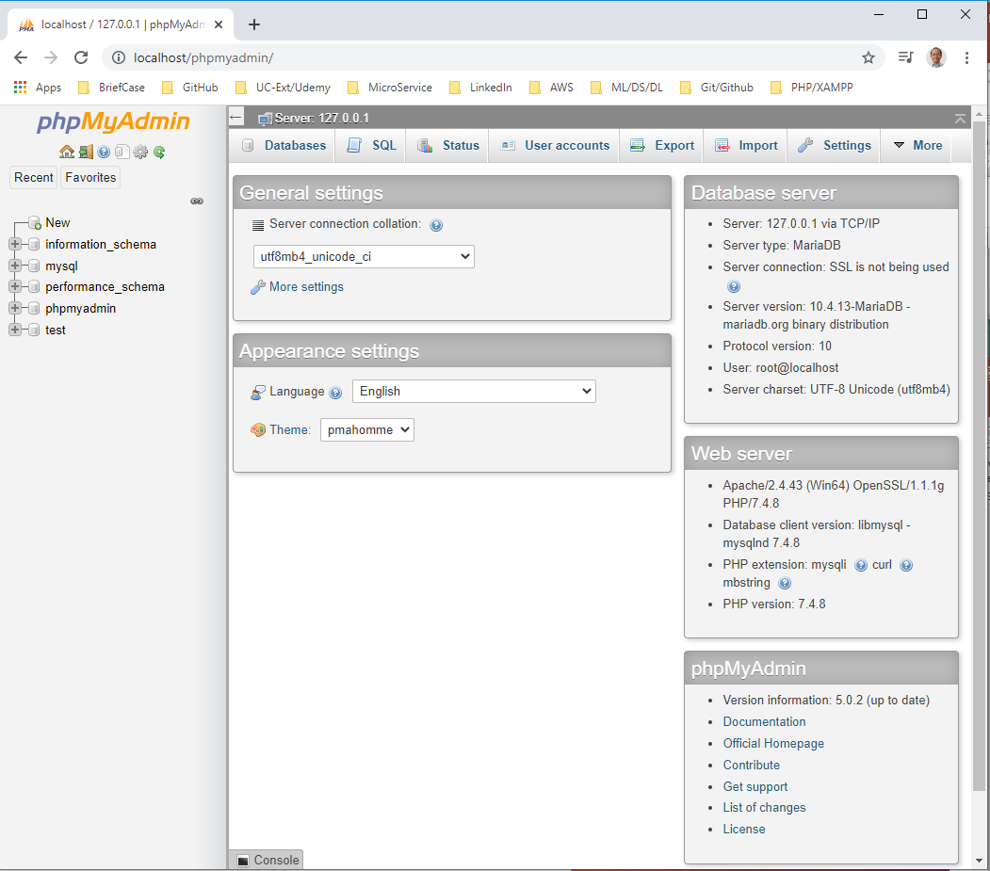
2 Setup Local Server
https://www.youtube.com/watch?v=mXdpCRgR-xE&list=PL0eyrZgxdwhwBToawjm9faF1ixePexft-&index=2
Setup Local Server
Open Chrome and type “localhost/phpmyadmin”.
We can see database server and Web server.

Slide 12
2.3 Database Server

Slide 13
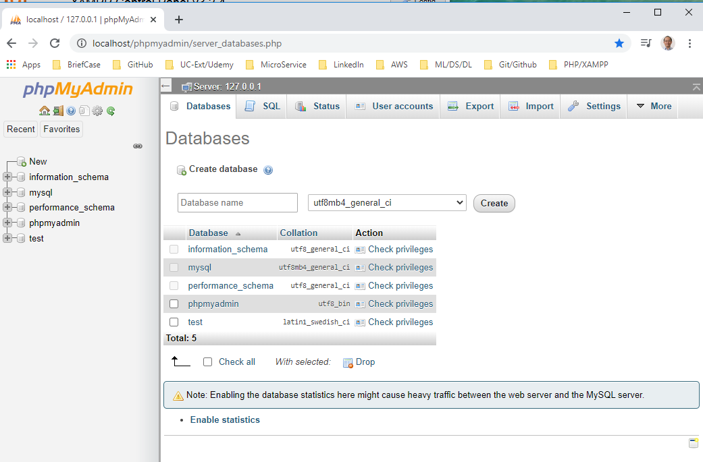
2.3 Database Server
https://www.youtube.com/watch?v=mXdpCRgR-xE&list=PL0eyrZgxdwhwBToawjm9faF1ixePexft-&index=2
Database Server
Click “Databases”

Slide 14
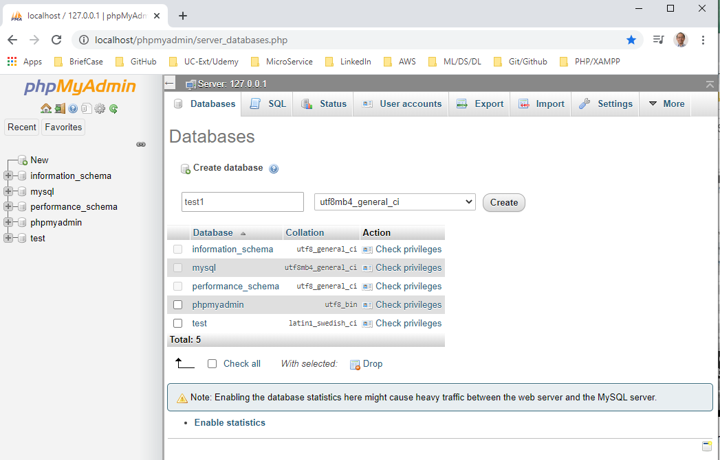
2.3 Database Server
https://www.youtube.com/watch?v=mXdpCRgR-xE&list=PL0eyrZgxdwhwBToawjm9faF1ixePexft-&index=2
Database Server
Create database: “test1” and click “Create”

Slide 15
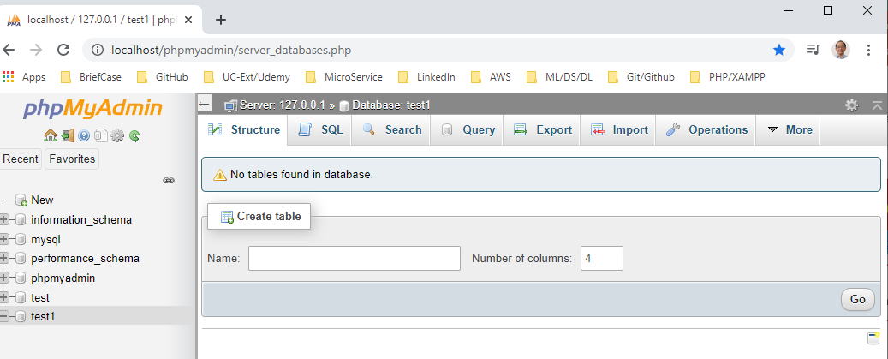
2.3 Database Server
https://www.youtube.com/watch?v=mXdpCRgR-xE&list=PL0eyrZgxdwhwBToawjm9faF1ixePexft-&index=2
Database Server
Create database: “test1” and click “Create”.
We do not have to touch the phpMyAdmin.
We just need to run XAMPP and then write and run the PHP code.

Slide 16
2.4 Create PHPproject

Slide 17
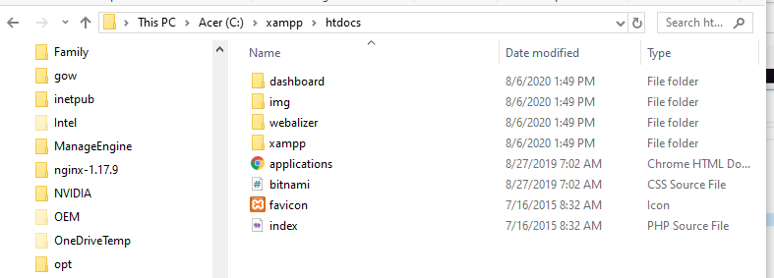
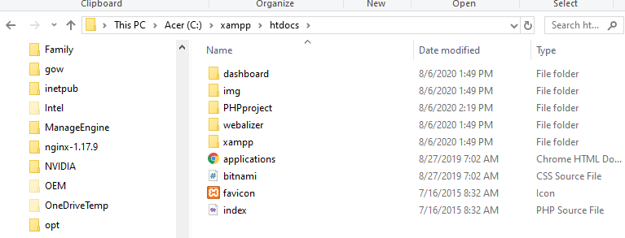
2.4 htdocs
https://www.youtube.com/watch?v=mXdpCRgR-xE&list=PL0eyrZgxdwhwBToawjm9faF1ixePexft-&index=2
htdocs
Inside the XAMPP folder, we look the htdocs.
There are some folders already created by XAMPP.
We need to create folder for our project. We create folder called “PHPproject”

Slide 18
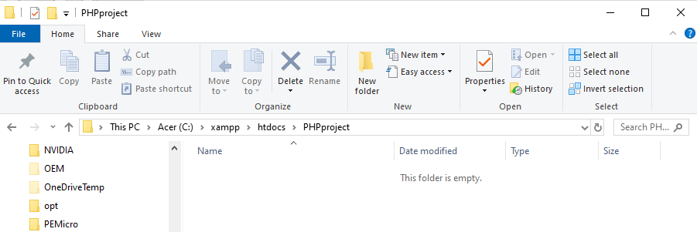
2.4 Create PHPproject
https://www.youtube.com/watch?v=mXdpCRgR-xE&list=PL0eyrZgxdwhwBToawjm9faF1ixePexft-&index=2
htdocs
We will write all the PHP code under the “C:\xampp\htdocs\PHPproject” folder

Slide 19
2.5 Verify

Slide 20
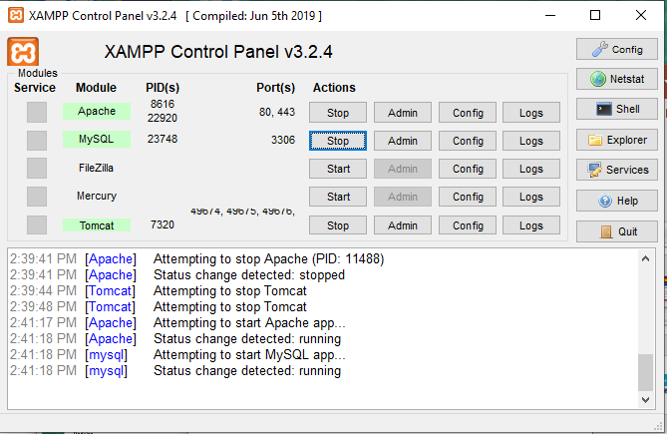
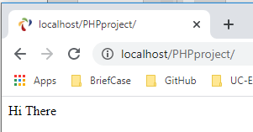
2.5 Verify
https://www.youtube.com/watch?v=mXdpCRgR-xE&list=PL0eyrZgxdwhwBToawjm9faF1ixePexft-&index=2
Verify
With the Apache and MySQL server running, open Chrome.
Type “localhost/PHPproject”

Slide 21
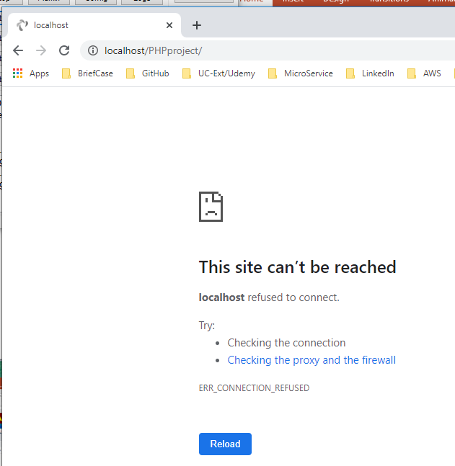
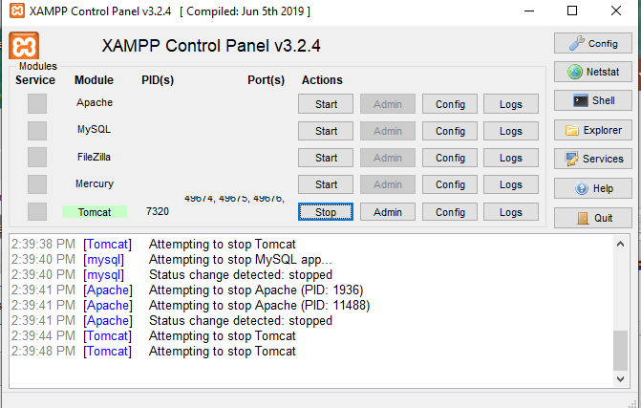
2.5 Verify
https://www.youtube.com/watch?v=mXdpCRgR-xE&list=PL0eyrZgxdwhwBToawjm9faF1ixePexft-&index=2
Verify
Stop the server Apache and MySQL.
Refresh the chrome.

Slide 22
2.5 Verify
https://www.youtube.com/watch?v=mXdpCRgR-xE&list=PL0eyrZgxdwhwBToawjm9faF1ixePexft-&index=2
Verify
Restart the Apache and MySQL server.
Refresh the Chrome with “localhost/PHPproject”

Slide 23
End of Chapter

