Slide 1

8 Arithmetic Operator
Peter H. Chen

Slide 2
8 Arithmetic Operator
https://www.youtube.com/watch?v=-nQHIE0LIDE&list=PL0eyrZgxdwhwBToawjm9faF1ixePexft-&index=8
Arithmetic Operation
+, -, *, /, %, **

Slide 3
3.1 Code

Slide 4
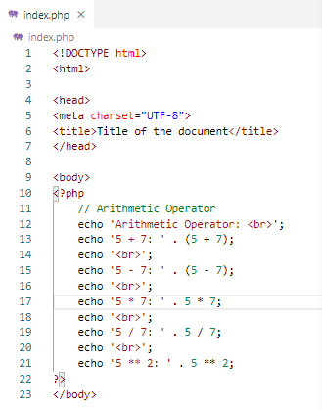
2.1 Code
https://www.youtube.com/watch?v=-nQHIE0LIDE&list=PL0eyrZgxdwhwBToawjm9faF1ixePexft-&index=8
Code

Slide 5
3.2 Verify

Slide 6
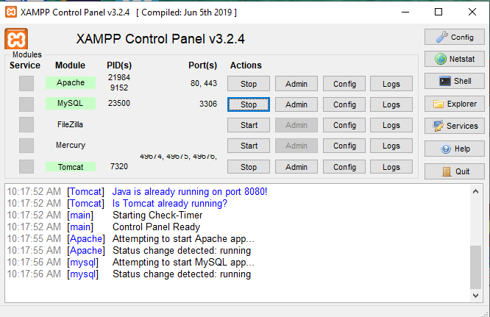
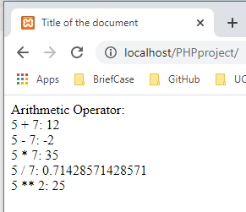
3.2 Verify
https://www.youtube.com/watch?v=-nQHIE0LIDE&list=PL0eyrZgxdwhwBToawjm9faF1ixePexft-&index=8
Verify

Slide 7
End of Chapter

