Slide 1

19 For Loop
Peter H. Chen

Slide 2
19 For Loop
https://www.youtube.com/watch?v=A2l7D6i5bRY&list=PL0eyrZgxdwhwBToawjm9faF1ixePexft-&index=19
For Loop

Slide 3
19.1 Code

Slide 4
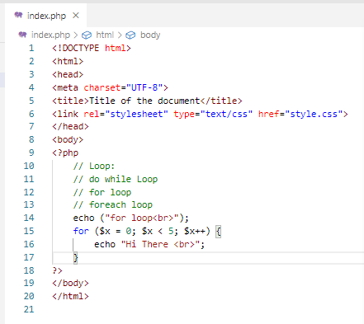
19.1 Code
https://www.youtube.com/watch?v=A2l7D6i5bRY&list=PL0eyrZgxdwhwBToawjm9faF1ixePexft-&index=19
Code

Slide 5
19.2 Verify

Slide 6
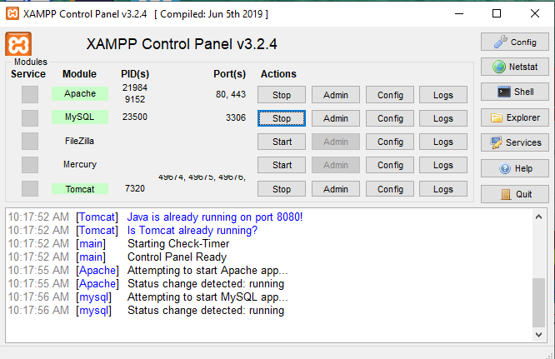
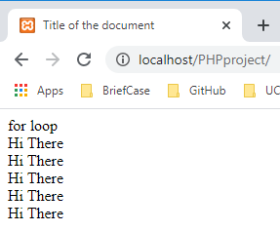
19.2 Verify
https://www.youtube.com/watch?v=A2l7D6i5bRY&list=PL0eyrZgxdwhwBToawjm9faF1ixePexft-&index=19
Verify:

Slide 7
End of Chapter

