Slide 1

29 Create Database
Peter H. Chen

Slide 2
29 Create Database
https://www.youtube.com/watch?v=u10xZgNpfCQ&list=PL0eyrZgxdwhwBToawjm9faF1ixePexft-&index=29
Create Database
We discuss what is database.
We will use database inside the web site.
Inside the web site, we need to save information.
We need to signup a system where people can go and create a user account.
Now, in order to create a user account, they need to go in and type in the first name, last name, user name, password, and etc.
After done that, they click signup and we need to save the information of that person who just signed up.
Now, in order to do that, we need to have a database.
In side the database, we save all the information regarding what the user just did.
So, when they do the actually log in, we can go into the database, fetch the information and use it inside our web site to check if the login has been correct.

Slide 3
29.1 Start XAMPP

Slide 4
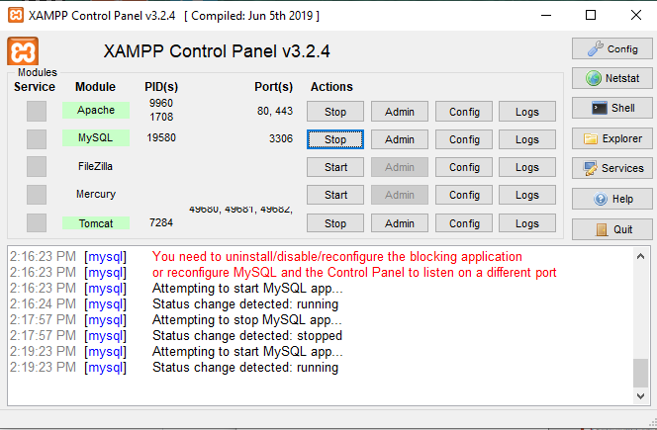
29.1 Start XAMPP
https://www.youtube.com/watch?v=u10xZgNpfCQ&list=PL0eyrZgxdwhwBToawjm9faF1ixePexft-&index=29
Start XAMPP
We are going to create a database.
It is go through something call PHPmyadmin.
We already have xampp installed and we should have PHPmyadmin

Slide 5
29.1 Start XAMPP
https://www.youtube.com/watch?v=u10xZgNpfCQ&list=PL0eyrZgxdwhwBToawjm9faF1ixePexft-&index=29
Start XAMPP
If you cannot start Apache server, run admin for command prompt and
> net stop http
To stop the http o port 80.

Slide 6
29.1 Start XAMPP
https://www.youtube.com/watch?v=u10xZgNpfCQ&list=PL0eyrZgxdwhwBToawjm9faF1ixePexft-&index=29
Start XAMPP
To stop the MySQL, click “config > my.ini” find the port number 3306.
> netstat -ano | grep 3306
Control+Alt+Del and find “mysql”, and click “End Task” to stop the running process.

Slide 7
29.1 Start XAMPP
https://www.youtube.com/watch?v=u10xZgNpfCQ&list=PL0eyrZgxdwhwBToawjm9faF1ixePexft-&index=29
Start XAMPP
Click “Start” for both Apache and MySQL.
Both should be turn into green colors and running as below.

Slide 8
29.1 Create a Database

Slide 9
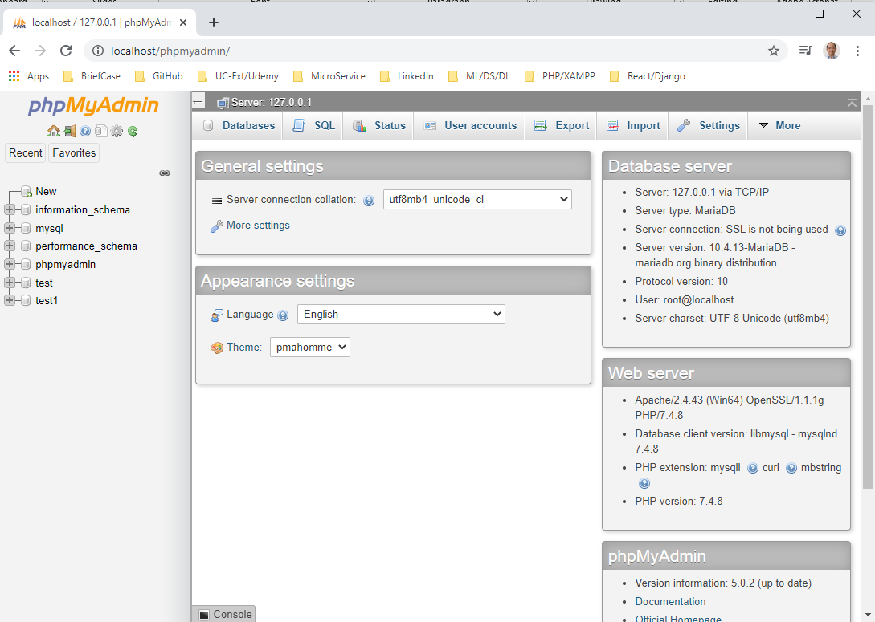
29.2 phpMyAdmin
https://www.youtube.com/watch?v=u10xZgNpfCQ&list=PL0eyrZgxdwhwBToawjm9faF1ixePexft-&index=29
phpMyAdmin
With XAMPP, Apache, and MySQL running.
Open Chrome.
> localhost/phpmyadmin
Then, we will get the following web site as below:

Slide 10
29.2 phpMyAdmin
https://www.youtube.com/watch?v=u10xZgNpfCQ&list=PL0eyrZgxdwhwBToawjm9faF1ixePexft-&index=29
phpMyAdmin
Now, this is where we create databases.
The left side have quite a few database created here.
We will create database.

Slide 11
29.3 Create a Database

Slide 12
29.3 Create a Database
https://www.youtube.com/watch?v=u10xZgNpfCQ&list=PL0eyrZgxdwhwBToawjm9faF1ixePexft-&index=29
Create a Database
On the top, there menu buttons Database and SQL.
We also have Export and Import. We will use them later.
For now, we will use Database and SQL buttons.

Slide 13
29.1 Create a Database
https://www.youtube.com/watch?v=u10xZgNpfCQ&list=PL0eyrZgxdwhwBToawjm9faF1ixePexft-&index=29
Create a Database
In the left, we have a list of all the databases.
You already do have created inside PHPMyAdmin.
There will be some here as a default. You can ignore them.

Slide 14
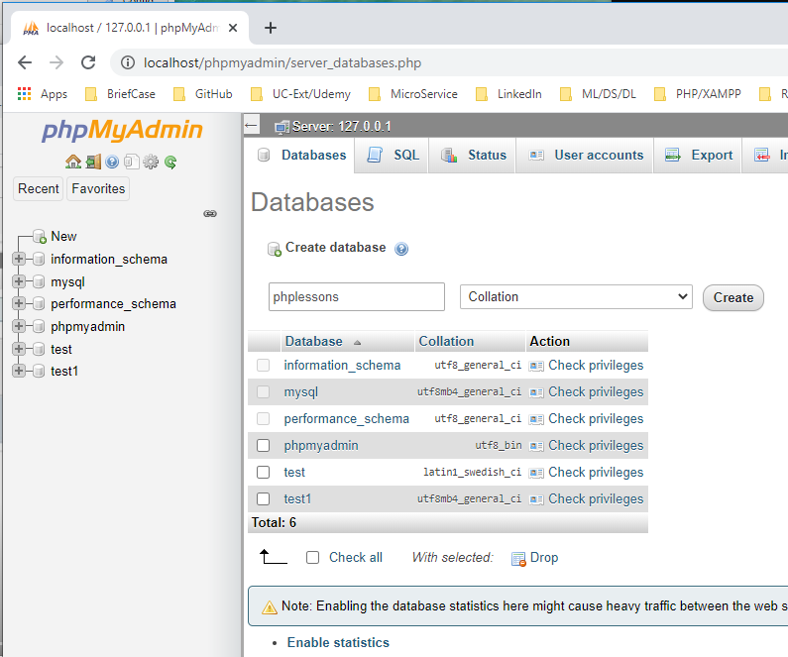
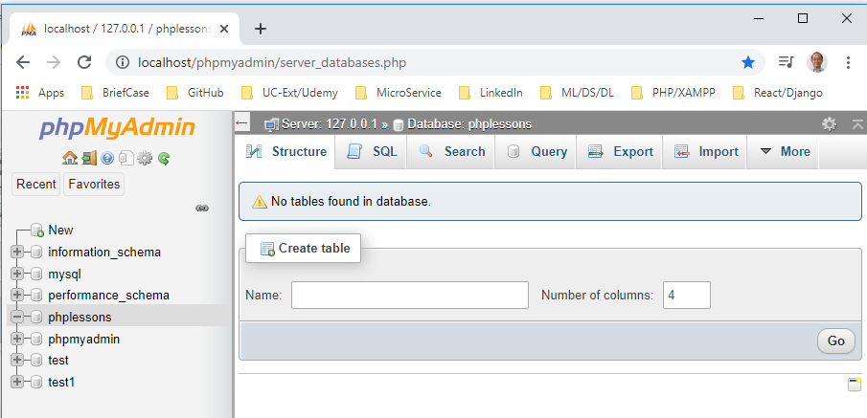
29.3 Create a Database
https://www.youtube.com/watch?v=u10xZgNpfCQ&list=PL0eyrZgxdwhwBToawjm9faF1ixePexft-&index=29
Create a Database
Foe database, do not use uppercase and slash. Just lowercase and underscore.
Type in “phplessons” in the “Database name”, select “collation”.
Click “Create” button.

Slide 15
29.3 Create a Database
https://www.youtube.com/watch?v=u10xZgNpfCQ&list=PL0eyrZgxdwhwBToawjm9faF1ixePexft-&index=29
Create a Database
Foe database, do not use uppercase and slash. Just lowercase and underscore.
Type in “phplessons” in the “Database name”, select “collation”.
Click “Create” button.

Slide 16
29.3 Create a Database
https://www.youtube.com/watch?v=u10xZgNpfCQ&list=PL0eyrZgxdwhwBToawjm9faF1ixePexft-&index=29
Create a Database
In the database, you can see “No tables found in database.”
You can see our new Database is actually to our list on the left hand side called “phplessons”.

Slide 17
29.3 Create a Database
https://www.youtube.com/watch?v=u10xZgNpfCQ&list=PL0eyrZgxdwhwBToawjm9faF1ixePexft-&index=29
Create a Database
We have no tables. We need to create tables.
Each table will store some information.
We may have one table that stores information regarding the user: The first name, last name, username, password, email, and etc.
We may also have a table that stores information regarding posts.

Slide 18
29.3 Create a Database
https://www.youtube.com/watch?v=u10xZgNpfCQ&list=PL0eyrZgxdwhwBToawjm9faF1ixePexft-&index=29
Create a Database
Let’s say, we have a forum inside a web site.
Now, in order for the use of text to go into the forum and write a message.
They may need to write in the subject of the message, date, the actual message, and who wrote it, and etc.
That sort of information you need to save and typically goes into a table called foreign posts or something.

Slide 19
End of Chapter

